Slide 1
Incoming 9th Grade Welcome Night 3.5.2025

Slide 2
Learning Objectives
Welcome
Introduce Administrative Staff
Introduce Skyline’s Learner Profile
Introduce “Flex Time” - Skyline’s Intervention Period
Introduce the International Baccalaureate (IB) Program & AP offerings
Learn about the Course Request Process (CRP) for 2025-2026 school year

Slide 3
Welcome
5:00-5:45 – Extra Curricular Open House (Clubs, Activities, Athletics)
Be involved in all things Skyline!
6:00-6:45 – Skyline & Course Request Process (CRP) Information
6:55-8:10 – Instructional Break Out Sessions (Four 15 minute rotations)
Graduate to Something!

Slide 4
Break Out Session – Locations (6:55, 7:15, 7:35, 7:55)
Counseling at Skyline (Commons) Humanities Department (Library)
College & Career Center (1202) Special Education: LRC I/II (1116) World Language: Chinese (2114) IB Science (1107)
Mathematics Department (2412-2414) World Language: French (2416)
Science Department (2402-2404) World Language: Spanish (2406-2408)
Computer Science (2218) World Language: Japanese (1214)
IB Program (Theater) World Language: ASL (1118)
Graphic Design & Yearbook (2207) Music: Choir, Band & Orchestra (2527)
Theater Arts (2519) Business & DECA (1404) Visual Arts (2501)

Slide 5
Follow Skyline on Social Media
spartans_shs
Skyline High School
@SHS_Spartan

Slide 6
Skyline Administration
Keith Hennig – Principal
Allison Strait (A-GAI)
Andrew Guss (GAJ-LIT)
Kevin Adamo (LIU-ROD)
Alanah Baron (ROE-Z)

Slide 7
Skyline Counselors
Hayden Kersey (A-COY)
Todd Caffey (COZ-HOW)
Megan Rieke (HOZ-LIT)
Stephanie Anderson (LIU-O)
Adam Dickenson (P-SKA)
Kristen Flemer (SKB-Z)

Slide 8
Vision/Mission & HOW Wheel
Develop honorable, thinking, skillful citizens who possess integrity, act with pride, and pursue scholarship and excellence in the service of humanity.
Our goal is that ALL of our students will be prepared for and eager to accept the academic, occupational, personal, and practical challenges of life in a dynamic global environment.

Slide 9
SHS LEARNER PROFILE

Slide 10
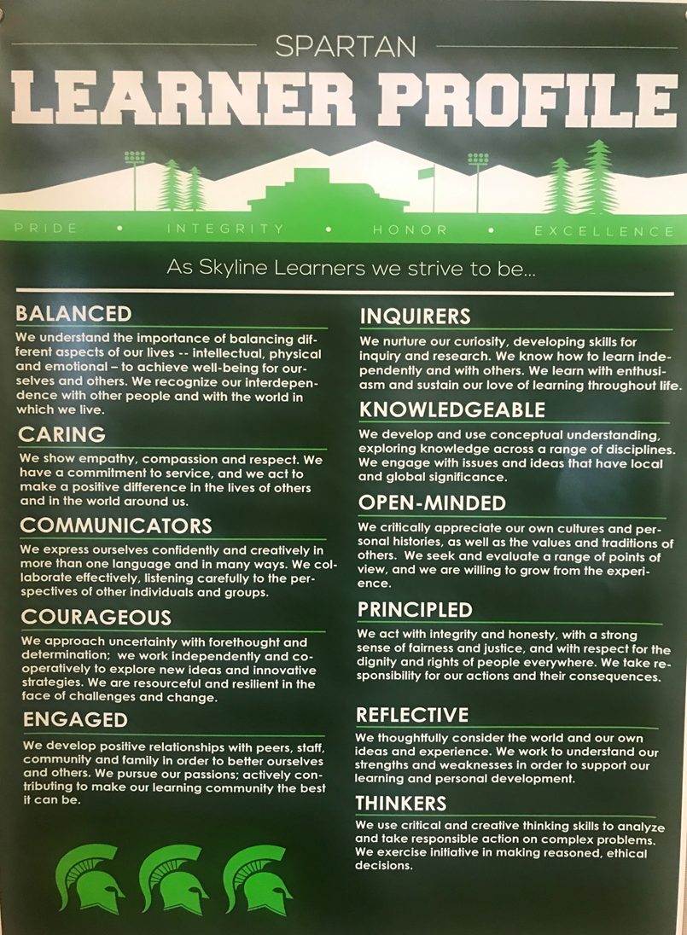
BALANCED
CARING
COMMUNICATORS
COURAGEOUS
ENGAGED
INQUIRERS
KNOWLEDGEABLE
OPEN-MINDED
PRINCIPLED
REFLECTIVE
THINKERS

Slide 11
Clubs/Athletics/Activities

Slide 12
Get Involved!
70-80 Clubs
Chess Club, Games Club, Investing Club, Writers, Club, Rocketry Club, Fashion Merchandising and Design Club, DECA, Coding for Medicine – and MANY MORE!
Athletic Programs (Fall/Winter/Spring)
Cross Country, Football, Golf, Tennis, Volleyball, Soccer, Swing & Dive, Basketball, Wrestling, Track, Baseball, Girls Flag Football, Badminton, Fastpitch Softball
Activities
Drama, Cheer, Dance, Unplugged, Gift Drives, Dances, etc.

Slide 13
FLEX TIME

Slide 14
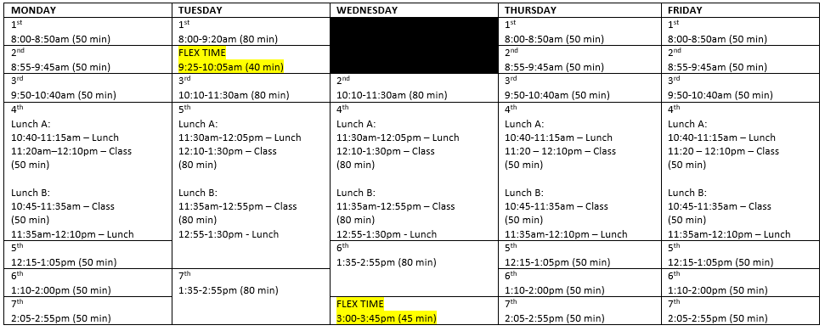
Bell Schedule

Slide 15
Flex Time Interests
Academic Interventions
Retakes and make-ups
Special Education Consult
Communication (announcements, SPTV)
Social/Emotional lessons
Alternate schedules (i.e., assemblies, surveys)

Slide 16
Flex Time Logistics
Students must attend their Flex Time class
Teachers will take attendance
Closed campus
Monitor Halls
Legitimate academic purpose

Slide 17
Flex Time Scheduler - gives Skyline the ability to schedule students to the support they need, while offering extended learning opportunities for others.
Scheduling System:
Teachers can request/require a student to attend a specific Flex Period.
Students are assigned the support area groups they need.
Students have the opportunity to self-select the intervention they need.

Slide 19
International Baccalaureate (IB)
Skyline runs one of the largest and most successful IB programs in the state – measured both by numbers of students involved, number of IB courses offered, and by our long-standing track record of excellent results.
SHS graduate routinely report back from college that their IB studies undertaken here gave them a meaningful leg up in starting college – boosted confidence, better communication skills and better self-advocacy skills.

Slide 20
International Baccalaureate (IB)
Pathways (11th and 12th grade students only):
Don’t take any IB courses.
Take an individual IB course(s).
IB Career Pathway (IBCP): 2-4 IB course, results in an IBCP Diploma.
IB Diploma Program: Most courses 11th and 12th grade year, results in an IB Diploma.
*IB influences a lot of what we do in grades 9-10 (i.e., Learner Profile, sequential courses, teaching and learning best practices, professional development, etc.).

Slide 21
Advanced Placement (AP) – 9th through 12th
AP Statistics AP Calculus
AP Computer Science Principles AP African American Studies
Earning college credit in high school (IB & AP) allows students to save time and money by reducing the number of courses they need to take in college, helping them graduate earlier and with less debt.
It also exposes students to rigorous coursework, building the academic skills and confidence needed for postsecondary success in the academic or professional worlds.

Slide 22
2025-2026 Course Request Process For Incoming 9th Graders
SHS Counseling Team

Slide 23
Quick CRP Details
Beginning on March 5th (at 4:00 PM), you will be able to request courses for next school year.
The window to request courses is March 5th - March 17th
The ONLY way to request courses is through Skyward during this window. You CANNOT request courses over email or any other way.
You will additionally request at least 8 alternate courses. Alternates will be used in the event one of the courses you request cannot be added to your schedule due to scheduling conflicts.

Slide 24
Who completes the Course Request Process?
EVERYONE!!

Slide 25
There are MANY changes this year
Skyward has a new user interface
New course offerings and pathways
New IB Courses
AP Courses
New course guide look

Slide 26
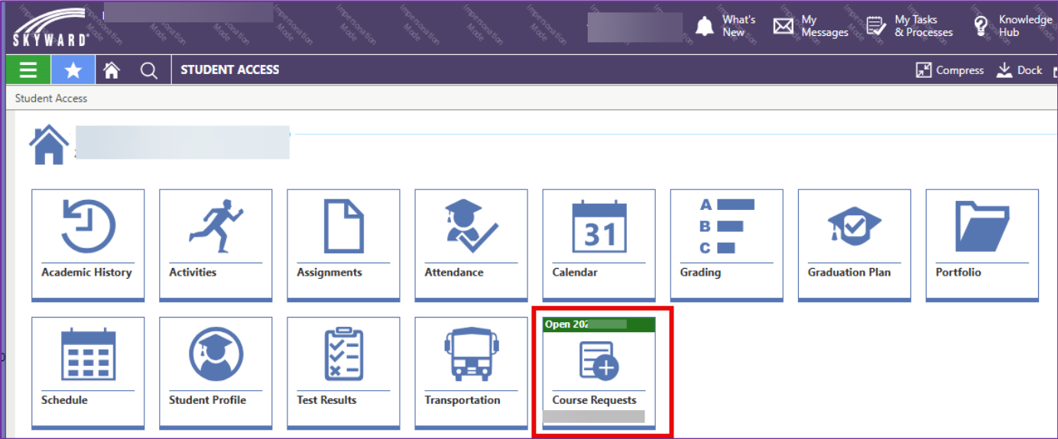
Making Requests in Skyward
Log into Student Access, select ‘Course Requests’

Slide 27
Making Requests in Skyward
2. Search for the courses you would like to request. Make sure you request 7.0 credits

Slide 28
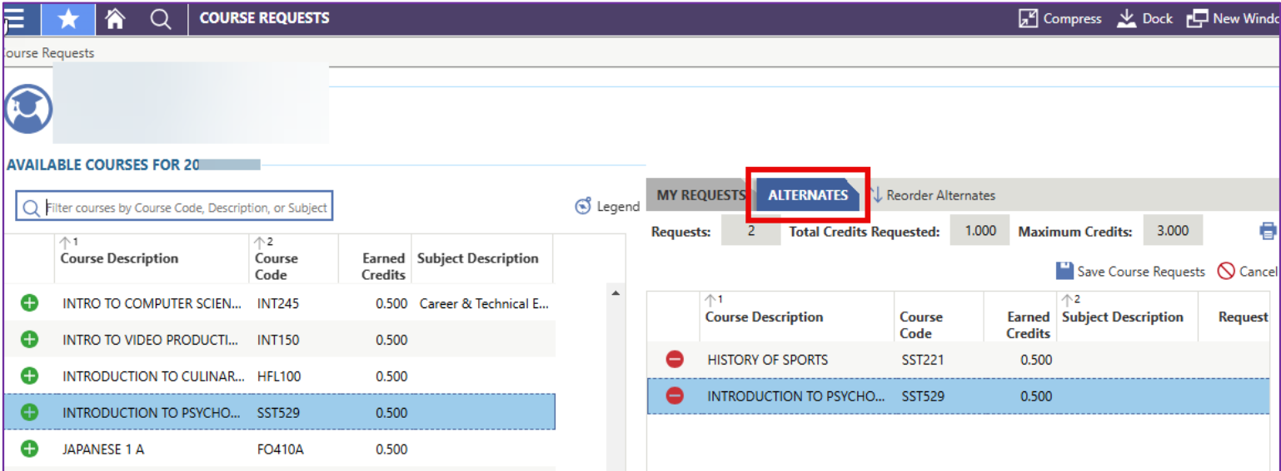
Making Requests in Skyward
3. Add alternates. Please requests at least 8 alternates in a variety of subjects, including electives and humanities courses.

Slide 29
Making Requests in Skyward
When you are finished, click Save Course Requests

Slide 30
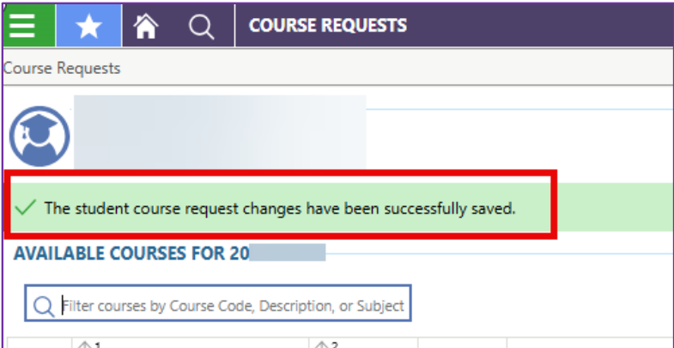
Finishing Your Course Requests
When you have saved your course requests, you will see this note:
You can make requests until March 17th at 8:00 AM

Slide 31
Am I guaranteed my course requests?
All requests are used to make our building schedule so students can take as many of their first-choice classes as possible. However, schedule conflicts can arise and graduation requirements will be prioritized. You are not guaranteed your requests, however you are guaranteed your graduation requirements.
If there is a schedule conflict and you do not get one of your first-choice classes, we will attempt to add a similar course from your alternates list.
If none of the courses in your alternates list work in your schedule, the system will assign you an available course that will meet a graduation requirement.

Slide 32
Required Credits

Slide 33
What should I request?
All 9th Grade students (that’s you) will take:
Language Arts (Yearlong class)
World History (Yearlong class)
Math (Yearlong class)
Science (Yearlong class)
World Language (You will need 2.0 World Language Credits during high school) or Elective
Other Graduation Requirements (1.0 Credit)
Other Graduation Requirements (1.0 Credit)
Can be CTE, Fine Art, Health, PE

Slide 34
9th Grade Requirements
Level: Honors vs On-level
Honors
Deeper analysis
More rigorous discussion
More student independence
Preparation for IB
On-Level
Standard level curriculum
More scaffolded support
Class Structure: Block vs. Individual
Block
Interdisciplinary
Two teachers for support in the classroom
Some integrated assignments
Teachers can coordinate on homework load, skills, and assessments
Individual
Smaller class size
No integrated assignments
Option for accelerated learning in only one discipline

Slide 35
9th Grade Requirements
LA/SS Pairing Options and course titles
Honors Block
SS: Honors World History 1 and 2 (block)
LA: Honors Lit & Comp 1 (block)
On-level Block
SS: World History 1 and 2 (block)
LA: Lit & Comp 1 (block)
Honors LA Individual + On-level SS Individual
LA: Honors Lit & Comp 1 (Sem 1 & 2)
SS: World History 1 and 2
Honors SS Individual + On-level LA Individual
SS: Honors World History 1 and 2
LA: Lit & Comp 1
On-level SS Individual + On-level LA Individual
SS: World History 1 and 2
LA: Lit & Comp 1
Honors SS Individual + Honors LA Individual
SS: Honors World History 1 and 2
LA: Honors Lit & Comp 1
Course Request Disclaimer: Students are not guaranteed their first-choice courses as there may be schedule conflicts, changes, or adjustments through the scheduling process and number of requests per class. Please remember to add alternate courses for ALL courses, not just for electives! For humanities classes, while you are guaranteed your grade level graduation requirement, the prioritization will then be: 1) request of on-level vs. accelerated and then 2) teaching method (block vs. individual).

Slide 36
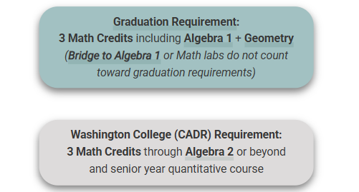
Math Pathways

Slide 37
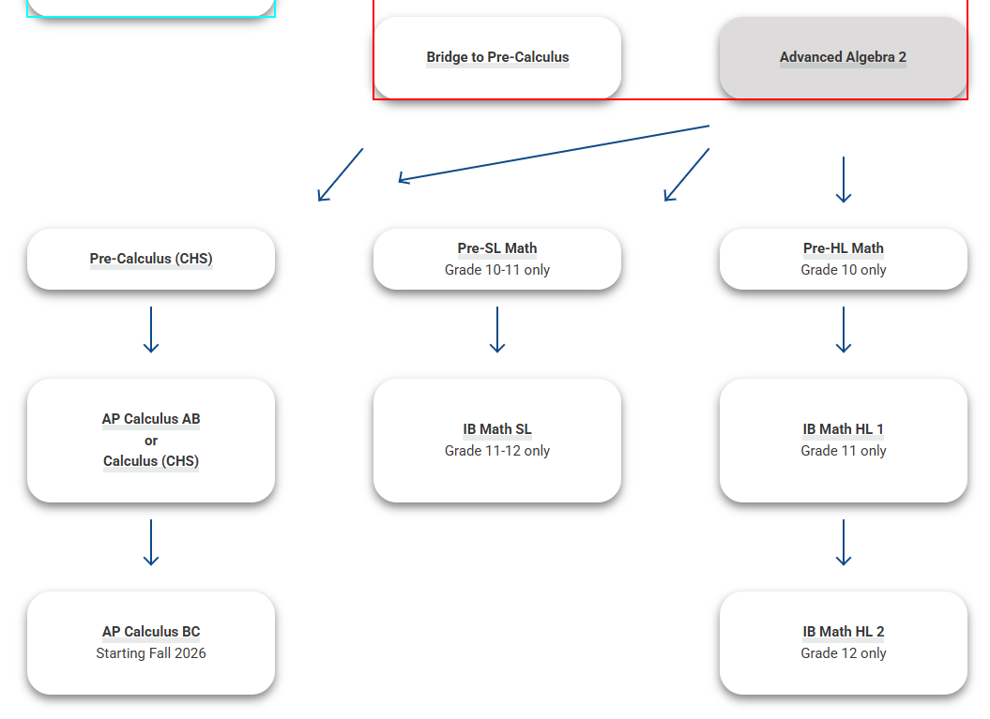

Slide 38
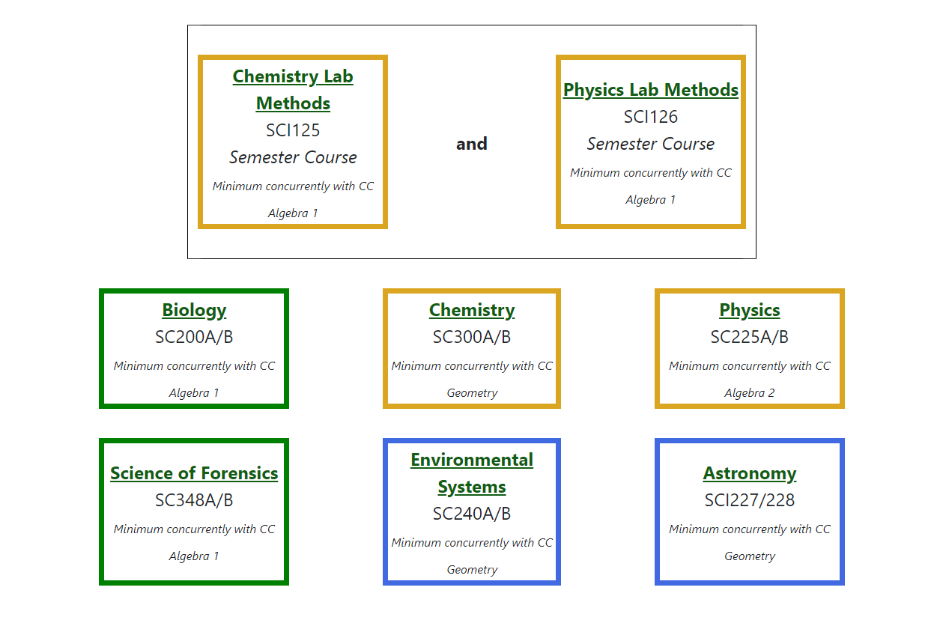
Science Sequencing
Notes about Science Course Options:
Make sure that you are choosing a science class that works with your current level of math. For example, Chemistry should only be taken if you are currently taking Geometry or above.

Slide 39
Science continued

Slide 40
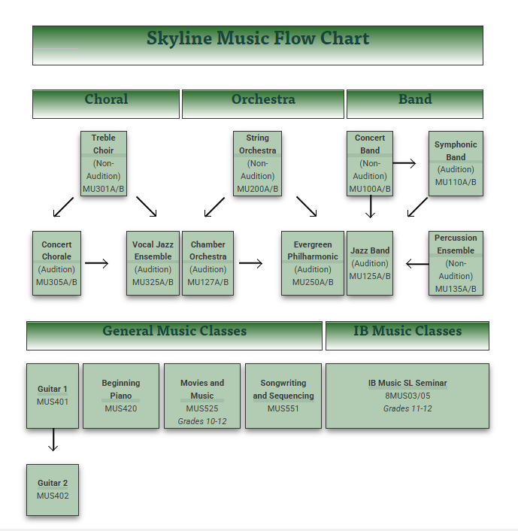
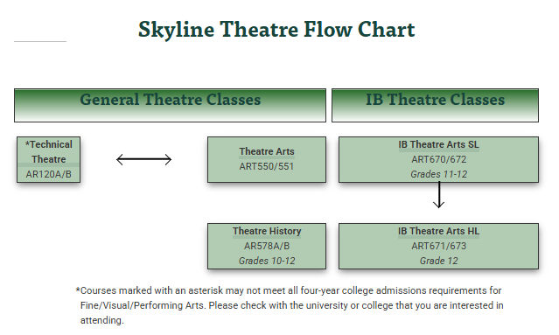
Music and Theater

Slide 41
Visual Arts

Slide 42
World Languages
Spanish, French, Mandarin Chinese, Japanese, ASL
What is my post-high school plan?
Most 4 year colleges require a minimum of 2 years of the same world language Some 4 year colleges recommend 3 years of one world language
2 year colleges, tech schools, military, etc… do not require world language completion
If you are fluent in a language other than English, it is possible for you to take the World Language Competency Exam for credit. This does not meet IB Diploma option.

Slide 43
Course Guide: CTE, World Language, Fine Art, Health, PE, and many more!

Slide 45
Graduation Requirements

Slide 46
Graduation Requirements: 24 Credits
Subject | Course Requirements to earn High School Diploma - State and District | Minimum College Entrance Required for WA public 4-year universities (CADRs)***
English Language Arts | 4 credits | 4 credits
Mathematics | 3 credits earned in 9th-12th: Algebra 1 Geometry 3rd year Math* If Algebra 1 and/or Geometry are successfully completed before 9th, higher level HS Math can be included. | 3 - 4 credits minimum through Algebra 2 and quantitative class in senior year
Science | 3 credits 2 lab sciences 1 additional science, lab or non-lab* (All ISD classes with SC course code are lab sciences) | 3 credits Biology Chemistry or Physics 1 additional science
Social Studies | 3 credits 1.5 World History 1.0 US History 0.5 Civics | 3 - 4 credits
World Language | 2 credits Both credits may be replaced with a Personalized Pathway Requirements** | 2 credits, must be two consecutive years in the same language.
 | NOTE: biliterate students can take a competency test to earn up to 4.0 World Language credits
Art​ | 2 (Fine or Applied Art) 1 credit may be replaced with a Personalized Pathway Requirement** | 1 (must be Fine Art)​
PE/Health​ | 1.5 PE and 0.5 Health​ | Not required for college entrance but provide opportunities for students to demonstrate and explore their learning​ Students are encouraged to reach out directly to colleges they are interested in applying to, as admissions processes and requirements vary by school.
Career and Technical Education (CTE)​ | 1 (many options in high school)
Elective (any course)​ | 4 credits, or enough to reach the total credit requirement for graduation.

Slide 47
Northwest Studies & Middle School Courses
Northwest Studies (can be earned in Middle School or online learning course)
Credit Earned Before High School
Credit from ISD middle schools for classes such as Algebra 1, Geometry, Algebra 2, Biology, and World Language are automatically added to HS transcript; students/ families must opt out by end of 11th grade

Slide 48
High School and Beyond Plan on Xello
The High School & Beyond Plan, a graduation requirement, helps students get the most out of high school and think about their future. It revolves around three questions:
Who am I?
What can I become?
How do I become that?

Slide 49
Graduation Pathway Requirement
The use of the term “Pathway” exists in multiple contexts. The graduation pathway refers to the many ways in which students can demonstrate readiness for a meaningful first step after high school.
Smarter Balanced Assessment
ACT / SAT / AP / IB Exams
Armed Services Vocational Aptitude Battery (ASVAB) Test
Dual Credit Courses
Career and Technical Education (CTE) Course Sequence
Washington Access to Instruction & Measurement (WA-AIM) Assessment
For more information click here for the Graduation Toolkit

Slide 50
Upcoming CRP Events
Wednesday March 5th 6:00-8:15: Incoming 9th Grade Night Student and Family Welcome Night
Thursday March 6th 6:00-7:00 on Zoom: Parent and Student Zoom Presentation.
Week of March 10th: SHS Counselors will be coming to you to answer any CRP questions that you may have!

Slide 51
Follow the counseling team on IG for updates!

Slide 52
Thank you!

