Slide 1


Creating a Canvas Parent Account on a Smart Device
Easy Walk Through – September 15, 2020

Slide 2
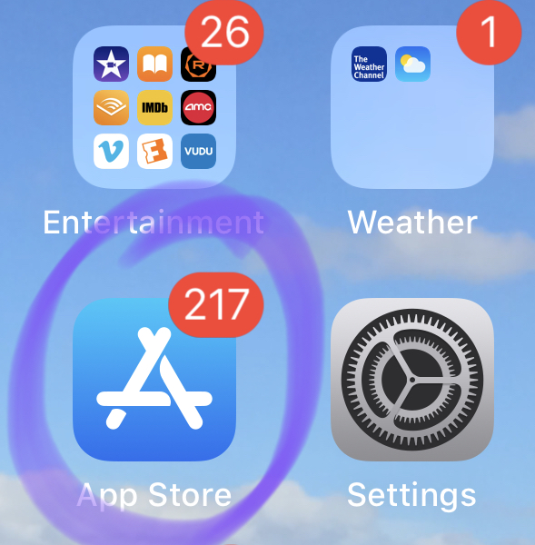
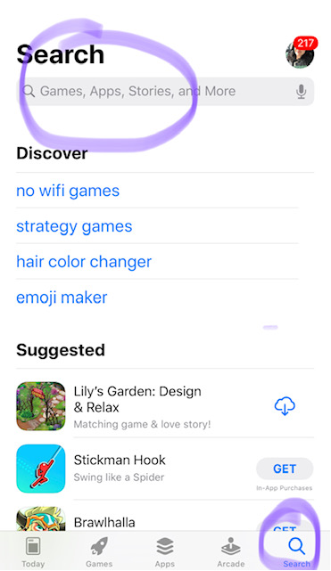
Creating a Canvas Parent Account on a Smart Device
Search for
Canvas Parent

Slide 3
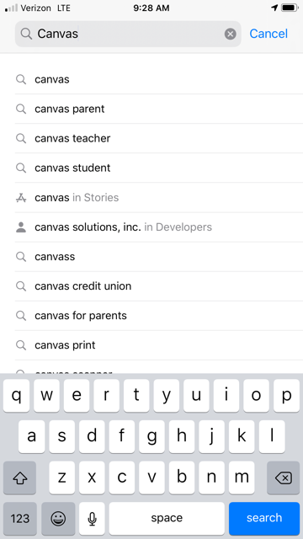
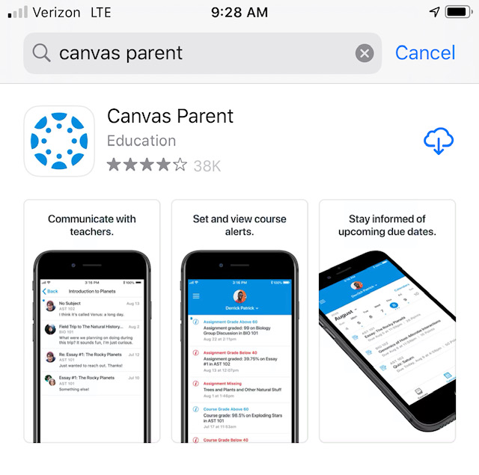
Choose the Blue Version for Parents
Click the Cloud to Download. This will take a minute. When it changes to Open, click Open.

Slide 4
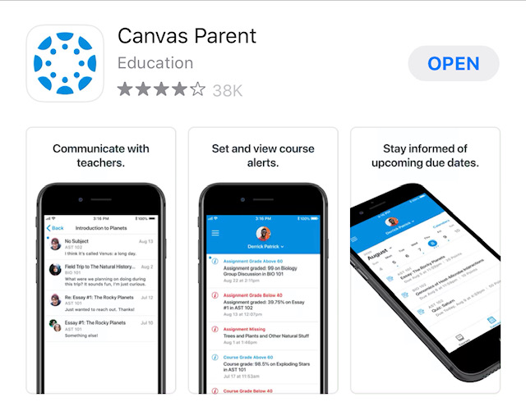
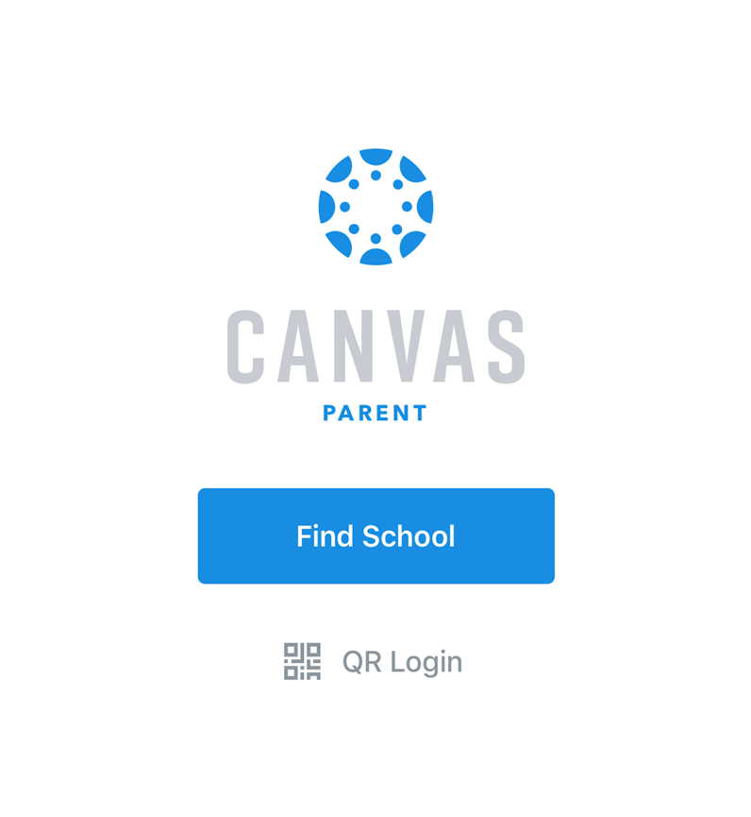
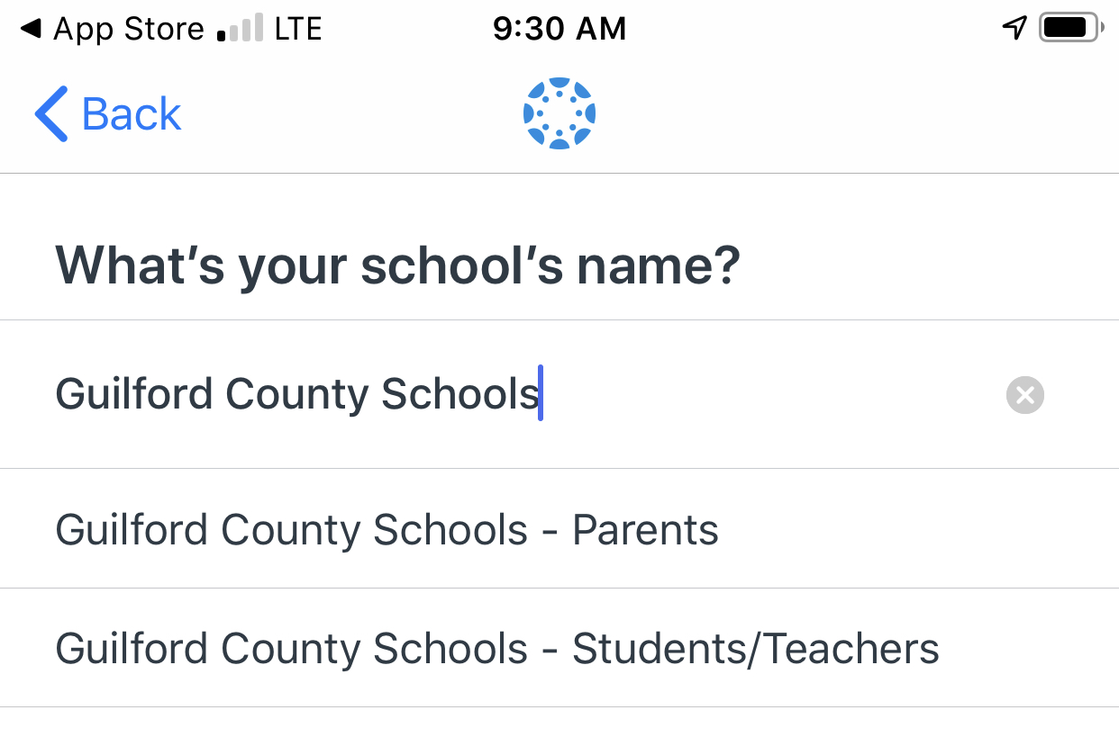
Find Your School

Slide 5
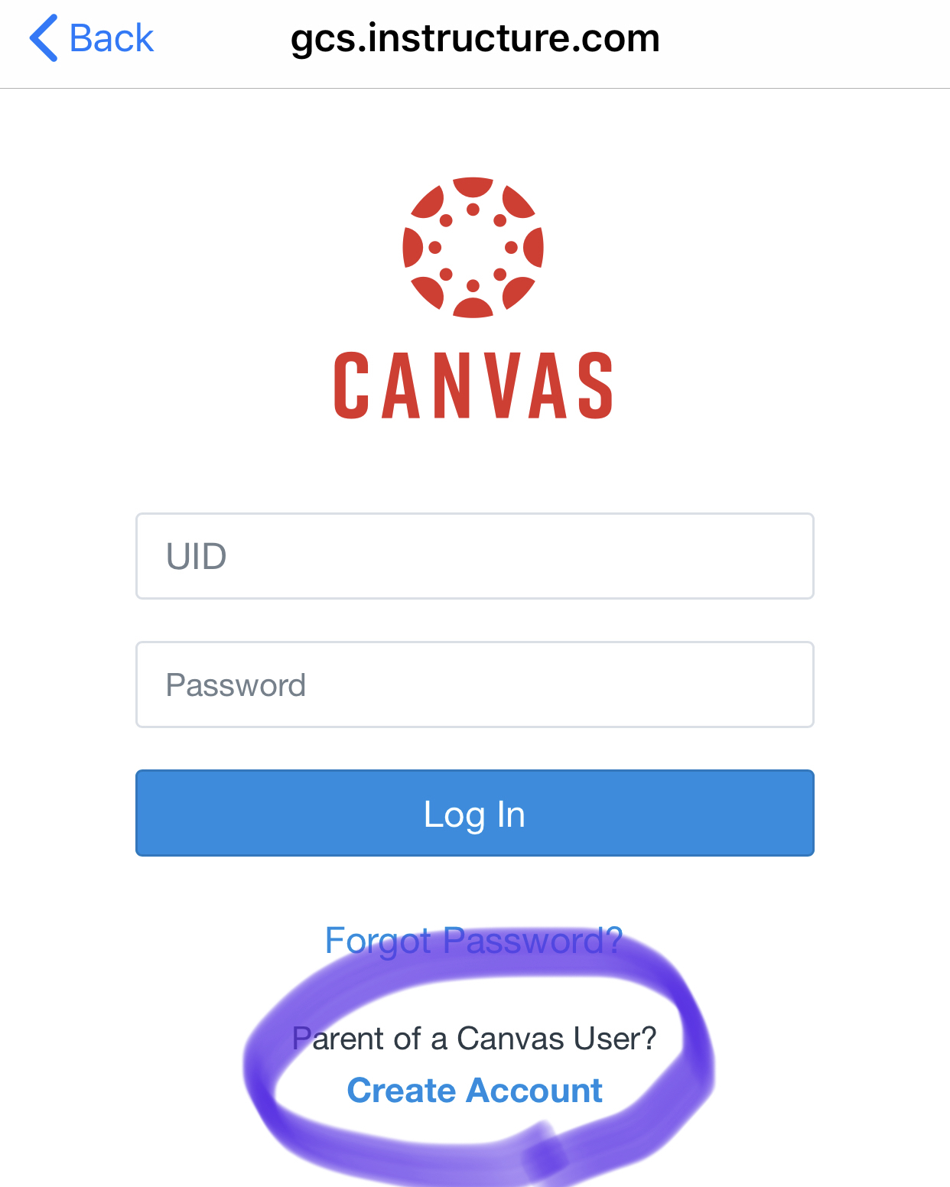
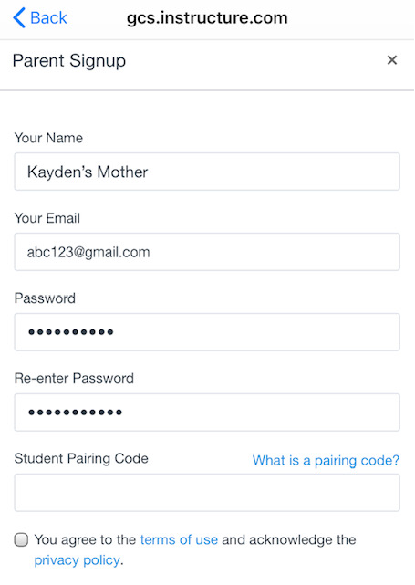
Create Your Account
Enter Your Contact Information and Create a Password
Follow the Next Set of Steps to Get Your Pairing Code
Check the Box

Slide 6
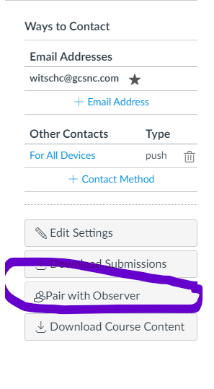
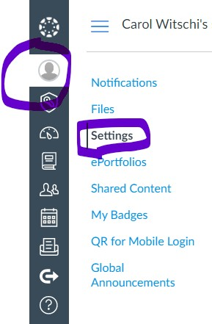

Get Your Pairing Code
On Your Student’s Canvas Page (Use the Chromebook or a Computer)
Click the Account Tab (It looks like a person)
Click Settings
Click “Pair with Observer”
Write Down the Code

Slide 7
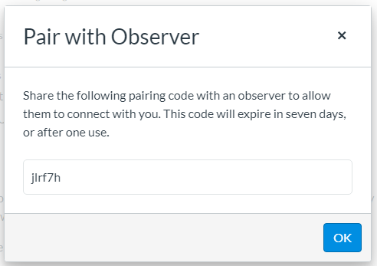

Return to Your Smart Device to Enter the Pairing Code
To access Canvas Parent from a Desktop computer:
1. Go to: gcs.instructure.com
You will need your student’s NCEd Cloud login credentials to access Canvas from this page.
OR
2. Go to: https://parentlogin.instructure.com/login/canvas
You can add additional students by clicking on “Manage Students” and the Plus (+) sign. You will need a separate pairing code for each student.
Paste or Type in the Pairing Code
Check the Box

