Slide 1

Let’s Talk…… about Military Families
POC (Point of Contact)
Christopher Scott
Approximately 9% of Southeast High students are Military connected
Notes:
1

Slide 2
Military Connection POC
Role
To bring awareness of military-connected students
The link among the school, military families, community, and district’s liaison
Help implement programs and practices to support military-connected students and families

Slide 3
Challenges
Deployments
Loss/Grief
Transition (Schools, Friends, TDY)
Increased stress level for families
Wounded Warriors (Physical, TBI, PTSD)
Distance from military community limits access to resources
Separation from military service (ETS, Medical, Retirement)

Slide 4

Challenges
http://www.youtube.com/watch?v=KDFXxgz0vHc

Slide 5
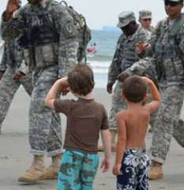
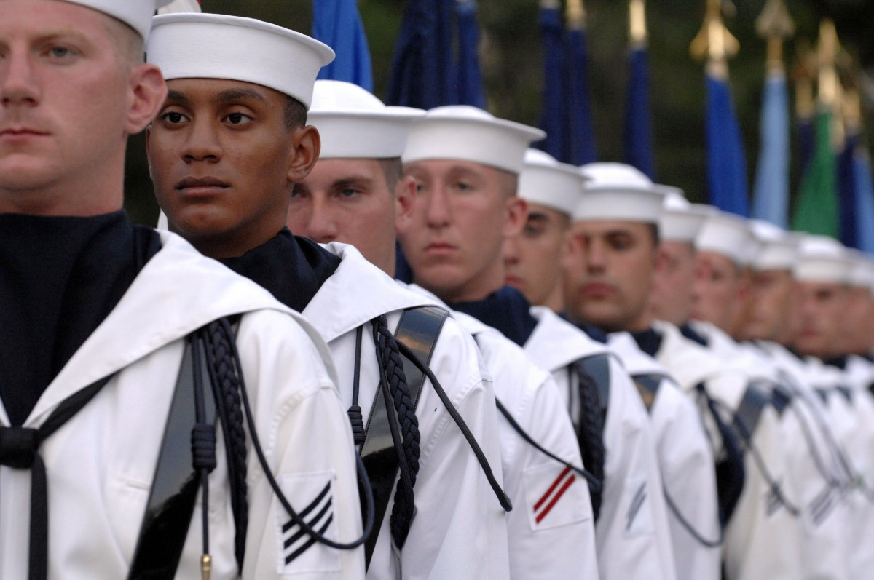
Strengths
Adaptable
Resilient
Global Knowledge
Flexible
Adventurous
Diversity
Tolerance & Respect
Value on Education
Team Players

Slide 6
Important Terms
Deployment - the act of sending troops into duty. Deployments have varying lengths depending on the situation, MOS (military occupation specialty= job), and duty stations.
Family Care plan - a plan that is created by the Service member to handle certain affairs such as children, finances and housing.
CAO - Casualty Assistance Office/Officer- This team can consist of a Chaplain and members from the Rear Detachment that come to notify a military spouse when their service member is seriously injured or killed in action (KIA).
Military orders - documents that detail a military servicemembers duty station, school location, training or deployment. ***NOT ALL SERVICE MEMBERS ARE INITIALLY GIVEN PHYSICAL ORDERS FOR DEPLOYMENT.
TDY - temporary duty yonder (temporary duty assignment).
AO - Area of Operation - location where service member is housed on deployment
JAG - Judge Advocate General; military law

Slide 7
Important Terms
Deployment - the act of sending troops into duty. Deployments have varying lengths depending on the situation, MOS (military occupation specialty= job), and duty stations.
Family Care plan - a plan that is created by the Service member to handle certain affairs such as children, finances and housing.
CAO - Casualty Assistance Office/Officer- This team can consist of a Chaplain and members from the Rear Detachment that come to notify a military spouse when their service member is seriously injured or killed in action (KIA).
Military orders - documents that detail a military servicemembers duty station, school location, training or deployment. ***NOT ALL SERVICE MEMBERS ARE INITIALLY GIVEN PHYSICAL ORDERS FOR DEPLOYMENT.
TDY - temporary duty yonder (temporary duty assignment).
AO - Area of Operation - location where service member is housed on deployment
JAG - Judge Advocate General; military law

Slide 8
Important Terms
Rear Detachment (Rear D) - a selective group from the unit that maintains the unit at the duty station; does not deploy or consists of soldiers that have returned early from deployment.
OPSEC - operational security
MOS - military occupational specialty code; service members job in the military
XO/CO - Executive officer or Commanding officer; CO is in charge of a company, battalion or brigade. XO is second in command- leader of a battalion - second in command
POA - power of attorney
ACS - Army Community Services - an organization that provides various comprehensive services for military families
CYS - Child and Youth Services; provide programs and services for children of eligible military and civilian families.

Slide 9
Military Deployment
Deployment can be a difficult time, for both the soldier and the family they leave behind. Children face a host of special issues when one or both of their parents are deployed.
Symptoms of Deployment Related Stress in the Classroom
~ Difficulty concentrating in school.
~ Unable to resume normal classroom assignments and activities
~Continued high levels of emotional response such as crying and intense sadness
~ Appearing depressed, withdrawn and uncommunicative
~ Expressing sad or violent feelings in conversation, writings or drawings
~ Intentionally hurting self or at risk for hurting others
~ Gain or lose a significant amount of weight in a short period of time
~ Discontinue taking care of personal appearance

Slide 10
Educator’s Interventions
~Focus on students and the classroom learning environment
~If student is distressed about circumstances of deployment, find an appropriate time for them to share feelings, needs and fears
~Regardless of political beliefs, refrain from expressing personal options
~Expect temporary slowdowns or disruptions in learning when a deployment occurs
~Provide structure
~Be approachable, attentive and sensitive to the unique needs of students coping with deployment and family separations
~Inquire about school, community, and military resources available to assist

Slide 11
Please remember to NEVER give out soldier location, troop movement, soldier names or ranks, or duration of deployment. If you have any questions about what is or is not safe to share : please do not hesitate to email one of the personnel listed in the directory.

Slide 12
Resources
www.militarychild.org
www.militarykidsconnect.org
www.sesamestreetformilitaryfamilies.org
www.mic3.net
www.tutor.com
www.nctsn.org

Slide 13
Support Military Connected Students
April 11, 2025 PURPLE UP DAY!
https://www.youtube.com/watch?v=yHgzc6dh8cs&t=4s

Slide 14

Questions
This Photo by Unknown Author is licensed under CC BY-SA
https://www.youtube.com/watch?v=yHgzc6dh8cs&t=4s

