Slide 1

Accessing E-Books
Welborn Academy media Center

Slide 2
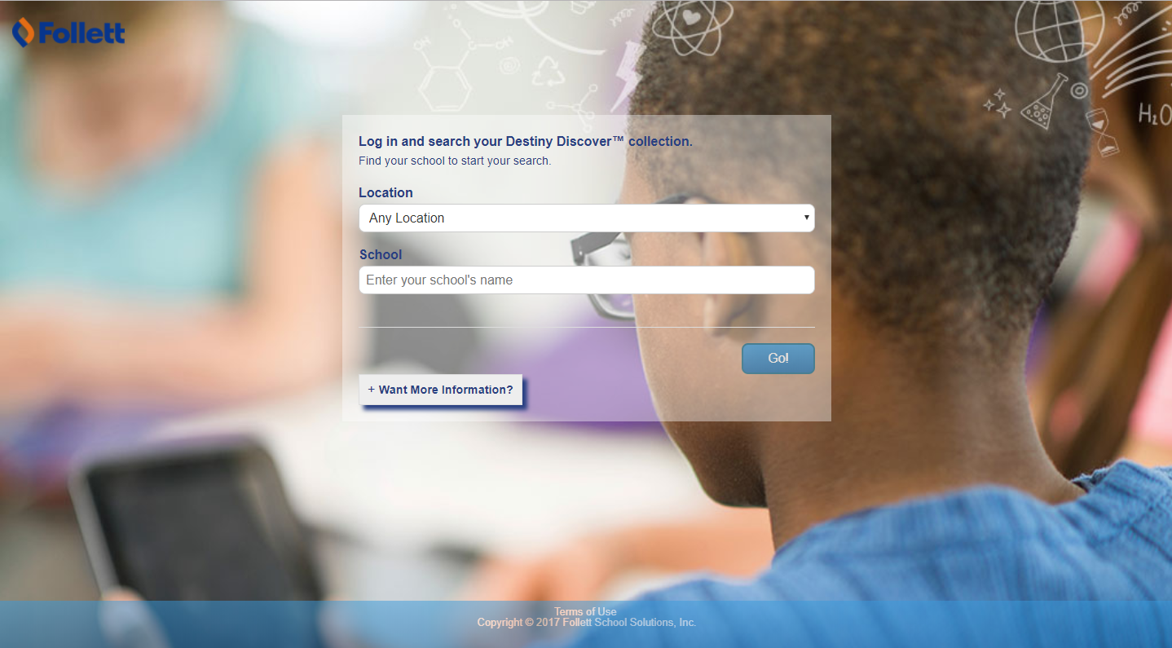
Go to: https://www.gofollett.com
students should see this screen

Slide 3

Put in the following information:

Slide 4
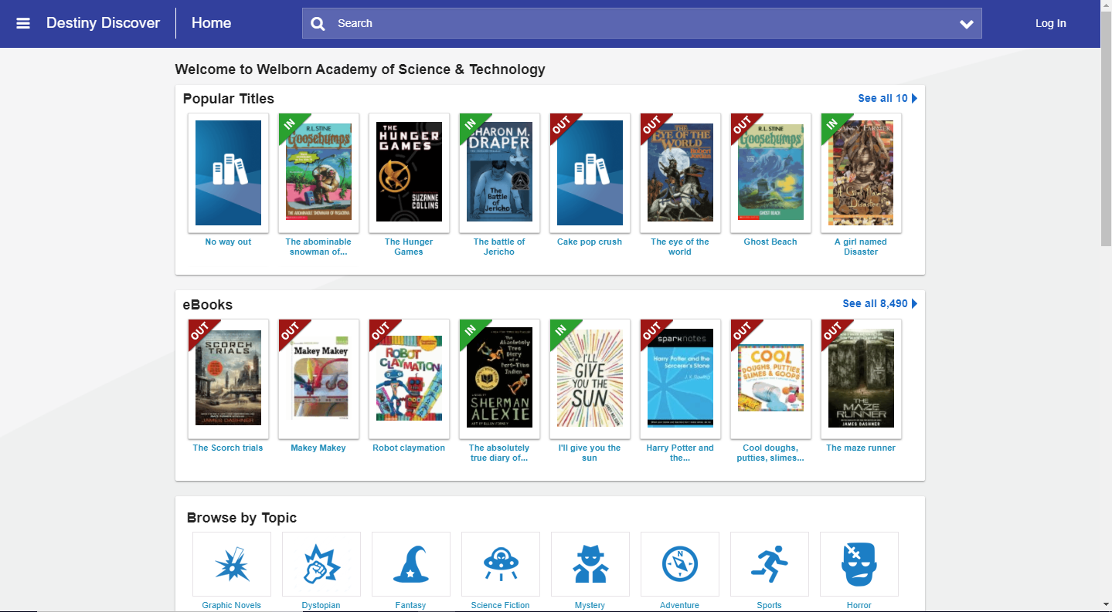
Students will click
to log in

Slide 5
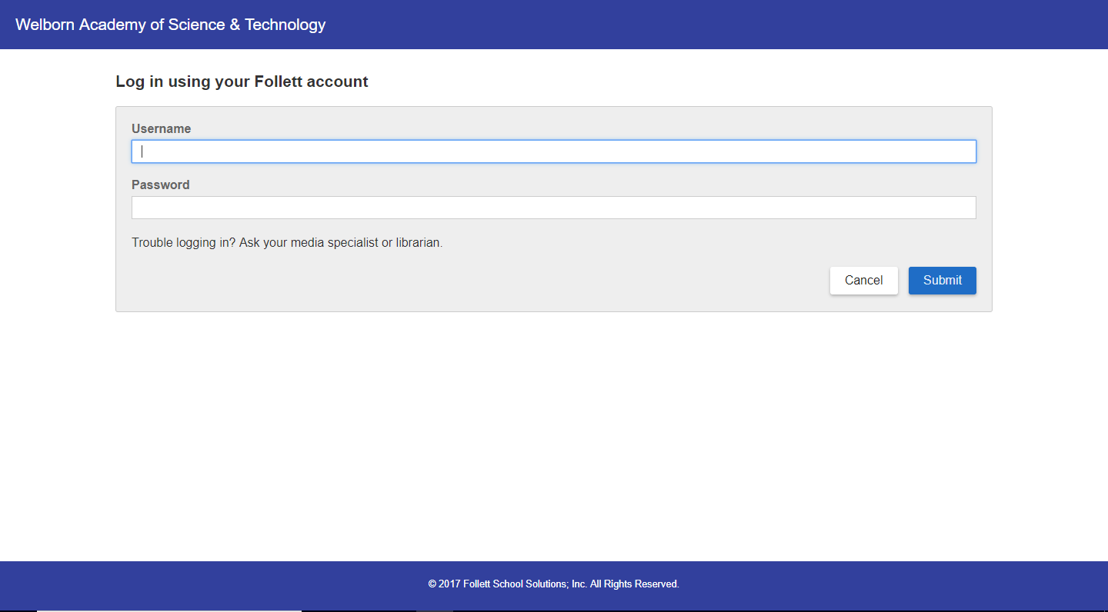
Students will login here just like they log into their device:
Username: lunch number
Password: birthday (00000000)

Slide 6
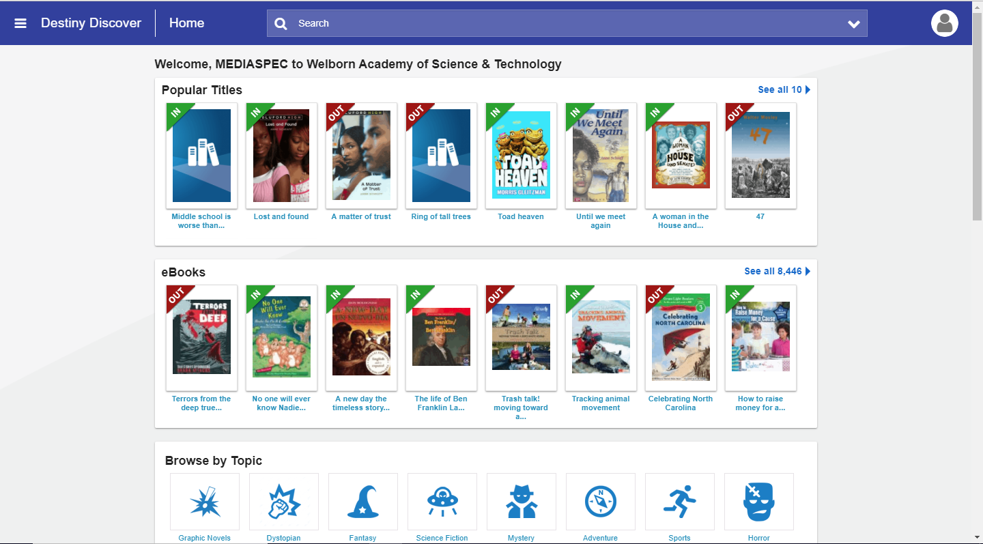
Search box
eBook shelf

Slide 7
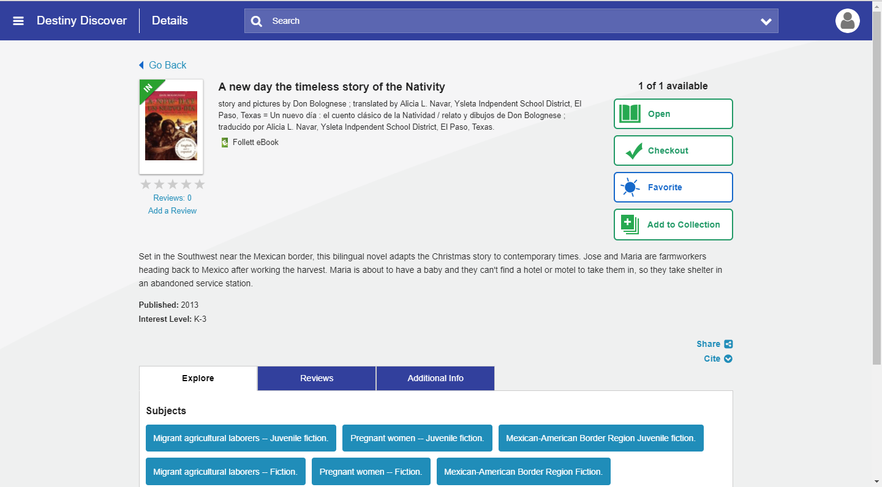
Students can open
to look at the book
and then checkout
the book.
*book is
automatically
returned
after two weeks

