Slide 1



Got a project due
and all the books
are checked out?

Slide 2


The Forsyth County Public Library…
Britannica Online
gives you the world at your fingertips

Slide 3
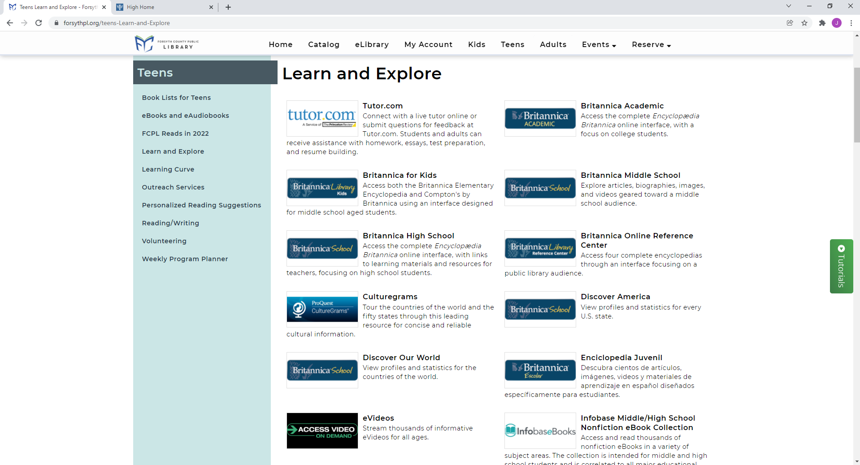
Use Britannica Online
a quality research tool… free
at www.forsythpl.org

Slide 4
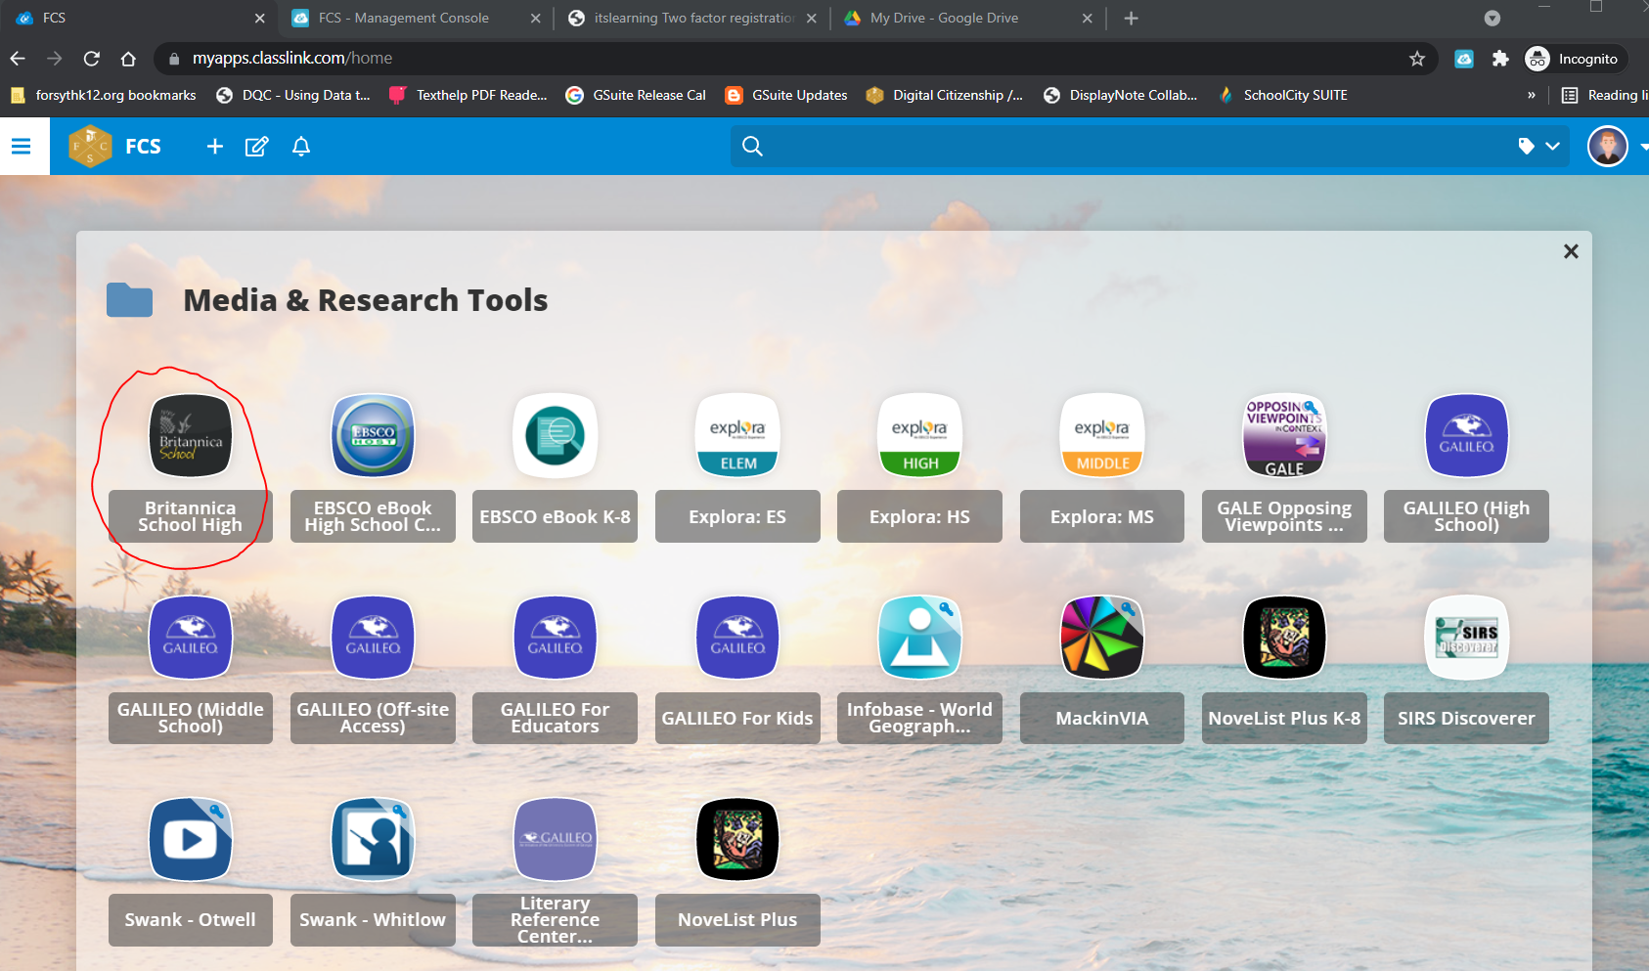
Britannica Online is also available in ClassLink
Media & Research Folder

