Slide 1

NGHS Mathematics Department 2024-2025
Course Descriptions and Recommendations.

Slide 2
Course Sequences:
The gray-shaded box indicates the last course the student must complete to satisfy graduation requirements. Courses in BOLD indicate a math credit. Courses not in bold indicate elective credit.
Typical Sequences for Standard Students under the Future Ready Core
 | Year 1 | Year 2 | Year 3 | Year 4
A | Math I | Math II | Math III | Math IV or Discrete Mathematics for Computer Science
B | Math II | Math III | Math IV | AP Statistics or Discrete Mathematics for Computer Science
Pattern of Grades in Standard Math I, II, and III | Next Math Course
high A’s | Honors Math IV
A’s, B’s, or high C’s | Math IV or Discrete Math for Computer Science*
low C’s or D’s | Math IV
*We prefer to only allow Seniors to take Discrete Math

Slide 3
Course Sequences:
The gray-shaded box indicates the last course the student must complete to satisfy graduation requirements. Courses in BOLD indicate a math credit. Courses not in bold indicate elective credit.
Typical Sequences for Honors Students under the Future Ready Core
 | Year 1 | Year 2 | Year 3 | Year 4
C | Honors Math I | Honors Math II | Honors Math III | AP Precalculus
D | Honors Math II | Honors Math III | AP Precalculus | AP Calculus AB/BC and/or AP Statistics*
E | Honors Math III | AP Statistics* | AP Precalculus | AP Calculus AB or AP Calculus BC
 |  | AP Precalculus | AP Calculus AB or AP Calculus BC | AP Statistics*
Pattern of Grades in Honors Math I, II, and III | Next Math Course
A’s or B’s, | AP Precalculus
C’s or D’s | Honors Math IV
*We prefer to only allow Seniors to take Discrete Math.
*AP Statistics may also be taken in the same year as any other AP math course.
*Summer work for Honors and AP Courses will be available on the department page in June.

Slide 4
Expectations for Honors Courses
Evidence of mastery of previous course topics.
Motivation towards the study of mathematics at a rigorous and abstract level.
Problem solving creativity and persistence.
Personal responsibility in the learning process.
Intellectual curiosity.
Time outside of the school day to prepare and complete work.

Slide 5
Math 4th Courses
Math IV (Honors and Standard)
Focus is on functions and statistical thinking, continuing the study of algebra, functions, trigonometry and statistical concepts previously experienced in NC Math 1-3.
The course is designed to be a capstone to introductory statistical concepts. Additionally, the course intentionally integrates concepts from algebra and functions to demonstrate the close relationship between algebraic reasoning as applied to the characteristics and behaviors of more complex functions.
In many cases, undergraduate students majoring in non-STEM fields will take an entry-level Algebra or Introductory Statistics course. Students will be prepared for college level algebra and statistics or as a bridge to prepare students for Precalculus or other advanced math courses.
AP Precalculus
Focus is to build upon the study of algebra, functions, and trigonometry experienced in previous high school mathematics courses.
This course will build on students’ algebraic skills and understanding of functions to delve into real world phenomena and to deepen understanding of the functions in the course.
This course is designed for students pursuing careers in STEM-related fields. Students will be prepared for Calculus, AP Calculus and any entry-level college course.
This course provides an opportunity for students to earn college credit and placement for their work and stand out in the admissions process. Qualifying AP Precalculus Exam scores can fulfill a college math requirement, so students can focus on courses most central to their major.

Slide 6
Take Math 4 if you:
Have completed Math 1-3
Sophomores, Juniors, Seniors can take this course.
Have had success in solving algebraic equations
Want to expand on topics learned in Math 1-3 and have an intro to statistics
Have not taken AP Stats or AP Precalculus
Not dual enrolled in AP Stats or AP Precalculus for the same school year as Math 4
Plan to take precalculus or an Algebra math course in college
Take Discrete if you:
Have completed Math 1-3
Seniors ONLY- we do not offer a course to follow this
Have difficulty solving algebraic equations
Want a “different” type of math course- this is NOT algebra based
Need a 4th math, or want a math Senior year, to go to college
Both courses meet UNC, as well as NCAA, eligibility requirements

Slide 7

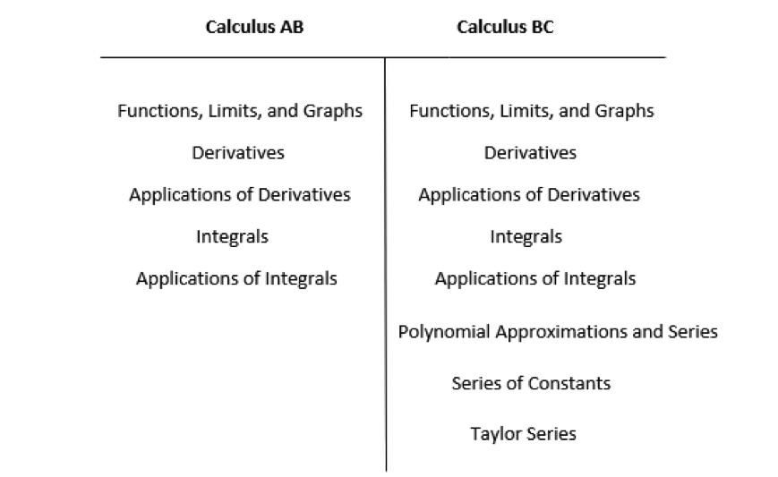
Key Differences between AB and BC Calculus
Pre-calculus is a prerequisite for both types of calculus.
Calculus AB covers the first semester of calculus only (Calculus I)
Calculus BC covers the first two semesters or a whole year of calculus (Calculus I and II courses combined)
All of the topics covered in Calculus AB are also found in BC.
Calculus BC goes further than AB, touching on additional mathematical concepts.
Because it includes more concepts, Calculus BC is a more fast-paced course than AB.
Summer work for both courses.

Slide 8

AP STAT
Honors Math 3 is a prerequisite for AP Stat.
AP Stat is an introductory course in statistics. More of us will use statistics than will use calculus, trigonometry, or college algebra; that makes AP Statistics your opportunity to learn how to produce and use data, to recognize bad data, and to make decisions with data. Statistics allows you to drive data, rather than being driven by it.
If you don’t do your homework, AP Stat is hard. But it’s not like a regular math class—we don’t have problem after problem in which the answer is “4” or “x + 3.”
Enrolled students will be asked to complete summer work.
This Photo by Unknown Author is licensed under CC BY-NC-ND

