Slide 1
High School Options
Northern Guilford Middle School
Mrs. Johnson, School Counselor

Slide 2
GCS High School Options
There are more than 30 magnet choices! (Transportation is provided)
Application window is October 9th-November 22nd
GCS Choice Showcase:
Wednesday, October 16th 5:30-8:00pm at the Greensboro Coliseum Special Events Center

Slide 3

How to Apply
www.gcsnc.com
Scroll to the bottom of the page-GCS Choice Application
You can apply for up to 5 magnet/choice schools

Slide 4

Tuesday Tours and Open Houses
www.gcsnc.com
  Departments
  Choice Schools & Programs
  Fall 2024 School Tuesday Tour and Open House Schedules
At this site you will find info for schools you are interested in and dates/times they are having tours and/or an open house.

Slide 5

January - February 2025
January 31st: Lottery and Notification to Families
February 7th: Families accept or decline offers

Slide 6

Sports
Check with your choice school about sports options. If they don’t offer sports on site, you will participate at your home school.
Need your own transportation

Slide 7

Weaver Academy
Performing and Visual Arts
FULL TIME-APPLY
AREAS OF CONCENTRATION
  Visual Art
  Recording Engineering
  Piano
  Vocal Music
  Classical Guitar
  Dance
  Orchestral Strings
  Theatre

Slide 8
Weaver Academy-CTE
PART TIME-YOU DO NOT HAVE TO APPLY (still attend NGHS for Core Content)
Students in CTE classes have the opportunity to study and earn industry and professional certifications in:
Adobe Academy and Media Production
Apparel Production and Fashion Merchandising
Architecture and Computer Aided Design and Drafting
Automotive Services
Collision Repair
Construction Technology
Culinary Arts and Hospitality

Slide 9
Weaver CTE Cont.
Diesel Technology
Electronics
Health Sciences
HVAC: Heating, Ventilation and Air Conditioning
Information Technology (IT)
Metals Manufacturing
Project Management

Slide 10
Early College at Guilford and STEM Early College at NCA&T
Must have a solid record of excellent academic performance and a desire for a challenging academic experience.
Students who thrive in the school’s learning environment are described as motivated, self-regulated, independent thinkers and learners.
Leave with a HS Diploma and 2 years of Undergraduate Credit

Slide 11
Several Middle College Choices
GTCC Campuses (Greensboro, High Point, Jamestown)
UNCG Campus
N.C. A&T (all male)
Greensboro College
Will earn college credits in addition to a high school diploma

Slide 12
Andrews Aviation Academy
https://www.gcsnc.com/Page/73300
To be accepted, students must have a 2.5 average and a record of good behavior.
Provides a hands-on environment for students to work on and around aircrafts, learn to plan flights and flight schedules, understand aviation meteorology and learn about space flight and exploration

Slide 13
Application Period
October 9th-November 22nd

Slide 14

Greensboro Coliseum
Special Events Center
October 16th
5:30 – 8 p.m.

Slide 15

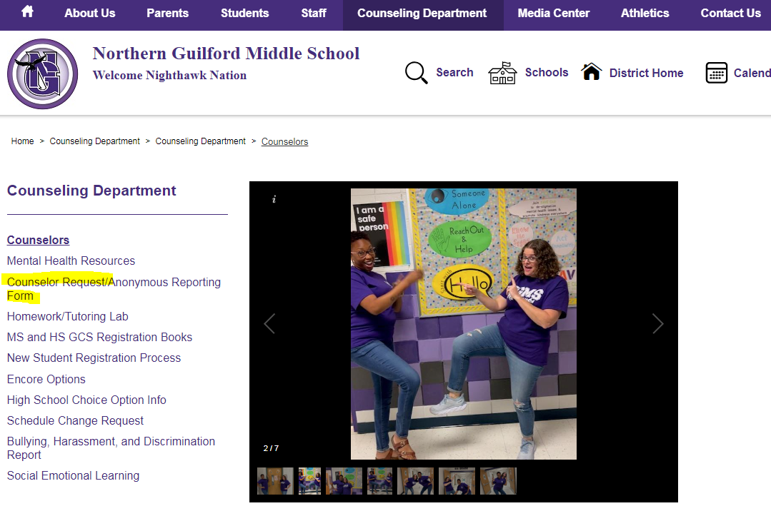
Questions?
I am here to help you through this process. Use the Counselor Request Form found on our school website under the COUNSELING Dept. tab to set an appointment.

