Slide 1
Service Learning
At
NWHS

Slide 2
What Is service Learning
Service Learning
integrates community
service with reflection
to teach students
about civic/social
responsibility and help
strengthen our
community.

Slide 3
How Can I participate
1)Personal Projects – where
you find a service
opportunity on your own
in the community.
2)Campus Opportunities –
where you serve with a
NWHS class or school
sponsored club.

Slide 4
How DO Set up my Account
➜ Go to x2Vol.com and register your account.
➜ Click “Join”
➜ Click on “Complete Registration”
➜ Enter “Northwest Guilford High School”
into the search box
➜ Enter your Last Name and in the email
box list your SCHOOL ID NUMBER
➜ Click “Search” and then complete the
entire Student Registration form

Slide 5
Tips for Completing your Profile
* Make sure to use an
email address you actually
Check!!!!!!!!
You cannot log hours until
your account/profile has
been verified

Slide 6
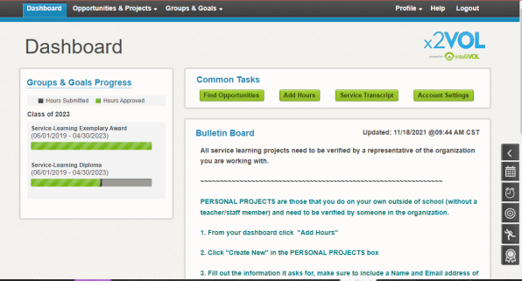
What your Dashboard should look like

Slide 7
Buttons you will Use
“Find Opportunities”
If you click this
button, you will see
all of the “Community
& Campus”
opportunities
available.
“Add Hours”
After you have
completed service
and you want to add
hours, you click on
this button to
document your time
and reflection.

Slide 8
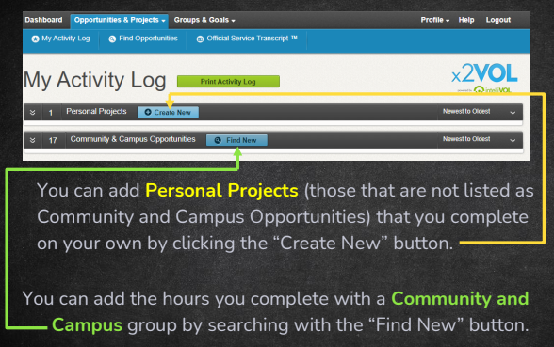
To “ADD Hours”

Slide 9
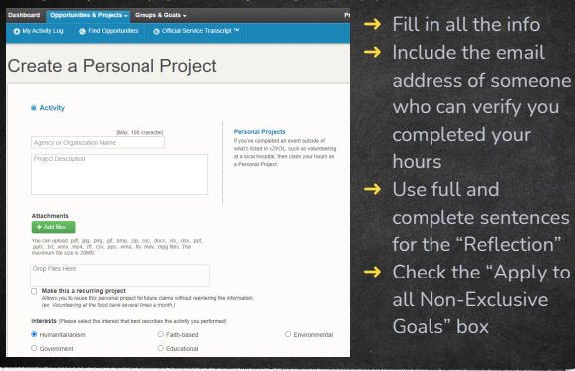
For Personal Projects

Slide 10
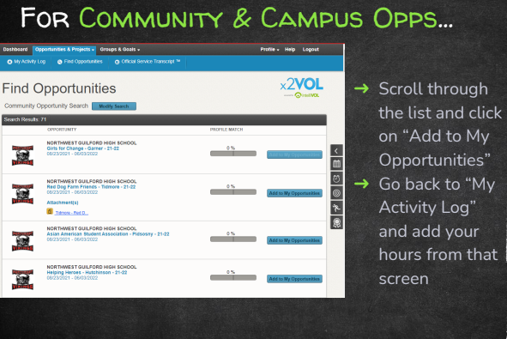
For Community & Campus Opps…

Slide 11
How Many Hours Do I need
Class of 2023
Diploma:186 Hours
Certificate: 75 Hours
Class of 2024 and Beyond
Diploma: 250 Hours
Certificate: 100 Hours

Slide 12
Questions?
Email Mr. Kaplan (Kaplanm@gcsnc.com)

