Slide 1
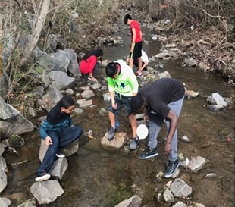
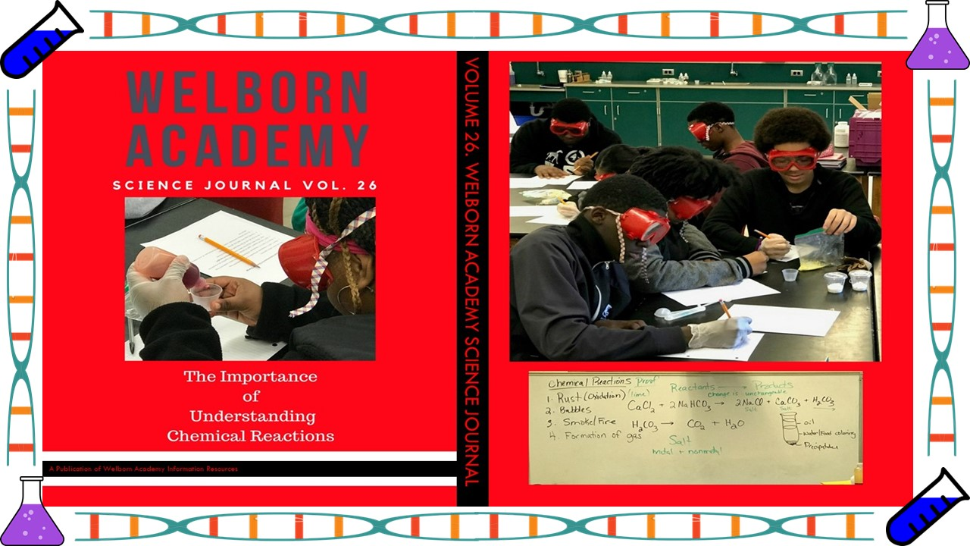
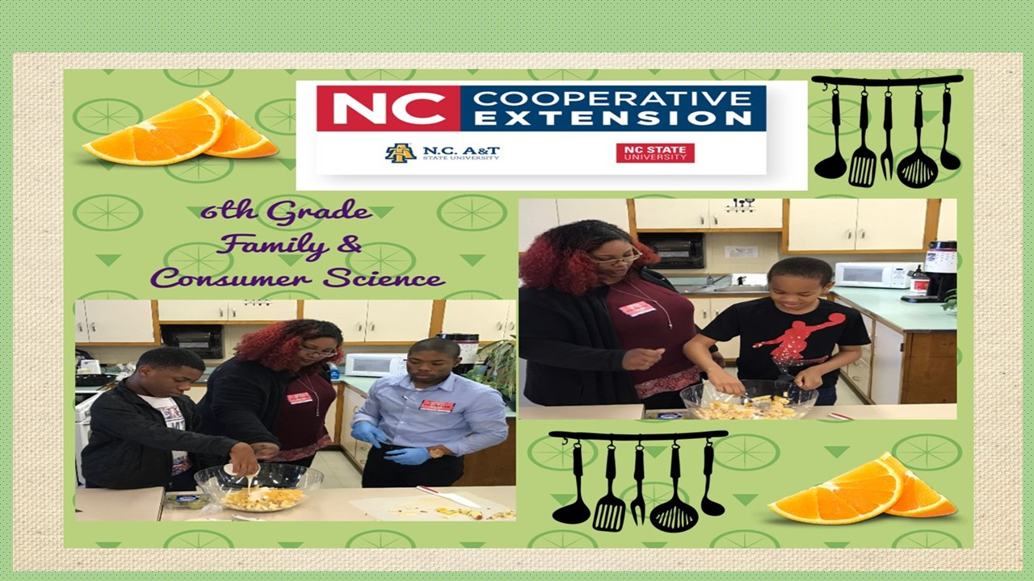
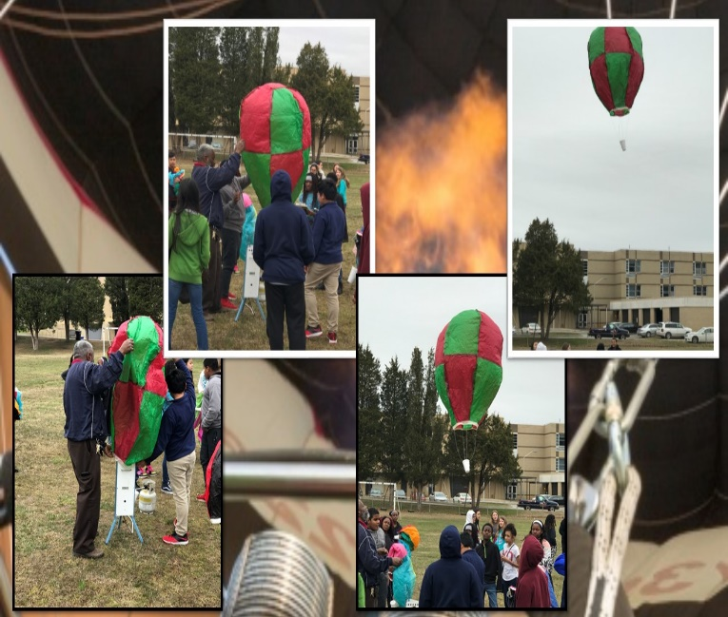
Welborn
Academy of
Science and Technology

Slide 2
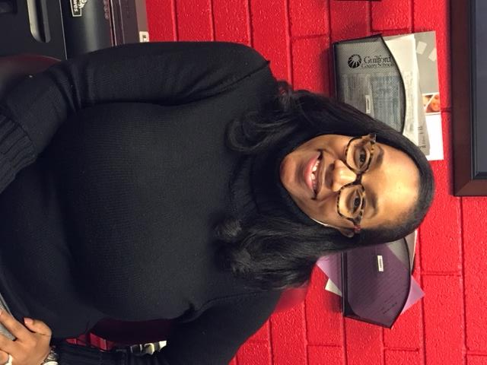
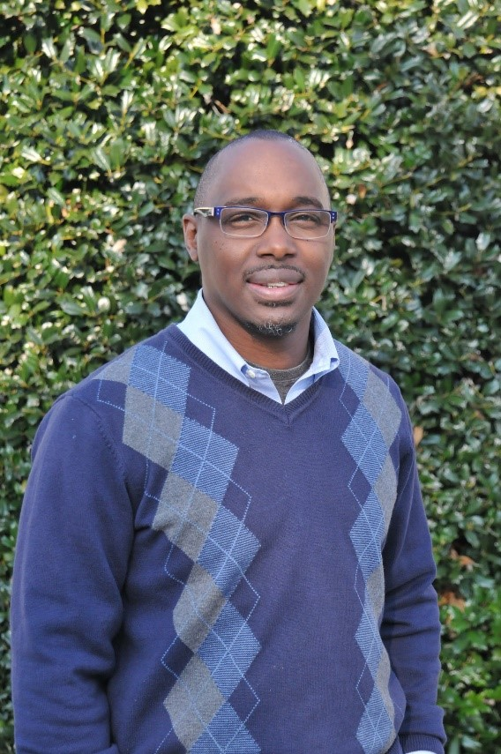
Welborn Academy administration
Mr. Domieka Cantey,
Assistant Principal
Dr. Ashauna Harris,
School Principal

Slide 3
Middle School expectations
Arrival time- 8:50/ Departure time- 3:45
AIG/ ESOL/ EC
Core Classes (ELA, Math, Science, Social Studies)
Encore Classes
Welborn Highlights
Offer AIMM (Math), and opportunities to take accelerated classes at the High School (Math 1 & 2)
Technology Workshop
Warm caring environment where students are greeted as they enter each morning, monitored during transitions
Grade level specific bell schedule throughout the building (Lunch, transitions…)
Yearlong 90 minute ELA and Math Classes
Yearlong 45 minute Social Studies and Science classes
Encore classes- 45 minutes each with a change at the semester
Free Breakfast in the classroom, Free Lunch
Nationally Ranked Robotics
Aviation Encore Opportunity

Slide 4
6th Grade encore Classes
Band (Year Long)
This course is open to all sixth-grade students with strong interest. Students receive instruction on fundamentals through group and individualized instruction. The groups are involved with performances throughout the school year. Except for large and/or expensive instruments, parents must secure instruments for their children.
Introduction to Spanish
This 6th-grade course is designed to introduce students to basic Spanish vocabulary and structures. They will develop an awareness of the Spanish language patterns and sounds. In addition, they will gain familiarity with the geography, customs, and traditions of the Spanish-speaking world as well as Hispanic influence in American culture.

Slide 5
6th Grade Encore Classes
Art
This course is open to sixth-grade students interested in exploring basic art techniques and media. It emphasizes and principles of design, along with opportunities for enhancing critical-thinking and writing skills.
Exploring Technology
In this course, students will investigate how products can be improved and invented based on the current need to solve problems. Through engaging activities and hands-on projects, students will focus on understanding system design and various manufacturing technologies; and how technology can impact society, the environment, and the economy, as well as utilize engineering design concepts such as computer-aided design and other communication technologies to brainstorm and analyze solutions to technological problems. They will examine how criteria, constraints, and processes affect designs. The course emphasizes brainstorming, visualizing, modeling, testing, and refining designs. Students will develop skills in researching information, communicating design information, and reporting results. Activities are structured to integrate physical and social sciences, mathematics, English language arts, and art. Technology Student Association (TSA) competitive events, community service, and leadership activities provide the opportunity to apply essential standards and workplace readiness skills through authentic experiences.

Slide 6
6th Grade Encore Classes
PLTW Gateway to Technology
Middle school students will engage their natural curiosity and imagination in this course through creative problem-solving. Students will apply the design process to solve problems and understand the influence of creativity and innovation in their lives. They will work in teams to design a playground and furniture, capturing research and ideas in their engineering notebooks. Using industry design software, students will create a virtual image of their designs and produce a portfolio to showcase their innovative solutions. They will also trace the history, development, and influence of automation and robotics as they learn about mechanical systems, energy transfer, machine automation, and computer control systems. Students will utilize robotics to design, build, and program real world objects such as traffic lights, toll booths, and robotic arms. This course provides a strong foundation for further science, technology, engineering, and math (STEM) learning in high school and beyond, challenging students to solve real-world issues. This course is offered at Eastern Middle School and Welborn Academy only.
Computer Science Discoveries 1
Students will learn keyboarding skills focusing on technique, accuracy, and speed. They will learn to create computer programs that will help them collaborate with others, develop problem-solving skills, and persist through difficult tasks. They will study programming concepts, computational thinking, and digital citizenship, and they will develop interactive games or stories they can share. The course teaches the foundational concepts of programming.

Slide 7
Welborn Accolades
2019 Recipients for IPG- Innovative Partnership Grant ($1.5 Million)
2018 Secondary Principal of the Year
1st Place Robotics Club for the last 3 Years
Spelling Bee
HP Police Youth Leadership Academy
Junior Achievement Economics for Success and It’s My Future Program
Beautification Projects
Friday Fun Days
Attendance Challenge
Awards/Celebrations & Recognitions
Red Room Food and Clothing Resources

