Slide 1
WELCOME
Frazier Elementary’s PTA Meeting
Tuesday, October 8th 6:00pm
PTA President: Melissa Poteat (Charlye’s Mom)

Slide 2
Agenda
Introduction
Fundraiser information
Spiritwear
Tax Referendum
Join PTA!
Q&A

Slide 3
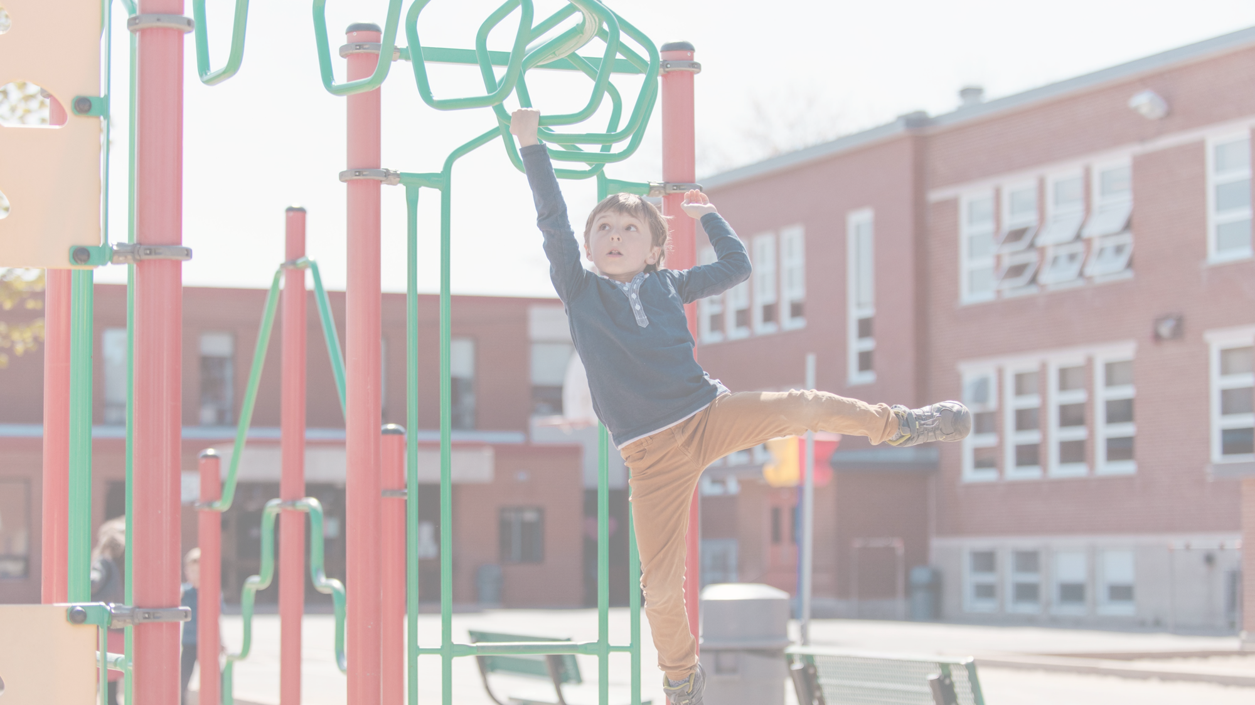
Cookie Dough Fundraiser Results:
→ 227 items sold (164 previously)
→Total profit: $1991.10 ($1243.20 previously)
→ Includes online sales
***Top Seller!!***
Quenzir McLeod
$1170 sold
Ms. Martin Kinder Class

Slide 4

SAVE THE DATE – FRAZIER SPIRIT DAY
Monday, November 4th (Teacher Workday)
12pm-3pm
Regular Admission – PTA Receives 20%
Urban Air Trampoline & Adventure Park is Greensboro's newest Adventure Destination, offering attractions and experiences for guests of all ages. From gravity-defying trampolines and epic ninja warrior courses to sky-high ropes courses and multiple climbing wall.
**MORE DETAILS TO COME**

Slide 5

BELK CHARITY SALE - TICKETS NOW ON SALE!
$5 per ticket
Sale starts November 8th
VOLUNTEERS NEEDED:
  PTA will set up at the entrance of Belk’s Shoes/Handbags Dept. to sell tickets on Saturday, Oct. 19th at 2pm-6pm
  Will also have a bake sale to push sales
  Looking for volunteers to help sell tickets and/or provide baked goods to sale
  Please contact PTA, if interested
  Please send funds with students if ticket needed, tickets will also be available in the front office.

Slide 6

Frazier Spiritwear Available
Shop online: www. frazierspiritwear.com
T-shirts, sweatshirts, polos, pants, and much more!
Choose from one of the pre-selected designs to represent Frazier Elementary!
Weekly sales will be posted on Dojo!

Slide 7

Frazier’s Principal:
Ms. Bowser
Important information regarding the 2024 tax referendum

Slide 8
Join PTA Today!
$7.00
Officers still needed:
- Vice President
- Secretary
- Treasurer
(Currently have 17 members)
Please contact PTA if interested

Slide 9
Thank you for attending!
Questions?
Melissa Poteat – PTA President
info.frazierpta@gmail.com

