Slide 1














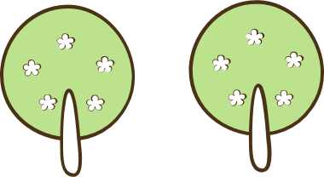
2
0
2
4
Media Center/Library
TEACHER: Mrs. Pence
Welcome

Slide 2


You will learn:
How to find information
How to become a better reader
How to be safe on the Internet
How to make lots of cool stuff

Slide 3

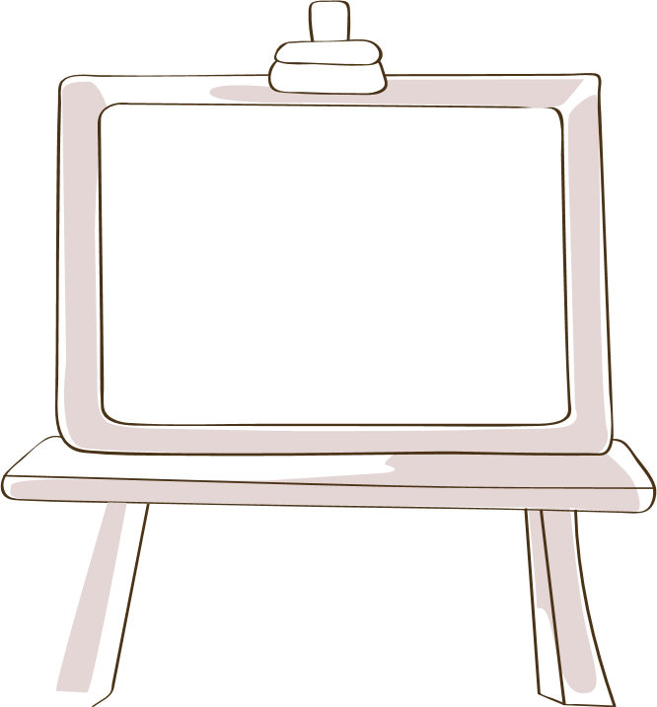



Library Rules

Slide 4
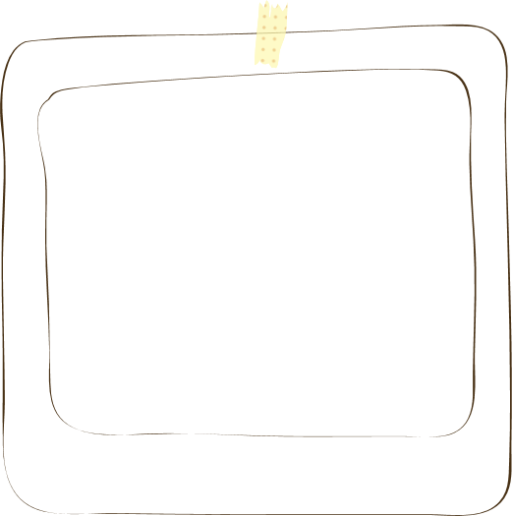

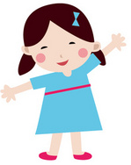
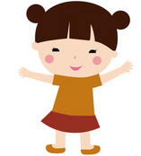
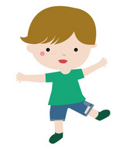
Library Rules
Why are rules important?
Keep us safe
Gives us more time to learn
Makes class enjoyable for all
Keeps tools, supplies and books in good condition

Slide 5

Library Rules
Be Respectful of Teacher
& Others
Keep Hands, Feet, & Objects to Yourself
Make
Good
Choices
Listen & Follow Directions
Raise Your Hand for Help
Sit in Chairs Correctly
No Food or Drinks
Use Tools Correctly

Slide 6
Consequences
Seat moved or sent
to another classroom
Call home
A
B
C
D
Time out with a
writing assignment
Loss of privilege
Points are added or subtracted in Class Dojo every day for everyone.

Slide 7
Book Care

Slide 8
Book Care
#1
#3
Keep books away from
pets and babies
Use clean hands
Use your shelf marker
No food or drinks
#2
#4

Slide 9
Seating

Slide 10
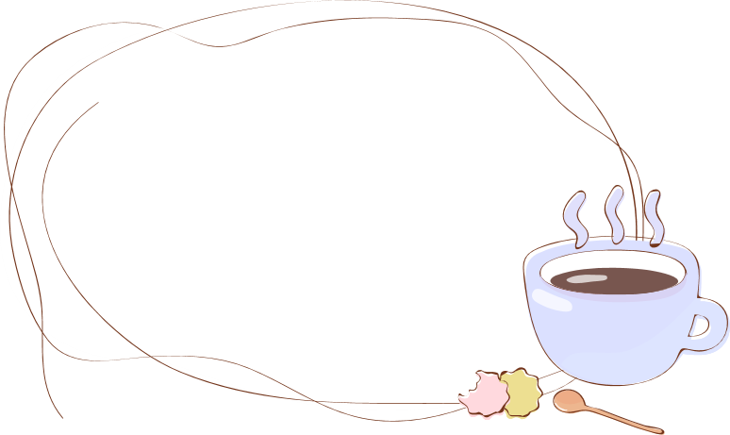
Seating
Assigned seating at tables with a number.
You must remember your table # and seat color.
Every seat has a color – red, yellow, blue and green.
Colors will be given jobs, or colors or tables will be sent to centers or stacks.

Slide 11

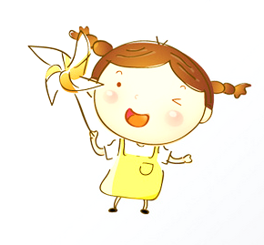
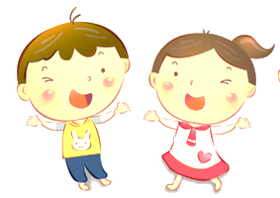
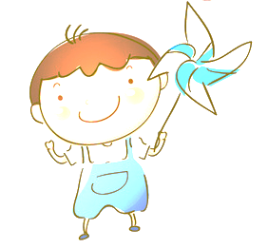
Seating
Your table is a team.
You must work together.
You must be kind.

Slide 12
Supplies

Slide 13



Supply Caddies
Caddies contain:
crayons, scissors, glue sticks, glue, pencils, markers, colored pencils, and an eraser.
All supplies must be handled with care and put away CORRECTLY.
01
Each caddie has an assigned table.
02
03

Slide 14
Centers & Activities

Slide 15
Center Examples
A
B
C
D
Reading
Technology
STEM
Craft
Find a quiet spot to read or read with a buddy.
Play a game about Internet safety and being a good digital citizen.
Build a bridge like the one in the story Three Billy Goats Gruff.
Make a Cootie Catcher game.

Slide 16



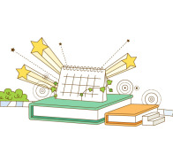
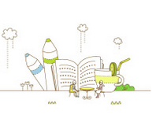
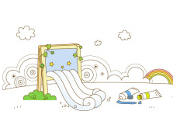
Centers
A
B
C
After lesson and activity, everyone rotates through the different centers. This is also the time to check out books by color or table #.

Slide 17


Centers
Follow directions and complete the center activity.
Take care of supplies and clean up after yourself.
Make good choices and be kind to others.

Slide 18

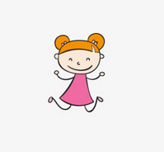
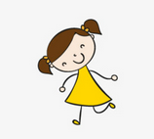

Checking Out Books
You will learn how to search for books on Destiny.
You will learn to use a shelf marker and keep books in order.
You will learn to check out books yourselves.

Slide 19
Coming to the Media Center on Your Own
Get trained to check out and show me you can do it right.
Only pairs and small groups may come, and you must make good choices.
Make
Good
Choices
Ask the teacher if you can come down to check out a new book during weeks you don’t have media class.
Check out a book correctly and leave my other class alone. If you don’t you will lose privileges.

Slide 20
2
0
2
4
Now it is time to practice.
The sooner you master the rules and procedures, the sooner we get to do fun stuff.

