Slide 1
Annual Middle School
AG Parent/Guardian Meeting
Brown Summit Middle School
Linsey McCarthy
October 8, 2024—Lunch and Learn
Whitney Oakley, ED.D. | SUPERINTENDENT
Revised September 2023
Notes:
Note to TAG Chair: Please preview and update this template for your school and save the update file. You will need to upload a copy to SharePoint as evidence of what was shared with your parents.
Suggested script:
Welcome to our AG Parent Meeting. Each year the district requires that all school’s hold a parent AG meeting to provide an opportunity for parents to understand their child’s AG service, receive the annual plan for classroom differentiation, and have the opportunity to ask any questions they may have.

Slide 2

2022 – 2025 AIG Plan
Notes:
Suggested script:
During this meeting, I will provide an overview of the current 2022 -2025 district AIG Plan. I will highlight information from the AIG Plan as it relates to middle school AG service.

Slide 3


Primary Goals for 2022 -2025 AIG Plan
Increase Availability of Advanced Coursework
Improved efficiency for AG Compliance
Notes:
Suggested script:
At the middle grades, revisions for the 2022 – 2025 AIG Plan fell into these two “buckets”. The first area that we will discuss is Increase Availability of Advanced Coursework. The second area we will discuss is Improved Efficiency for AG Compliance.

Slide 4
Increase Availability of Advanced Coursework &
Appropriate Instruction
Differentiation Canvas Module provides support to classroom teachers by providing relevant information and sample on differentiation techniques for gifted and advanced learners.
AG PD Series focuses on the characteristics of academically gifted students and highlights best practices for meeting their needs in the classroom.
The AG Department goal is that by the end of 2025, there will be:
  Increase access to English I enrollment as an 8th grade option.
  Provide an advanced course option for middle school Science and Social Studies.
Notes:
Suggested Script:
At the middle grades level, AG students are served through appropriate differentiation and enrollment in advanced math and/or reading courses. To help teachers implement effective differentiation strategies, the AG Departments provides a Canvas Course with modules on instructional strategies for advanced learners. All teachers in GCS have access to this course and the resources provided within the course.
The AG Department also provides their AG PD Series, which is two courses that focus on the characteristics of academically gifted students and instructional practices that can best meet their learning needs. As will be highlighted later, the district’s expectation is that all teachers of AG students complete this course or have their AIG licensure.
For the 2022 – 2025 plan cycle, the district had hope to mee the goals listed in purple font. However, as we approach the end of this plan cycle, accomplishing these goals is not feasible and these goals will be brought back to the district’s AIG Advisory Board for consideration in the 2025 – 2028 plan cycle. For ELA, the district implemented a new curriculum resources. Through intentional partnership between the Literacy Department, Media Services, and the AG Department efforts were implemented to ensure that the curriculum resource met the academic strengths of students enrolled in an advanced ELA course. For example, the AG Department wrote or revised several protocols for instruction implementation that highlight best practices for differentiating learning for advanced learners.

Slide 5
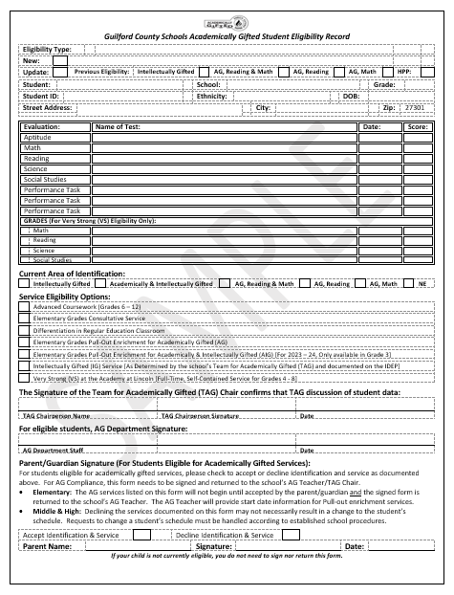
Improved Efficiency for AG Compliance
Revised
Student Eligibility Record (SER)
Data reviewed to make decisions regarding AG eligibility;
Identification and service details; and
Updated to include a place for parent/guardian to accept or decline identification and service.
Notes:
Animated Slide:
Bullet points come in one at a time. The square box comes in with the last bullet point.
Suggested Script:
The Student Eligibility Record, often referred to the SER, (click mouse) documents the data that was reviewed to determine if the student met the criteria for AG identification. The SER (click mouse) also details the student’s eligibility area and the service that is to be provided to the student. At the middle grades level, the service provided to students is enrollment in advanced coursework. The SER (click mouse) has been updated to include a place for the parent/guardian to accept or decline their child’s AG identification and service. Although enrollment in advanced coursework begins from the first day of school, it is important that the SER is returned to document the parent’s/guardian’s acknowledgement of their child’s AG identification. Additionally, at the middle grades level, should the parent decline identification and service, the child’s status in the state’s student management system (currently PowerSchool) would be updated and the family would be referred to the counseling department to discuss any possible schedule changes. Declining identification and service does not necessarily lead to an immediate schedule change and unenrollment from advanced coursework.

Slide 6
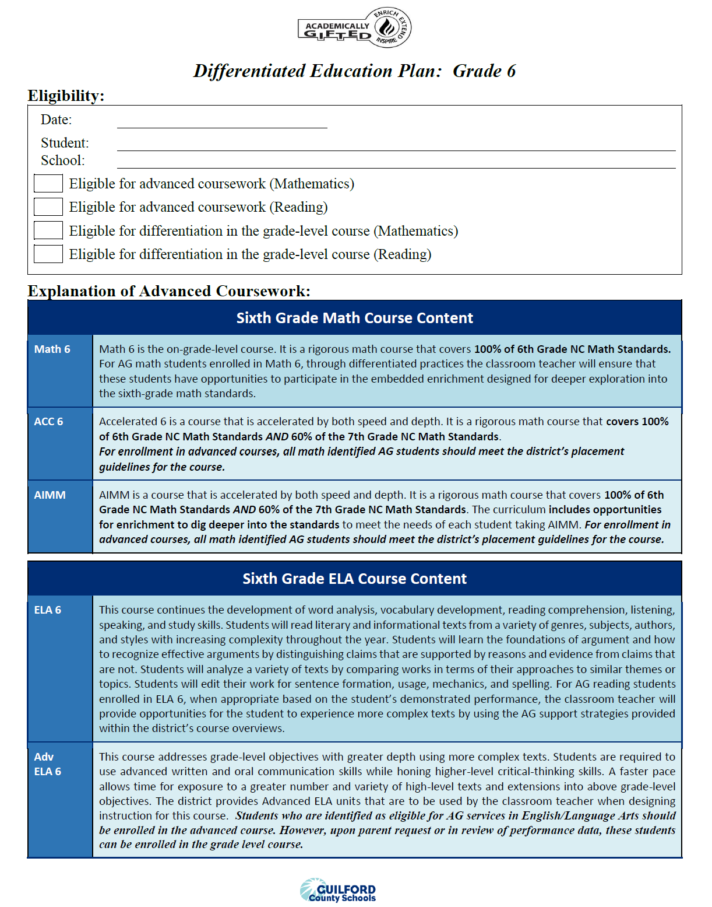
Improved Efficiency for AIG Compliance
Revised
Differentiated Education Plan (DEP)
Parent receives DEP annually (updated by grade level)
Provides an explanation of the service that is marked on the SER
  For each grade level, describes the differences between the on-grade level course and the advance course options.
  For advanced courses, serves as the Group Annual Plan for Differentiation because it details the embedded acceleration and extension provided in these courses.
The Progress Report and Report Card serve as documentation of student performance in AIG programming.
Notes:
Animated Slide:
Bullet points come in one at a time.
Suggested Script:
The Differentiated Education Plan, often referred to the DEP (click mouse) is provided to parents annually at our beginning-of-year parent meeting. (Click mouse) The DEP explains the services marked on the SER. For middle grades, the DEP describes the differences between on-grade level course and the advance course options. It serves as the Group Annual Plan as it details the embedded acceleration and extension provided in advanced courses. Parents should use their child’s Progress Report and Report Card as documentation of their child’s performance in AG programming.

Slide 7

Questions regarding the AIG Plan should be directed to the AG Department. The AG Coordinator, Dr. Dee Jordan serves as the middle school AG contact. You can reach her at:
336-370-8322
OR jordand@gcsnc.com
Note: After October 31, district questions regarding middle school academically and/or intellectually gifted service should be directed to Kelly Woody at woodyk@gcsnc.com.
Notes:
Suggested Script:
The completed AIG Plan is available on the AG Department’s website. You can access the website by going to www.gcsnc.com, click on the “Departments” tab, and select the Academically Gifted Department. Once of the AG Department page, on the left side, click on “AIG Plan 2022 - 2025” link. If you have any questions regarding the AIG Plan and middle school AG services, you can contact Dr. Dee Jordan to express your concerns or share your feedback. Dr. Jordan will be retiring. As such, after October 31, any questions regarding middle school services should be directed to Kelly Woody.

Slide 8

Providing Support to AG Students and their Families
Notes:
Suggested Script
The next protion of our meeting, we will focus on the how the district and our school can support you and your student.

Slide 9
AG Support
At the School Level:
Classroom Teacher – Responsible for the implementation of the standard course of study and using differentiation to address student need.
Team for Academically Gifted (TAG) – A cross section of school staff who act on behalf of all gifted students in the building
Curriculum Facilitator – Supports all teachers, in the building, with best instructional practices for all students.
School Counselor – Supports students with the development of the social, emotional, and academic skills needed for post-secondary success. Also available to address scheduling questions.
School Administration – Ensures that the school’s vision is implemented in a way that meets the learning needs of all students in the building.
Notes:
Suggested Script
Unlike elementary schools, where there is a person in the building who is an AG specialist and who handles all AG matters as well as serves students in a pull-out enrichment program, middle school AG is addressed through a collaboration of multiple people in the building:
the classroom teacher who uses appropriate differentiation to implement the NC standard course of study.
the team for academically gifted which is a cross section of school staff who advocate for the needs of academically gifted students.
the curriculum facilitator who supports all teachers on understanding instructional practices and district mandates regarding teaching and learning.
the school counselor who helps students build the social, emotional, and academic skills and mindsets needed for post-secondary success.
And finally, our school administration team that ensures that the district goals and initiatives are implemented in a way that meets the learning needs of all students in our building.

Slide 10
Team for Academically Gifted (TAG)
What is the function of TAG?
An interdisciplinary team comprised of school staff and a parent representative
Supports and advocates for gifted education in the school
Reviews data to determine student eligibility for AG services
Monitors AG student records and services
Notes:
Suggested Script:
The role of the Team for Academically Gifted (TAG) is to serve as the decision-making team for gifted services at the school level.
The TAG provides support and advice to AG students, their parents, and their teachers. TAG members serve as advocates for gifted services. Each member shares the responsibility of ensuring that services and documentation within the school comply with the current board-approved AG Plan; doing the work for the grade level they represent.
The TAG Chairperson serves as the lead contact person, in the school, for the AG services and they oversee the function of TAG Team.
TAG meets monthly with face-to-face, virtual, and quick check-in options.
If you school does NOT currently have a parent representative, suggested script:
The TAG Team must include a parent representative who will share parent voice and concerns regarding AG services. Often parent TAG members are contacted by the AG Department to provide a parent perspective to district concerns. Currently our school’s TAG team does not have a parent representative, if you are interested in serving on our team, please … insert how you wish for them to contact you or another member of TAG to express their interest.

Slide 11
Meet Our School’s TAG Team:
TAG Role: | Team Member: | School Role:
TAG Chair | Linsey McCarthy | ELA 8 Teacher
Principal/Principal Designee | Dr. Jones-Goods | Principal
6th Grade Representative | Ashley Hughes | SS/Sci. 6 Teacher
7th Grade Representative | Rebecca Cox | Science 7 and 8 Teacher
8th Grade Representative | Linsey McCarthy | ELA 8 Teacher
Parent Representative | TBD
Advising Member, School Counselor | Sonja Sloan | Counselor
Advising Member, EC Teacher | Tara Stanley | EC
Advising Member, EL Teacher | NA
Advising Member, 504 Coordinator | Sonja Sloan | Counselor
Notes:
Suggested script:
This slide summarizes the membership of our school’s current TAG Team. Tell member’s name and their school role.

Slide 12
Our TAG’s Communication Plan
Quarterly Newsletters—posted on our BSMS AG page
Communications through weekly grade level announcements and Remind 101
Updates on our BSMS AG page
Notes:
Suggested Script:
As parents of AG students, you can expect to hear from our school’s TAG team through quarterly newsletters. We also will provide mass communication to parents by … insert how your school’s TAG will provide as needed communications and include any information about your school’s AG website (if applicable).

Slide 13
AG Support
At the District Level:
AG Department– Provides support to schools and families with identification and service of AG students in grades 6-8
Guilford Gifted (formerly known as Guilford PAGE)– A community group comprised of parents and other stakeholders with an interest in gifted programming throughout the district.
Notes:
Suggested Script:
Our district’s AG Department provides support to schools through appropriate professional development. Additionally, the department provides enrichment experiences, such as the Academic All-Star Camp.
A district wide support is Guilford Gifted, which was formerly known as Guilford PAGE. However, this caused a lot of confusion with Page High School. Therefore, to avoid confusion with Page High School, the organization will now be referred to as Guilford Gifted. The organization remains a non-profit affiliate of the North Carolina Association for Gifted & Talented. Our Guilford Gifted chapter advocates specifically for students in Guilford County.
Information for TAG Chair:
Academic All-Star Camp is a summer enrichment opportunity for rising ninth graders (i.e., your currently enrolled 8th grade students). The AG Department reviews previous year EOG data to identify the top performing 30 students from each middle school. These students receive an invitation to register for the camp. Finally, selection is based on the number of applicants and the department’s goal to ensure that those selected to fill the 200 slots represent all of our middle schools. Slide 25 provides more details about this opportunity.

Slide 14
If you have a question or concern:
Talk with your child
Contact the classroom teacher
Contact the principal/TAG Chair
Contact the AG Department at 336-370-8361
  Dibrelle Tourret, Director
  Dee Jordan, AG Coordinator
  Barry McDougald, Lead Teacher
  Kelly Woody, Interim AG Coordinator (After 10/31)
  Tia Thompson, Interim Lead Teacher
Reminder: After October 31, Kelly Woody will be serving as the district’s AG Coordinator.
Notes:
Suggested Script:
If you have a concern regarding your child’s AG service, after talking to your child about the situation, you should speak to the appropriate teacher. After speaking with the classroom teacher, if you still have concerns, at that time, you can share your concerns with the school principal or the TAG Chair. Since the TAG chair does serve in a supervising role over any classroom teachers, they may find it necessary to consult with the principal to address your expressed concern. If you feel that your concern has not been addressed at the school level, you may contact the AG Department. On our slide, Dibrelle Tourret and Dee Jordan are in bold font because they primary address middle school services.
Suggested Activity:
After hearing what is being presented during this meeting, you may have question. If you have questions, please write your questions or comments on a post it on and post to our parking lot chart. Our TAG Team will review all questions submitted and provide a written response … list how you will share the response (some suggestions … create FAQ and post on website or send in next newsletter; send a mass email; send Remind or other communication app notification).

Slide 15

Guilford Gifted
(formerly known as Guilford County Chapter of PAGE)
https://www.guilfordgifted.org/
Notes:
Suggested Script:
As previously stated, the Guilford Gifted is the community advocacy group for gifted education in Guilford County. With the rebranding from Guilford PAGE, the organization has a new website. We encourage you to visit their website to learn more about their programming and advocacy efforts.

Slide 16

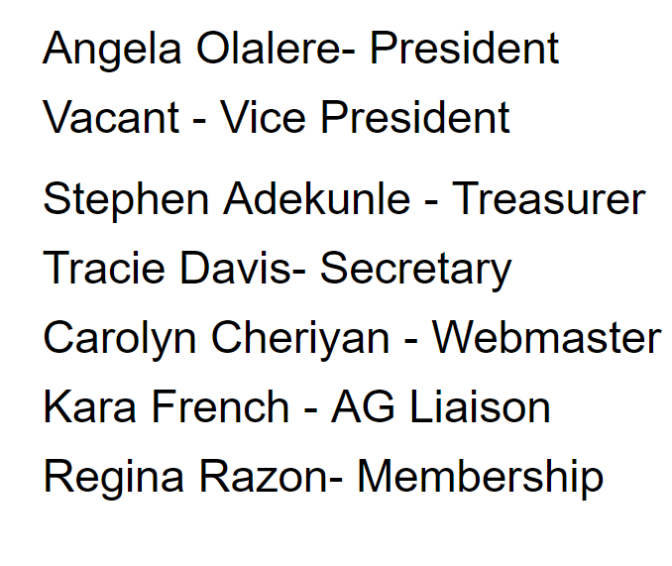
Meet the Guilford Gifted Team:
Guilford Gifted Board
info@guilfordgifted.org
Notes:
Suggested Script:
Guilford Gifted continues to rebuild and become a more visible support to families. This slide provides the names of the current board members. There is a need for person to serve in the capacity of Vice President. If you are interested, please send an email to info@guilfordgifted.org.

Slide 17

Goals of Gifted Guilford
Continue growing our membership with aim to have all schools represented. Membership is FREE!
Interactive events for parents, students, and teachers
A Guilford Gifted member on every TAG Team
Support our AG teachers
Offer resources/education to families
Promote resources aimed at MS/HS students
Notes:
Suggested Script:
This slide highlights 6 goals of the organization. Those that are related to the needs of academically and/or intellectually gifted middle school students include:
Having a membership in which all GCS schools are represented. You can help the organization reach this goal by joining. Membership is FREE!
Once the membership includes representation of all schools, Guilford Gifted will be better prepared to assist our TAG teams with securing parent representation.
Another middle school related goal is to ensure that families have access to resources that specifically address the needs of middle school students.

Slide 18
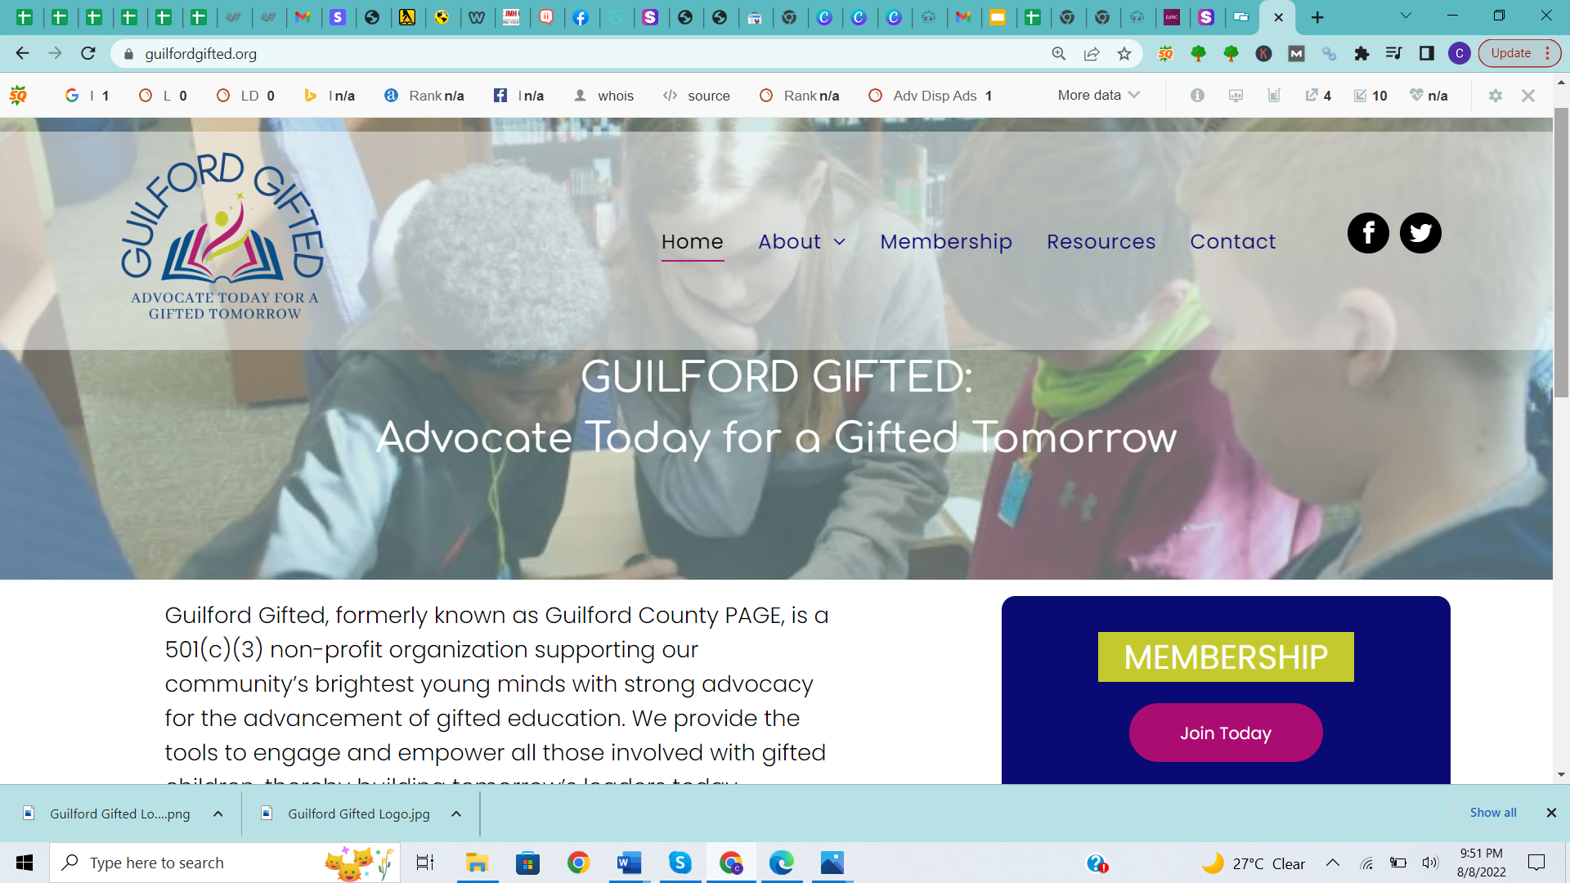
Become A Member
Free Membership
If you already joined, we ask you to renew your membership each year.
Find us at www.guilfordgifted.org
Email us at
info@guilfordgifted.org
guilfordgifted@gmail.com
Notes:
Suggest Script:
During this period of rebuilding and rebranding, membership to Guilford Gifted is FREE! To assist with programming, the organization is accepting donations.
Suggest Activity:
During your meeting allow 5-minutes for families to access webpage and join.

Slide 19
How to Help Guilford Gifted
Advocate for Your Child:
JOIN Guilford Gifted it’s the only local agency dedicated to advocacy for academically and/or intellectually gifted children.
ATTEND the programs that Guilford Gifted organizes.
SHARE their website, www.guilfordgifted.org
FOLLOW them on Facebook: (https://www.facebook.com/GuilfordGifted)
Notes:
Suggested Script:
Guilford Gifted is the only local agency dedicated to advocating for the academic, social, and emotional needs of academically and/or gifted learners. During the Summer of 2023, when the state introduced bills that would have a dramatic, negative impact on academically gifted programming across the state and in Guilford County, Guilford Gifted launched a campaign that informed parents and guardians on how they could contact their state representatives to change the law. Thanks to their efforts minimum changes occurred, at the state level, and funding for academically gifted program was not impacted. Guilford Gifted needs you to …
JOIN the organization, remember membership is FREE but needs to be renewed annually. This means if you joined last year, please rejoin this year.
ATTEND the events the organization sponsors
SHARE the website so that others become aware of the organization
FOLLOW them on Facebook to quick tips regarding meeting the needs of your academically and/or intellectually gifted child.

Slide 20
Overview of Middle School AG Services

Slide 21
Middle School Service Model
The entirety of the academically gifted student’s day is spent in a general education setting, therefore, the responsibility for differentiation is with the classroom teacher.
  The middle school AG service model does not include pull-out enrichment services.
Advanced Courses:
  ELA: Advanced ELA at all grade levels and English 1 available, at grade 8, at select schools.
  Math:
    Grade 6: Accelerated Math, AIMM
    Grade 7: Accelerated Math, NC Math 1
    Grade 8: NC Math 1, NC Math 2
Notes:
Suggested Script:
The middle school service model does not include a pull-out enrichment model like the elementary school service model. At the middle grades level, AG students receive their service through enrollment in advanced coursework. As previously stated, the students DEP details the curriculum expectations of the advance course.
For ELA, at grades 6, 7, and 8, there is an English 1 option for 8th grade at select schools. The current AG plan states that students identified in reading should be placed in advanced ELA.
For Math, the district guidelines determine math class placement. On the slide, we have listed the math options. It is important to know that all of these courses meet AIG plan requirements as appropriate advanced courses.

Slide 22
Differentiation in the Classroom
Schools are given guidance for grouping AG students in classes.
Teacher Qualification: AG students will be assigned to a teacher with AIG licensure or who has met minimum LEA requirements.
  AG PD Course
  AG Scholarship
Clustering Grouping: Students are grouped with similarly achieving peers in the fewest grade level classrooms possible and placed in the appropriate course according to their area of AG identification and district placement criteria.
Number of AG Students: | # of Teachers with AIG Licensure | # of Teachers Meeting the Local Requirement
218 | 3 | 5
Notes:
Note: TAG Chair MUST update this slide with their school’s current number.
Suggested Script:
In order to facilitate appropriate classroom differentiation and meet the academic needs of gifted and advanced learners, classroom teachers of AG students should hold their AIG licensure or, at a minimum, meet the district’s minimum requirement. To assist teachers in meeting the district’s minimum requirement, the AG Department offers the AG PD Series several times throughout the year. For teachers who want to gain a deeper understanding of AG students, the AG Department offers scholarships for teachers to participate in four graduate courses from a partnering university to complete the requirements for AG licensure.
The use of clustering grouping is the intentional grouping of academically gifted and advanced learners. The AIG Plan recommends that academically gifted and advanced learners are group in groups of 6 – 10 in the least amount of grade level classrooms as possible.
Finally, this slide provides a chart that summarizes the number of teachers, on our staff, who have met the district’s requirement for teaching AG identified students.

Slide 23
Required AG Documents
Newly Identified
Updated Identification
Students new to GCS with previous AG identification (in-state transfer)
Previously Identified Students
Student Eligibility Record (SER) – must be signed by parent and returned to the school. Copy in AG folder and copy to parent/guardian.
Grade level Differentiated Education Plan (DEP) –copy provided to parent/guardian.
Grade level Differentiated Education Plan (DEP) –copy provided to parent/guardian.
Notes:
Suggested Script:
As a parent, you can expect to receive the following documents. If your child is newly identified, has had a change in their AG identification, or was previously identified in another NC district and meets the GCS criteria you will get a copy of the SER and the DEP. If your child was previously identified and does not have a change in their AG identification, you will get the appropriate grade level DEP.

Slide 24

Enrichment Opportunities

Slide 25
Academic All-Star Camp
FREE opportunity for high-achieving rising ninth-grade students
The camp provides students with a unique experience that exposes them to subject-related interests, ACT/SAT preparation, an overview of advance placement (AP) opportunities, and leadership skills.
Selection:
Eighth-grade students from each middle school are selected to participate based on their 7th grade end-of-grade scores. Top 10% from each middle school
Two hundred (200) seats are available.
Held at two GCS high schools. Last year was held at Western High and Ragsdale High.
Transportation may be available
All students who accept the invitation must be able to attend the duration of camp (3 weeks)
Notification and registration begins late January.
Notes:
Suggested Script:
The AG Department offers a summer enrichment opportunity to rising 9th grade students. The top 10% of 8th graders from each of the district’s middle schools are selected based on their previous year’s EOG performance. The camp has 200 slots, 100 slots at two high schools. Last year the camp was held at Grimsley High and Ragsdale High. The AG Department anticipates that limited transportation will be provided based on the proximity of the student’s address to one of the camp locations. Notification and registration will begin in January.

Slide 26
Talent Identification Programs (TIP)
Unfortunately, during the global pandemic, the Duke TIP program underwent transitions and was dissolved. Duke University now focuses on it’s Pre-College Program, with some programming available to middle school students. Visit their website to learn more.
Duke Pre-College Programming:
https://learnmore.duke.edu/about/duke-pre-college-middle-school-program
Notes:
Suggested Script:
Duke TIP use to be one of the premier opportunities for gifted students. However, due to the global pandemic, the university made the decision to discontinue to the talent search program and focus on the university’s youth programming. You can visit the website listed her (or Google Duke University Pre-College programming) to learn more about the university’s enrichment opportunities.

Slide 27
Talent Identification Programs (TIP)
Although Duke TIP has discontinued its talent search services, there are three talent identification programs in the country. The programs listed below may have virtual opportunities for your child:
Johns Hopkins University Center for Talented Youth
  Accepts NC EOG Data as evidence of eligibility.
Northwestern University Center for Talent Development
University of Denver – Rocky Mountain Talent Center for Bright Kids
Notes:
Suggested Script:
Although Duke TIP’s talent search program has been discontinued, families of academically gifted students can contact the nation’s three other talent identification programs to determine their programming availability.

Slide 28
Talent Identification Programs (TIP)
The links below provide information on additional talent search opportunities:
Davidson Institute: Talent Search Opportunities for Gifted Students
Hoagies’ Gifted Education Page: Talent Search Programs
Notes:
Note: On the SharePoint, there is a PDF “Enrichment Opportunities (Supplement to BOY Parent Meeting)”. This file can be electronically shared with parents so that they will have the links.
Suggested Script:
Our TAG will share a document with you that will includes all the links to enrichment opportunities mentioned in this presentation. This slide highlights two websites that have links to other talent search opportunities that may be of interest to your child. Also, in previous years the Guilford Gifted (formerly Guilford PAGE) has been able to provide additional enrichment opportunities.

Slide 29
Extracurricular/Enrichment Opportunities
Academic Clubs: Chess, The 12, The Quill, Quiz Bowl, Forensics, Mock Trial, Battle of the Books, Math Counts
Friday Clubs by Interest and Change Quarterly: Board Games, Art Club, 24, Gaming, Dungeons and Dragons, Outdoor Sports, etc.
Notes:
Use this slide to list enrichment/extracurricular activities available at your school. It would be really helpful to include the name of the faculty advisor for each so parents have a contact for their questions.

Slide 30

It was a pleasure meeting you, our school’s TAG looks forward to the opportunity to serve your child.

