Slide 1



Slide 2
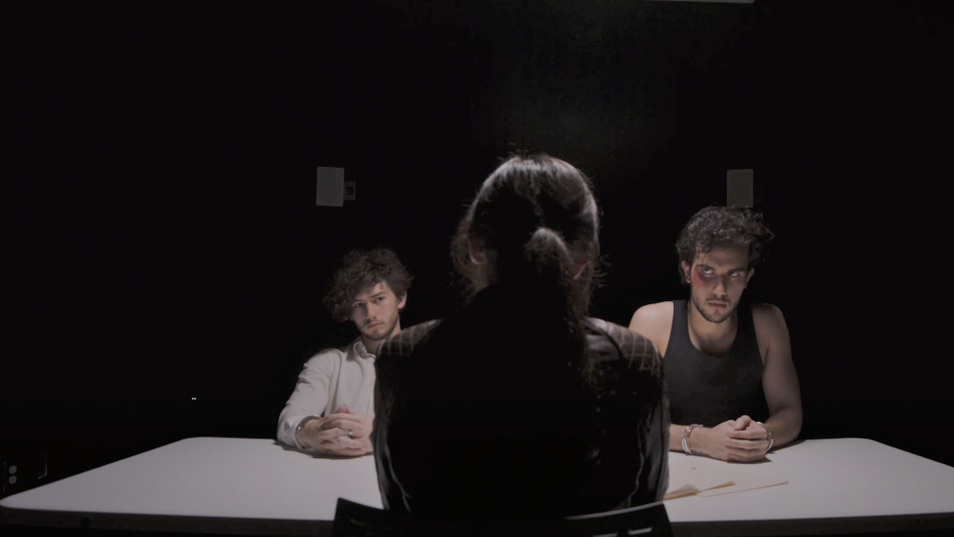
Hey, click HERE to find out....what’s going on?

Slide 3
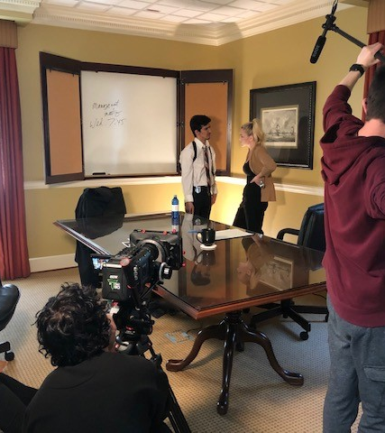
Why the Film Industry?
Why an academy in high school?
The Georgia Film Office, a strategic office within the Georgia Department of Economic Development (GDEcD), reported that film and television productions spent $2.6 billion in Georgia during fiscal year 2024, a total of $11 billion over the last three fiscal years.
The State of Georgia hosted 273 productions between July 1, 2023, and June 30, 2024
This month, Georgia was ranked No. 1 in Film Production by Business Facilities Magazine, featured in the publication’s annual 2024 Rankings Report, an accolade that demonstrates the state’s competitive advantages in this multi-billion-dollar industry.

Slide 4





Georgia
Film
Studios
Trilith Studios
Tyler Perry Studios
Turner Studios
Blackhall Studios
Screen Gems Studios
Third Rail Studios
ATL Film Studios
Liongate Studios
Atlanta Filmworks
Assembly Atlanta
…. And many more!

Slide 5

CFA Curriculum
What do you get?
Cohorted group- you'll be with each other for all 4 Years in CFA classes
Applications are open to ALL Schools in Forsyth County
Focuses on learning filmmaking according to how the film industry works and standards
In addition to Audio/Visual classes, you will also take:
  Vis Arts 1
  Acting for Film/Film Appreciation
  Tech Theater for Film
  Dramatic Writing
CFA enrollment also qualifies you for field trips, Film Festivals and guest speaker engagements from professional filmmakers
Create: Short Films, Documentary Films, Movie Trailers, Music Videos in all genres.

Slide 6
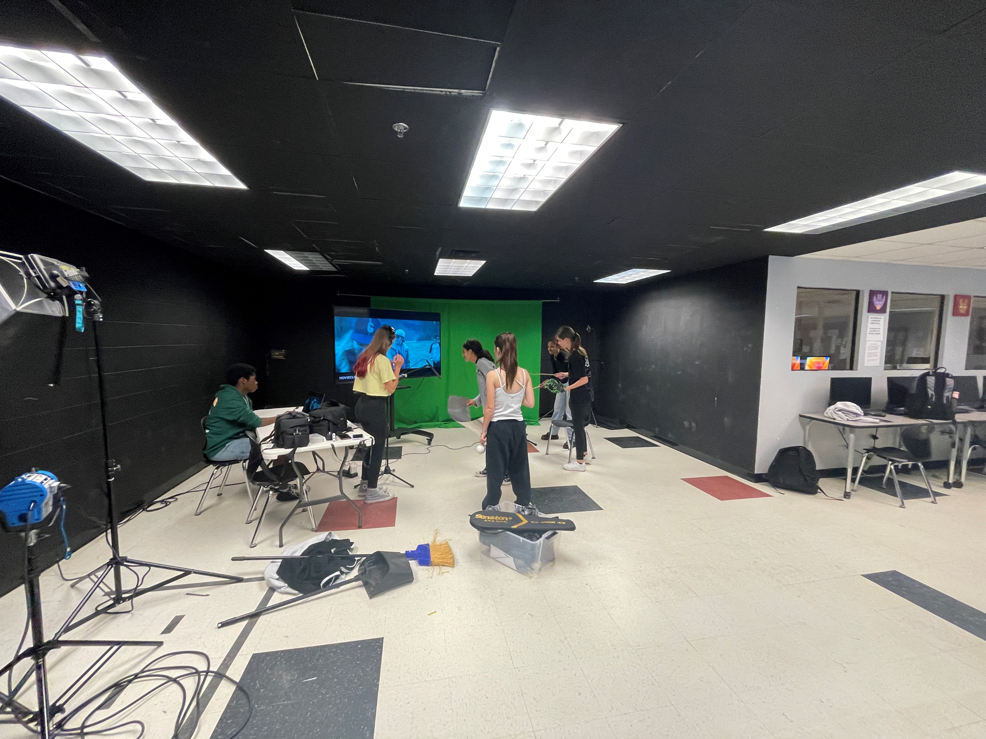
Most important thing CFA can offer!
You get to experience 4 years of High School with a close-knit friend group.
Surrounded by creativity and exciting experiences in the film industry
Whether you have a career in the film industry or not, it will provide a much richer education that opens doors for success in many different areas.
CFA will add a great deal to ANY future you decide as well as connections and experiences through a variety of skills and creative problem solving.
Part of something big and a one-of-a-kind education in Forsyth County

Slide 7
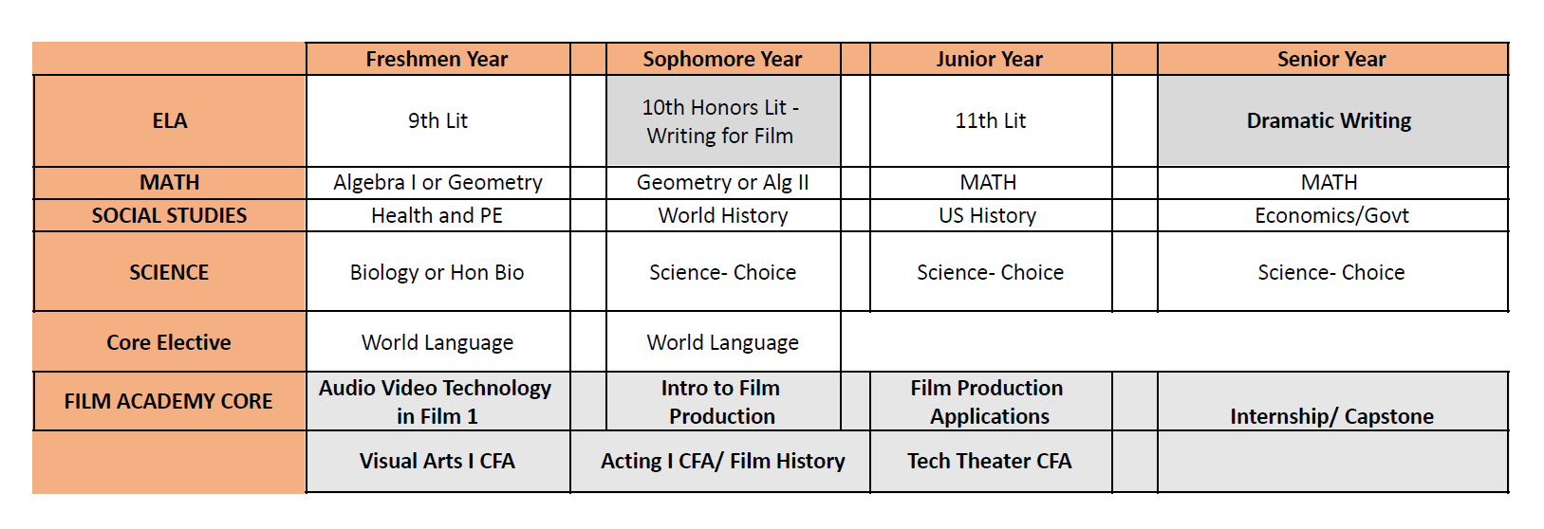
Central Film Academy Pathway

Slide 8
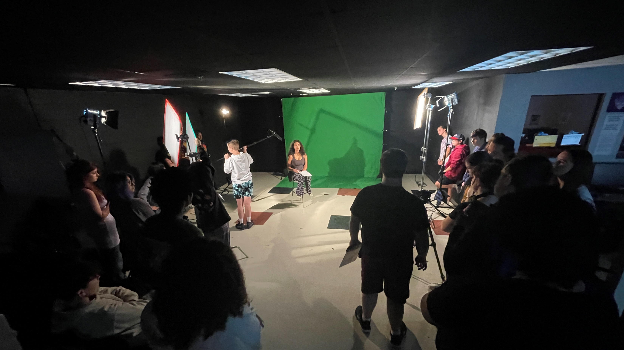
What does a CFA Student look like?
Highly motivated
Creative, original thinker
Storyteller
Strong work ethic
Proactive
Team Player

Slide 9
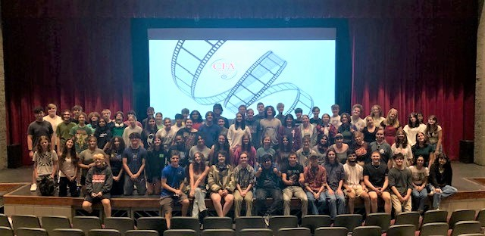
Click HERE to find out who we are?

Slide 10
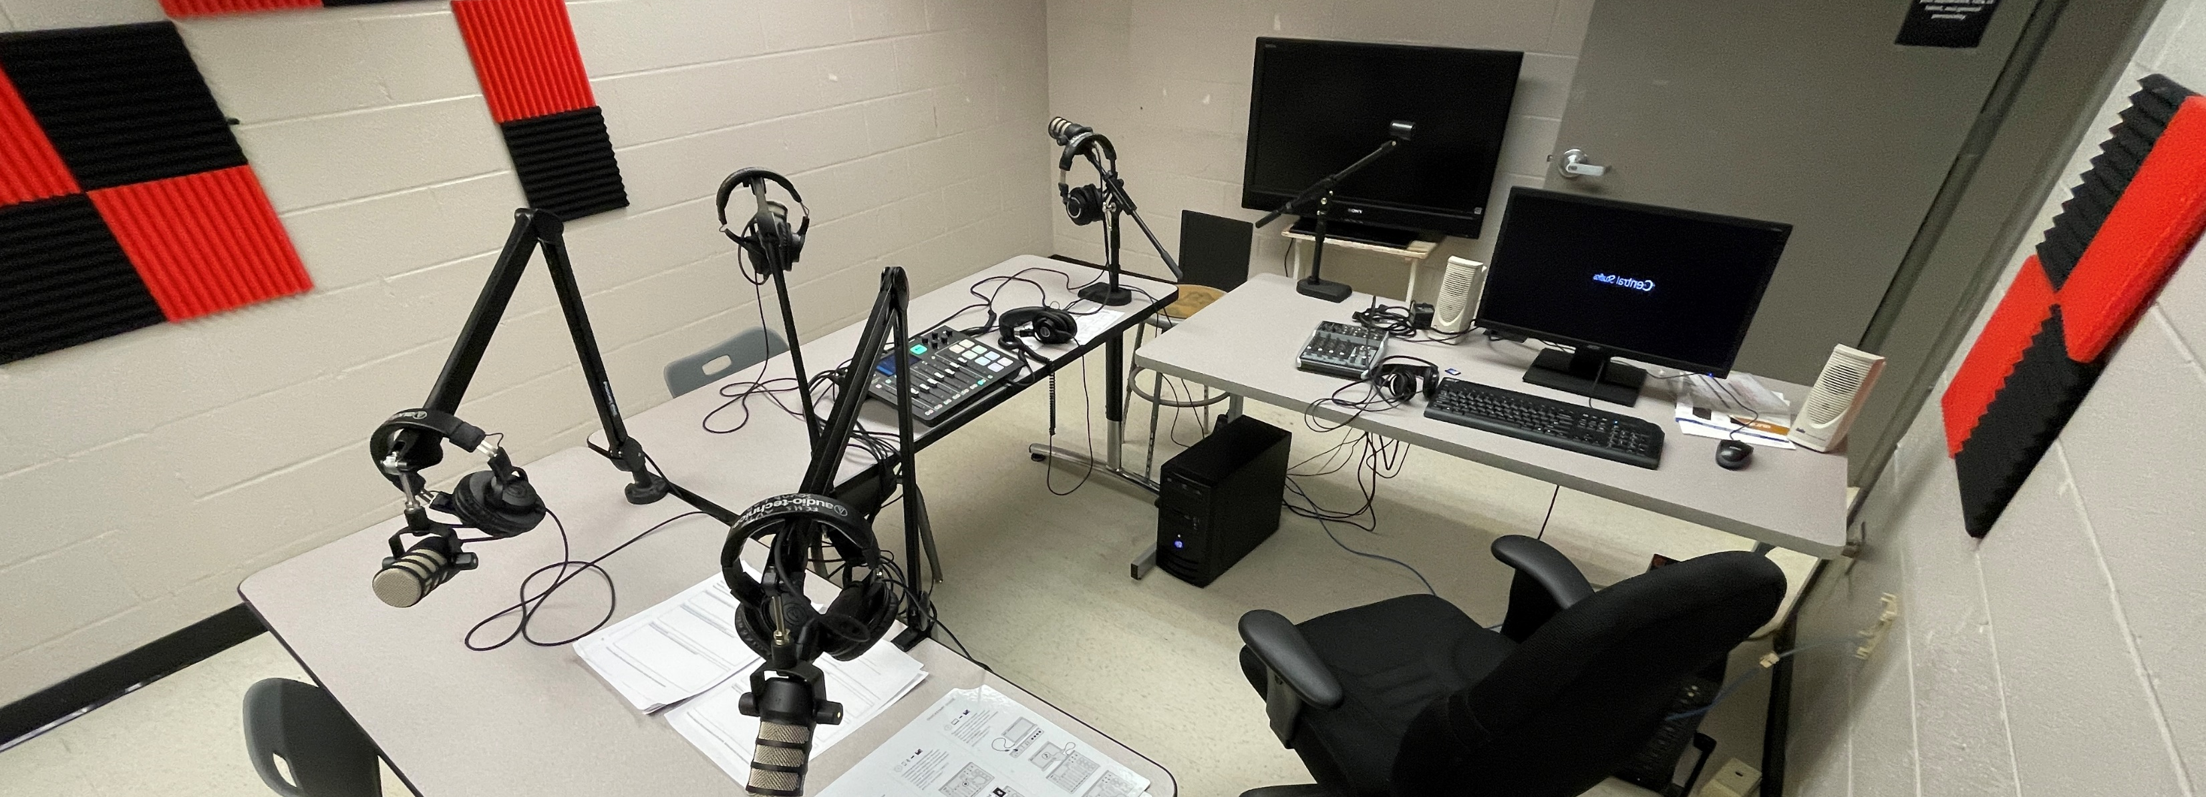
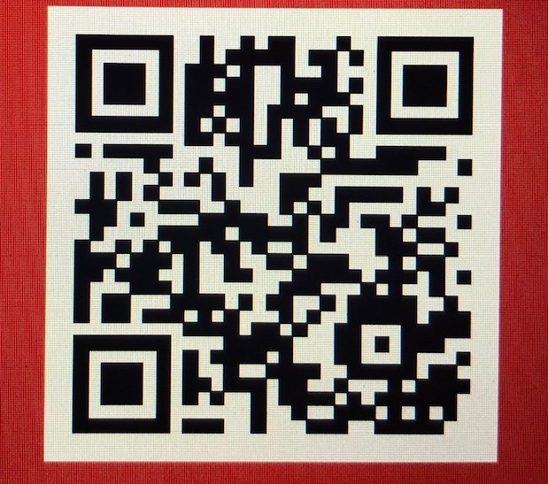
How to Apply!
QR Code takes you to the webpage with the application link. https://fcsapps.forsyth.k12.ga.us/FCSStudentApplication/FilmAcademy.aspx
Any questions please contact Kevin Whitley
kwhitley@forsyth.k12.ga.us

Slide 11
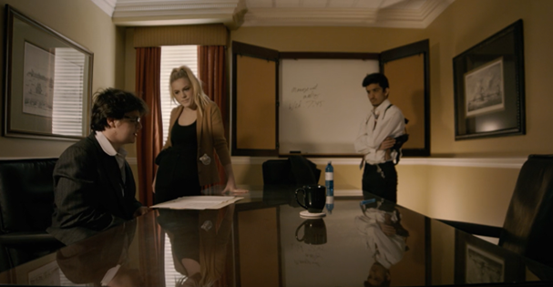
Click HERE to find out what we do.

Slide 12


