Slide 1
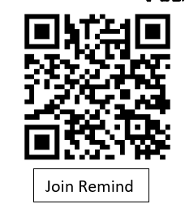

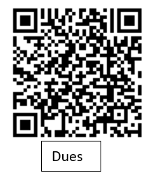
Please join our Remind app

Slide 2
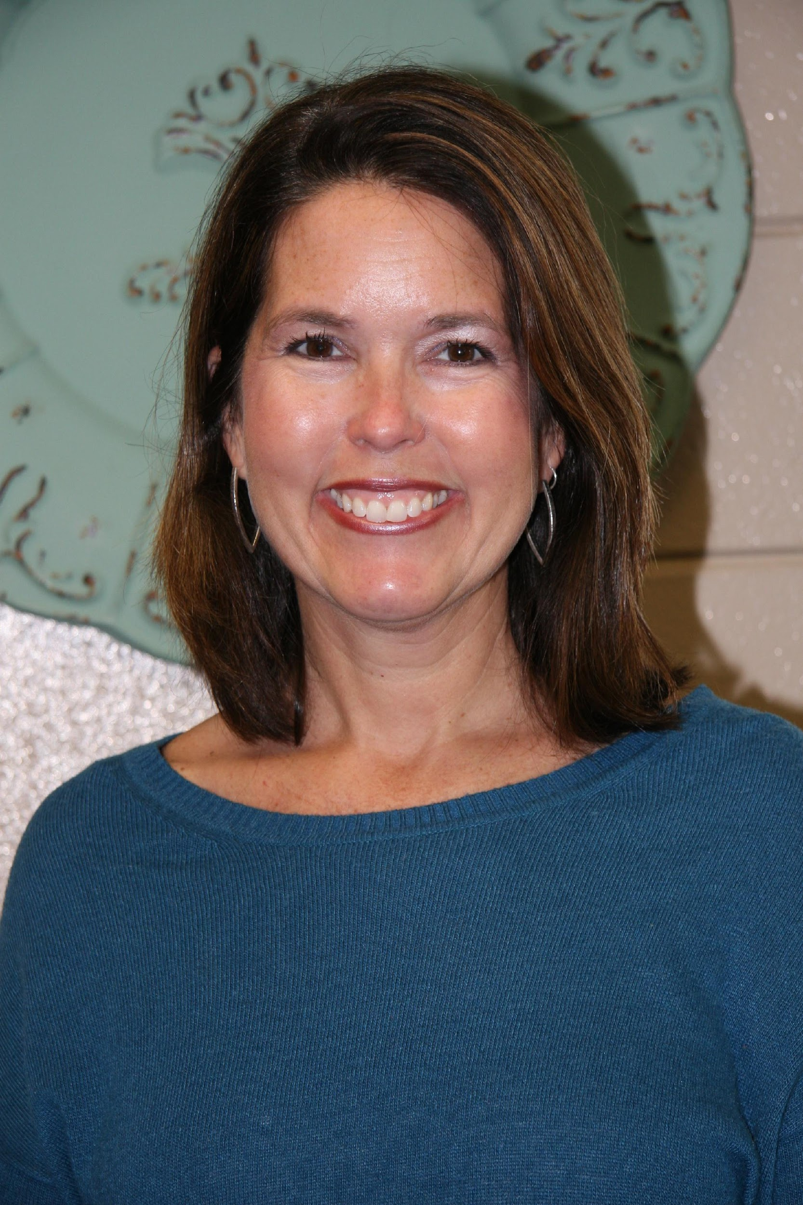
Meet the Sponsors
Mrs. Nizialek, Room 1724
snizialek@forsyth.k12.ga.us
Mrs. Wright, Room 1267
f43984@forsyth.k12.ga.us

Slide 3

Science Ambassadors
Please turn in completed applications to Mrs. Nizialek/room 1724.
Mrs. Nizialek

Slide 4
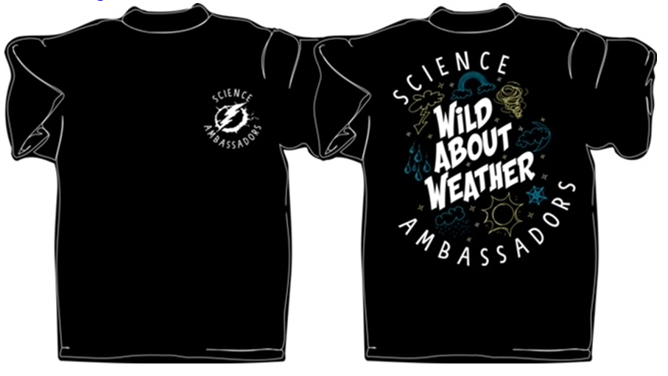
Science Ambassadors
Dues are $40 and can be paid on SchoolPay (see QR code)
They cover meals before the Science Nights and a tshirt

Slide 5

Club Overview

Slide 6
Science Ambassadors
Science Ambassadors is a club that provides Science Nights at local elementary schools. Students work in groups to teach a science concept to children and their families.

Slide 7
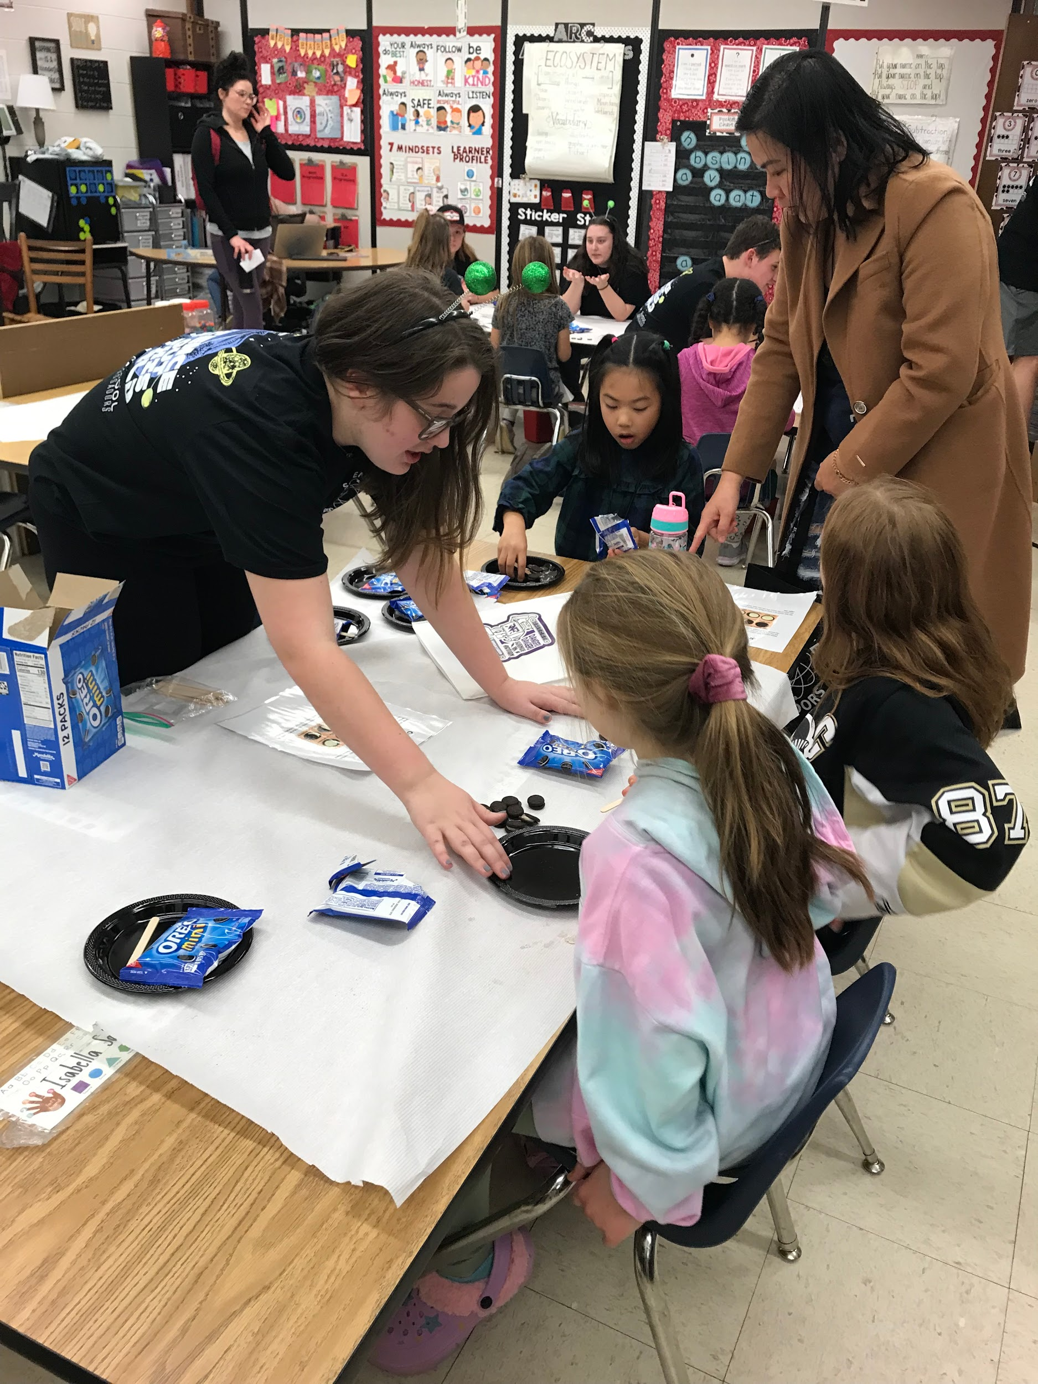
Students work in groups to teach a science concept to children and their families.

Slide 8
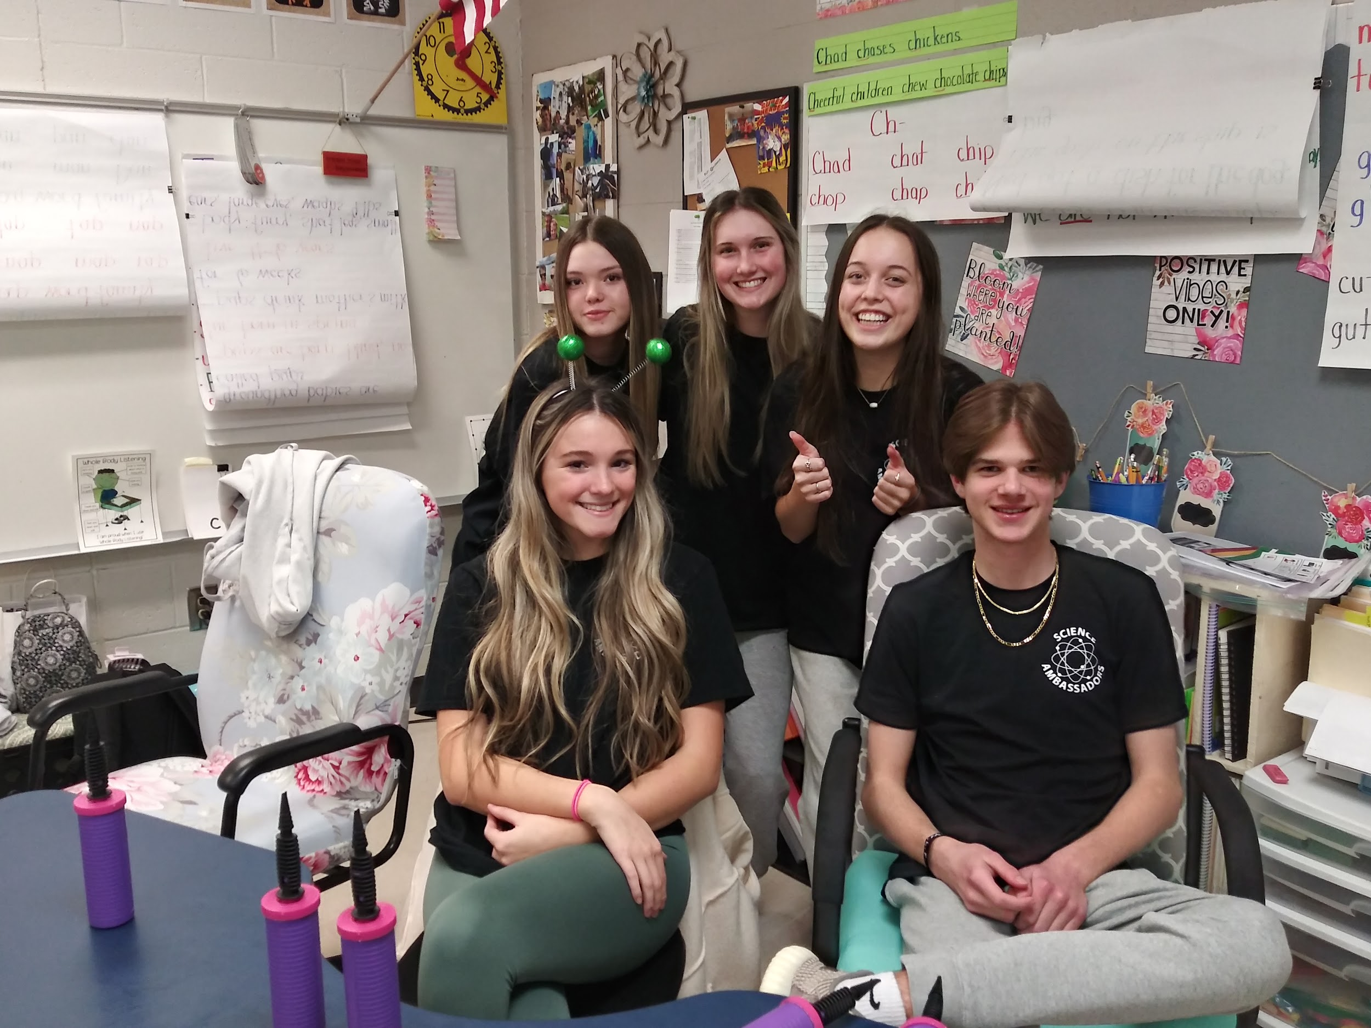
Students can pick their own groups and work with their friends.

Slide 9
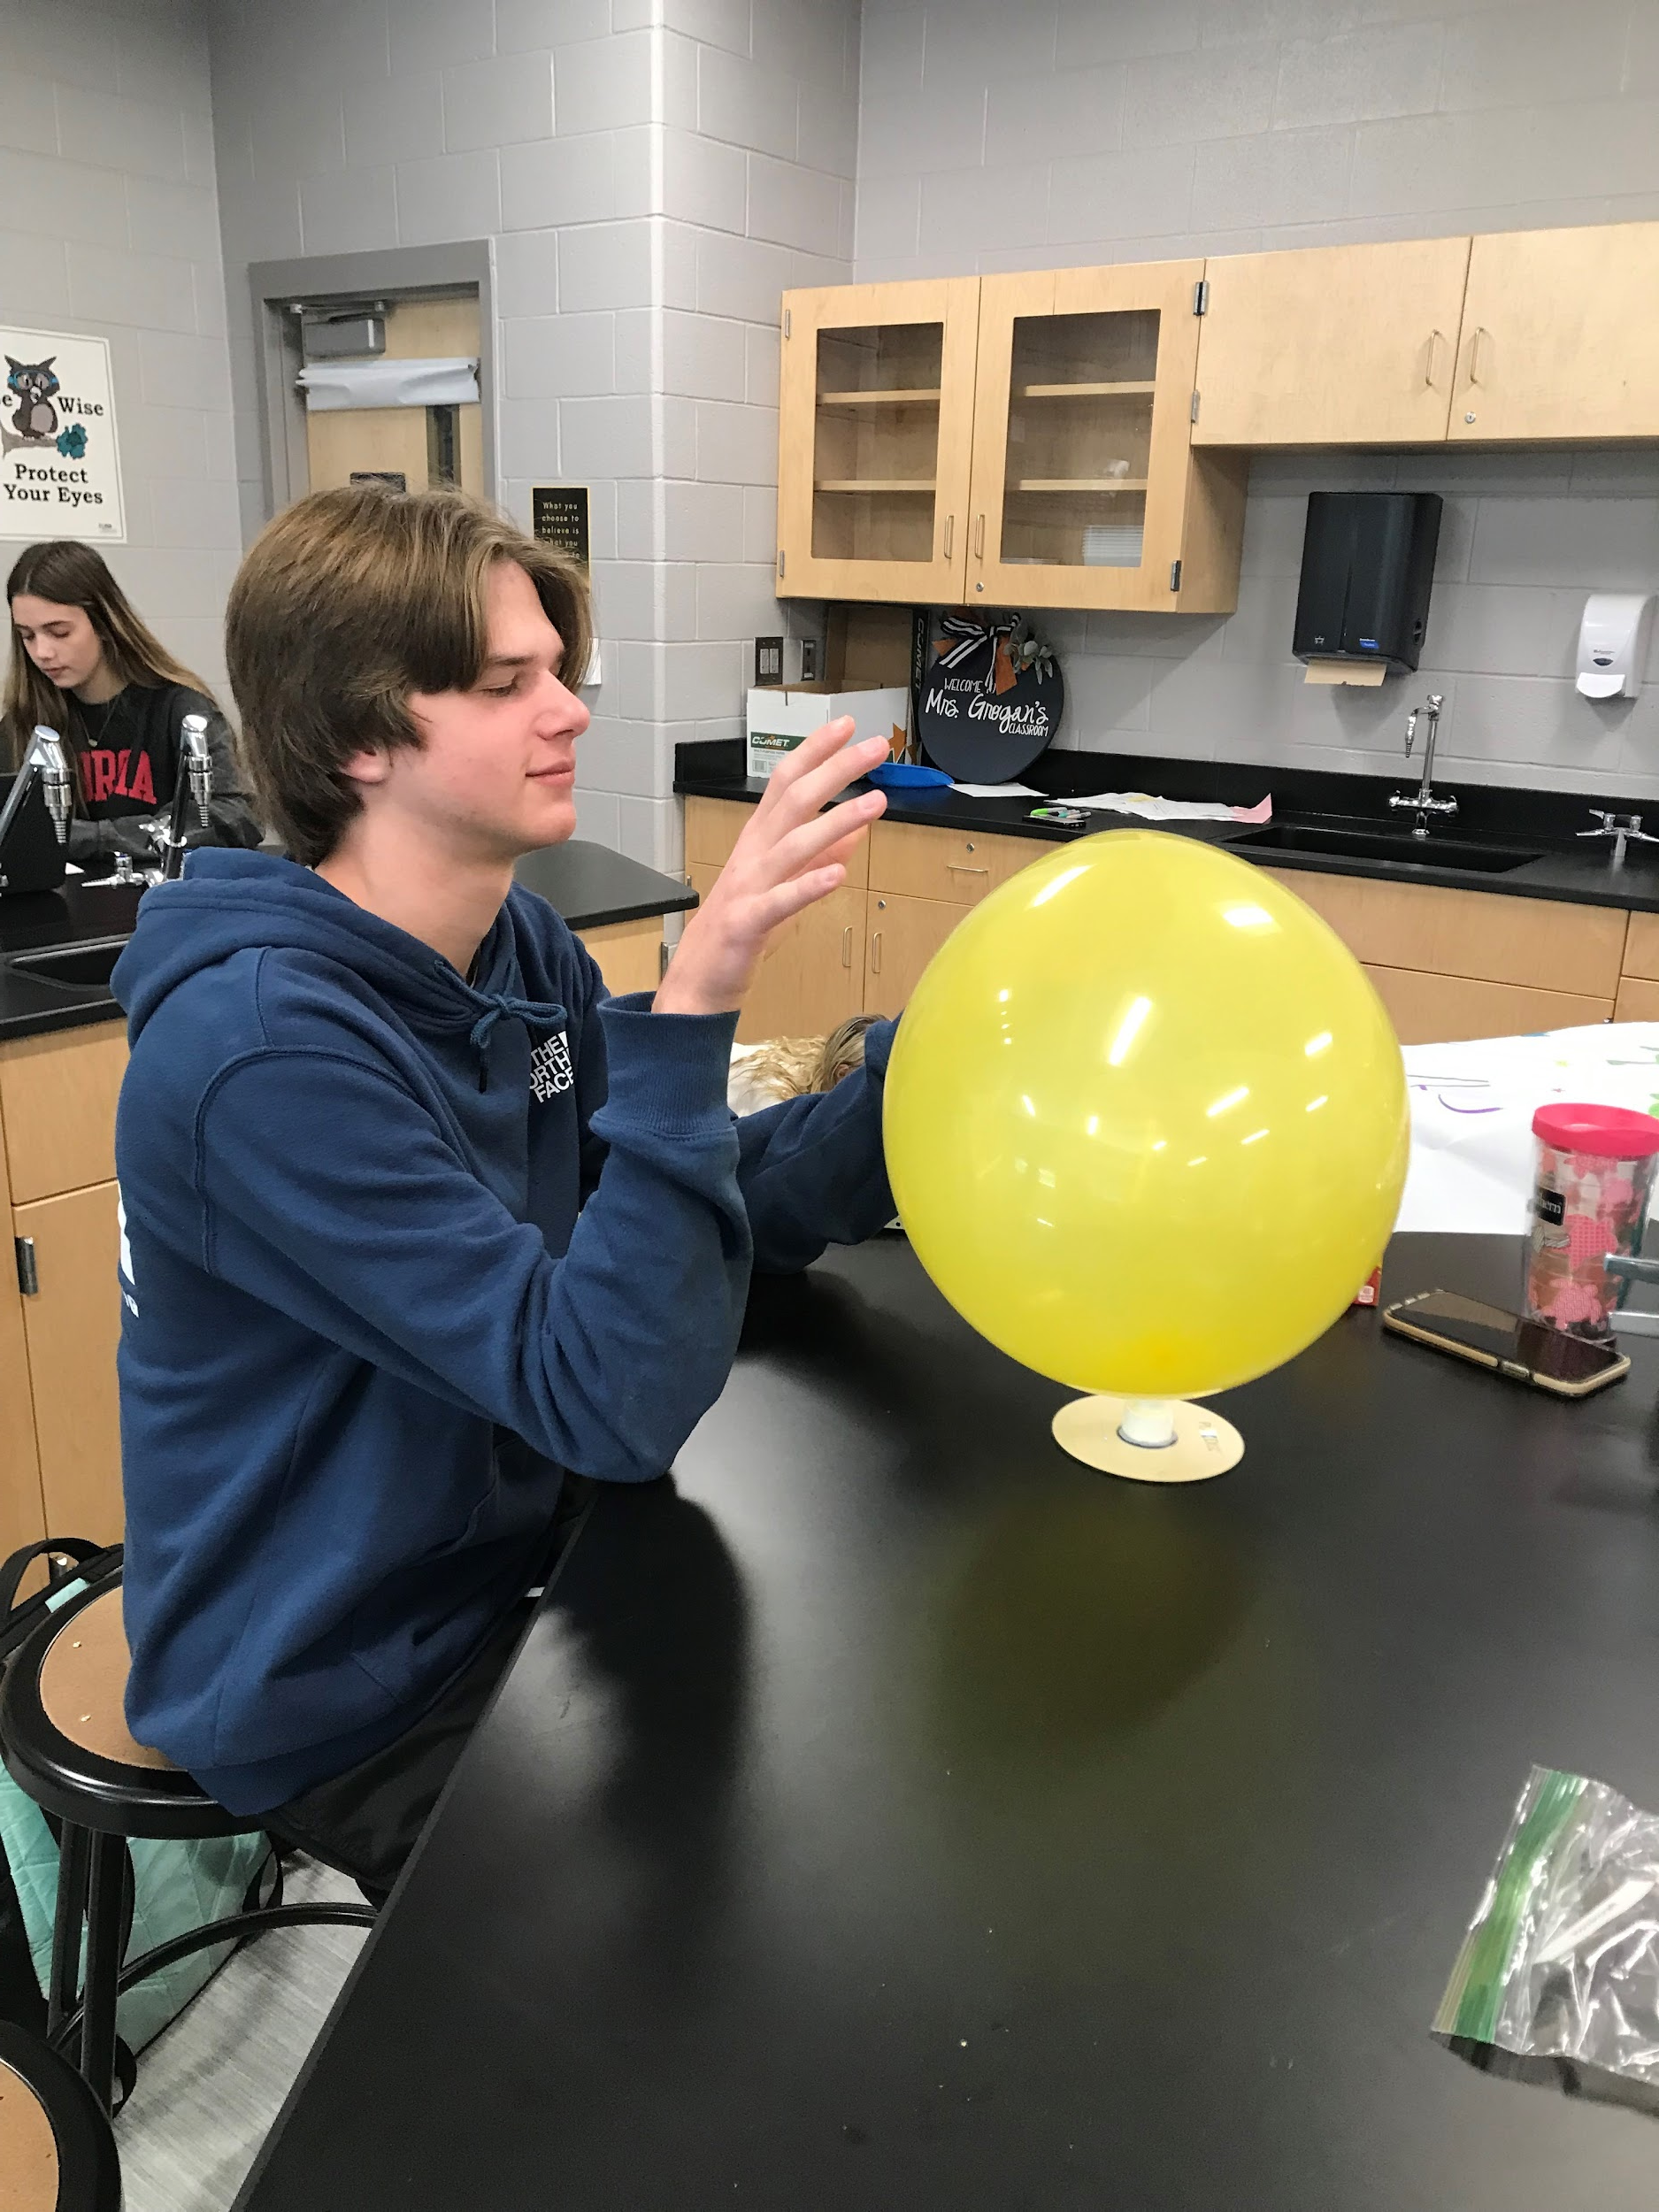
Materials and instruction are provided to ensure Science Night success.

Slide 10
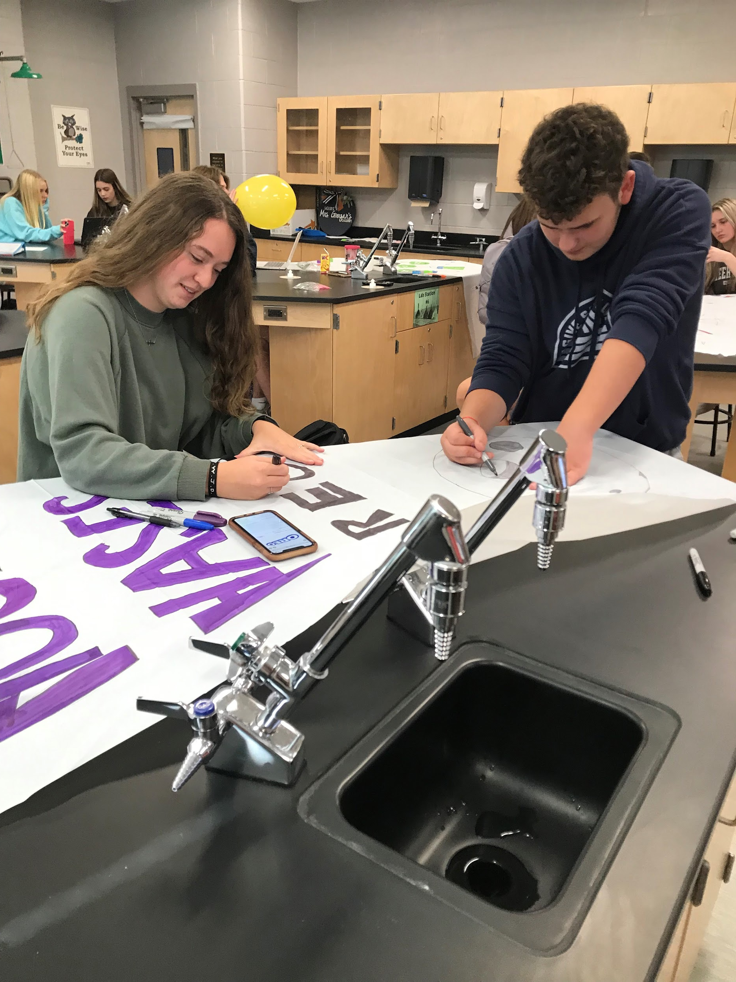
Meetings are held in the Fall during Flex Time to get organized: once during September, October, November, and December.

Slide 11
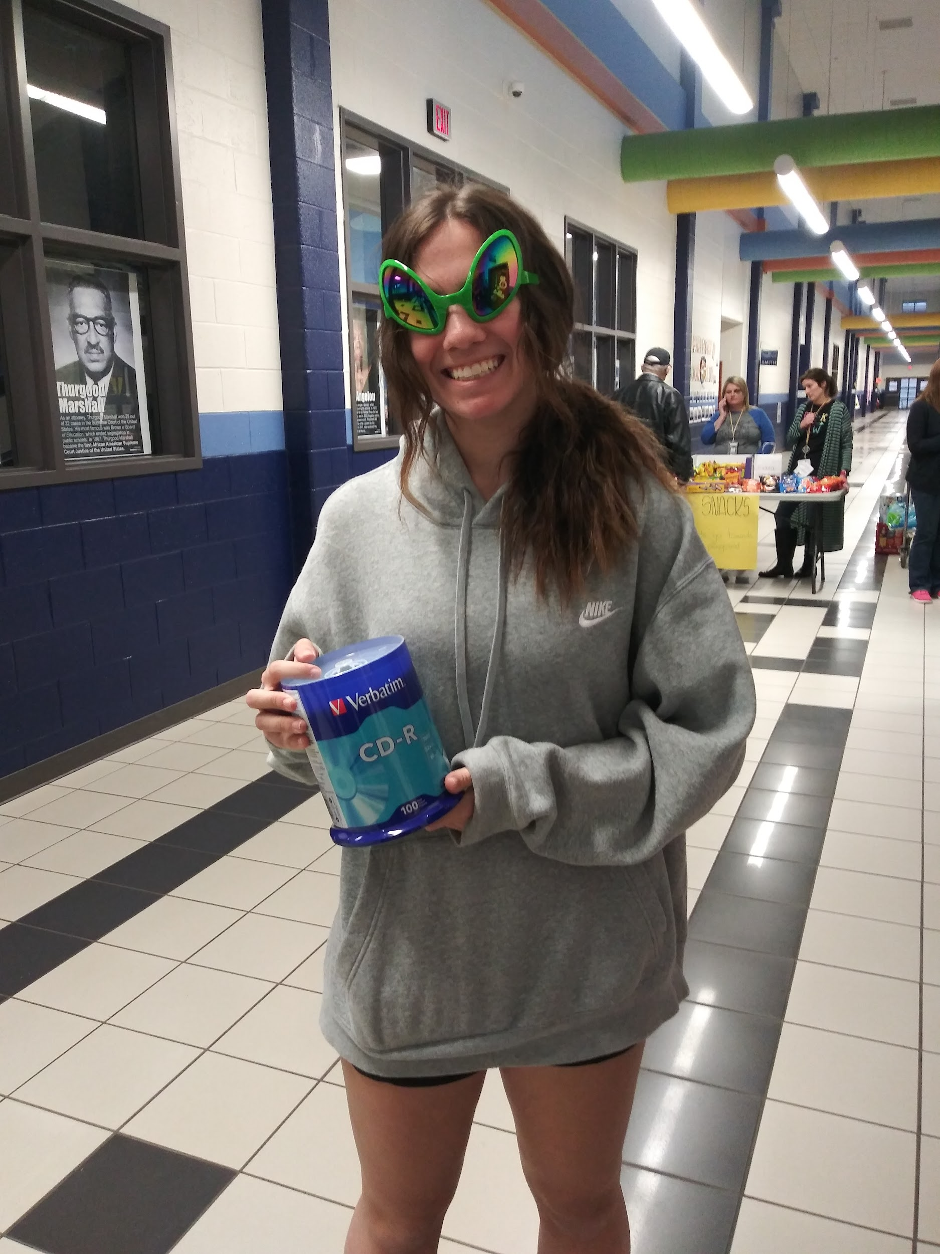
Then, the Science Nights are on select Tuesday nights in January through March.

Slide 12
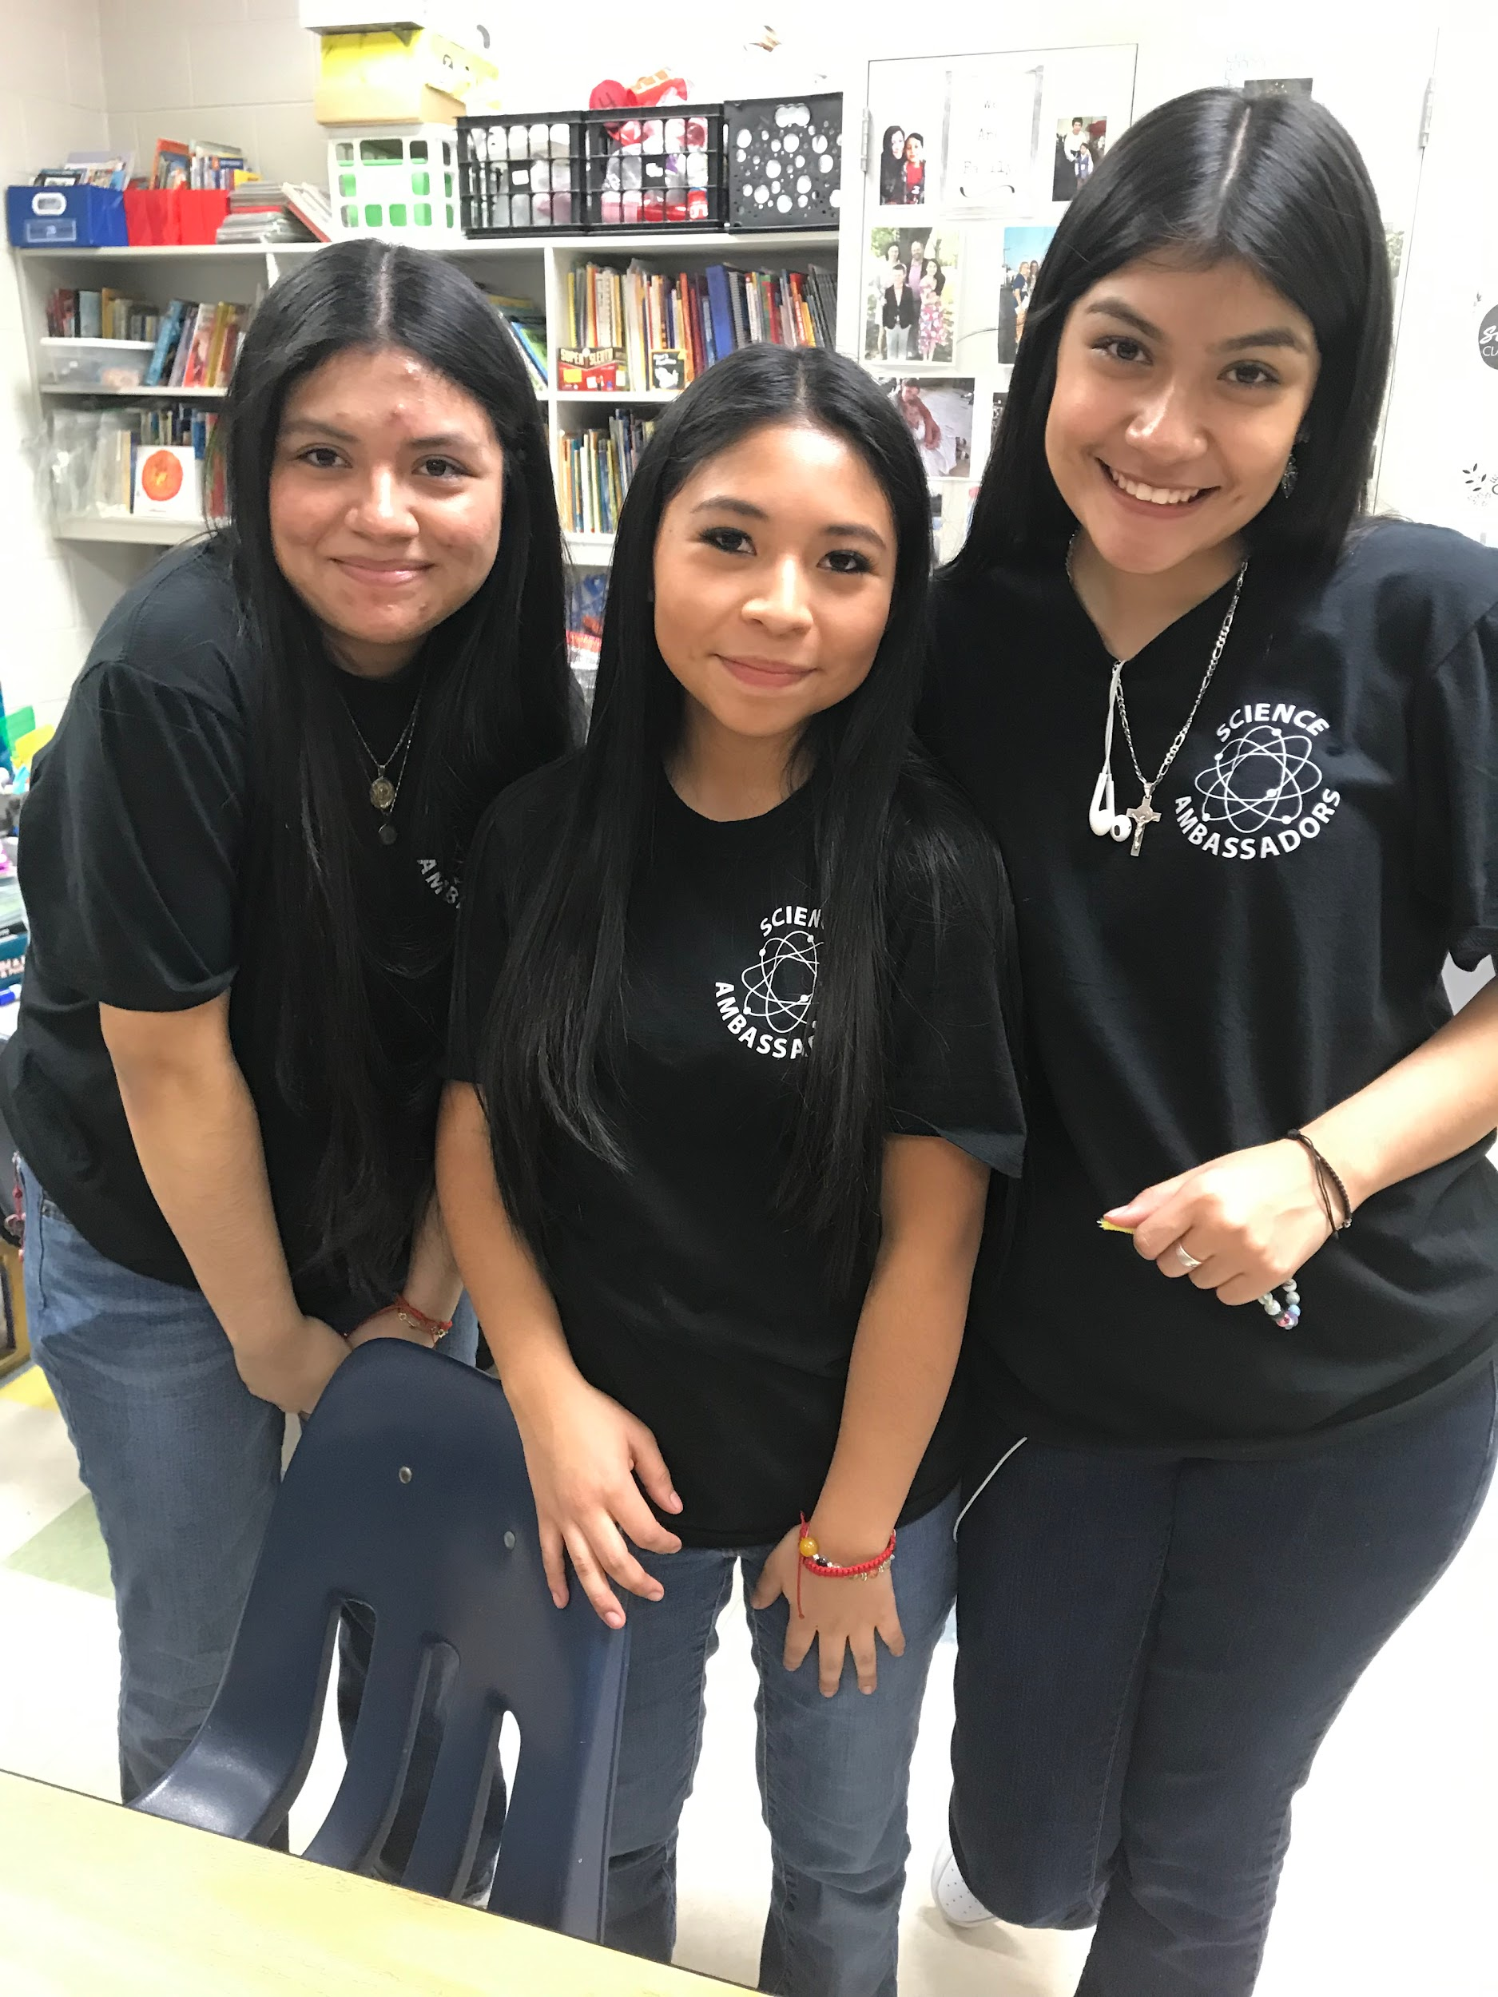
Student club dues are used to provide a tshirt and meals for each elementary school Science Night.

Slide 13
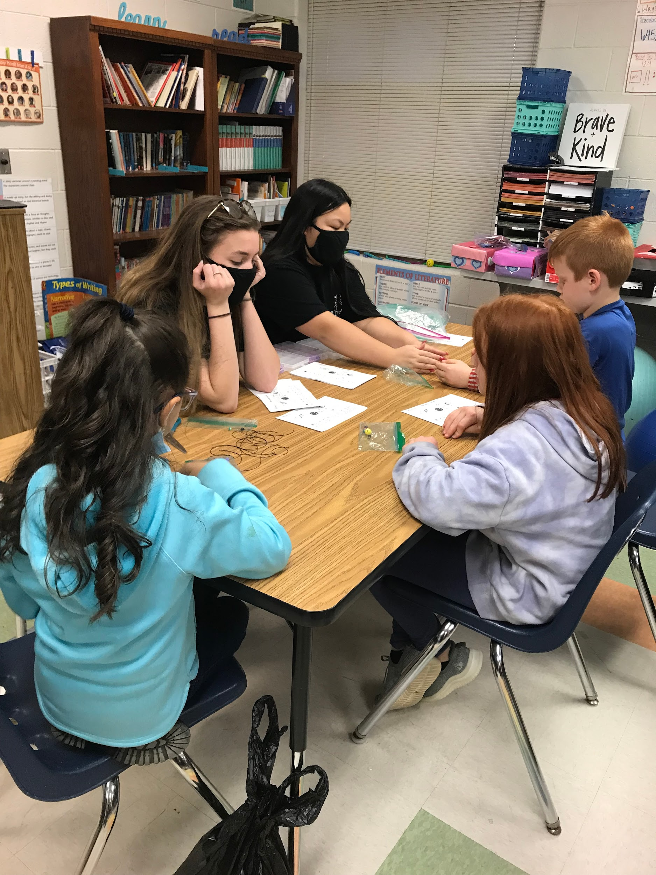
Science Ambassadors is a great opportunity for service hours for Beta Club and other Honor Societies! Students typically earn 16-24 hours.

Slide 14
Important Dates
Club Meetings
Science Nights
During Be Better Time on the following dates:
  September 20
  October 18
  November 15
  December 13
  January 17
January 23
  Coal Mountain ES
February 6
  Silver City
February 13
  Poole’s Mill
February 27 Matt
March 12
  Chattahoochee ES
March 26
  Chestatee ES

Slide 15
On Science Nights
Wear Science Ambassador t-shirt
Meet in Room 1724
Get organized– ensure you have your door sign and all supplies needed for your station, put all items into bin
Eat dinner
Load bus and travel to elementary school– be sure to have your bin with you!!!
Ensure you have a ride home/pick up is 7pm!

Slide 16
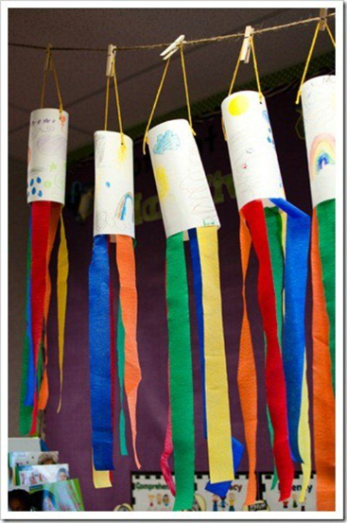
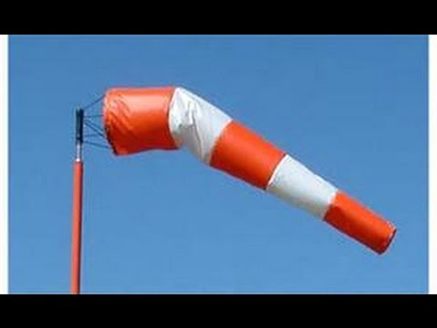
Example Activities
Students will make their own wind sock to find out the direction the wind is blowing. Need USB fan…Informational Poster with pictures of real life windsocks & explanation

Slide 17
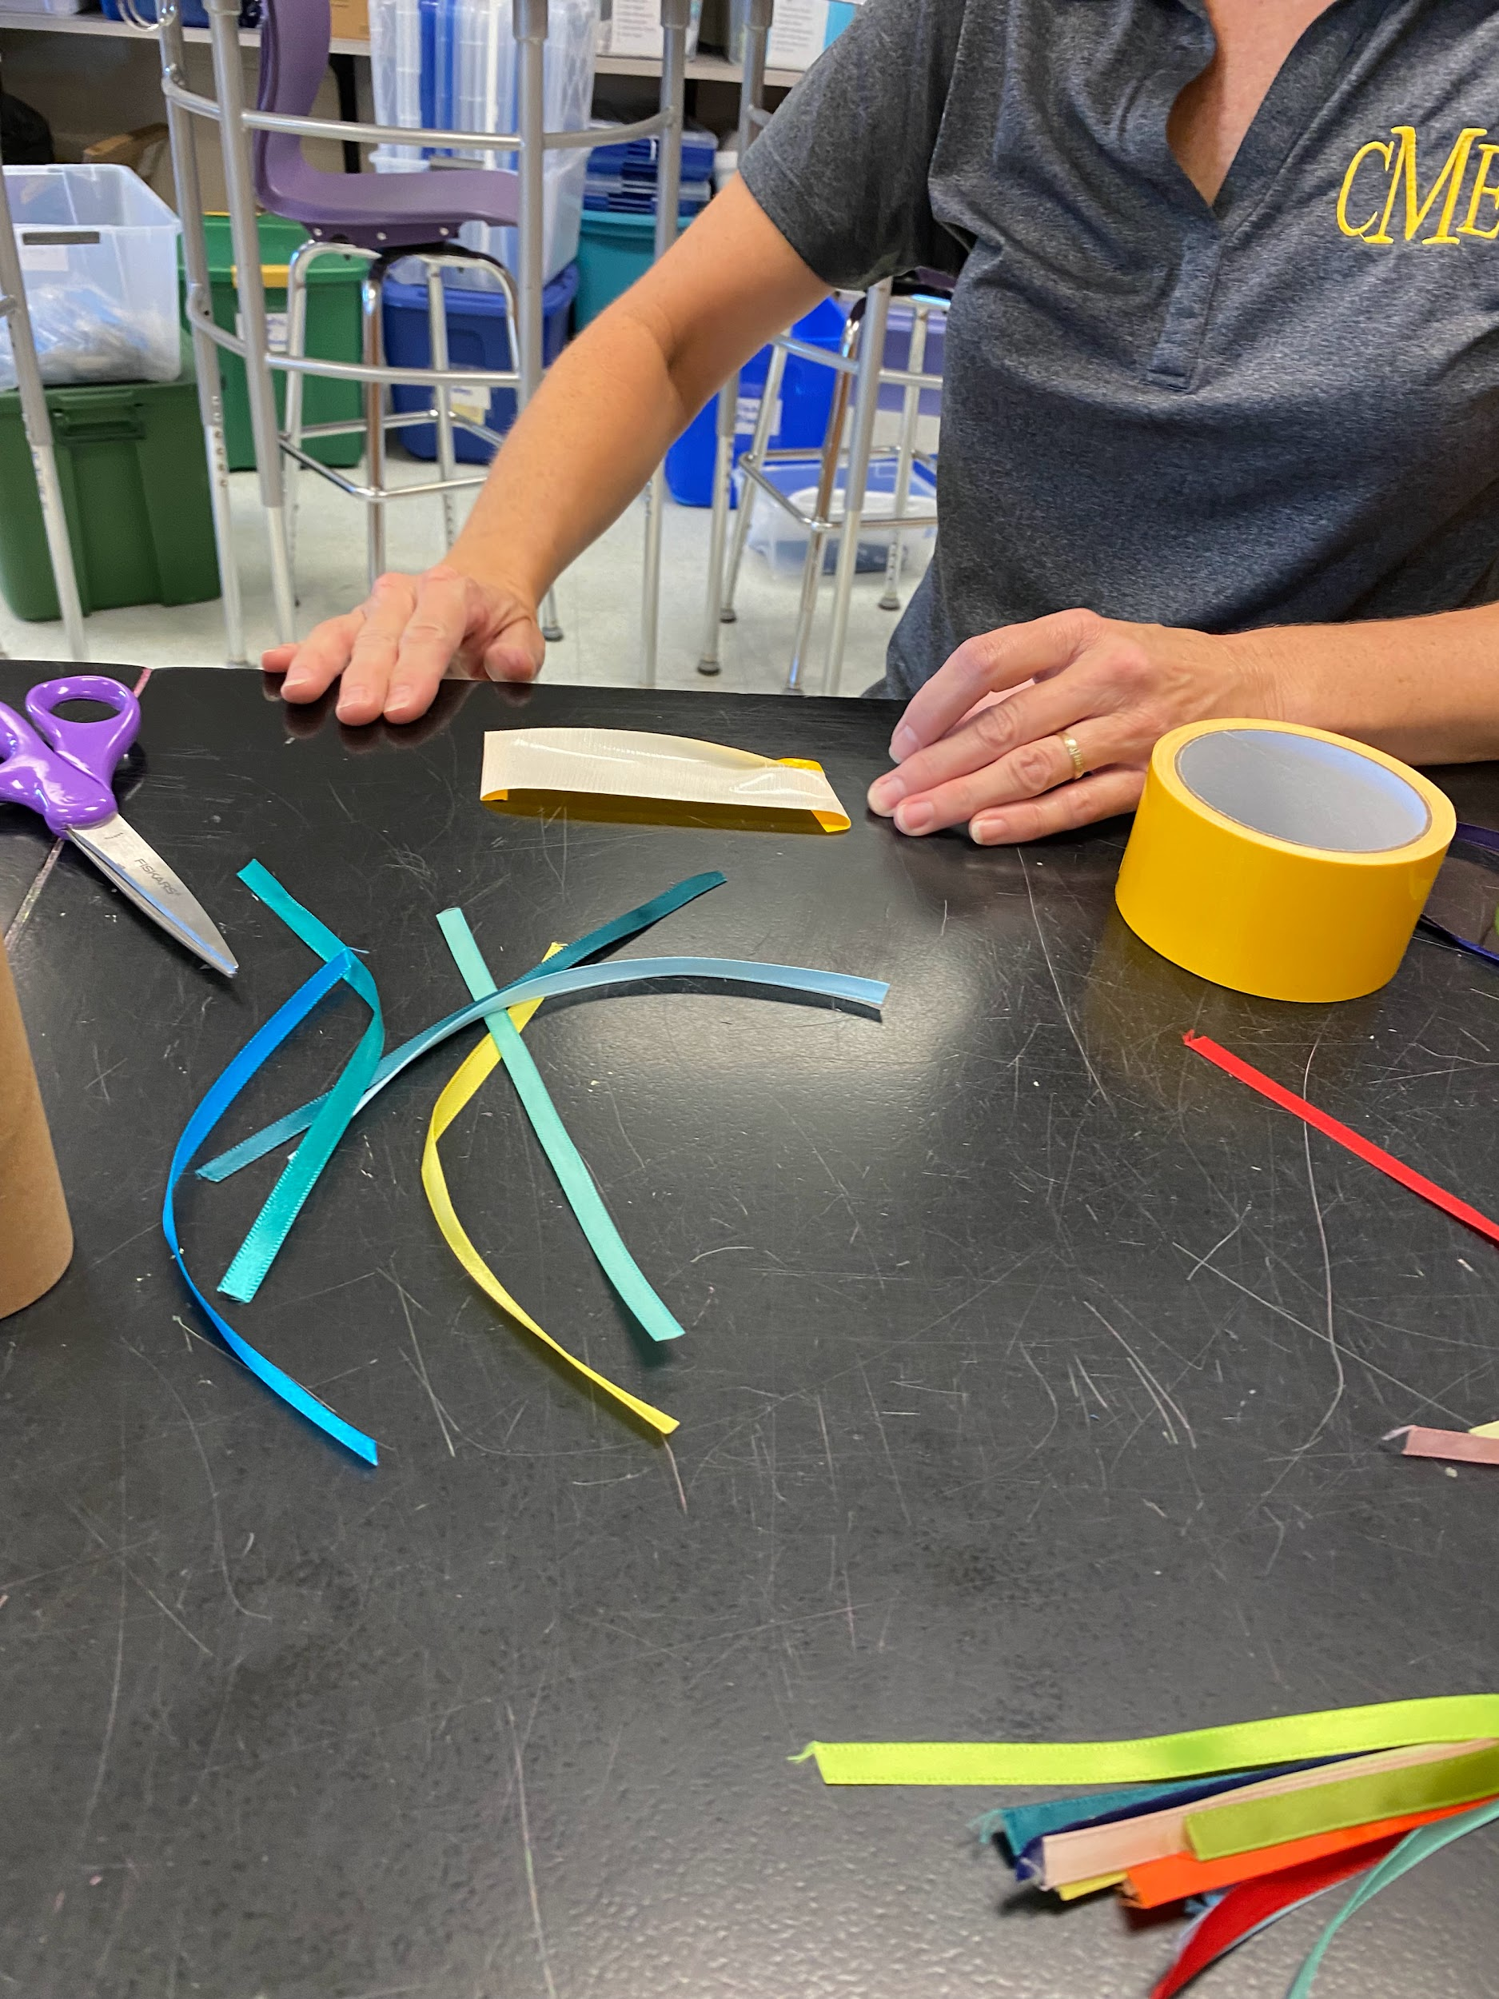
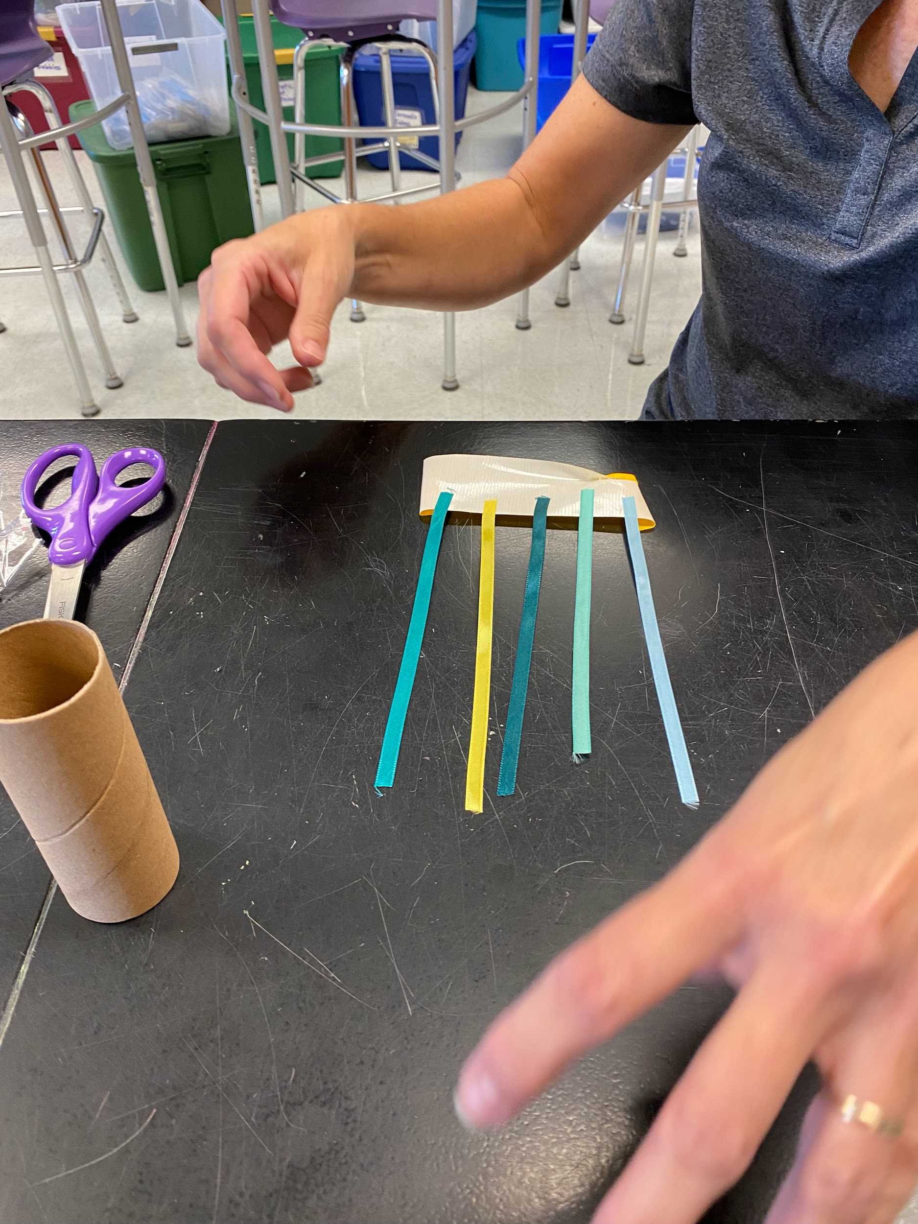
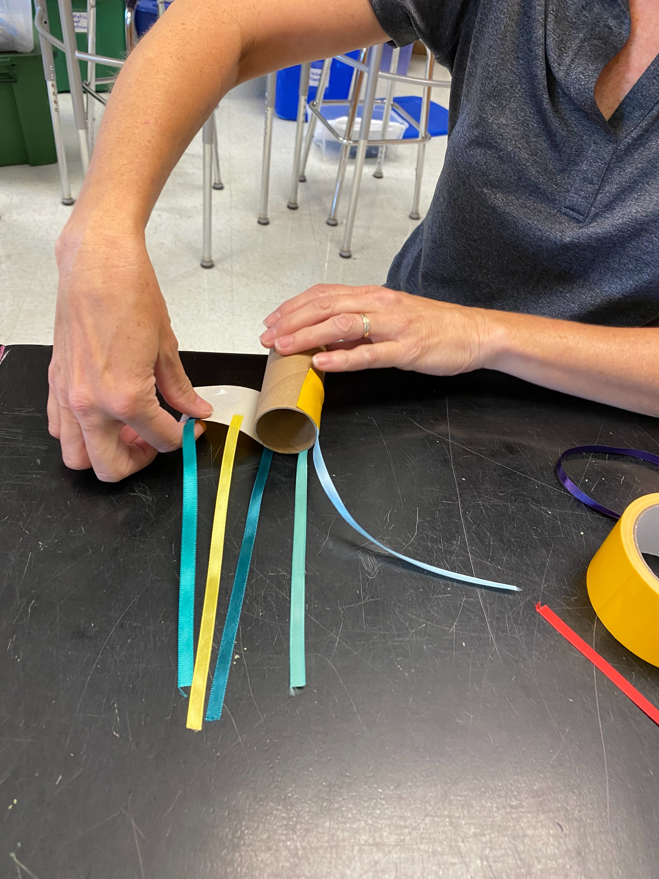
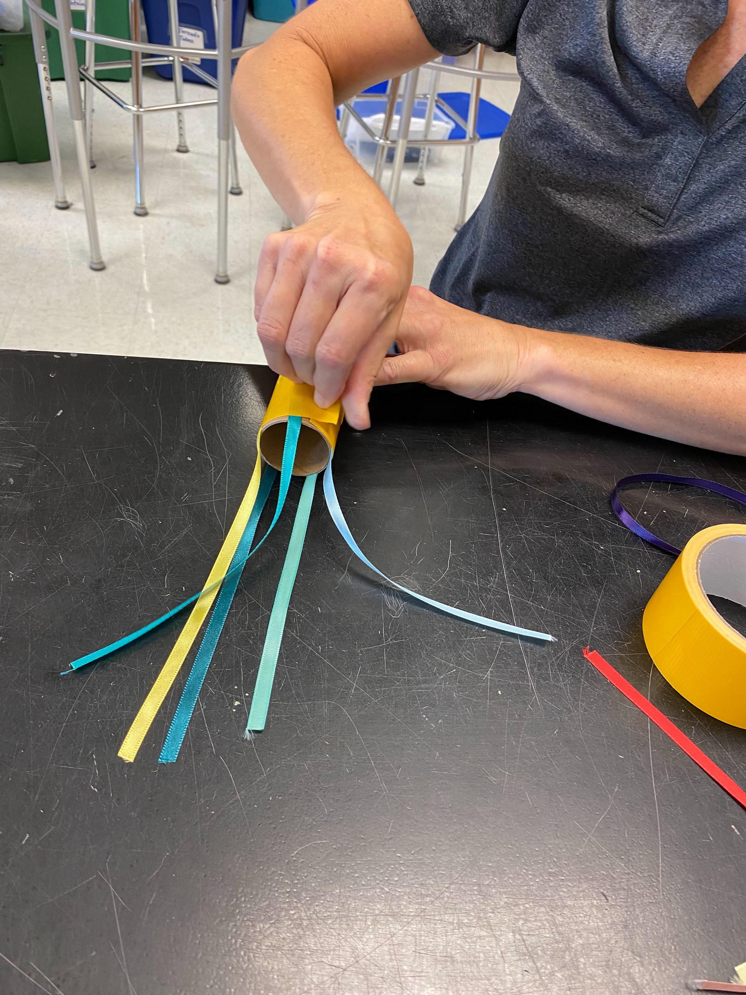

Slide 18
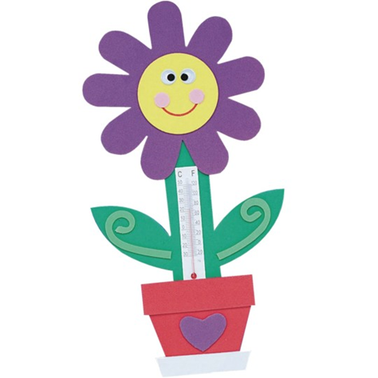
Temperature
HS students will have table where students can observe how the thermometer changes when it is in different temperatures of water.
The kids will make and take their own temperature flower.
*HS might want to do sticky tabs for kids and have kids stick on
*Heat lamp at end, also have cups of ice water to demonstrate
Info poster on freezing/boiling and line on thermometer

Slide 19
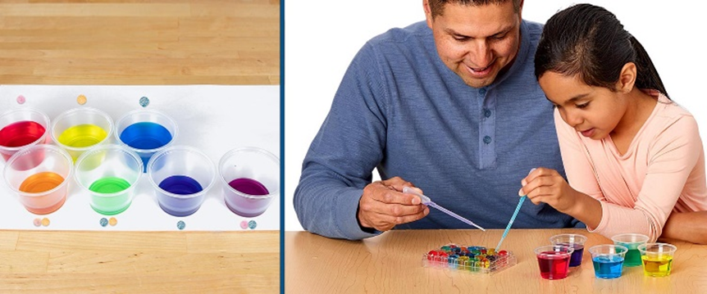
Mix a Rainbow
Kids will mix different colors to discover new colors.
*Need info poster on why rainbow is ROYGBIV

Slide 20
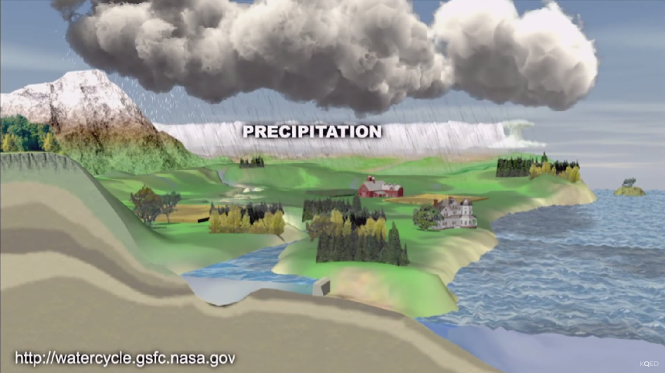
Life of a Raindrop
Make a poster explaining the Fujita Scale and pictures of different kinds of tornadoes.
*Keep Forsyth County Beautiful will be teaching/students will assist
*kids will move to next center after 10 beads
*Need a “give away “ info sheet explaining how every journey is different for a raindrop

Slide 21

Freezing Flurries
*Scratch Art Snowflake
*Cut coffee filters to make Snowflakes
*Watch videos on how to make these
*Make a infographic on how no two snowflakes are alike

Slide 22
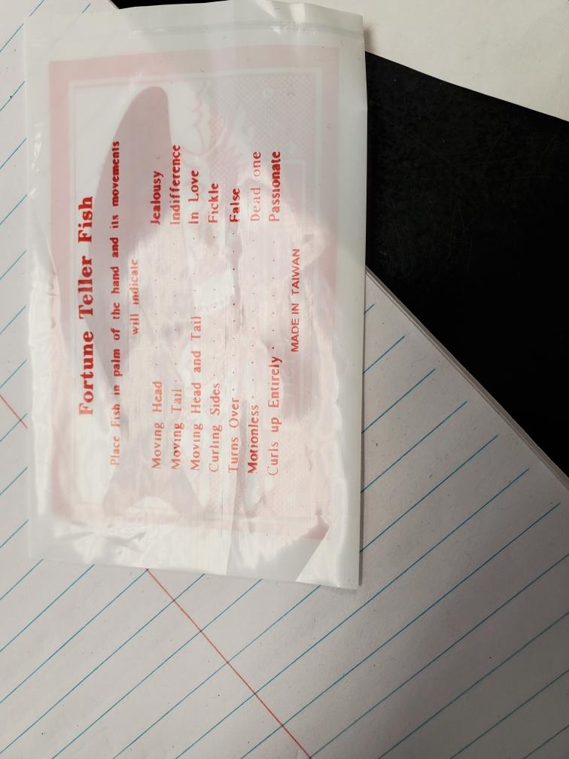
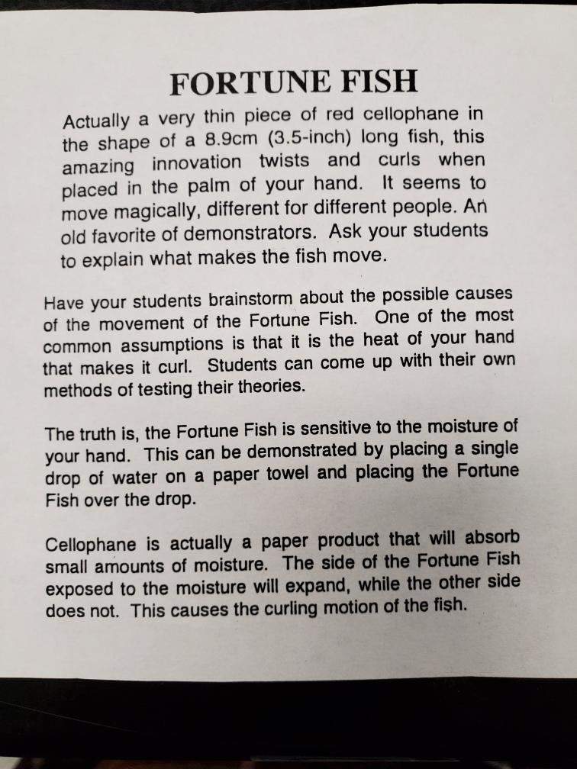
Fishy Forecast
Need a door sign and explanation?

Slide 23
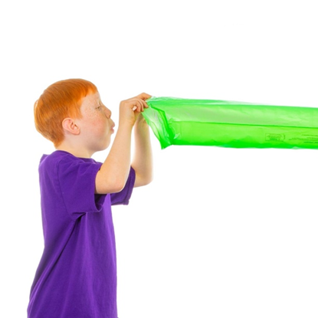
Power of Air
Use this air-mazing experience to demonstrate the properties of air molecules and how they move. Teach students about the Bernoulli Effect, a scientific principle that explains why you can blow up the amazing Windbag with only one breath.
Expand your lesson and use this opportunity to discuss how air pressure creates weather systems that move across the continents and how airplanes fly.
*Watch video explanation for how to do
*This one is EXPENSIVE so don’t waste bags
Watch how to do this experiment here

Slide 24
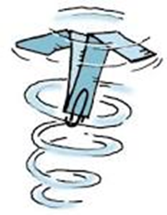
Wind Spinner

