Slide 1

9th Grade Classroom Guidance
December 2024

Slide 2
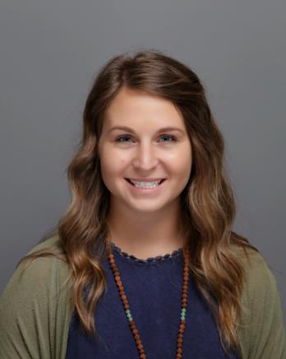
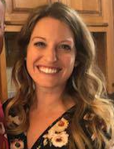

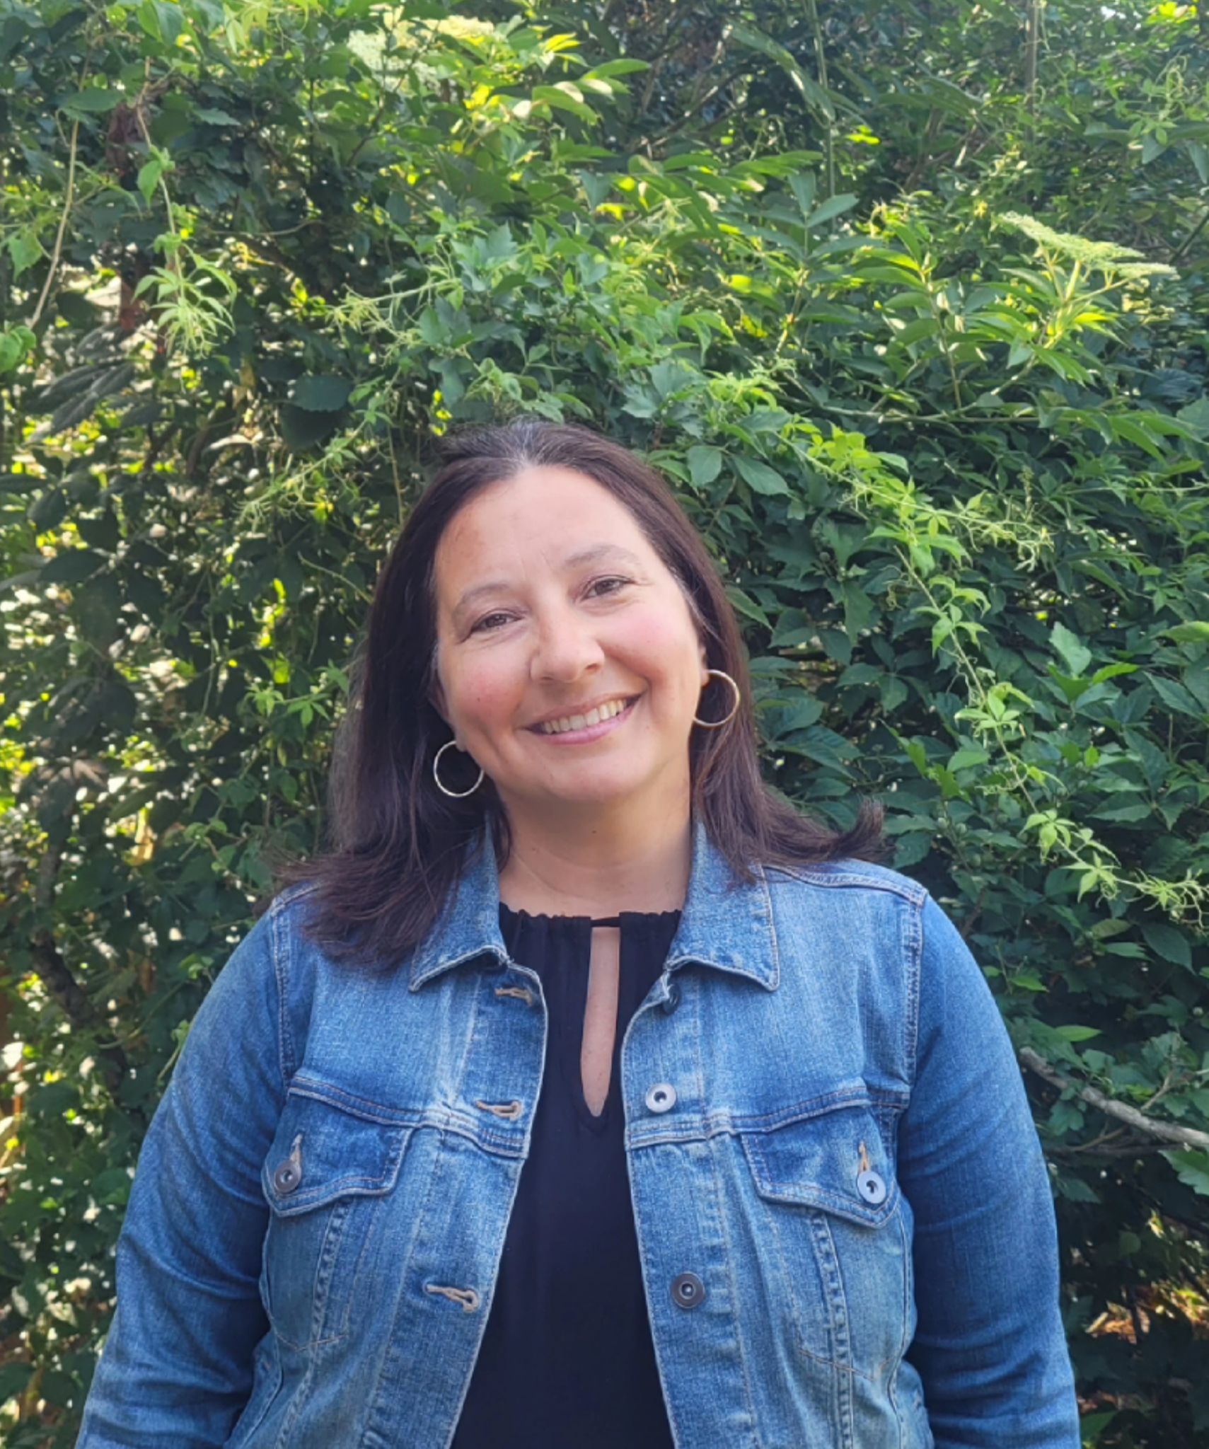


Who is my counselor?
Mrs. Carlson
A-Crute
Mrs. Spurlock
Cruz-Han
Mr. Brooks
Har-Mala
Mrs. Shariett
Mald-Rah
Mrs. Lyons
Raj-Shai & ESOL
Ms. Locke
Shak-Z

Slide 3
Making an Appointment with your Counselor
Stop by the counseling office. If we are available, we will meet with you!
Email or send a Canvas message to your counselor. We will try to meet with you during a non-core class.
  Use your personal email address - NOT school email address.
  Use our emails ended with —@forsyth.k12.ga.us

Slide 4
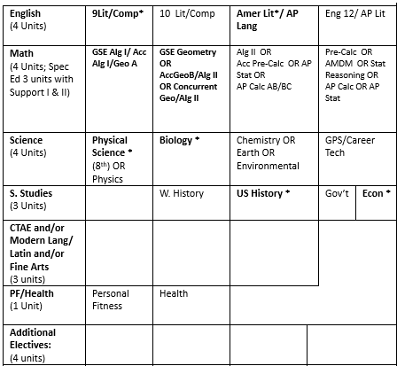
How do I graduate from High School?
Earn 23 credits in the 7 sections listed on the right -->
Check out our GPA calculator & credit check form on the website!
In January your teachers will start talking to you about recommendations for 10th grade. You will need an english, math, science, and world history course as part of your core schedule. Elective selections will also be made at this time.
As fd

Slide 5
Why is it important to keep my grades up?
Cumulative GPA
A overall weighted grade point average. This includes every class you take throughout your four years in high school.
This GPA is what you send to colleges when you apply your senior year.
You can never “remove” a course from your transcript so every course counts!
Core GPA
To calculate your core GPA, we have to remove the fluff. We have to calculate the GPA based solely on the five academic solids:
Math
English or Language Arts
Social Studies
Science
Foreign Language
The core GPA is your “real” GPA: this is the measure of your academic performance in high school. (It’s not a measure of self-worth.)
VS.

Slide 6
Dual Enrollment
Most students participate in the program Junior and/or Senior year
Students attend college classes while earning high school credit.
Students can take CTAE, core classes, or online classes
Popular Programs
  Core classes, associates degree programs
  Nursing
  Automotive
  Criminal Justice

Slide 7
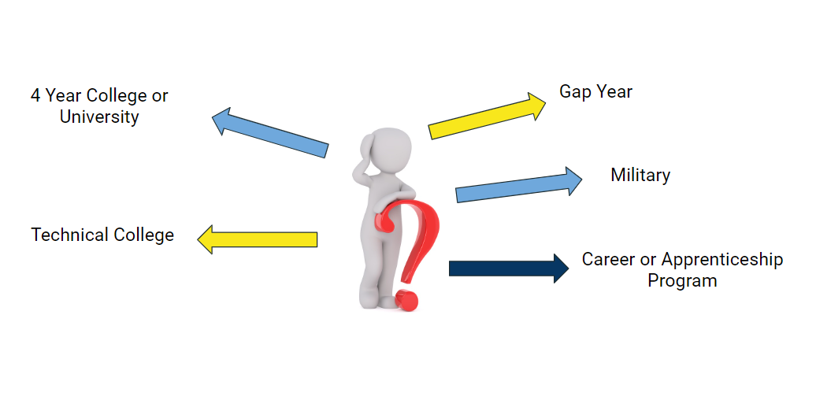
OPTIONS

Slide 8



College/Career Search
youscience.com
Login through Classlink
Features:
Aptitude Inventory
College/Career Search
Describing You (helps with resumes/interviewing)
https://www.gafutures.org/
Create login & password (add SSN to profile)
Features:
Dual Enrollment Funding
College/Career Search
HOPE Scholarship Calculation
https://bigfuture.collegeboard.org/
Create login & password
Features:
College Search, Career Search, Financial Aid, Navigating College Applications
Find Colleges→ College Search

Slide 9
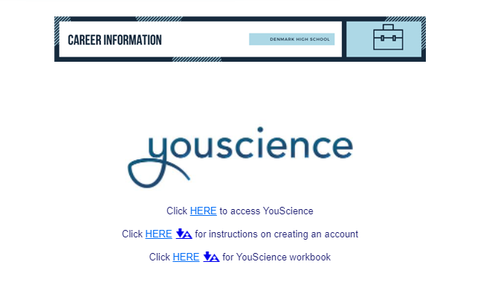
Login Instructions
Infinite Campus→ More
SLDS Portal (Top Right)
My Career Plan
Go to YouScience (blue)

Slide 10
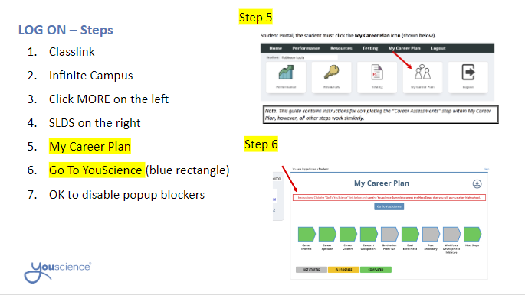
Login Instructions Contd.

Slide 11
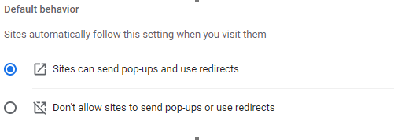
Pop-Up Blocker:
For the pop up removal on Chrome:
Click 3 dots in right corner of Chrome browser
Settings
Type in Pop Ups (under site settings), click the corresponding one that pops up
Scroll Down and click Pop-ups and redirects
Change it to the top:
Notes:
During the Assessment, provide 10- and 5-minute warnings before class time is up.
Do not have students be in the middle of an exercise when the bell rings. Give 10- and 5- minute warnings, and tell your students not to begin a new exercise if it will take longer than the amount of time they have left. See The YouScience Profile Timeframe in Introduction to YouScience.
If a student was interrupted in the middle of an exercise and could not complete it, please contact YouScience through chat. We will reset that student’s interrupted exercise so they can complete it in one sitting when they return.
Make sure the students LOG OUT of their account prior to shutting down their computer or closing the browser.
If they do not, the computer will remember them as the user and the next student will immediately be in that student’s account. You do not want students completing each others’ assessment.

Slide 12
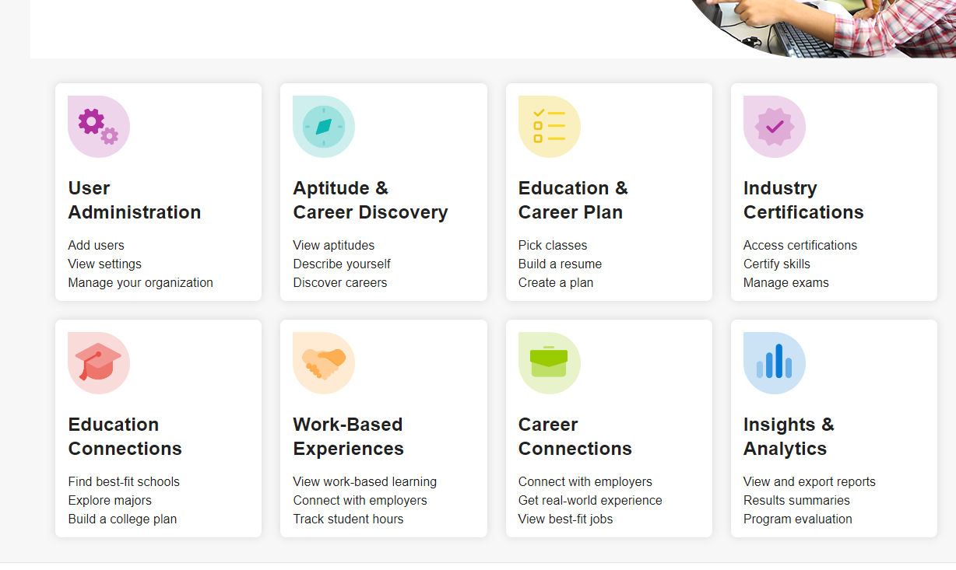

You will click Aptitude and Career Discovery
Click Here 1st
CLICK here 2nd

Slide 13
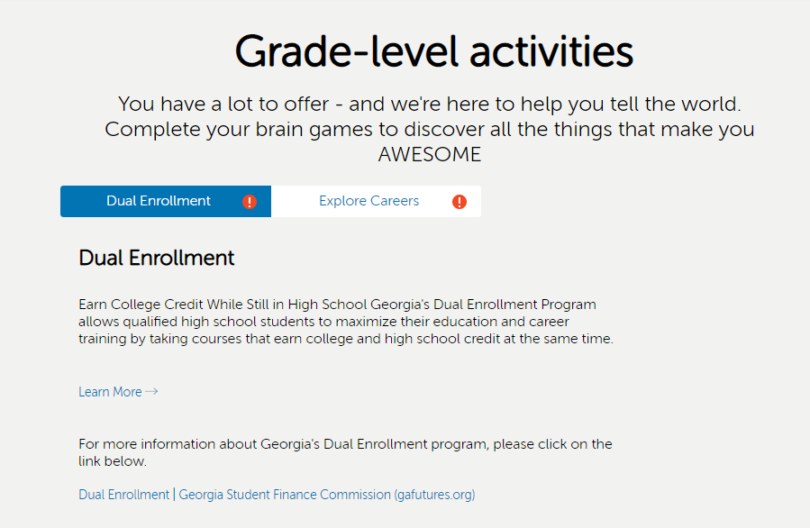
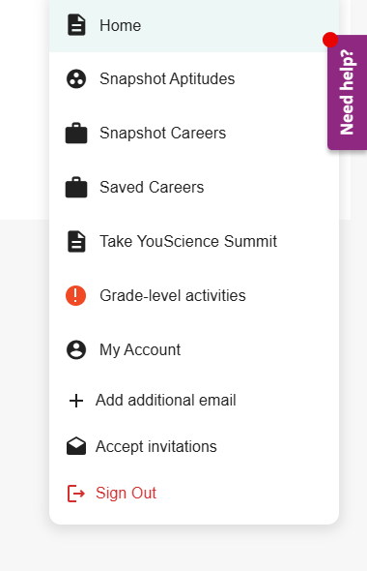
Grade Level Activities & Worksheet
You will complete the dual enrollment by clicking learn more and reading the information.
Explore careers and save at least 3 careers.

Slide 14
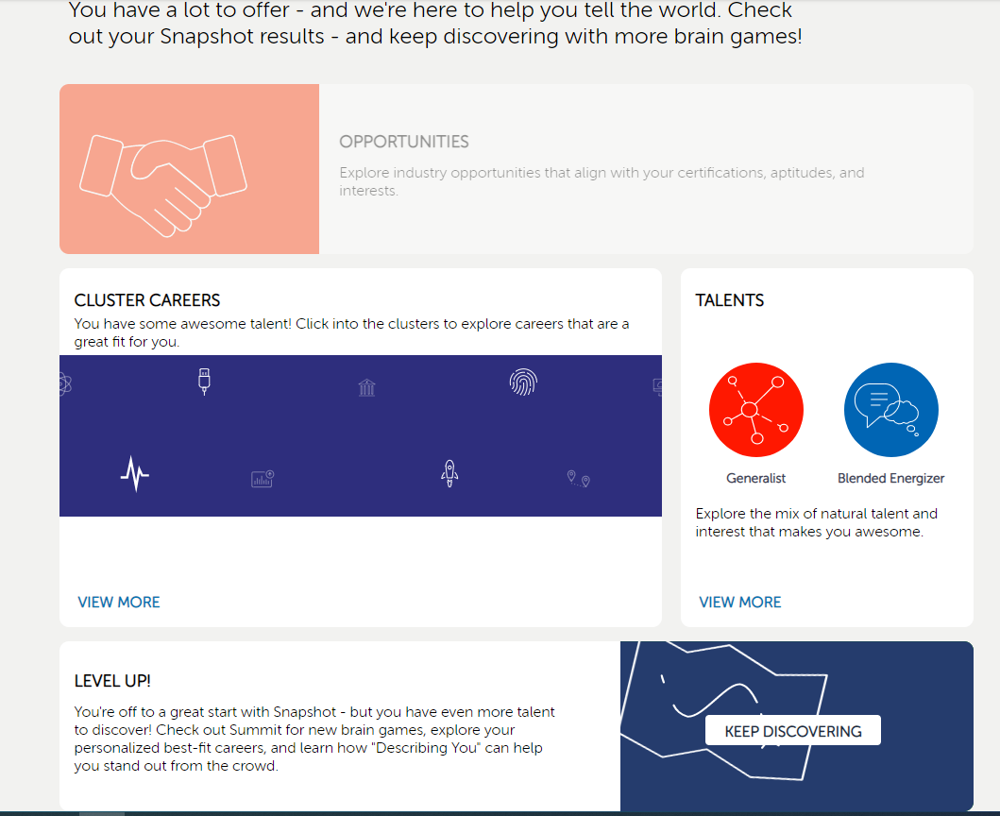
If students completed Snapshot in 8th grade, they should see this screen and need to continue with Summit by clicking “Keep Discovering”.

Slide 15
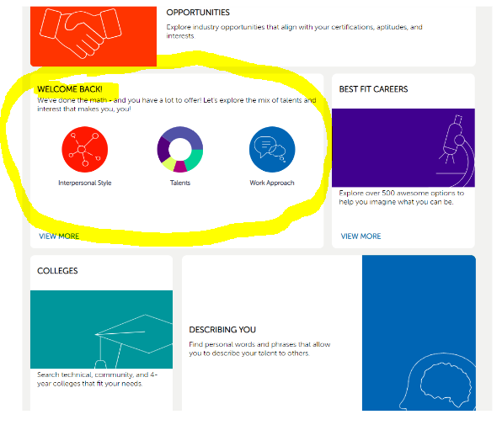
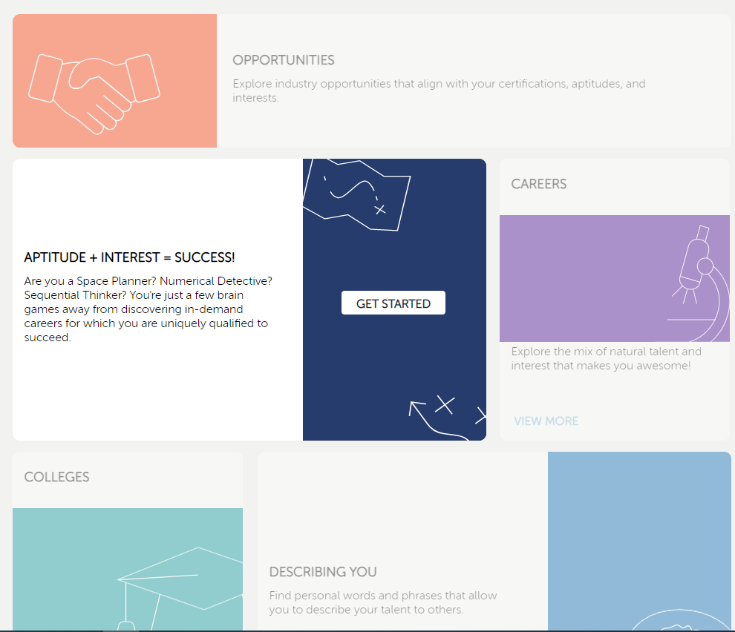
Incomplete
Complete
IF THE “WELCOME BACK” SCREEN IS VISIBLE, THEY ARE DONE WITH BRAIN GAMES

Slide 16
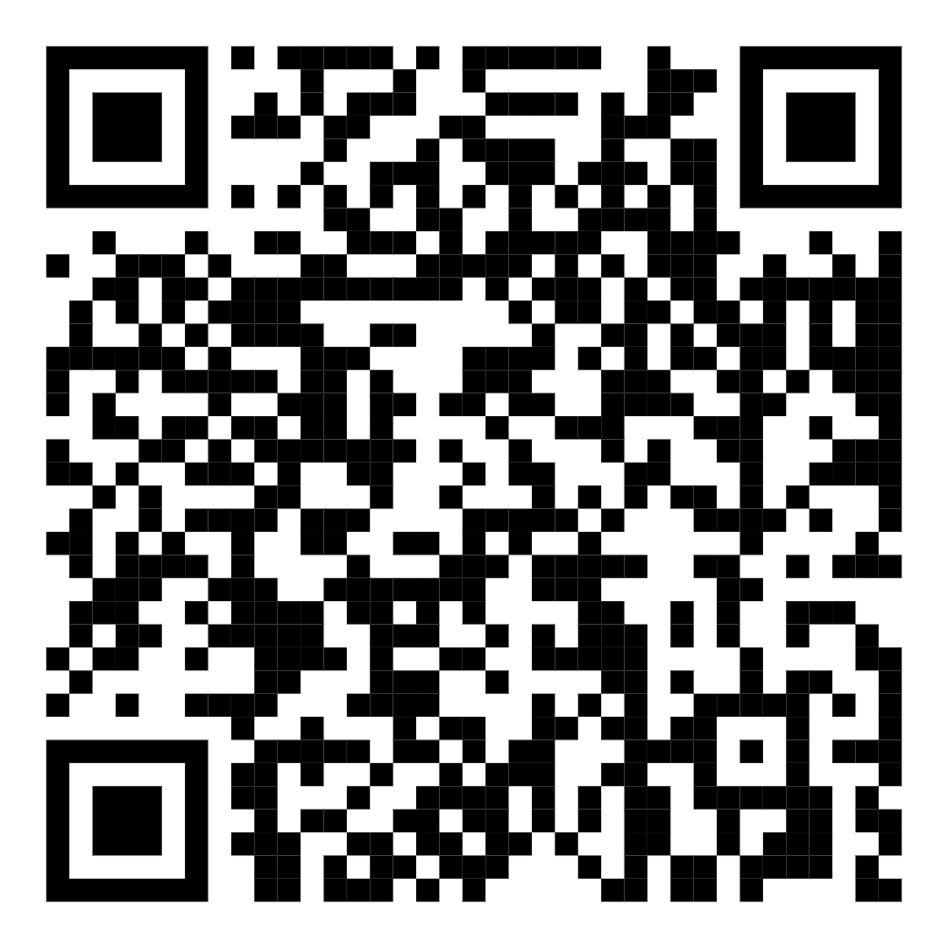
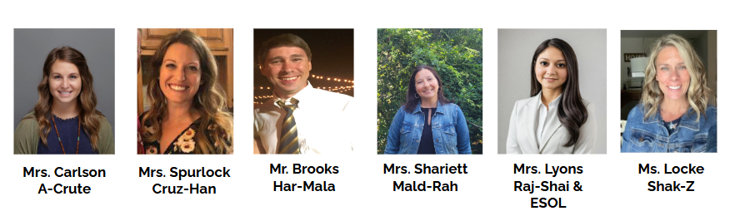
Feedback
Feedback Form
https://forms.gle/CR3FtZp3yaVZBoyM6

Slide 17

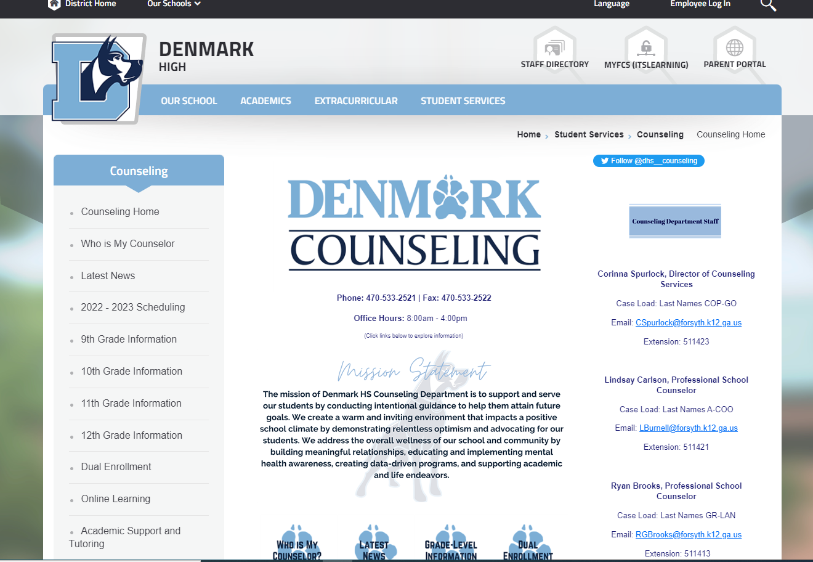


Website
Social Media
@denmarkhscounseling
@dhssourcesofstrength
text DHSsss4 to 81010

