Slide 1




Annual Title I Parent Meeting
Dobbins Middle School
637 Williams Lake Dr
Powder Springs, GA 30127
Zoom Meeting
Monday, October 14th @ 8:15am
Go

Slide 2



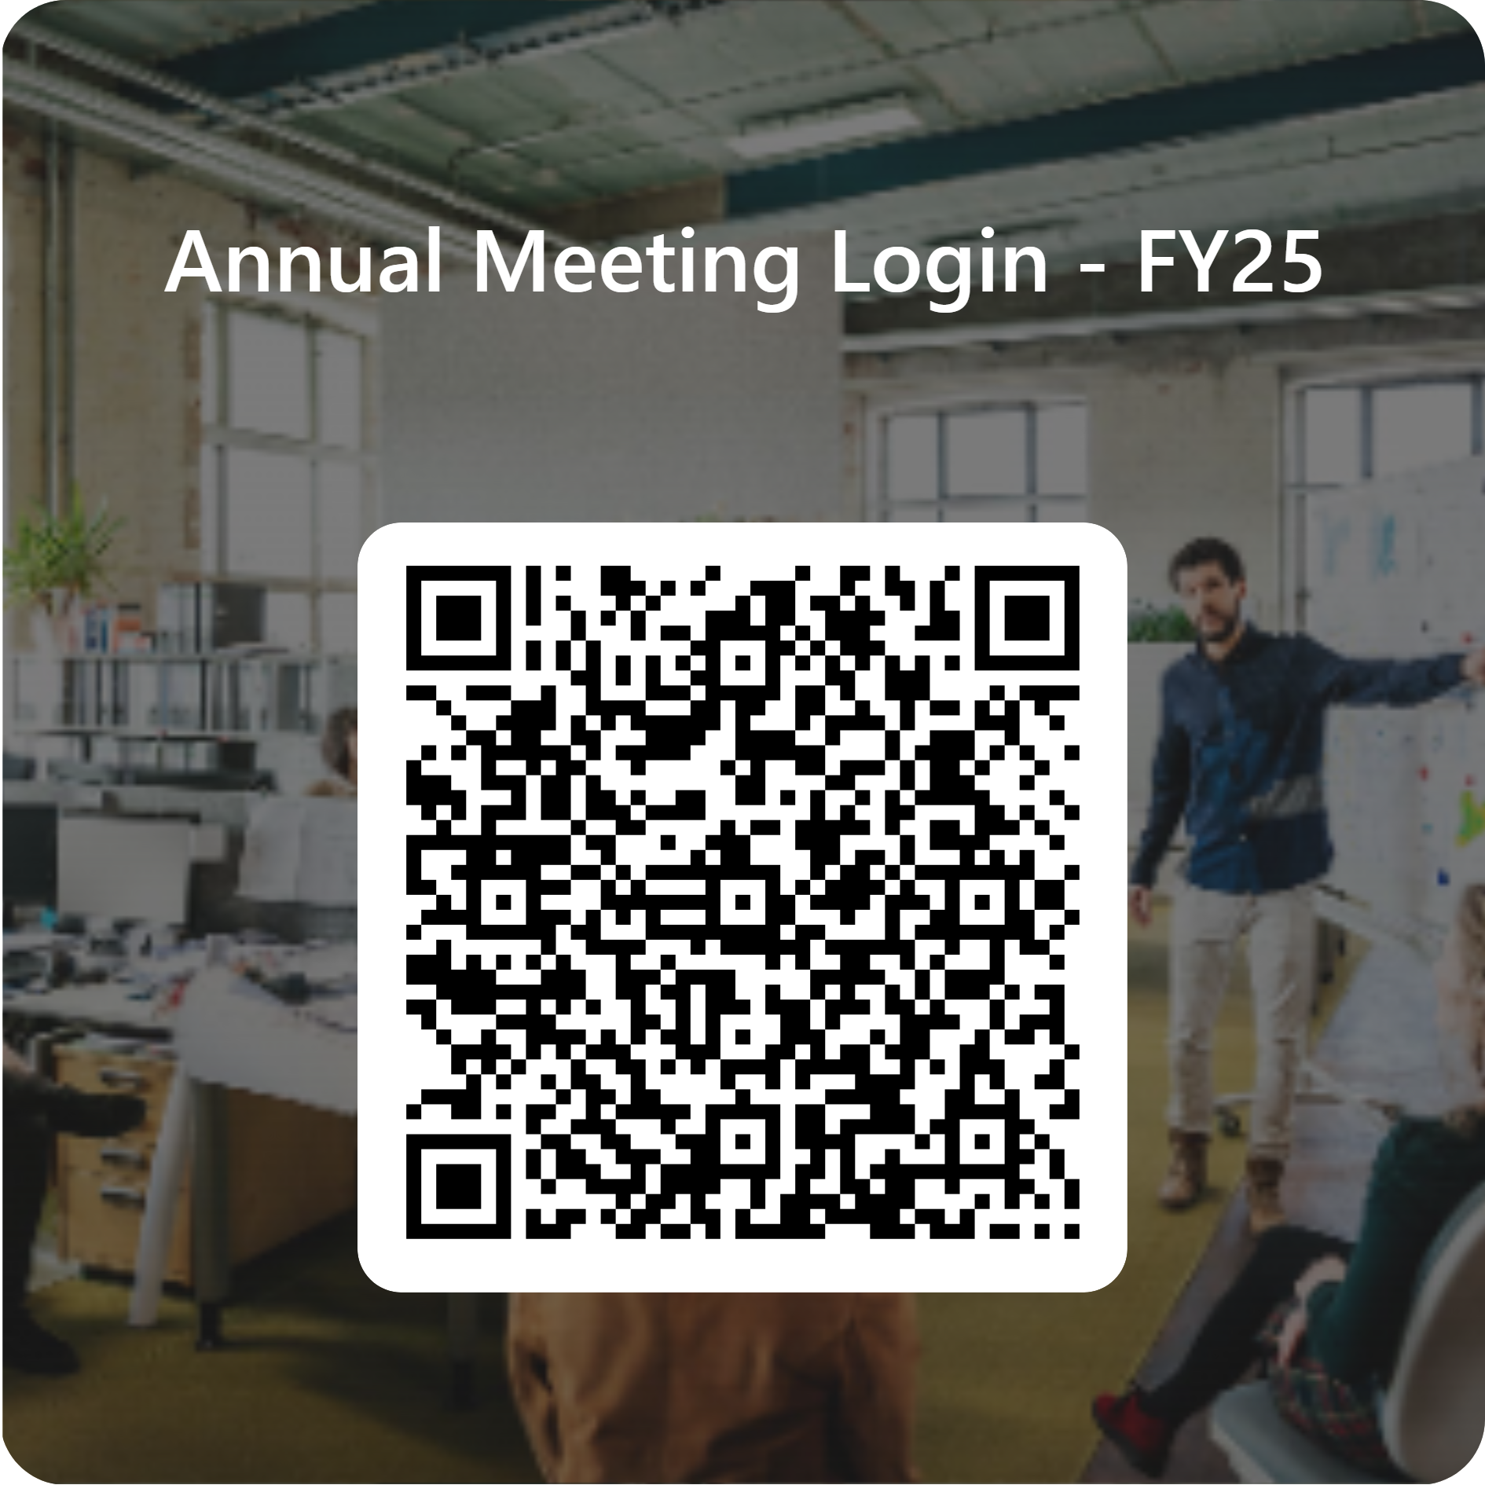
Welcome parents and community members!
We welcome your feedback throughout this presentation! We want to ensure you leave informed about the Title I program and know what opportunities we provide for families and the community to be involved.
FY25 Annual Title I Meeting Agenda (Link)

Slide 3

What Is a Title I School?
Title I was enacted in 1965 under the Elementary and Secondary Education Act and amended by the Every Student Succeeds Act (ESSA). It is the largest Federal Assistance Program for our nation’s schools.
The purpose of Title I is to ensure that all children have a fair, equal, and significant opportunity to obtain a high-quality education and to achieve proficiency on high academic standards.​
Title I provides federal funds through the Georgia Department of Education to Title I schools based on the student population receiving free and reduced meals. Funds are used to help impact student achievement.

Slide 4



Title I funds are applied to:
Supplementing programs that are already in place in schools, with the goal of providing all students with equal opportunity for achieving academic success
Hiring additional teachers and other support staff
Purchasing supplemental (additional) instructional materials, resources, and educational programs
Conducting parent activities and workshops focusing on how the school and families can work together to support students in content academic areas and other opportunities parents request
Providing professional development for teachers and staff
Establishing a parent resource center
Outreach to local Pre-K schools

Slide 5

How Dobbins Participates in the Title I Program
Title I support Staff​
Parent & Family Engagement Meetings​
Parent & Family Engagement Events/Nights​
Parent Resource Center​
School Compacts​
Open Lines of Communication and Parent Contact​

Slide 6
Our Targeted Assistance Requirements
Identifying school needs and areas requiring academic focus for improvement by reviewing student achievement data
Setting goals for improvement, and making plans to incorporate strategies that are based on scientific research to increase student achievement
Identifying students who will benefit from additional support
Partnering with families in order to provide the best support possible for all students to make progress
Providing staff with training, professional learning, resources, and materials in order to enhance their teaching, and ability to work effectively with families
Sharing of School Improvement Plan

Slide 7


School Targeted Assistance Program
Our Title I Targeted Assistance Improvement Plan (schoolwide goals) includes the following:
During the 2024-2025 school year, DMS teachers will increase the school percentage of Level 2's, 3's and 4’s on the Math GMA by 5%.
The programs and supports in place to help us achieve these goals:
Professional Learning for teachers​
Reduced Class Size
Parent and Family Engagement​ Opportunities
Resources purchased with FY25 Title I Grant Funds​
Student Centered Parent Resource Center
Dobbins Middle School State’s Grades Report

Slide 8
Curriculum Used at School
Illustrative Math
Online curriculum used in a hybrid model to give all students access to the math standards.
My Perspectives / Savvas
Research based curriculum that allows access to texts through the eyes of a reader and writer while providing access to the ELA standards.
1.
2.

Slide 9
Tests and Assessments for Students
in Middle Grades
Teacher -Projects, Reports, Unit/Chapter Tests, Presentations
County - Universal Math & Reading Assessments (Beacon), Writescore, Dibels
State - Georgia Milestones, ACCESS, Georgia Alternative
Assessment (GAA)
Other assessments may apply. If applicable, our school will notify parents/guardians.

Slide 10
Tests and Assessments for Students in Middle Grades
How do these assessments measure student progress?
Identifies areas in need of improvement, and plan for instruction
Provides information for teachers and parents on areas where students have mastered learning and where they may need additional support
Provides information to plan for “next-steps” so that the student will experience continuous growth
What proficiency levels is my child expected to meet?
Teachers share specific information about student expectations/goals and assessment results during parent meetings, conferences, and at the request of parents/guardians
Access previous test performance, standards, and attendance about my child using the Statewide Longitudinal Data System (SLDS) through the school’s parent portal (if applicable)

Slide 11
Georgia Milestones
Designed to measure how well students have learned the skills and knowledge described in the curriculum in the areas of English Language Arts and Mathematics in grades 6, 7, & 8
Science and Social Studies, grade 8
Taken at the end of the school year
Provides information on academic achievement at student, class, school, system, and state levels
Used to diagnose individual student strengths and weaknesses as related to the instruction of the state-adopted curriculum, and to gauge the quality of education throughout Georgia.
Go

Slide 12


FY25 Family Engagement Plans
PCSD Family Engagement Plan
Dobbins Middle Family Engagement Plan
Family – School Compact

Slide 13

Teacher Professional Qualifications
Parent’s Right-to-Know
All parents have the right to request the following information about the professional qualifications of your student’s teacher(s):
Whether the teacher has met the Georgia Professional Standards Commission’s requirements for certification for the grade level and subject areas in which the teacher provides instruction;
Whether the teacher is teaching under an emergency or other provisional status through which Georgia qualifications or certification criteria have been waived;
Whether the student is provided services by paraprofessionals, and if so, their qualifications.

Slide 14
Parent & Family Engagement Opportunities
Parent-Teacher Conferences: October 7-8, 2024 & March 10-11, 2025
STEM/Curriculum Nights - November 21, 2024 & February 27, 2025
FAME Meetings - January 30, 2025 & April 29, 2025
Transitioning to the Next Level – May 2025
Additional Activities may be shared throughout the year​
Volunteer opportunities​
Parent decision making opportunities/meetings/councils​
Local School Council​
Spring Planning Meetings for Development of Parent & Family Engagement Plan, Budget, Compacts, School Improvement Plan​
Title I Parent Survey​

Slide 15
Any
Questions?
Yes
Email Jamye Pierce, Instructional Lead Coach
Jpierce@paulding.k12.ga.us
No

Slide 16
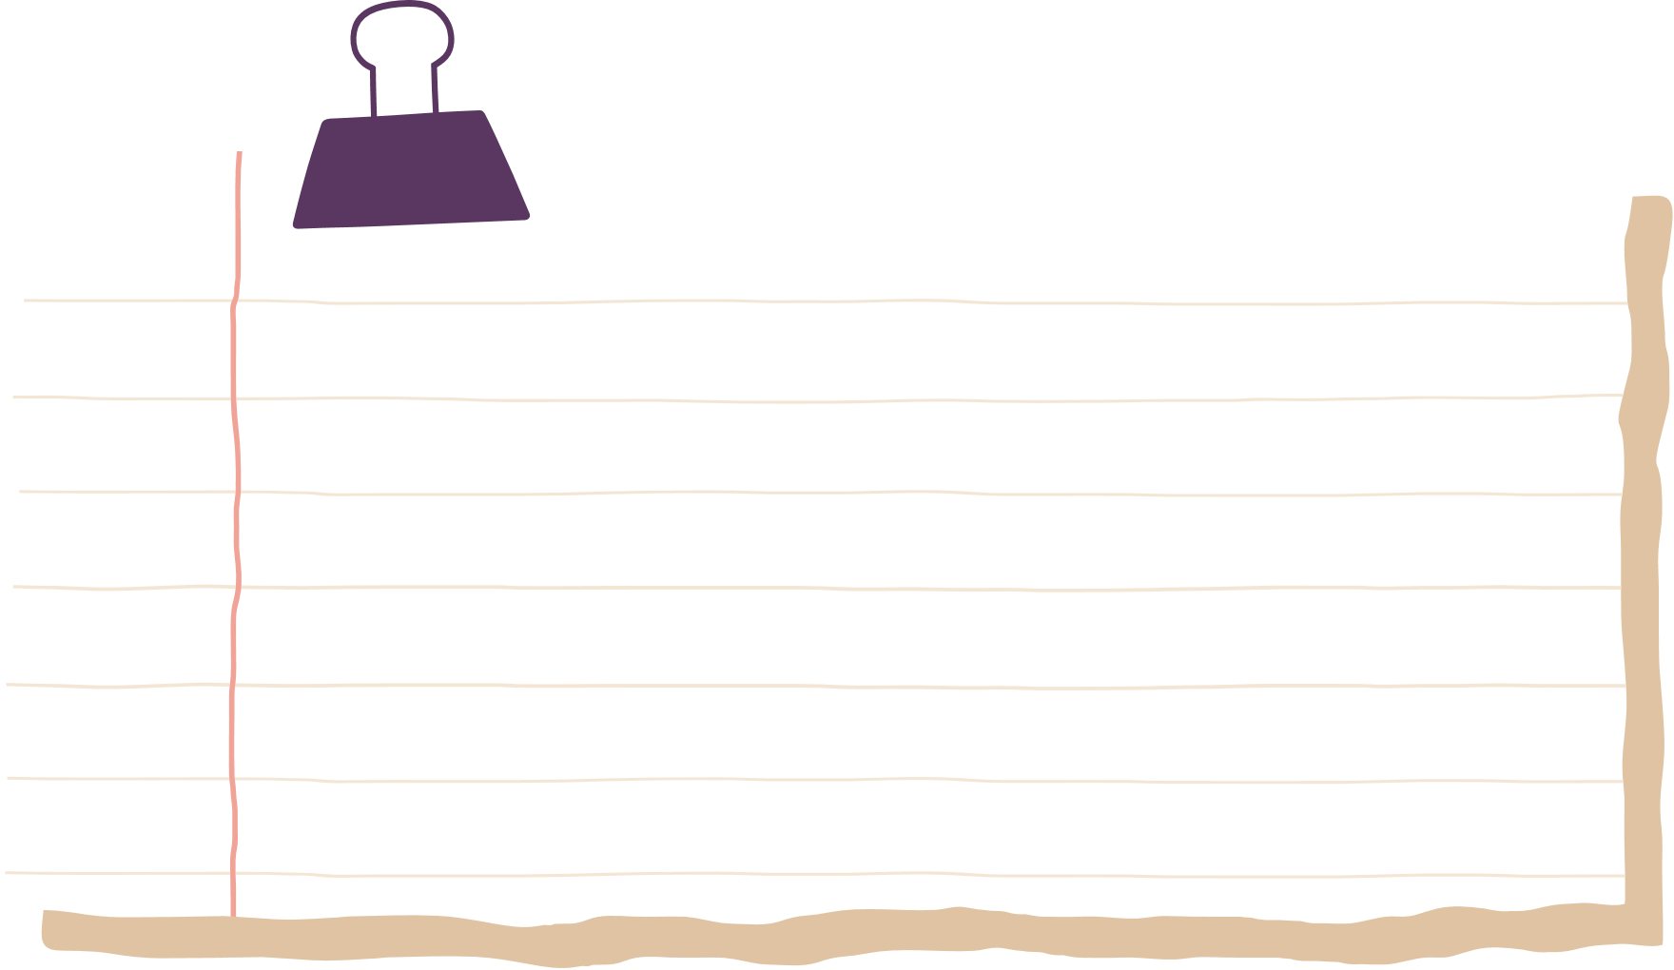
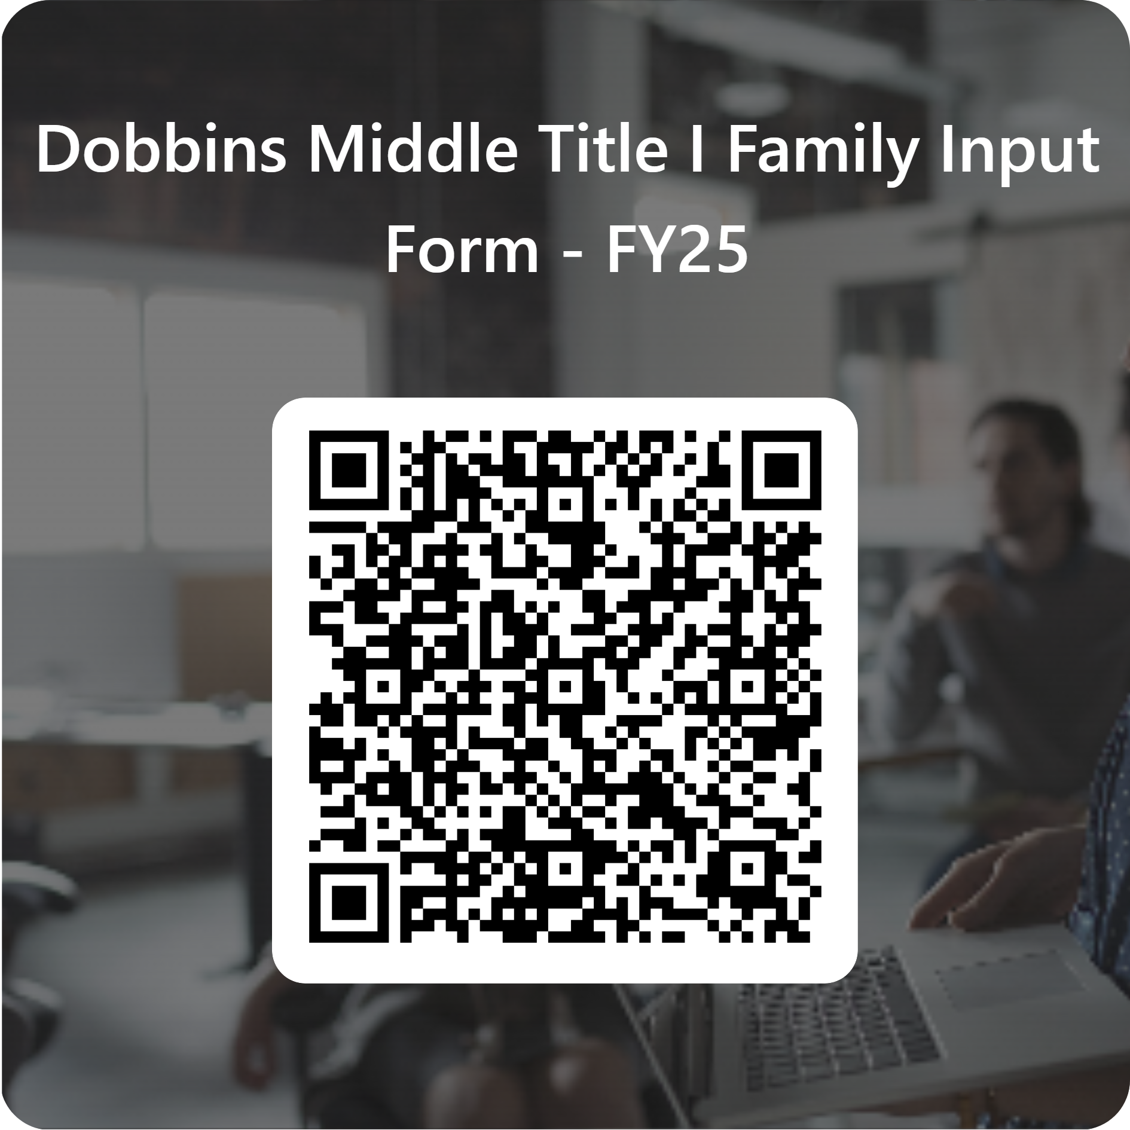

We value your feedback
https://forms.office.com/r/TYzgY9F28m

Slide 17
Thank
You

