Slide 1
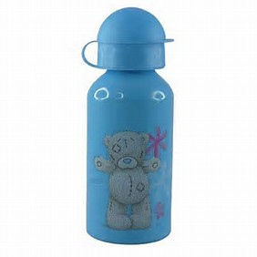
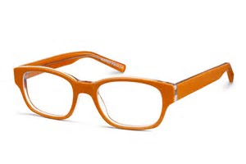
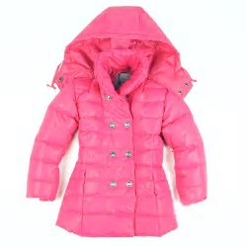
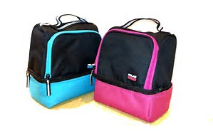
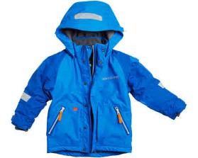
HELP US REDUCE SHELTON’S
LOST & FOUND
by
WRITING YOUR CHILD’S FULL NAME
ON THEIR JACKETS/LUNCHBAGS/
WATER BOTTLES, ETC.
by
REMINDING THEM THAT, IF THEY TAKE THEIR JACKETS TO SPECIALS/RECESS, TO BRING THEM BACK,
and by
CHECKING TO SEE IF THEIR ITEMS MADE IT BACK HOME.
THANK YOU!

