Slide 1


WELCOME
TO THE WOLFPACK
Transitioning from 5th to 6th Grade
SAMMY MCCLURE MIDDLE SCHOOL
Class of 2030

Slide 2
Top Concerns of New 6th Grade Students
Getting LOST!
Homework!
Making Good Grades!
Will I know someone at LUNCH?
Lockers!?
Bullying!
Will I get in trouble?

Slide 3
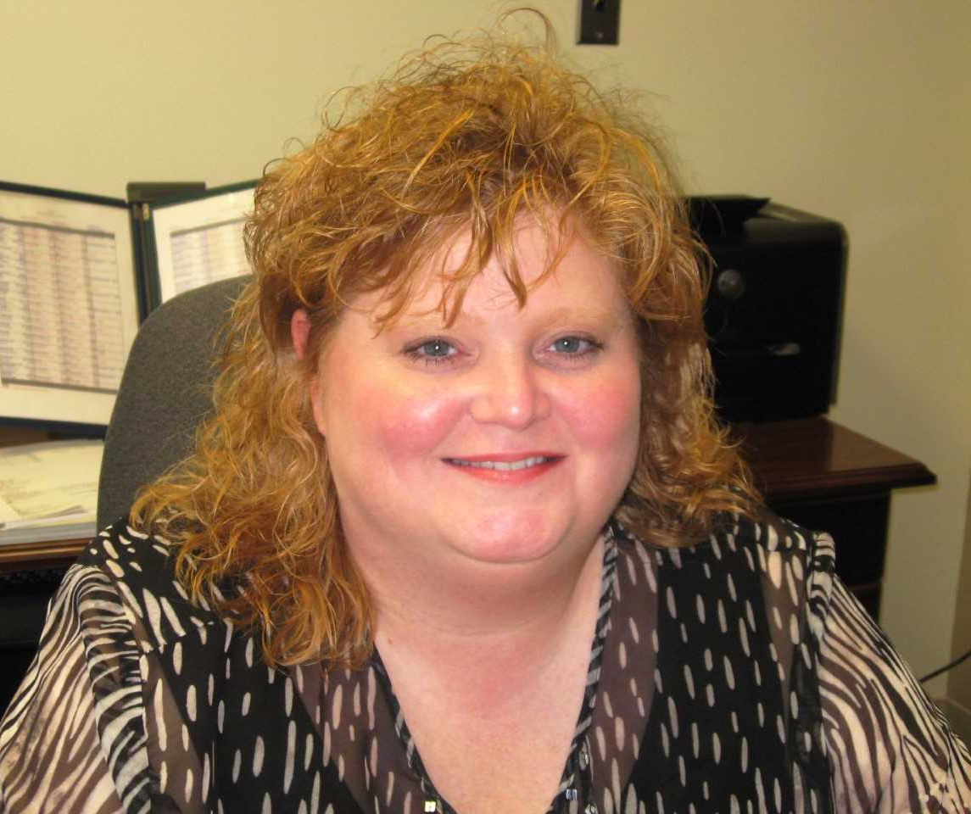
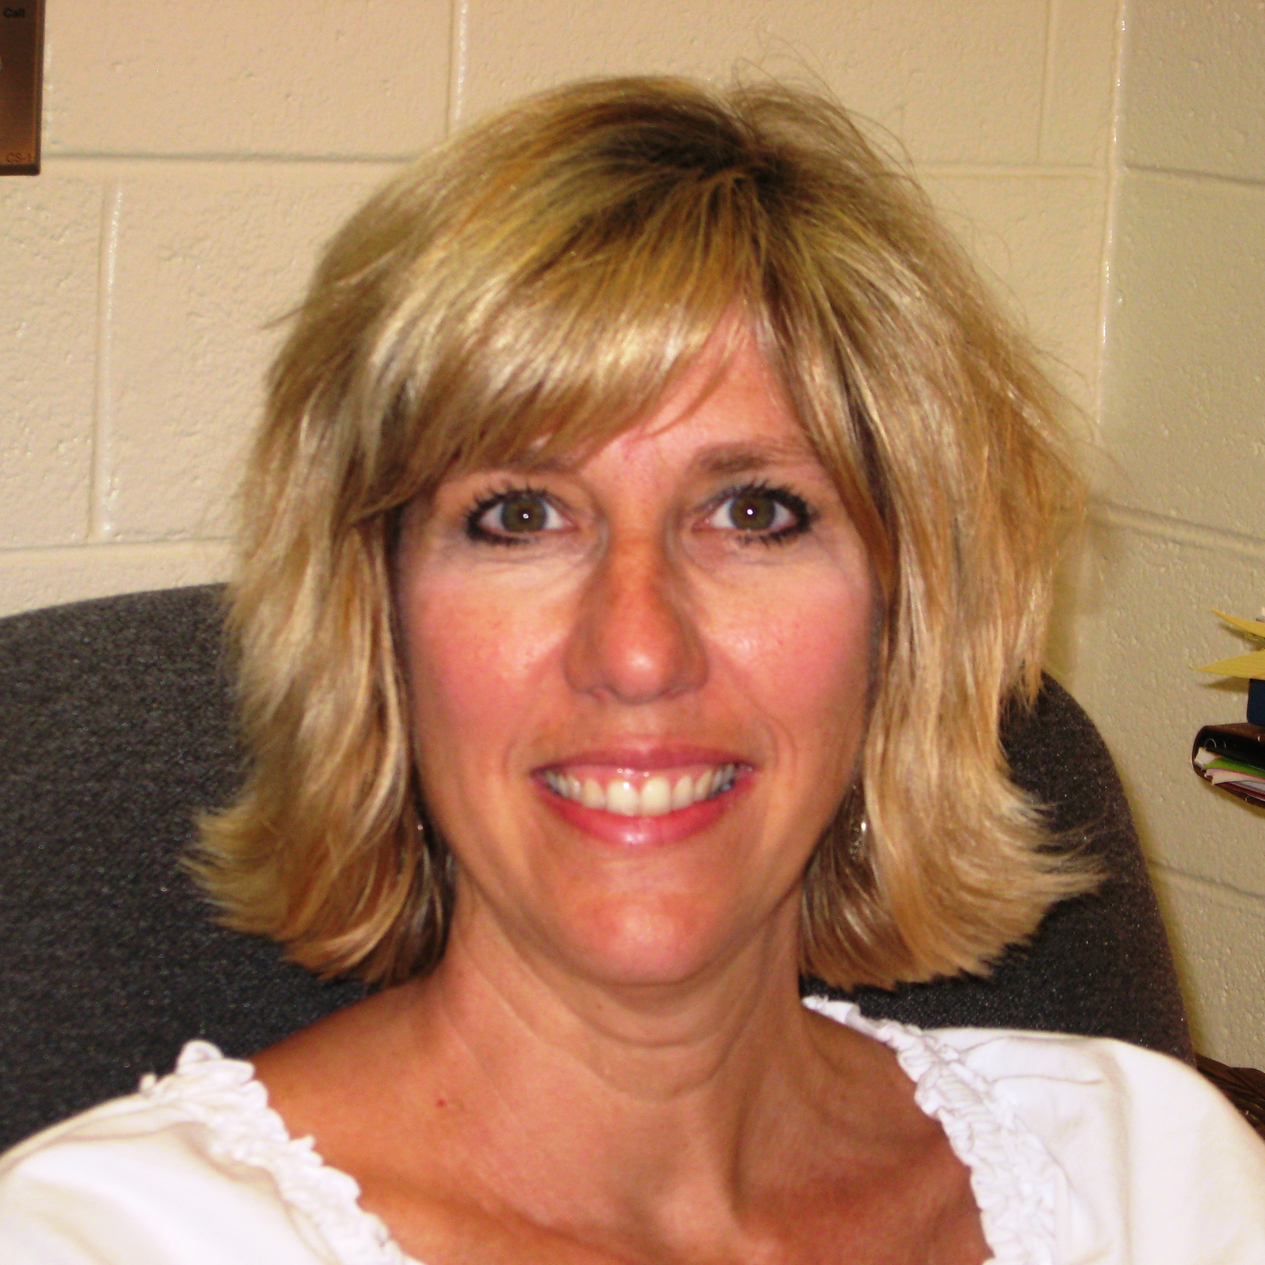
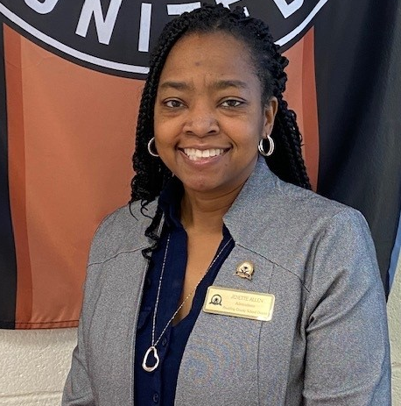
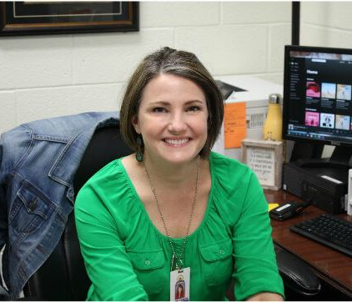
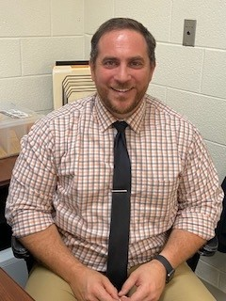
Ms. Teresa Bowles
Evaluation & Assessment Coordinator
tbowles@paulding.k12.ga.us
ADMINISTRATORS
Ms. Jaynath Hayes
Principal
jhayes@paulding.k12.ga.us
Ms. Jenette R. Allen
7th Grade Assistant Principal
jrallen@paulding.k12.ga.us
Mr. Sean Schinella
6th Grade Assistant Principal
sschinella@paulding.k12.ga.us
Ms. Tammy R. Ponder
8th Grade Assistant Principal
trponder@paulding.k12.ga.us

Slide 4
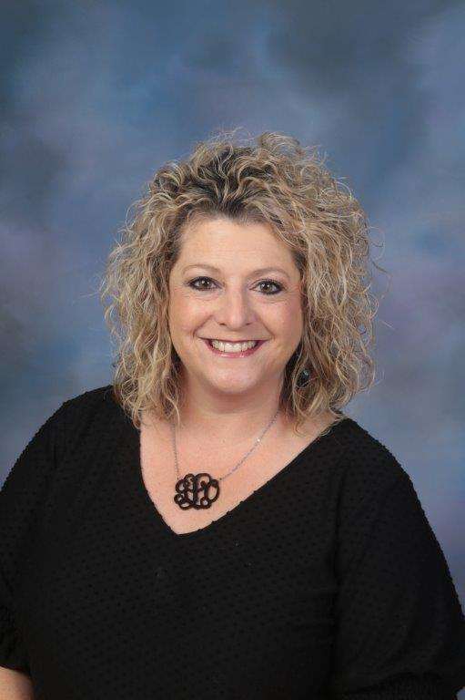
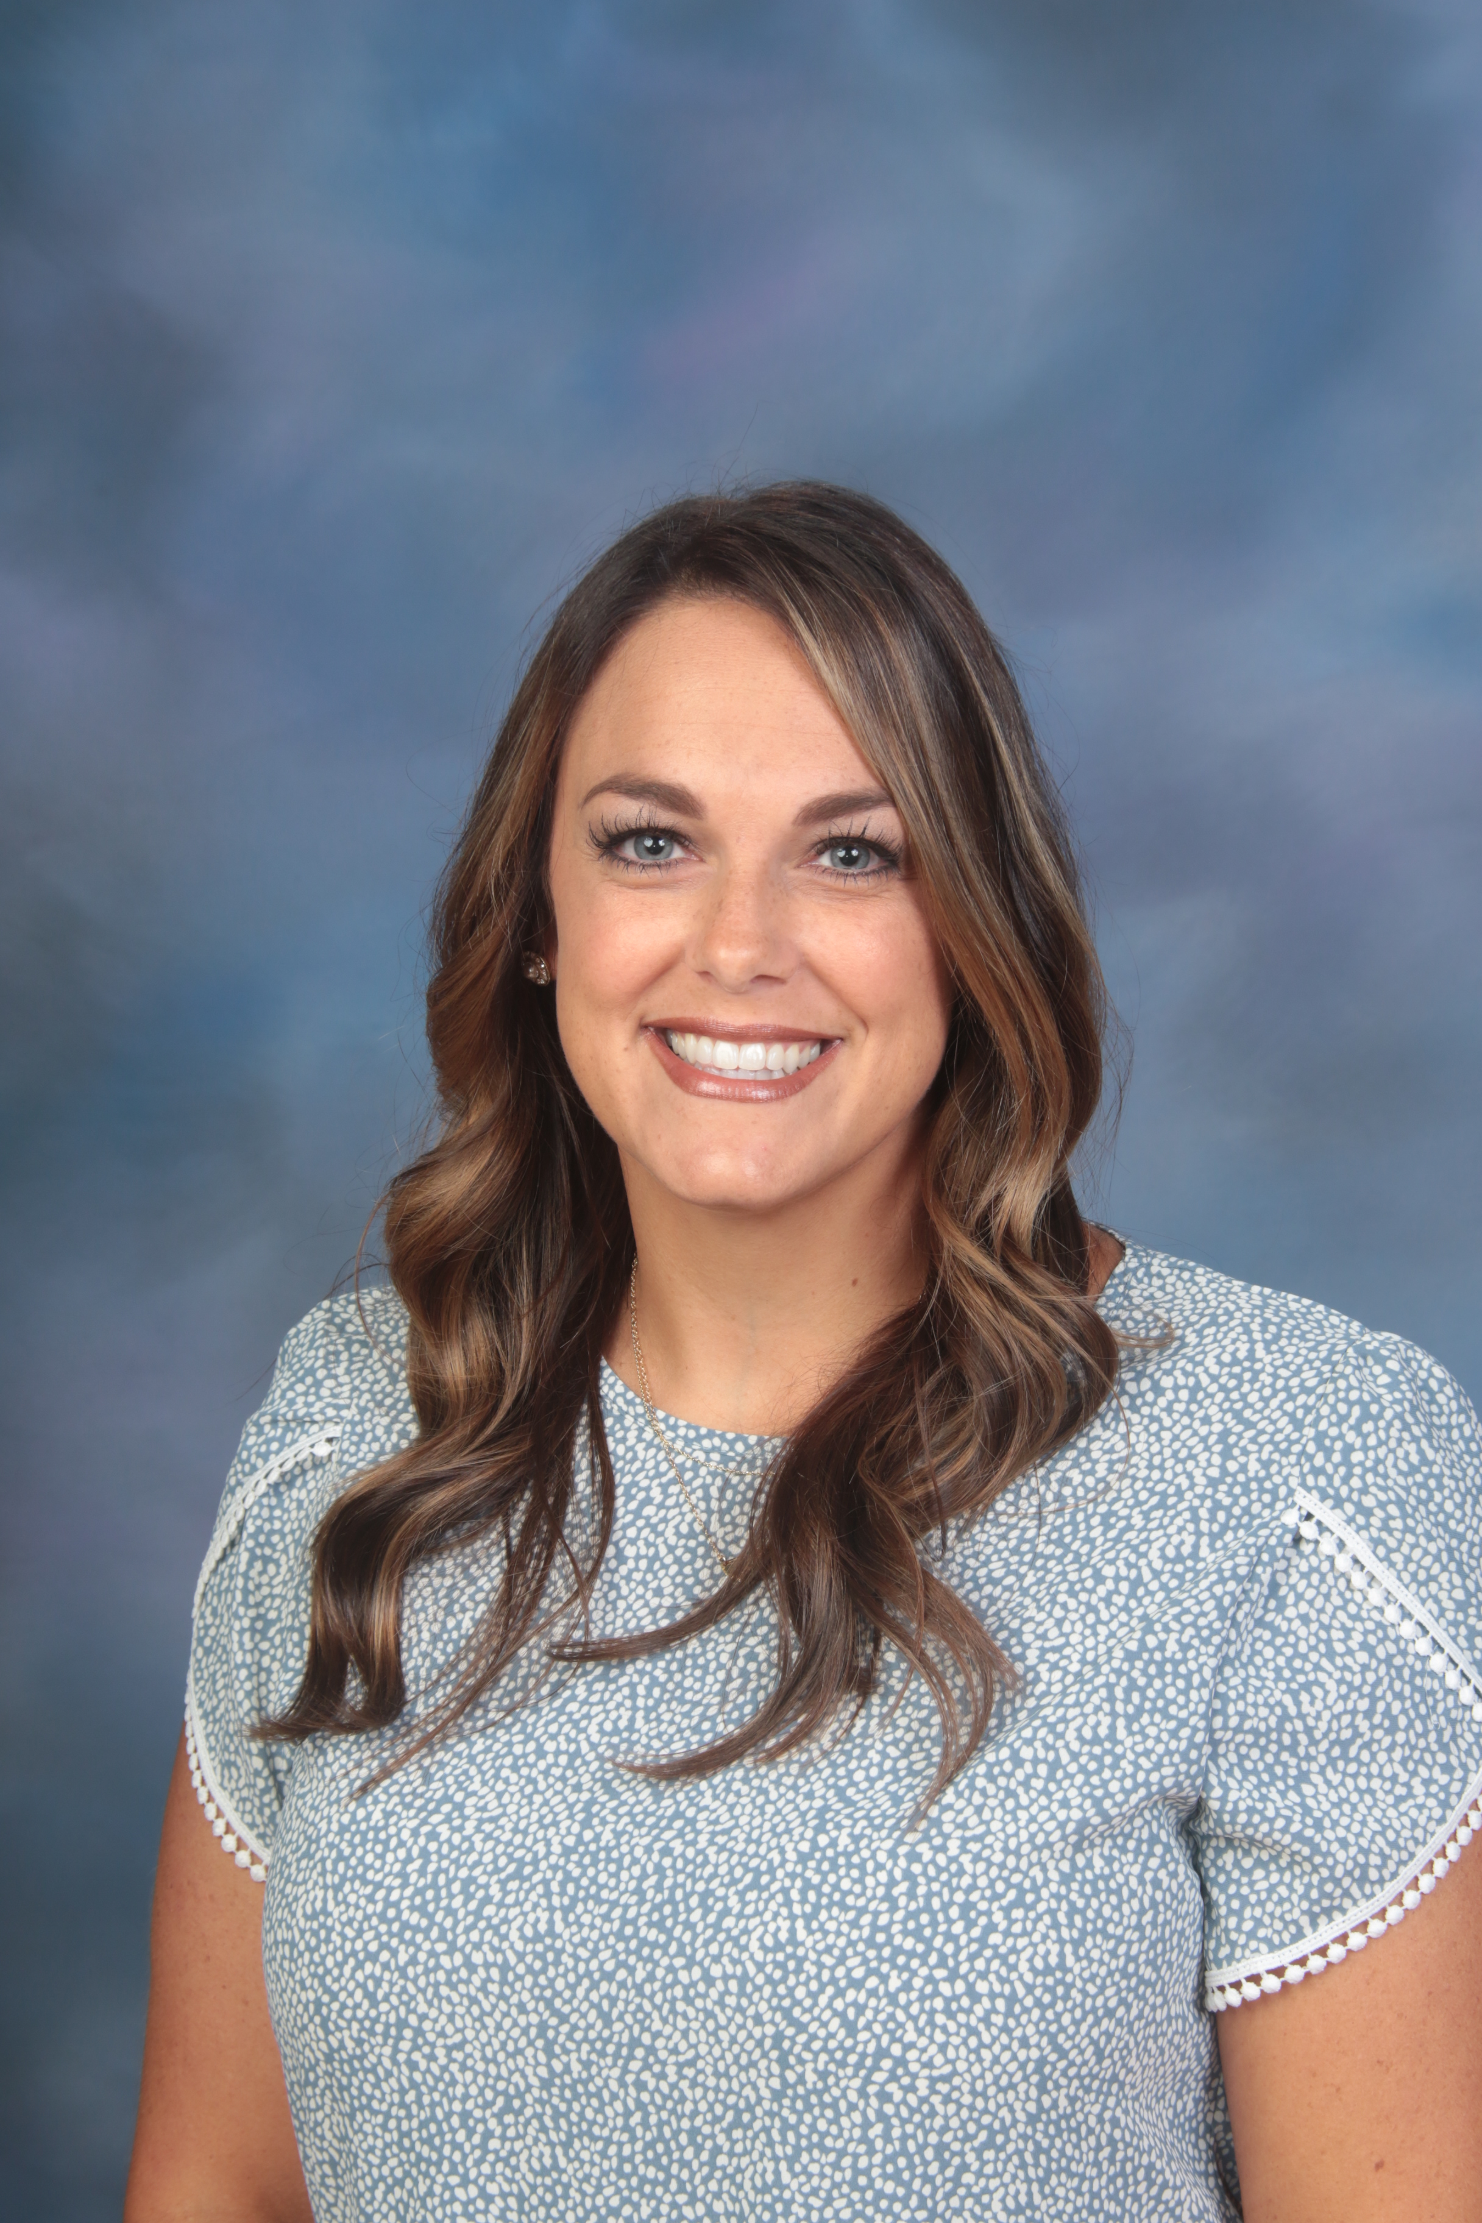
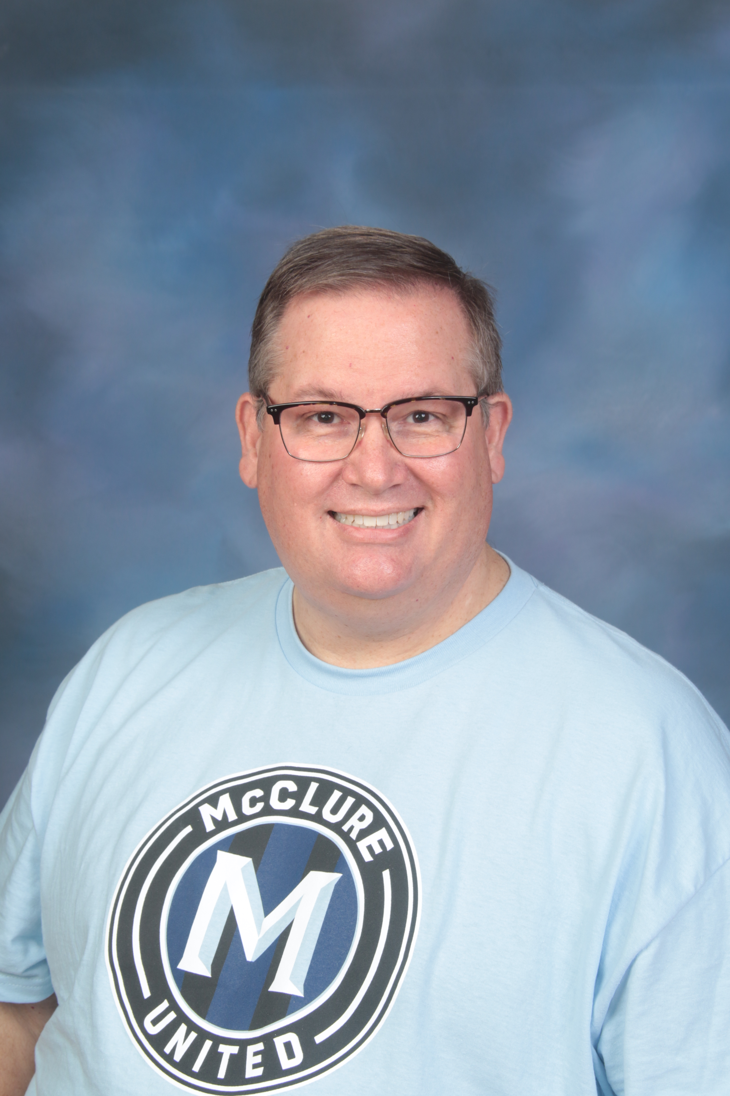
School Counselors for 2023-2024
Mrs. Gina Lowe
Counselor-6th Grade glowe@paulding.k12.ga.us
Mrs. Ashley Stockelman
Counselor- 7th Grade
astockelman@paulding.k12.ga.us
Dr. Phillip Greeson
Lead Counselor-8th Grade pgreeson@paulding.k12.ga.us
School counselors support students in three life areas-academic, career, and personal/social. The focus of the counseling program facilitates student learning and academic success.
Middle school counselors are available to work with students, parents, and teachers through advisement, counseling, consultation services, and referral delivery systems.

Slide 5
What to Expect At the Beginning of the Year
Students will receive a SCHEDULE on paper showing their classes, room numbers, and teacher names in the order they go to the classes.
Teachers and Staff will help students find their next class and be able to direct them in the hallways.
Lunch is with your 3rd Period Class.
Remember, all the 6th grade students are new!

Slide 6

drop off begins at 8:10 am
8:10-8:45 Homeroom (Same as 4th period)
8:48-9:33 Pack Time
9:36-10:34 1st Period - Academic
10:37-11:35 2nd Period - Academic
11:38-1:03 3rd Period - Academic (and lunch)
1:06-2:04 4th Period - Academic
2:08-2:50 5th Period - Connections Class
2:53-3:35 6th Period - Connections Class
Connections Class Choices on Next Slide.
All Students take Physical Education all year.
Typical 6th Grade Schedule

Slide 7

Connections
PE
Visual Arts
STEM
Spanish Connections
Computer Science
Reading or Math Connections
Music Appreciation
Chorus**
Band**
** If interested in Chorus or Band, please contact these teachers below for information.
Band: Mrs. Katherine Crozier-Price Kcrozierprice@paulding.k12.ga.us
Chorus: Mrs. Liz Dean- Ldean@Paulding.k12.ga.us

Slide 8
About Connections Classes
A Typical SMMS Connections Schedule:
  5th Period: Yearlong PE
  6th Period Fall: Spanish Connections | 6th Period Spring: Art
Students randomly rotate through:
  Art, STEM, Business & Computer Science, Music Appreciation, PE and Spanish Connections
Students may elect to take Band or Chorus.
  Signup link is on our website.
  Usually scheduled with year long PE.
Spanish Connections is different than Spanish 1 in 7th/8th Grade.

Slide 9
What if I make a bad grade?
Talk to your teacher. (Ask your parent to help if you need.)
Do NOT give up or say, “I can’t.”
Improve your classroom habits. (Notebook, Listening, Completing Work)
Go to Tutoring

Slide 10



Contacting Staff Via Email most mCclure staff can be emailed using this example
First initial + last name @paulding.k12.ga.us
Infinite Campus-Parent Portal is how parents access attendance and grades.
CANVAS is our Learning Management System and houses content and communication.
COMMUNICATING WITH STAFF

Slide 11

Advanced Classes in 6th Grade
Elementary Schools provide Middle Schools with placement for Advanced Classes.
Advanced Classes are offered for Language Arts, Science, & Social Studies.
Advanced Math is an accelerated class.

Slide 12
Grade/Course | Grades | Teacher Recommendation
Advanced ELA | • Demonstrates or exceeds mastery on 15 out of 18 assessed reading standards by the end of the 3rd term • Demonstrates or exceeds mastery on 8 out of 10 assessed writing standards | Considering attendance, homework completion, participation, and student work habits
Accelerated Math | • Demonstrates or exceeds mastery on 13 out of 17 assessed math standards by the end of the 3rd term. | Considering attendance, homework completion, participation, and student work habits
Advanced Science | Demonstrates or exceeds mastery on 5 out of 7 assessed science standards by the end of the 3rd term | Considering attendance, homework completion, participation, and student work habits
Advanced Social Studies | Demonstrates or exceeds mastery on 3 out of 4 assessed social studies standards by the end of the 3rd term | Considering attendance, homework completion, participation, and student work habits
Criteria for
Consideration

Slide 13

High School Credit in Middle School
Advanced Math is an accelerated class. Eligible for Honors GSE Algebra I (1 HS credit) in 8th grade if successfully completed Advanced Math in 7th grade.
Honors Language Arts: (1 HS credit) eligible if successfully completed Advanced Language Arts in 7th grade.
Honors Physical Science (1 HS credit) eligible if successfully completed Advanced Science in 7th grade.
Spanish I -7th and 8th Grade (equals 1 HS credit) eligible to take if student received an "A" in 6th Grade Advanced Language Arts:
  This is a two-year course; usually scheduled with year long PE

Slide 14
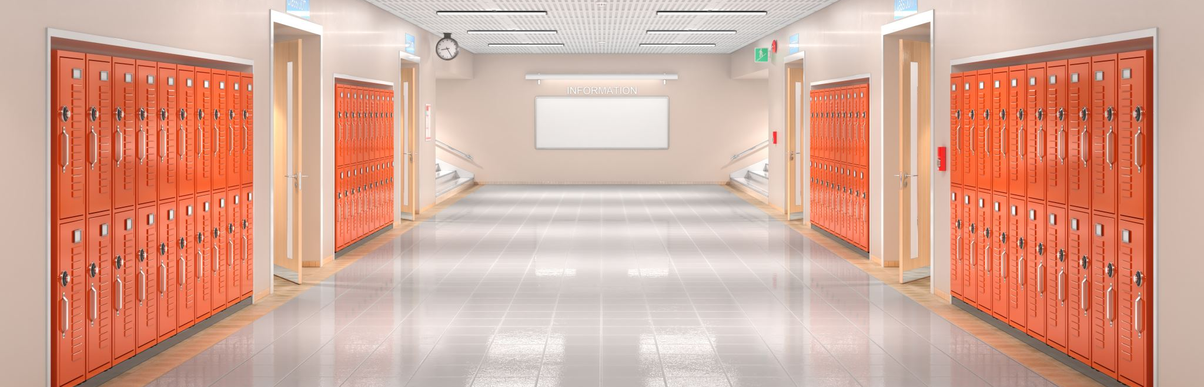
-All Students will be assigned a locker ($5.00 fee).
-All bookbags and belongings will be kept in their lockers.
-Teachers will give students breaks throughout the day to go to lockers.
LOCKERS
“Combination Locker Practice” (free app)

Slide 15



Dress code is enforced strictly.
What to Avoid:
-spaghetti straps
-showing midriff
-t-shirts with inappropriate
-pictures/sayings
-ripped jeans in thigh area
-short shorts and dresses
The parent handbook talks more specifically about what is allowed and expected.
Dress Code

Slide 16
Will I Get Bullied in Middle School?
What is Bullying?
Intentional physical, verbal, or social aggression.
  Repeated
  Intentional
  Power Imbalance
What Should I Do?
Support
Speak Up
Get Help
Teachers, Counselors, and Administrators are here to help you.
A lot of students use the word “Bullying” to mean any unkindness. We will help you better determine when something is bullying or if it is some other type of poor behavior.

Slide 17
What happens if students do something wrong?
Everyone makes mistakes.
Teachers set clear expectations to help students do well.
Counselors are here to help students understand and cope.
Administrators help students understand what has happened and do not punish them harshly unless they repeatedly do things wrong.

Slide 18

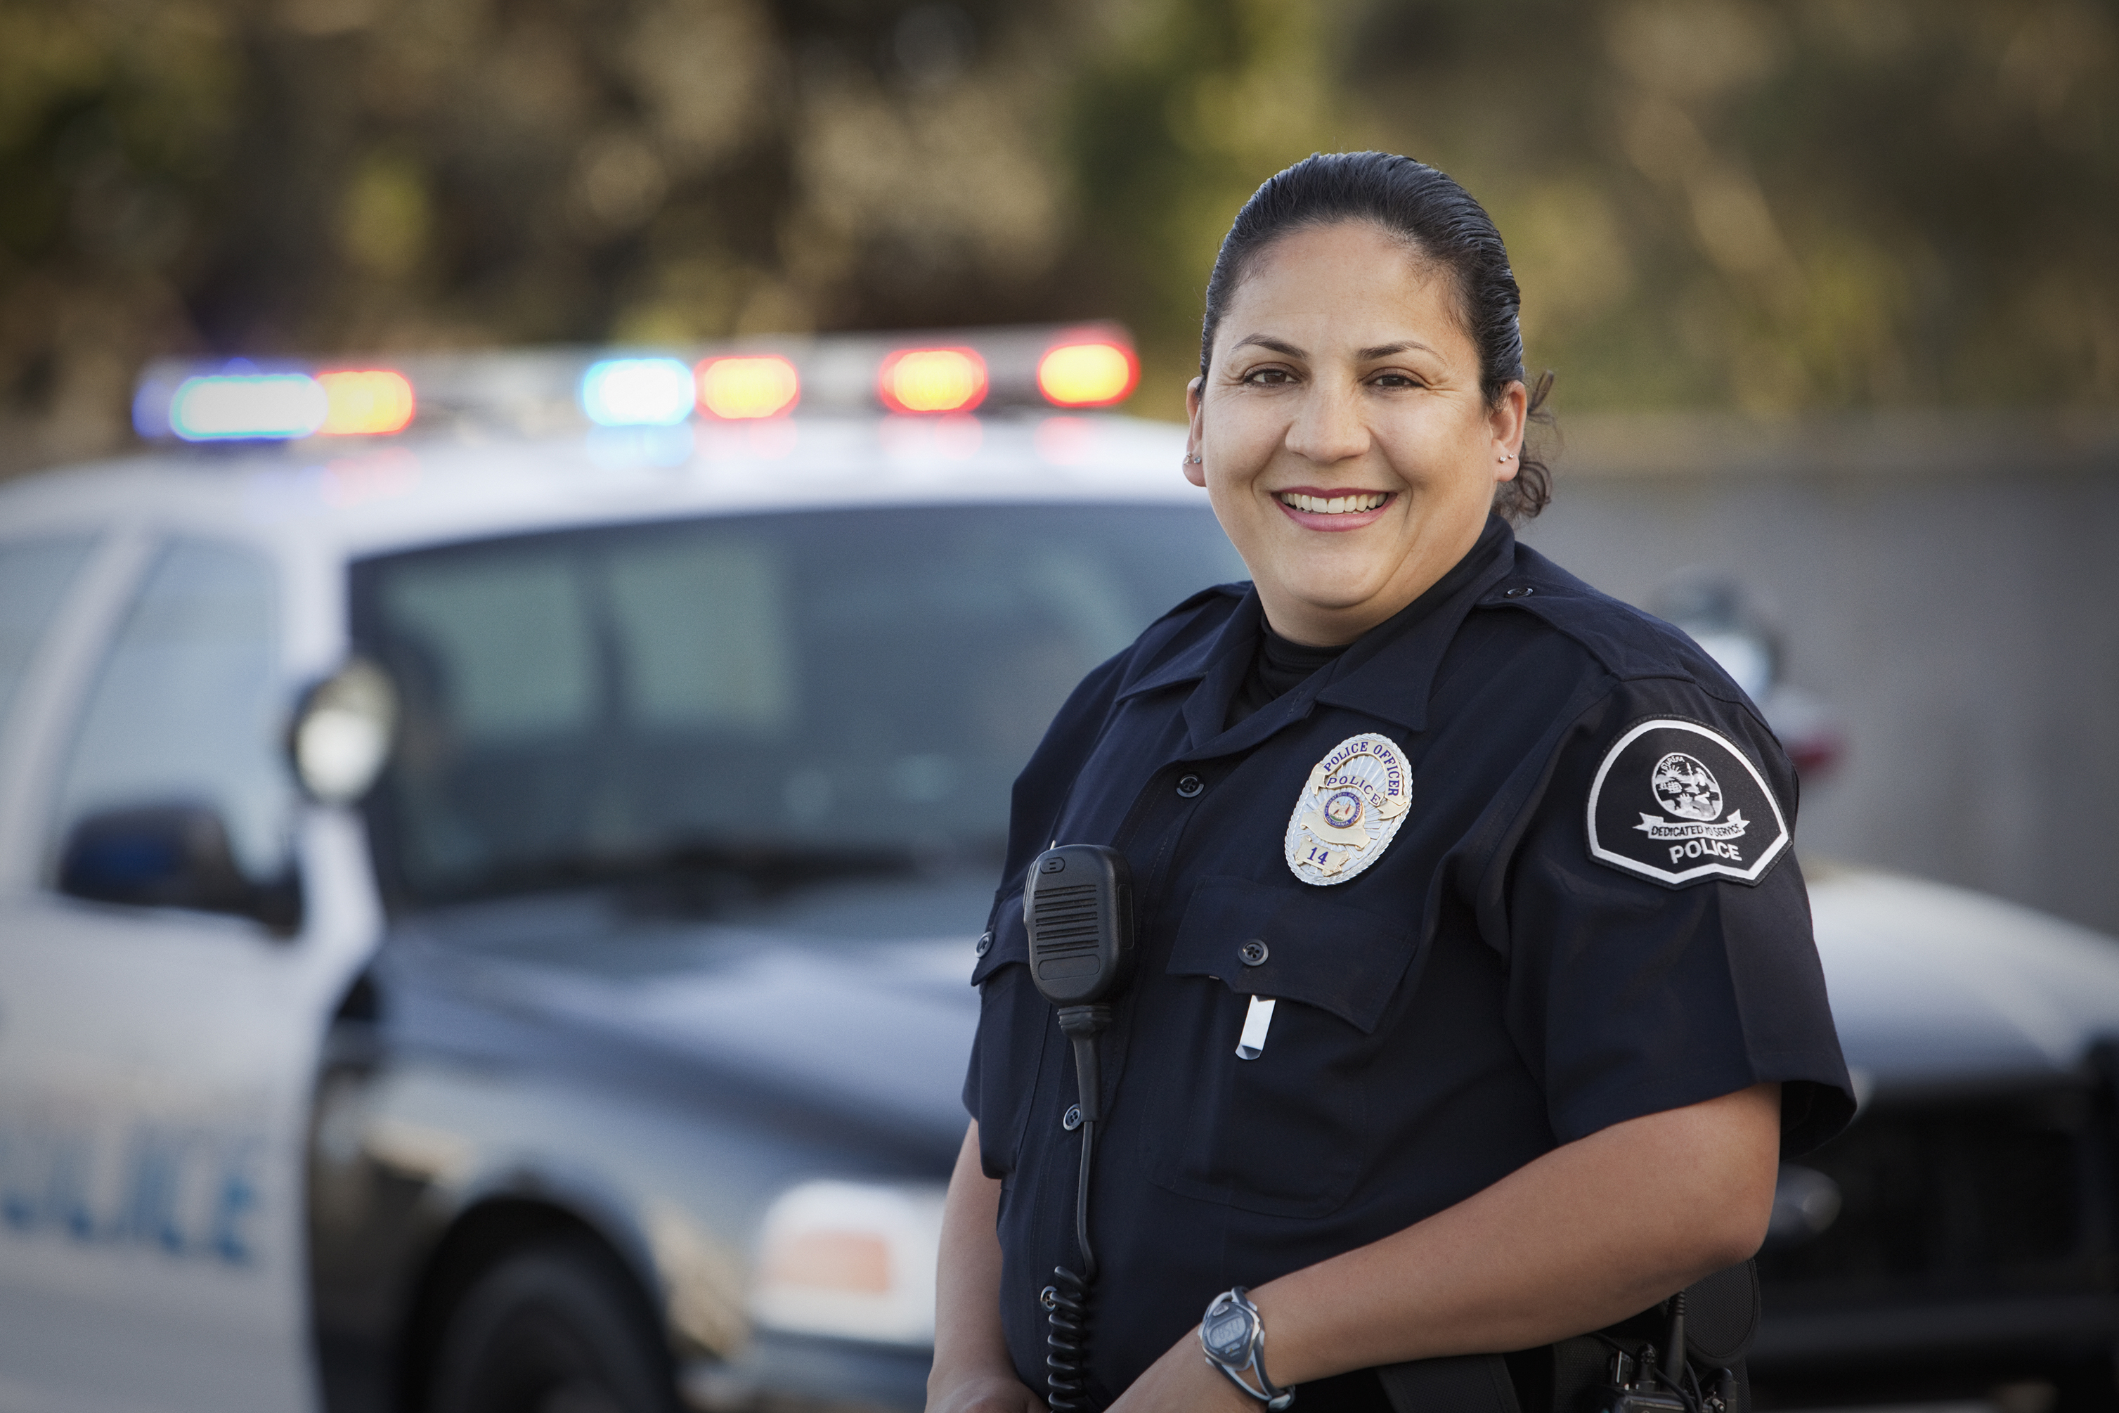

The School Resource Officer or SRO is a uniformed officer whose assignment is to help ensure that the students have an atmosphere that is conducive to a good education.

Slide 19

Bridge Law for Middle School
6th Grade- YouScience Snippet a career interest survey
7th Grade-YouScience Snapshot a career aptitude inventory and explore 3 career clusters
8th Grade- Create an Individual Graduation Plan using results from YouScience

Slide 20


Cafeteria Information
Mrs. Harris
County Link: http://www.schoolnutritionandfitness.com/index.php?sid=0305131813425871

Slide 21
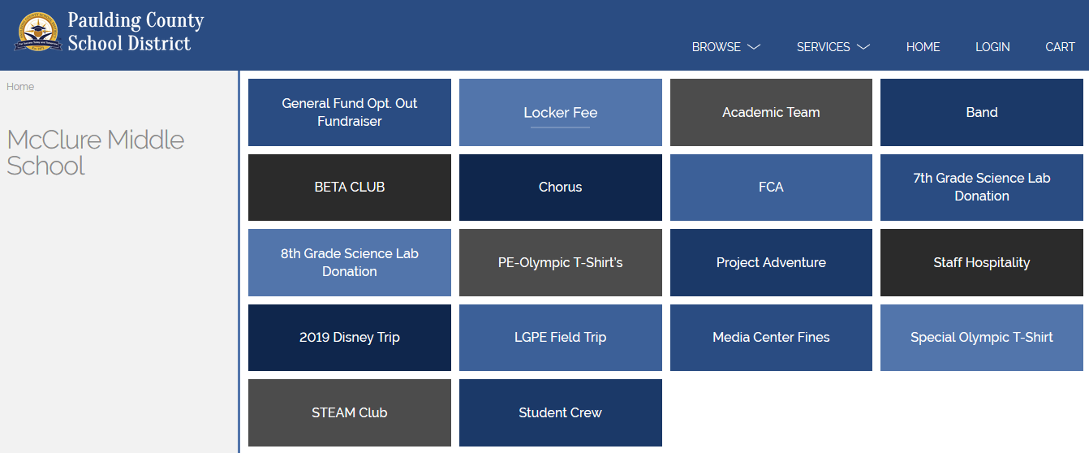
RevTrak for Online Payments
McClure Web Site: For Parents: Web Store
https://paulding.revtrak.net/

Slide 22

ESEP Questions?
Mrs. Sarah Glosson, Lead ESEP Teacher
sglosson@paulding.k12.ga.us
Please contact her with any specific questions regarding ESEP

Slide 23

We Can’t Wait For You To Join Our Pack….
GO WOLVES!!!

Slide 24

Questions?

