Slide 1
Living, Non-Living, Dead
How can you tell the difference?

Slide 2
Living Things
Living things have at least 6 common characteristics
  1. They have cellular ORGANIZATION
  2. They have similar CHEMICALS of life
  3. They use ENERGY
  4. They respond to STIMULI
  5. They GROW and DEVELOP
  6. They can REPRODUCE

Slide 3

Uses Energy
Living things need energy to live
  Animals get energy from eating food
  Plants make their own food using energy from the sun.
The sun is the main source of energy for living things.

Slide 4
Respond to Stimuli
A stimulus is anything that gets an organism to respond.
Example: plants grow when sunlight is shown on them.
  Sunlight is the stimulus
  Plant growth is the response

Slide 5
Grows and Develops
Living things have the ability to grow and change.

Slide 6
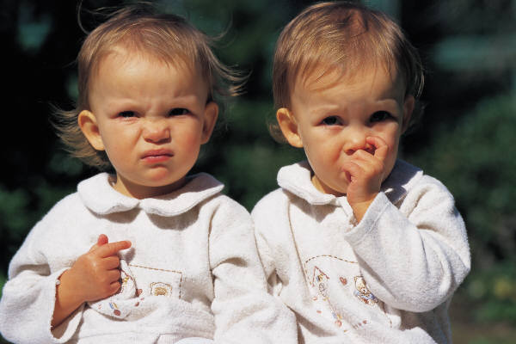
Can Reproduce
Reproduction is when a living organism can make another living organism like itself.

Slide 7
Homeostasis
Homeostasis is when a living thing can maintain a balance of proper conditions inside it so it can live.
Homeostasis is one way an organism responds to stimuli.

Slide 8
Needs of Living Things
All living things need:
  Water
  Food
  Living space (shelter)
  Stable internal conditions (homeostasis)

Slide 9
Organism
An organism is any living thing.

Slide 10
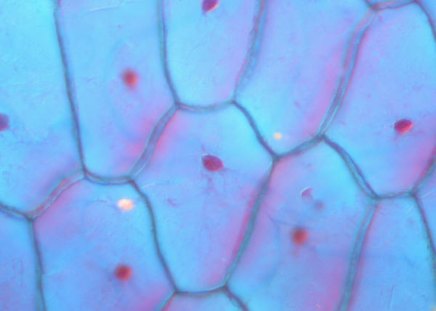
Organization
Organization means that the living things are made up of cells
Cells are orderly and structured living units that are capable of carrying out specific processes

Slide 11
Organization
Organism
Organ System
Organ
Tissue
Cell

Slide 12
Living
To be considered a living thing, it must have all 6 characteristics of living things

Slide 13
Non-Living
In order to consider something non-living, it must not have any of the 6 characteristics of living things.
  Examples: chair, pen, desk, water
or
It was living or dead and has been processed (chemically altered)
  Examples: paper, leather shoes, apple juice

Slide 14
Dead
In order to consider something dead, it must have been alive at one time and it no longer has any of the six characteristics of living things.

Slide 15
Living,
Non-Living or Dead?
Let’s Discuss

Slide 16
Tree

Slide 17
Tree
Living
  It is able to do all 6 functions necessary to all living things
    It is made up of cells (organization)
    It has similar chemicals
    It uses the sun’s energy to make food
    It can respond to stimuli in its surroundings
    5. It can grow
    6. It can make seeds that can grow into more trees.

Slide 18
Wood

Slide 19
Wood
Dead
  It is NOT able to do all 6 functions necessary to all living things
    1. It is made up of cells (organization), but the cells are dead
    2. It cannot grow in response to sunlight
    3. It cannot uses the sun’s energy to make food
    4. It cannot grow
    5. It cannot make seeds that can grow into more trees.
    6. It does not have similar chemicals of life

Slide 20
Paper

Slide 21
Paper
Non-Living
  Although as a tree it was once living, now it is NOT able to do all 6 functions necessary to all living things and it has been processed
    1. It was made up of cells (organization), but the cells were broken down when the wood was chopped up to make the paper
    2. It cannot grow in response to sunlight
    3. It cannot uses the sun’s energy to make food
    4. It cannot grow
    5. It cannot make seeds that can grow into more trees.
    6. It does not have similar chemicals of life

Slide 22
Soil

Slide 23
Soil
Non living
  1. Not made of cells
  2. It cannot grow in response to sunlight
  3. It cannot uses the sun’s energy to make food
  4. It cannot grow
  5. It cannot reproduce
  6. It does not have similar chemicals of life
  What about cryptobiotic soil??

Slide 24
Potential for life
When something has the potential for life, it means that it could have all of the characteristics of a living thing if it was under the right conditions.
  Examples would be:
    Seeds
    Nuts
    Eggs

Slide 25
Factors in an Ecosystem
Abiotic: all the non-living factors in an ecosystem
  Example: air, water, dirt, rocks, mountains, etc.
Biotic: all the living factors in an ecosystem
  Example: grass, trees, moose, humans, insects, etc
All of the biotic factors in the ecosystem are dependent upon the abiotic factors

