Slide 1
Interactions Among Living Things

Slide 2
Adapting to the Environment
Natural Selection – a characteristic that makes an individual better suited to its environment; the trait may eventually become common in that species.
Natural selection results in adaptations or behaviors and physical characteristics that allow organisms to live successfully in their environments.
Niche – The role of an organism in its habitat, or how it makes its living.

Slide 3
Niche
An organism’s niche includes:
  the organism’s food
  how it obtains food
  other organisms that use the organism as food
  when and how it reproduces
  any physical characteristics required to survive

Slide 4
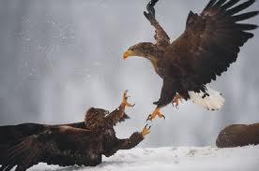
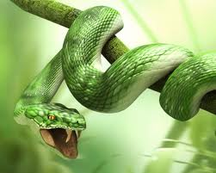
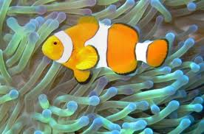
Three types of Interactions among Organisms
Competition
Predation
Symbiosis

Slide 5
Competition
It is the struggle between organisms as they attempt to use the same limited resource
Occurs when two species occupy
the same niche
Why can’t two species occupy the same niche?
  If two species occupy the same niche, they will compete directly against each other and one species will eventually die off

Slide 6
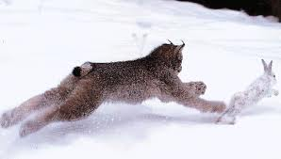
Predation
The interaction in which one organism kills another for food is called predation
The organism that does the killing is the predator
The organism that is killed is the prey

Slide 7
Predation and Population Size
If death rate > birth rate, then population size decreases
If birth rate > death rate, then population size increases
When the death rate exceeds the birth rate, the size of the population decreases, resulting in a decrease in the size of the population of their prey. As this occurs, the predators go without food and the predator population decreases.
Predator and prey populations rise and fall in related cycles.

Slide 8
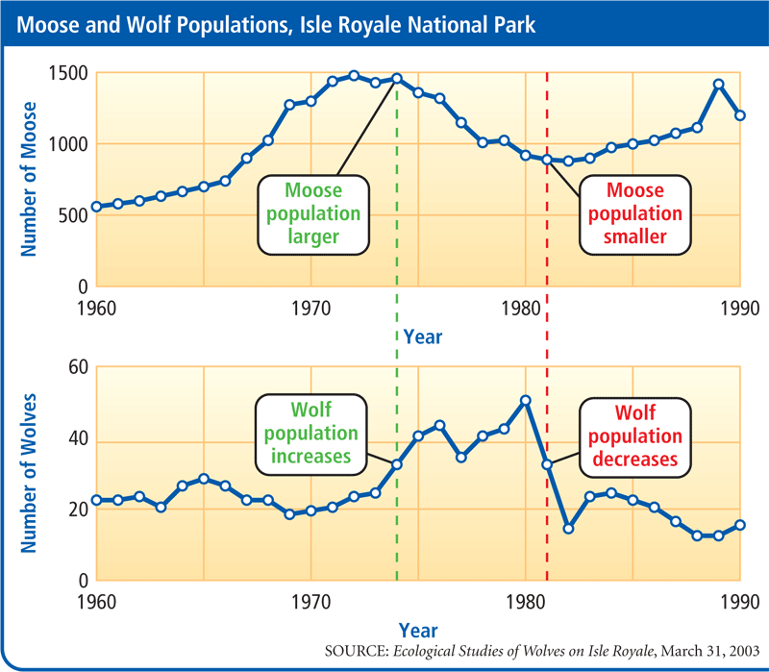
Predation
Notes:
Questions:
What variable is plotted along the x-axis? What variable is plotted along the y-axis? Year; number of wolves/moose.
How did the moose population change between 1965 and 1972? What happened to the wolf population from 1970 through 1978? The moose population increased and then decreased; the wolf population increased.
How might the change in the moose population have led to the change in the wolf population? As the moose population increased, more food was available to the wolf population and it increased.
What is one likely cause of the dip in the moose population between 1974 and 1981? The wolf population increased.
How might a disease in the wolf population one year affect the moose population the next year? Disease would cause a decrease in the wolf population, so fewer moose would be eaten and the population could increase.

Slide 9
Adaptations
Predator adaptations
  Help them catch and kill prey
    Cheetah can run very fast for a short time
    Jellyfish’s tentacles contain a poisonous substance that paralyze tiny water animals
Prey adaptations
  Help them avoid becoming prey
    Alertness and speed of an antelope help protect it from its predators
    Smelly spray of a skunk

Slide 10
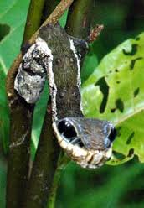
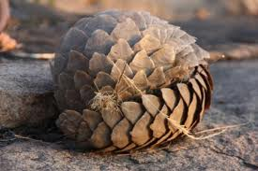
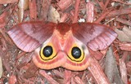
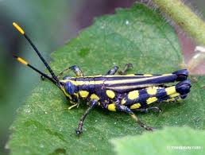
Defense Strategies
False Coloring
Mimicry
Protective Covering
Warning Coloring
Camouflage

Slide 11
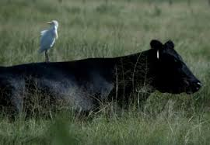
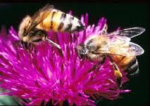
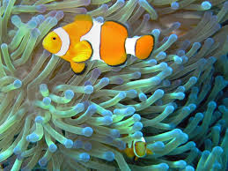
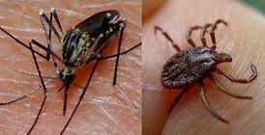
Symbiosis
Organisms within a community interact with each other in many ways. Some are predators, some are prey. Some compete with one another, some cooperate. Some species form symbiotic relationships with other species:

Slide 12
Symbiosis Notes Review
There are 3 major types of symbiotic relationships.
Mutualism: Both organisms benefit
Commensalism: one organism benefits and the other is unharmed.
  Ex: Human eyelash and the demodicids, which are tiny mites that feast on oils and dead skin. Humans provide them with a place to live.

Slide 13
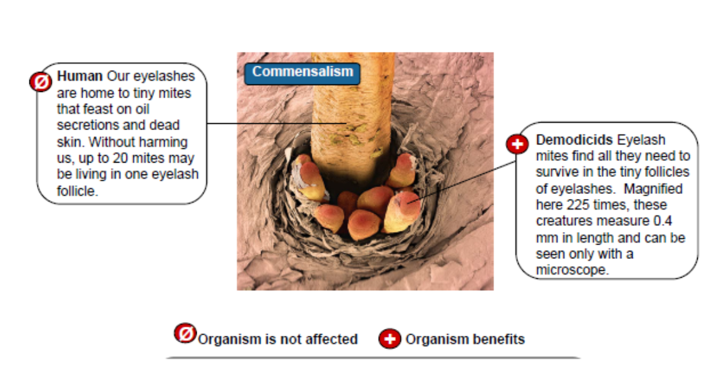

Slide 14
Parasitism: One organism benefits and the other is harmed.
  Ex: The hornworm caterpillar and the Braconid wasp. The caterpillar is the host, and as the wasp larva consume the caterpillar, the larvae are the parasite.
  Ex: The leech obtaining its nutrients from a human (host).
  Ex: The hookworm obtaining its nutrients from a human intestine (host).

Slide 15
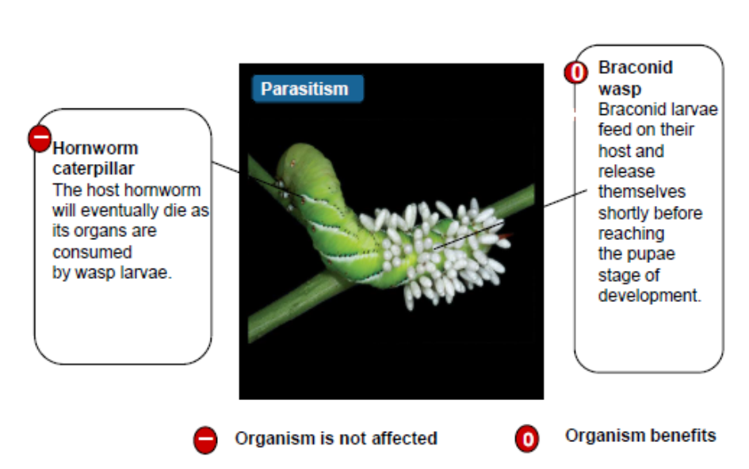
harmed

Slide 16
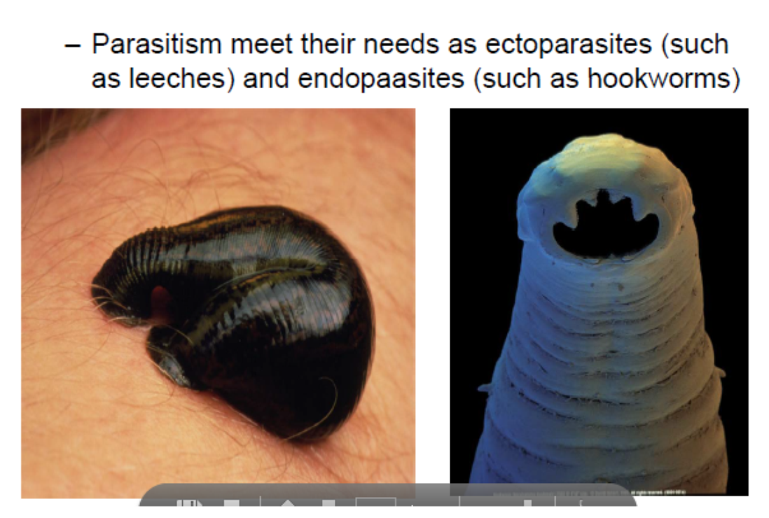

Slide 17



Symbiosis: Here’s a way to help you remember the different types
Mutualism
Both organisms benefit, or are happy in the relationship
Commensalism
one organism benefits or is happy, and the other is unaffected, neither happy
Or hurt in the relationship.
Parasitism
one organism benefits, or is happy, and the other organisms is harmed, or
is hurt in the relationship.

Slide 18
Let’s Review: Identify the type of interaction in the following examples:

