Slide 1
Energy Flow In Ecosystems
Guided Reading WB pgs. 285-287, and 291-292
http://safeshare.tv/w/qIPsABhnFU

Slide 2
True or False?
Each organism has a role in the movement of energy through its ecosystem?
True!
Although each organisms role is different, all parts of the ecosystem are necessary for the ecosystem to work!

Slide 3
Energy Roles in an Ecosystem
An organism’s energy role is determined by how it obtains energy and how it interacts with other organisms within the ecosystem.
The energy roles within an ecosystem are producer, consumer, and decomposer.

Slide 4
Producers
Organisms that make their own food by using the sun’s energy to turn water and carbon dioxide into food through a process called photosynthesis.
Producers are the sources of all the food in an ecosystem!
Examples of Producers: Plants, algae, and some bacteria

Slide 5
True or False?
Energy enters all ecosystems as sunlight?
False!
Energy enters most ecosystems as sunlight, but the rest enters the ecosystem through producers!

Slide 6
Consumer
An organism that obtains energy by feeding on other organisms.

Slide 7
Types of Consumers
Type of Consumer | Type of Food
Herbivore | Only plants
Carnivore | Only animals
Omnivore | Both plants and animals
Scavenger | Dead organisms

Slide 8
Decomposer
Organisms that breaks down waste and dead organisms.
The two major groups of decomposers are bacteria and fungi.

Slide 9
True or False?
Decomposers return raw materials to the environment.
True!

Slide 10
Food Chains and Food Webs
A series of events in which one organism eats another and obtains raw energy is called a food chain.
The many overlapping food chains in an ecosystem make up a food web.

Slide 11
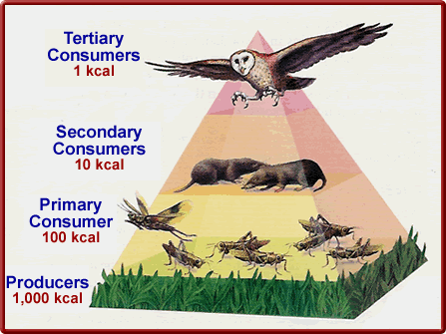
Energy Pyramids
As you move up the energy pyramid, each level has less energy available than the level below.

Slide 12
Energy Pyramids show…
The amount of energy that moves from one feeding level to another in a food web.

Slide 13
Food Webs
Producers form the base of the food web.
First-level consumers feed on the producers, and the movement of energy is from the producers to the first-level consumers.
Second-level consumers feed on the first-level consumers, and the movement of energy is from the first-level to the second-level consumers; they may be carnivores or omnivores.
Note: An organism may play more than one role in a food web.

Slide 14
Food web example:
Producer
Grass is a __________________.
A mouse is a ____________________ consumer.
A kestrel is a ____________________ consumer.
If the kestrel died, and a buzzard was eating the kestrel, then the buzzard would be a _____________________.
Primary/First Level
Secondary/Second Level
Tertiary/Third Level

Slide 15
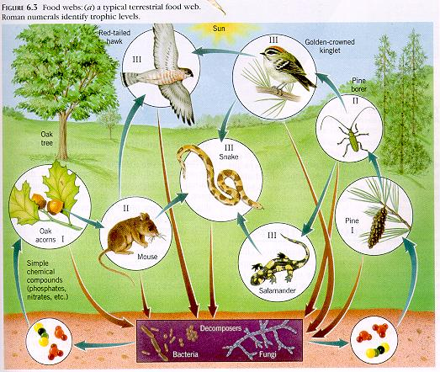
True or False?
Most food webs only have three or four feeding levels.
True!

Slide 16
Why are there usually few organisms at the top of a food web?
…because there is a limited amount of energy available at that level of a food web.

Slide 17
Succession and Changes in Ecosystems

Slide 18
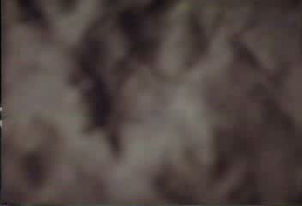
Stages of Succession

Slide 19
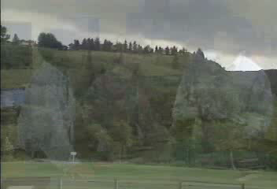
Ecological Changes and Diversity

Slide 20
Video Questions
What are the two different types of succession?
How have organisms become dependent upon frequent changes in their ecological environments?

Slide 21
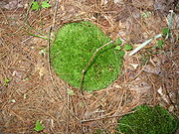
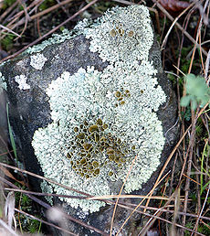
Primary Succession
Series of changes that occur in an area where no soil or organisms exist
  New land formed from a volcano
  Area uncovered by snow or ice
In a barren area, a new community is established with pioneer species (first species in the area), like mosses that do well with little or no soil.
  animation

Slide 22
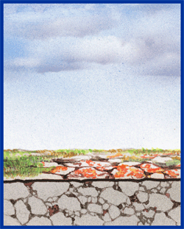
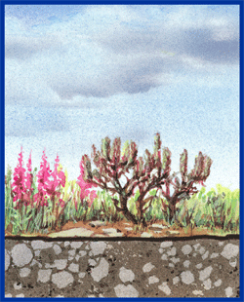
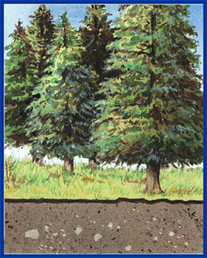
Primary Succession

Slide 23
Secondary Succession
Secondary Succession – a series of changes that occur in an area where the ecosystem has been disturbed.
When a disturbance (fire, flood, tornados, or hurricanes) damages a community but soil remains, the community gets reestablished from seeds and roots left behind. Grasses grow, then small shrubs, and eventually trees.

Slide 24
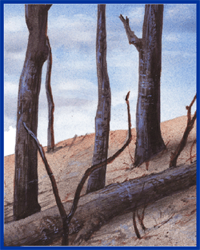
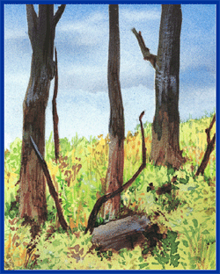
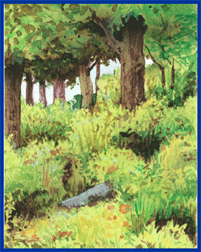
Secondary Succession

Slide 25
Let’s Review… Factors in Succession
Factors in Succession | Primary (1°) Succession | Secondary (2°) Succession
Possible Cause(s) | Volcanic _______________ _____________ retreating | Fire ______________ Tornados ______________
Type of Area | Barren: _______ soil or ______________ exist | An area where ___________ and organisms existed but have been __________________.
Existing Ecosystem?
Eruption
Flood
Glacier
Hurricane
soil
No
Organisms
Disturbed
No
Yes

Slide 26
Results of Changes to Ecosystems
Threatened Species – species that could become endangered in the near future
Endangered species – species in danger of becoming extinct in the near future
Extinction – the disappearance of all members of a species from Earth

