Slide 1
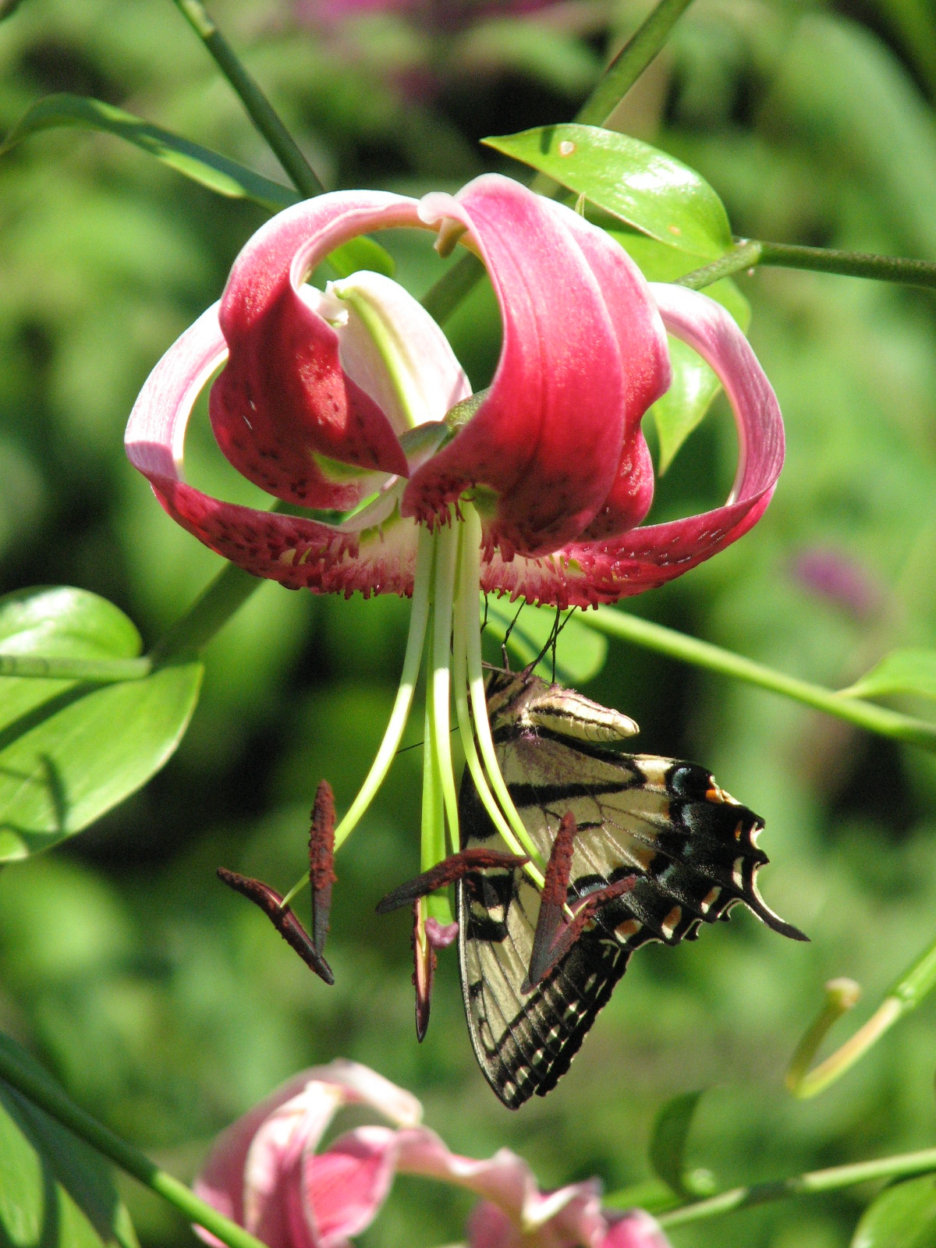
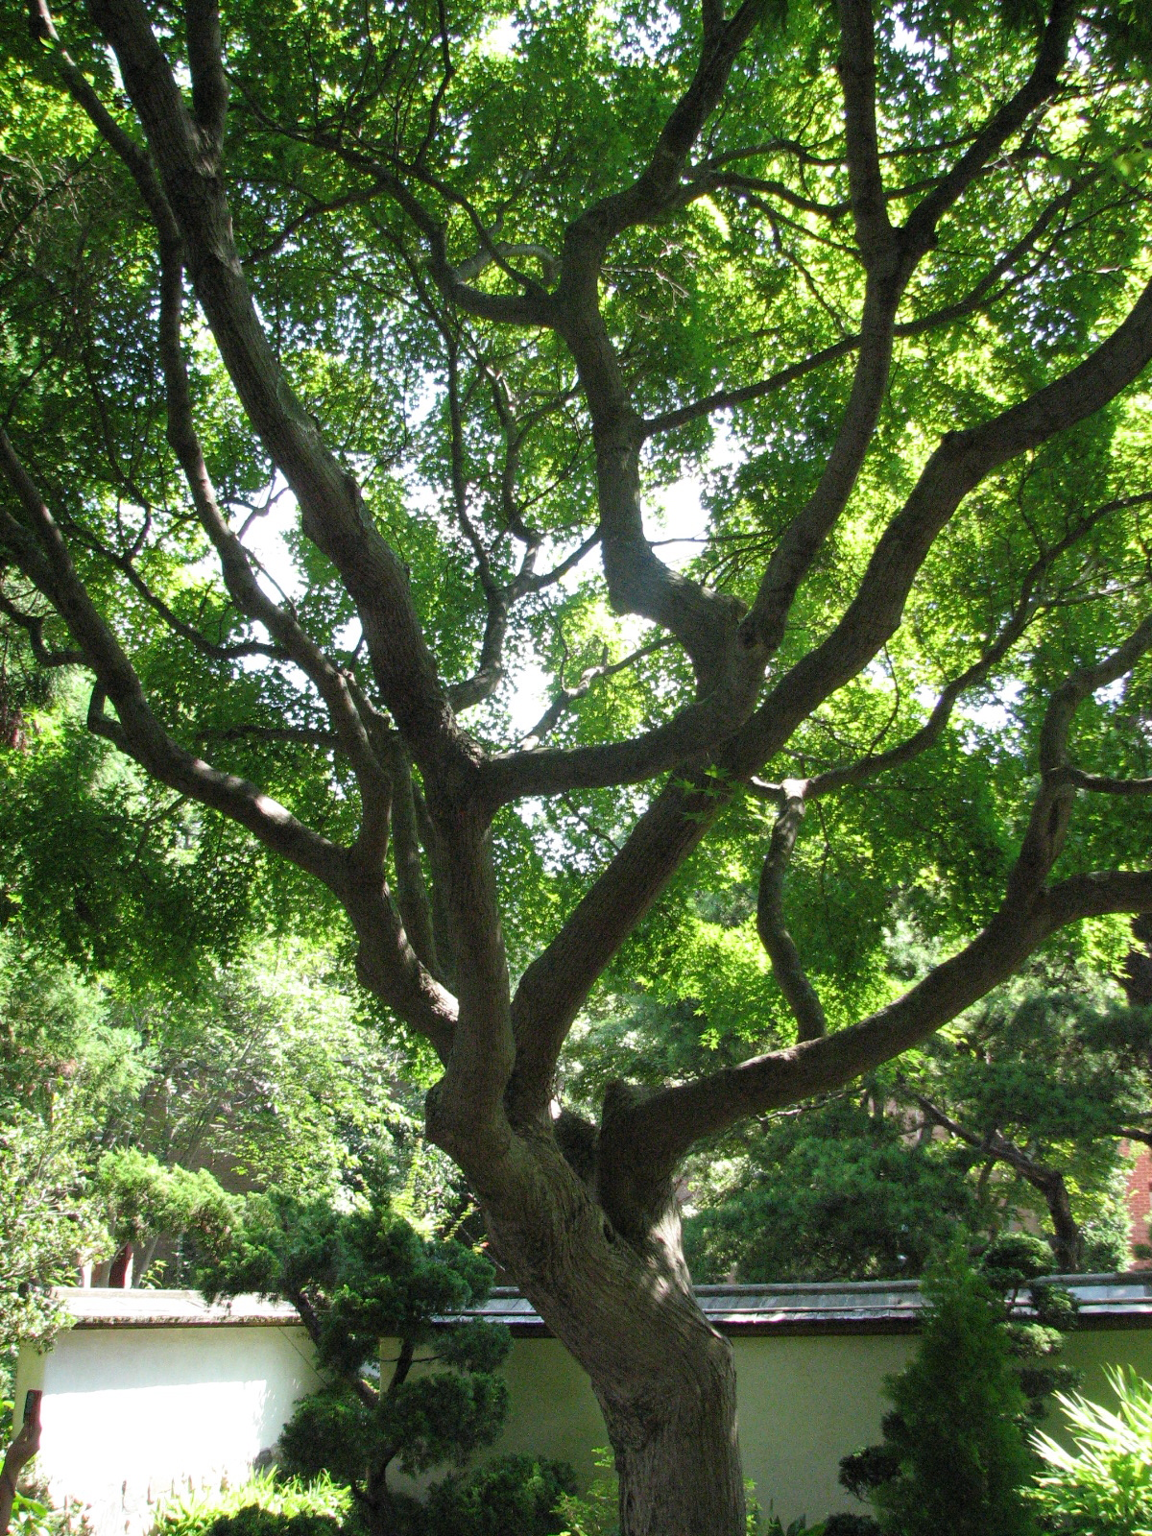
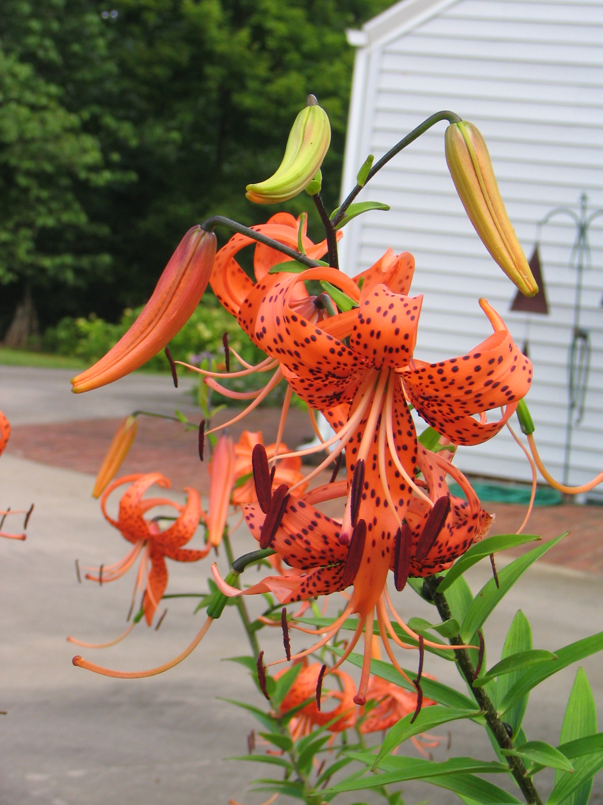
Plant Kingdom
Domain Eukarya

Slide 2
Imagine…
What would a day be like without plants?
Why would it matter if we did not have any plants?
What would you eat?

Slide 3
What is a Plant?
Characteristics of plants
  Autotrophs which means they can make their own food
  Eukaryotes (multicellular and have a true nucleus)
  Contain cell walls, chloroplasts, and a large storage vacuole
They are similar to a sun-powered, food-making factory

Slide 4
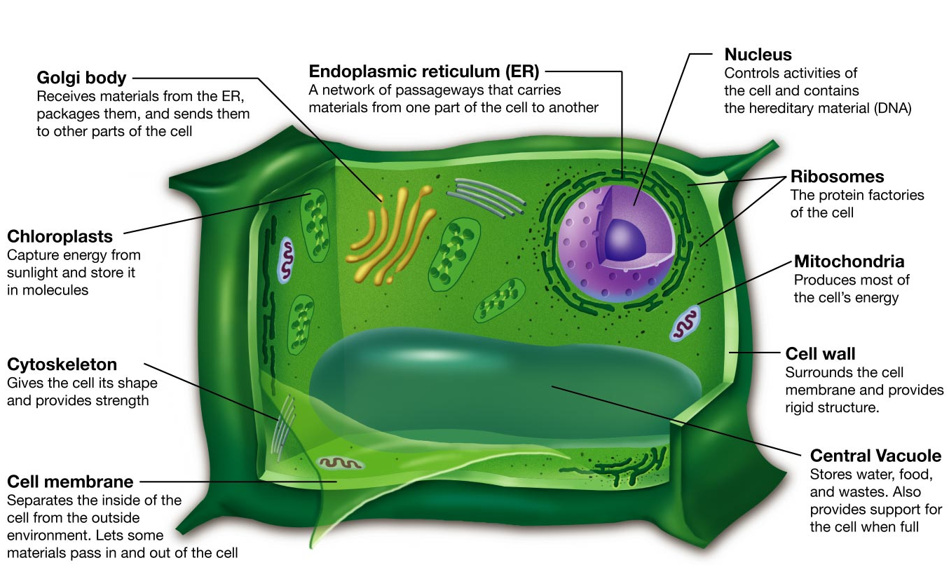
Structure of a plant cell

Slide 5
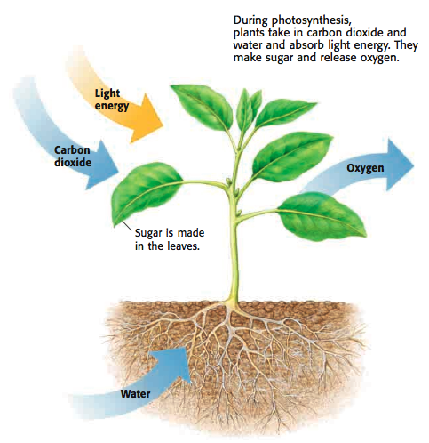

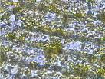
How they make their food
Photosynthesis
  Plants cells contain chlorophyll that capture energy from the sunlight making the cell green

Slide 6
Plant Cellular Organization
Remember that similar cells make up tissues.
Plant cells make up tissues, or leaves
Cellular organization
Cell → Tissue → Organ → Organ System → Organism

Slide 7
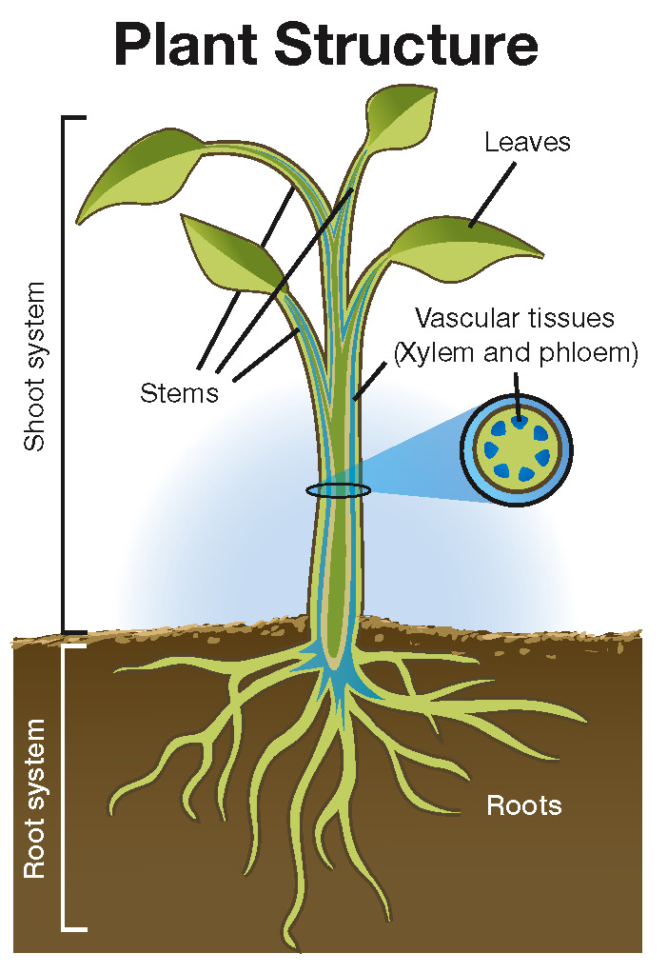
Adaptations for living on land
Obtain water and nutrients from their surroundings
Retain water
Transport materials within their bodies
Support their bodies
Reproduce

Slide 8
Obtaining water and nutrients
Algae absorbs water from their surroundings (algae lives in water)
Plants must remove it from their surroundings in the soil by roots.

Slide 9
Retaining water
Retain water because of the adaptation of the cuticle to help reduce the amount of water loss from plant cells into the atmosphere.

Slide 10
Transporting Materials
Plants need to transport food from the top of the plant to the bottom, and water from the bottom to the top of the plant.
Vascular tissue is a system of tube-like structures inside a plant through which water, minerals, and food move.
  Xylem – transports water and minerals
  Phloem – transports food in the form of sugars (hint: phloem and food sound the same)

Slide 11
Support
Rigid cell walls and vascular tissue strengthen and support the large bodies of these plants.

Slide 12
Sexual Reproduction
All plants undergo sexual reproduction that involves fertilization (the joining of sperm and egg cells)
The fertilized egg is called a zygote
Fertilization can occur in water or on land for plants

Slide 13

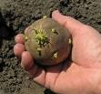
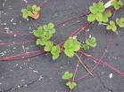
Asexual Reproduction
Occurs using plantlets, tubers, and runners
  Plantlets are tiny plants growing along the edge of a leaf
  Tubers are underground stems
  Runners are above-ground stems that grow new plants

Slide 14
Classification of plants
Nonvascular plants
  Plants that lack a true system of transportation for food, water, and minerals
  They obtain needed materials by absorbing it from their surroundings
  Short & low-growing to the ground
  Ex: mosses, liverworts, and hornworts

Slide 15
Classification of plants
Vascular plants
  Have a true system for transporting needed materials
  Better adapted to life in dry environments
  Vascular tissue provides strength, stability, and support to the plant allowing it to grow tall

Slide 16
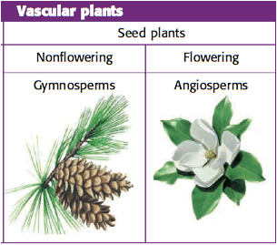
Vascular Plants
Seedless vascular
  Reproduce by releasing spores
  Can grow tall because of vascular tissue
Seeded vascular
  Reproduce by joining of sperm (pollen) and seed (egg)
  Complex life cycle: sporophyte and gametophyte stages
  Have roots, stems, and leaves
  Have vascular tissue

Slide 17
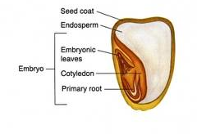
Seed Structure
Embryo – the young plant that develops from the zygote, or fertilized egg
Stored food – is used by the embryo in the seed until it can make its own food by photosynthesis
Seed coat – similar to a “skin” that protects the embryo and food from drying out. In many plants the seeds are surrounded by a structure called a fruit
                Germination is when the embryo begins to grow again and pushes out of the seed
Stored Food

Slide 18
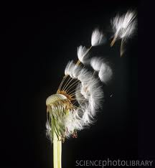
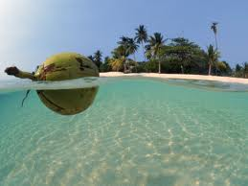
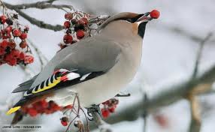
Seed dispersal
Means of dispersal
  Wind
    Ex: dandelion fruits with “parachutes”
  Water
    Ex: floating coconut palm fruit
  Other living things
      Ex: barblike fruits

Slide 19
Roots
Anchor a plant in the ground, absorb water and minerals from the soil, and sometimes store food

Slide 20
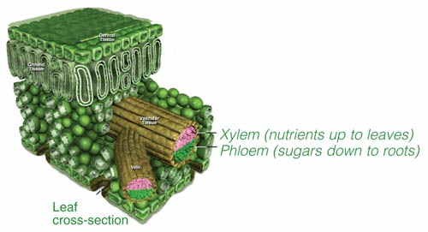
Stems
Carries substances between the plant’s roots and leaves
Provides support to the plant
Some store food

Slide 21
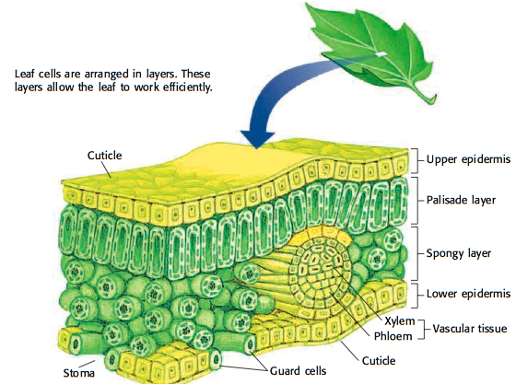
Leaves
Capture the sun’s energy and carry out photosynthesis

Slide 22
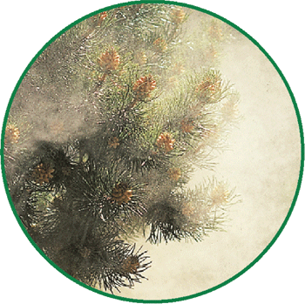
Gymnosperms
A seed plant that produces naked seeds because the seeds are NOT enclosed in a fruit
Reproduce with pollen and seeds
Have needle-like or scale-like leaves

Slide 23
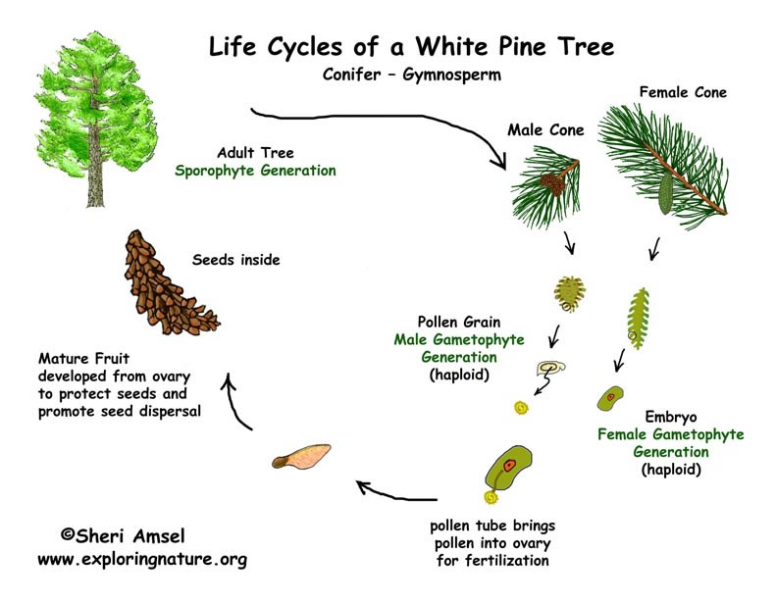
Life Cycle of a Gymnosperm

Slide 24
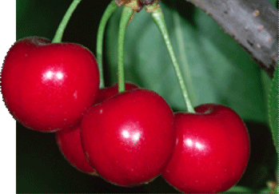
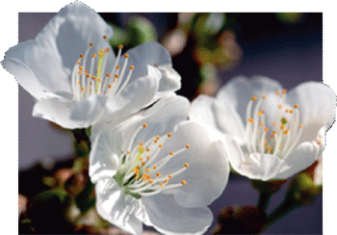
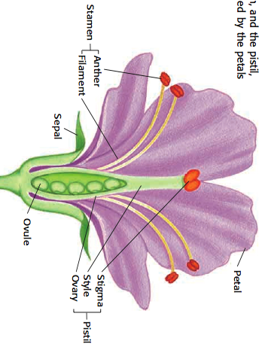
Angiosperm
Flowering plants
They produce flowers and seeds
enclosed by a protective fruit

Slide 25
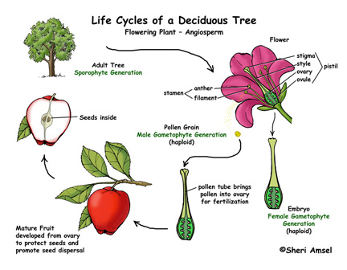
Life Cycle of an Angiosperm

Slide 26
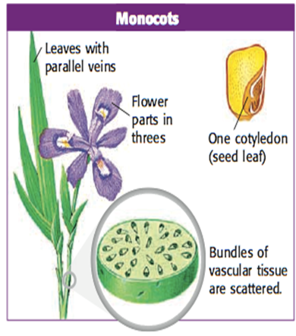
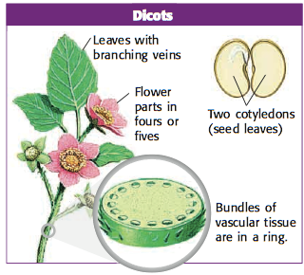
Types of Angiosperms
Monocots
  Mono means “one”
Dicots
  Di means “two”

