Slide 1
Human Body Systems

Slide 2
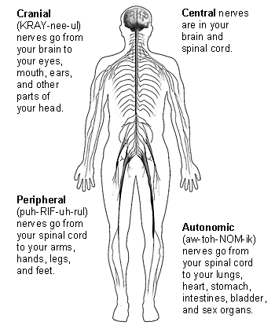
Nervous System
Functions
  Controls all body’s functions
  Senses and recognizes information from inside and outside of the body

Slide 3
Nervous System
Main Parts
  Brain
  Nerves
  Spinal cord

Slide 4
What it helps you do…
Move
Sense things from the environment
And much more!

Slide 5
Interactions with other systems:
All systems – helps keep the systems functioning

Slide 6
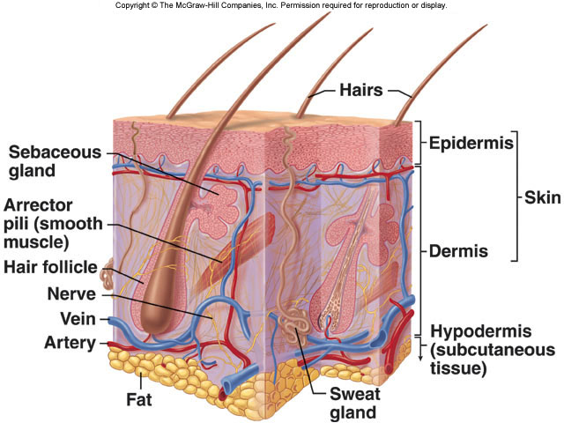
Integumentary (Skin) System
Function
  1st line of defense against disease
  Helps maintain body temperature
  Keeps fluids inside
Main Parts
  Skin
  Sweat glands
  Hair
  nails

Slide 7
What it helps you do…
Helps you maintain fluids (don’t dehydrate)
Helps you know your environment by feeling things around you
Protect organs
Remove waste

Slide 8
Interactions with other systems…
Works with the excretory and the immune system to help remove cellular waste and protect us from disease.

Slide 9
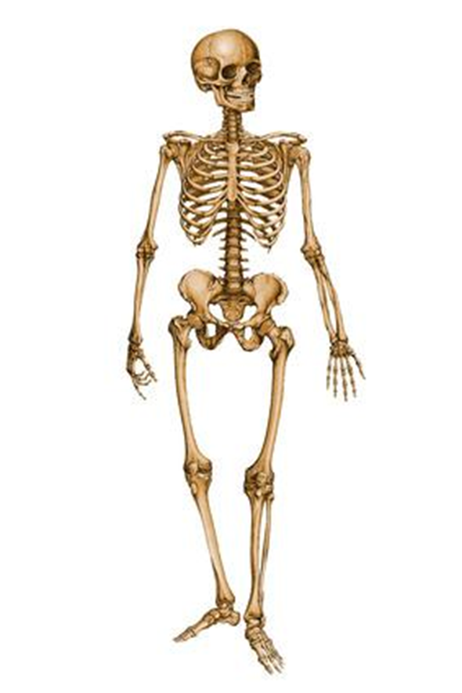
Skeletal System
Support and protect body parts.
Helps maintain homeostasis
Makes red blood cells (red bone marrow)

Slide 10

Skeletal System: Parts & Function
Main parts:
  Bones
  Cartilage
  Connective Tissue
Function:
  Helps support your body parts
  Helps support your body during movement
  Helps protect your major organs:
    Skull protects the brain
    Sternum and ribs protects the heart and lungs
    Vertebra protect the spinal cord

Slide 11
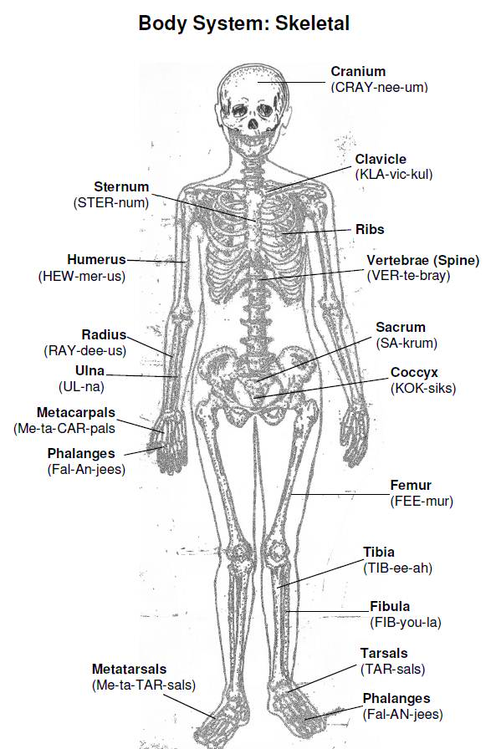
Skeletal System Interactions
Works with the muscular system to help you move.

Slide 12
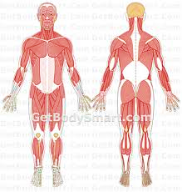
Muscular System
Function
  Helps you move.
  Moves materials through the body
Main parts
  Muscles
  Tendons
  Ligaments
  Muscles in organs

Slide 13
Types of Movement
Voluntary - under conscious control
Involuntary- not under conscious control

Slide 14
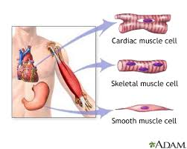
Three types of muscles found in the body:
Cardiac (Involuntary)– found in the __Heart_
_Skeletal_(Voluntary)_ - attaches to the bones
Smooth (Involuntary) – lines _organs_ and vessels.

Slide 15
Muscular Systems help you…
Helps you move
Helps you move materials through the body
Maintain homeostasis
Skeletal muscles work in pairs: one contracts and the other returns to its original length.

Slide 16
Interactions with other systems
Works with the skeletal system to help you move by your muscles pulling on your bones.
Works with the nervous system and controls the types of movements: voluntary (under your control – ex: talking) and involuntary (NOT under your control – ex: heartbeat)

Slide 17
Circulatory (Cardiovascular) System
Function
  Carries blood and oxygen to the cells of the body
  Carries waste away from the cells, such as carbon dioxide.
Main Parts
  Heart
  Blood (made up of plasma, red blood cells, white blood cells & platelets)
  Veins
  Arteries

Slide 18
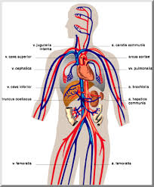
What it helps you do…
Arteries help carry oxygenated blood away from the heart
Veins carry un-oxygenated blood toward the heart
Capillaries are tiny blood vessels that connect arteries and veins. Gas exchange takes place here.

Slide 19
Interactions with other systems:
Works with the respiratory system to help you transport oxygen and carbon dioxide.
Works with the excretory to help remove waste from the body.
Works with the digestive system to transport nutrients.
Works with the muscular system to help circulate nutrients.

Slide 20
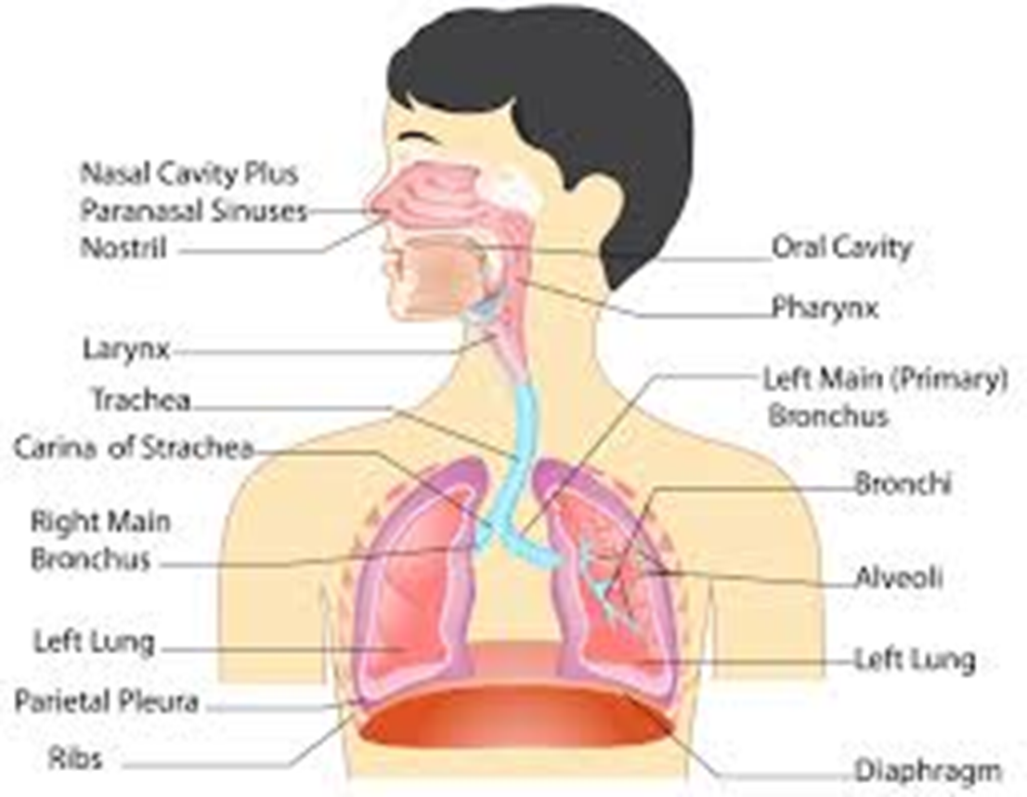
Respiratory System
Function
  Puts oxygen into the body & removes Carbon dioxide
Main parts
  Lungs
  Nasal passages
  Throat
  Nose

Slide 21

What it helps you do…
Breathe
Sustain life

Slide 22
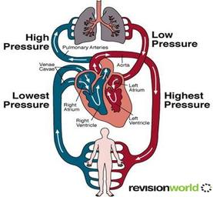

Slide 23
Interactions with other systems:
Circulatory – transports vital materials to the cells

Slide 24
Digestive System
Function
  Takes food & breaks it down into nutrients the body needs

Slide 25
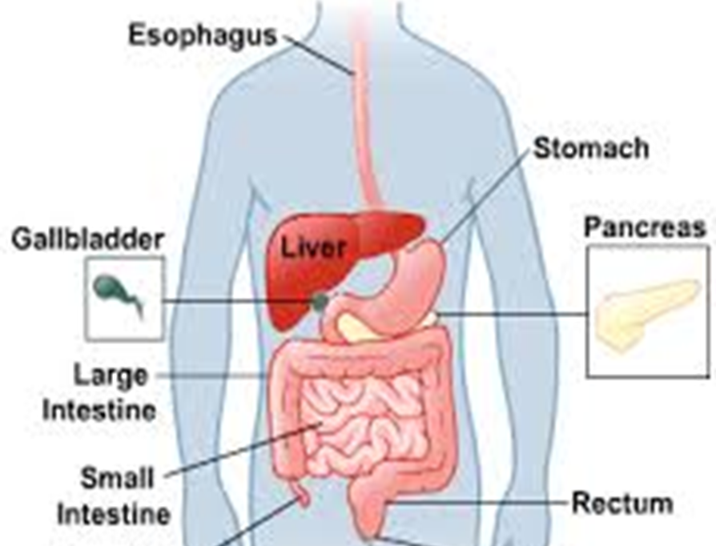
Digestive System
Main parts:
  Mouth
  Esophagus
  Stomach
  Liver
  Pancreas
  Small intestines
  Large intestines
  Rectum
Path of Food
Mouth
Esophagus
Stomach
Small Intestines
Large Intestine
Rectum

Slide 26

What it helps you do…
  It provides nutrients to your body’s cells

Slide 27
Interactions with other systems:
Circulatory – helps transport nutrients to the body’s cells

Slide 28
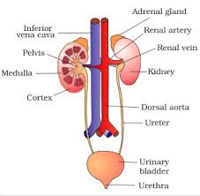
Excretory System
Functions
  Removes wastes from blood
  Removes harmful substances from blood
  Regulates body fluids

Slide 29
Excretory System
Main Parts
  Kidneys
  Urinary bladder

Slide 30
What it helps you do…
Maintain homeostasis
Removes waste

Slide 31
What system does it interact with:
Circulatory – to help remove waste from the blood

Slide 32
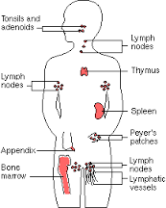
Immune System
Functions
  Fights off disease

Slide 33
Immune System
Main Parts
  Lymph nodes
  White blood cells
  Skin

Slide 34
What it helps you do…
Maintain a healthy body

Slide 35
Interactions with other systems:
Circulatory, integumentary, lymphatic – helps fight diseases

Slide 36
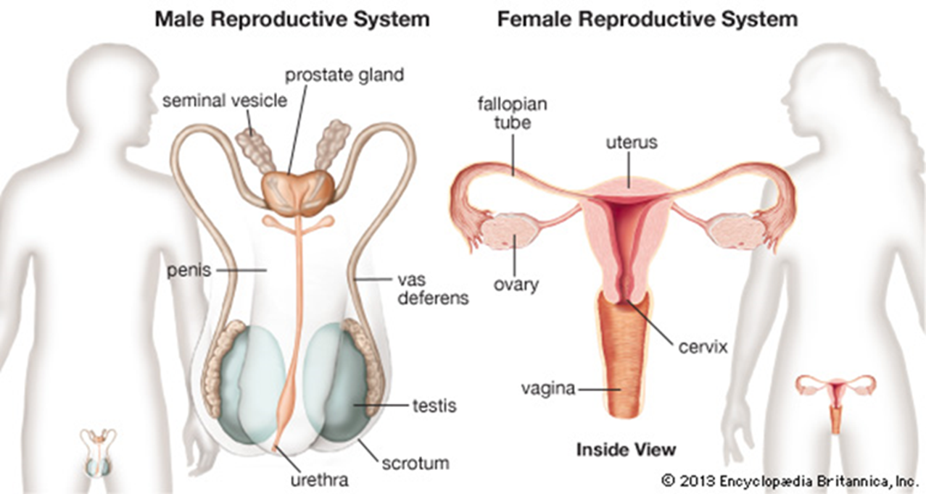
Reproductive System
Functions
  Produce offspring
  Males- make sperm
  Females- make eggs

Slide 37

Reproductive System
Main Parts
  Male
    Penis
    Testes
  Female
    Uterus
    Ovary
    Vagina

Slide 38
What it helps you do…
Continuation of the species

