Slide 2
Box and Whiskers

Slide 3
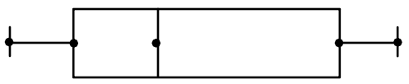
A box-and-whiskers plot is a good way to show the spread (or variation) of a set of data visually.

Slide 4
A box-and-whiskers plot shows both the median and extremes of a data set.
Median: the middle term, or the average of the two middle terms, when the terms are arranged from least to greatest.
Lower
Extreme
Upper
Extreme
Extremes: the minimum and maximum values

Slide 5
The extreme values are used to find the range of the set of data by finding the difference between the lower extreme and the upper extreme.
Upper Extreme – Lower Extreme = RANGE
Lower
Extreme
Upper
Extreme
EXTREMES

Slide 6
Quartiles: the medians of the lower and upper halves of the data.
Lower
Quartile
Upper
Quartile
Upper Quartile – Lower Quartile= INTERQUARTILE
RANGE

Slide 7
Box-and-whiskers plots are uniform in the use of the box. Therefore, no matter the size of each section, the data is evenly divided in quarters (25%).
25%

Slide 8
Box-and-whiskers plots are uniformed in the use of the box. Therefore, no matter the size of each section, the data is evenly divided in quarters (25%).
25%
50%

Slide 9
Box-and-whiskers plots are uniformed in the use of the box. Therefore, no matter the size of each section, the data is evenly divided in quarters (25%).
25%
75%

Slide 10
Therefore the entire box-and-whiskers plot is equal to
100% of the data.

Slide 11
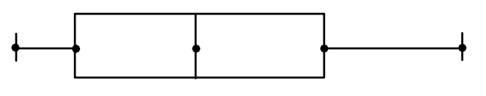

No matter how the diagram appears to be equally or unequally divided, each section is always 25%
25%
25%

Slide 12
No matter how the diagram appears to be equally or unequally divided, each section is always 25%
25%
25%

Slide 13
No matter how the diagram appears to be equally or unequally divided, each section is always 25%
25%
25%

Slide 14
No matter how the diagram appears to be equally or unequally divided, each section is always 25%
25%
25%

Slide 15
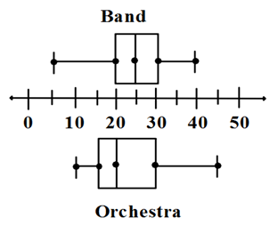
Mr. Patterson surveyed members of the school band and members of the school orchestra to find out how many CDs each owned. His data is shown in the box-and-whiskers plot on the left.
a) Which group has a higher percent of members with 20-30 CDs?
Which group has the higher range?
c) Which group has the higher interquartile range?

Slide 16
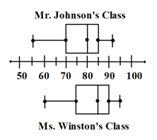
The double box-and-whiskers plot below shows the test scores for two classes.
a) Which class had the lowest test grade and what was the score?
b) Which class had the higher median and what was it?
If 80 is a passing grade, which class had the higher percent of students who passed? Explain your answer.

Slide 17
