Slide 1
Genetic Engineering and Selective Breeding
Everything you need to know!

Slide 2
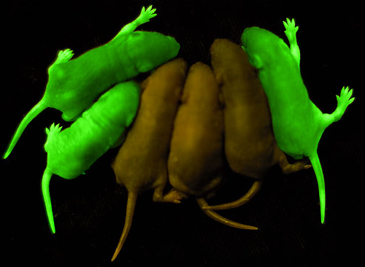
Scientists used a bioluminescent gene from a jellyfish to create “glowing” green mice!

Slide 3

Know
  Selective Breeding involves choosing two organisms of the same species and mating them with the hope of getting the best qualities of each parent to show up in the offspring.
  Genetic Engineering involves identifying certain genes and moving them from one organism to another – even to a different species or removing the gene entirely!
  Both activities are controversial.
Understand
  Genetic engineering is an ethical issue that needs to be regulated by the personal, cultural, and global conscience.
Do
  Discuss the advantages and disadvantages of both processes.
  Analyze scenarios and determine if the situation is an example of genetic engineering or selective breeding.

Slide 4
Genetic Engineering: Details
Taking DNA from one organism and inserting it into another organism’s DNA sequence to ensure the organism will have a specific trait.
It produces an organism that has a new trait it would most likely not have developed on its own

Slide 5

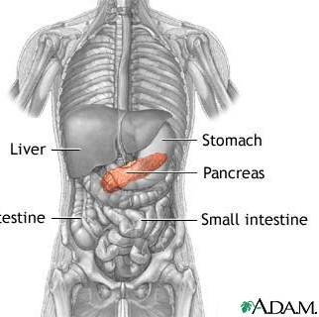
Genetic Engineering Example A:
  Diabetic = a person whose pancreas cannot create the important hormone insulin.
  Take the gene for making insulin from a healthy donor’s DNA
  Add that gene to the DNA of pancreas cells from a diabetic
  Let mitosis happen for a while (in a “test tube”) so you get LOTS of pancreas cells with the good gene.
  Surgically implant the good cells back into the diabetic
Give the insulin gene to diabetics.

Slide 6
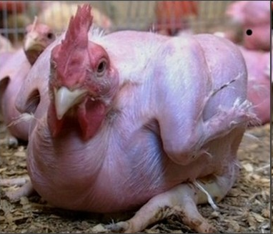
Genetic Engineering Example B:
Make chickens with no feathers.
  Scientists engineered chickens to be featherless by REMOVING the gene in chicken DNA that causes them to grow feathers

Slide 7
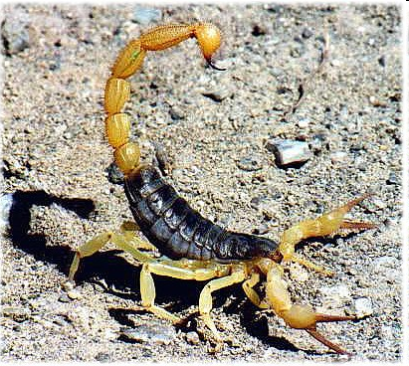
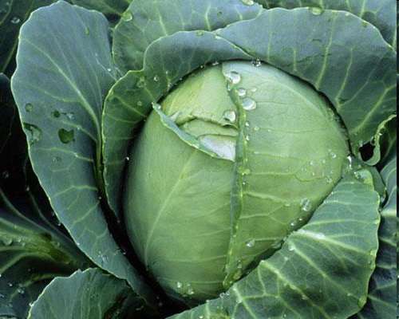
Genetic Engineering Example C:
Cabbage plant +
scorpion venom =
bug-proof veggies
Scientists added a gene for producing scorpion venom to cabbage plants to kill pesky caterpillars that eat crops!

Slide 8

Genetic Engineering Example D:
Give tomatoes the ability to make anti-freeze.
Placing the “anti-freeze gene” from a fish in tomatoes so the tomatoes can still grow in cold weather.

Slide 9

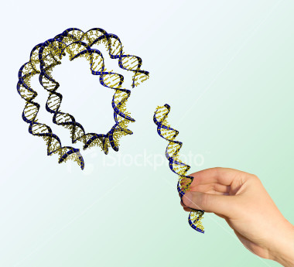
Remember!
Genetic engineering involves the manipulation of genes!
Gene: a segment of DNA

Slide 10
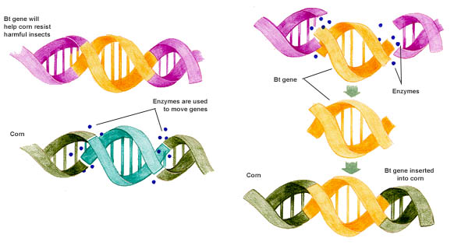
Genetic Engineering of insect- resistant corn
#2 Use enzymes to cut
desired gene loose
#1 Identify desired gene
#3 Remove undesired gene
#4 Insert desired gene into corn

Slide 11
Advantages of Genetic Engineering
Will get improved organisms
Can create organisms with traits not previously thought possible
Can remove “bad” genes
Reduces the chance of getting “undesirable” organisms

Slide 12
Disadvantages of Genetic Engineering
Co$tly
Must be performed in a lab with special equipment
Ethical issues
Long term negative affects
Negative environmental impacts
Super-C apples (allergies!)
Superweeds!
Natural insecticides get into soil
Unknowns?????

Slide 13
Genetic engineering has few limits - except our imagination, and our moral or ethical code.

Slide 14
Selective Breeding: Details
Selective breeding involves mating organisms with different “desirable” traits to get offspring with the desirable traits of both parents
Selective breeding is used mostly for dogs, cats, other pets, cattle, and crops.

Slide 15
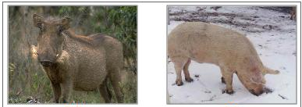
Selective Breeding Example A
Tough wild boars mated with friendly meaty pigs give you robust & meaty pigs for your farm.
Tough Boar + meaty pig = Superpig

Slide 16
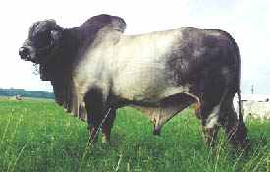
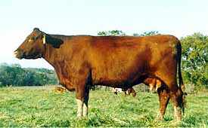
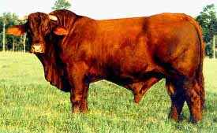
Selective Breeding Example B
Santa Gertrudis cattle
(cross of 2 breeds)
RESULT = good beef and resistant to heat!
Brahman cattle:
Good resistance to heat, but poor beef.
English shorthorn cattle: Good beef but poor heat resistance.
hot weather cow + beefy cow = supercow

Slide 17
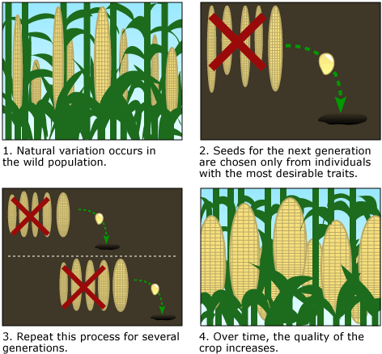
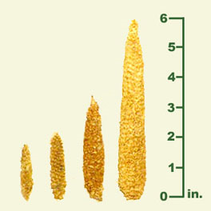
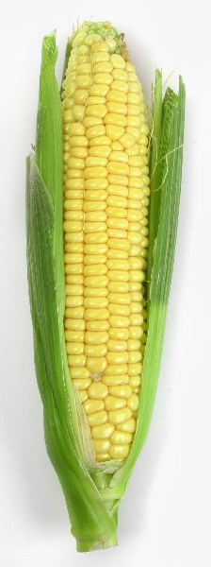
Selective Breeding: Example C
Ancient corn from Peru
(~4000 yrs old)
Choosing only the best corn plants for seeds results in better crops over a long time.

Slide 18
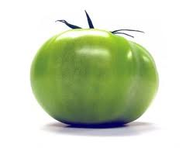


Selective Breeding Example D
X
=
little red tomato + big green = BIG RED TOMATO

Slide 19
Remember!
Selective breeding crosses (mates) organisms with desirable traits to produce offspring that have the traits from both parents!

Slide 20
Advantages of Selective Breeding
Might get improved organisms
Don’t need any special tools or lab
Can be performed easily by farmers & breeders

Slide 21
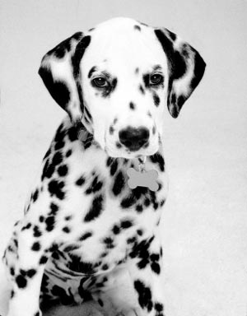


Disadvantages of Selective Breeding
Undesirable traits from both parents may appear in the offspring
Disease can accumulate in the population
  Remember the deaf dalmatians, boxers with heart disease, labs with hip problems, etc.?

Slide 22
REVIEW
Genetic Engineering
  Relatively new process performed within labs
  Manipulates or alters the genetic makeup of organisms
  Results in organisms with new traits
Selective Breeding
  Process has been around for thousands of years
  Combines the best traits of two organisms
  Results in organisms that have the desirable traits of their parents

Slide 23
Scientific Example or Fact | GE or SB?
Farmers removed the gene in chicken DNA to make them grow featherless.
This process attempts to combines the best traits of 2 parents.
Dog breeders wanted to breed a dog that would run fast but also be born with long, shiny fur, looking for the best characteristics from the parents.
Scientists take out a gene for bioluminescence from a jellyfish and put that gene into a mouse’s DNA to see if it will have a glowing effect.
This process is relatively new and done in science labs.
This process manipulates or alters the genes/DNA of organisms.
This results in organisms with new traits.
English Shorthorn cattle, which produced good beef were bred with Brahman cattle from India to make the offspring both tasty and resistant to heat and humidity.
This process has been around for thousands of years.
Scientists removed a gene for fat in bison to make them leaner.
This results in organisms with desirable traits from both parents
GE
SB
SB
GE
GE
BOTH
BOTH
SB
SB
GE
SB

Slide 24
