Slide 1
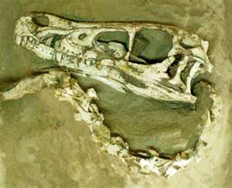
The fossil Record

Slide 2
What we will learn about Fossils?
We will learn how fossils form?
What types of fossils exist?
How do scientists determine the age of fossils?
What do fossils reveal to scientists?

Slide 3
What is a fossil?
Fossils are the remains or imprints left behind from plants and animals.
They can be whole parts of an animal, or just pieces of their remains.
They can also include evidence of movement of animals, such as footprints or imprints.

Slide 4
How do fossils form?
In order for a fossil to form, an animal or plant must be trapped into a material.
In many instances, fossils are found in sediment.
Layers of sediment will envelop the remains;
This can continue for thousands of years.

Slide 5
How do fossils form?
The actual remains that are found aren't the animal or plant at all. Instead, the remains begin to decay within the sediment.
Minerals then replace the space that was once the remains.
The mineral hardens and makes an impression of the animal or plant.
What is left is what is known as a fossil.

Slide 6
What parts of an organisms remains will form a fossil?
The soft parts of an animal or plant decay more quickly than its hard parts, therefore teeth and bones are more likely to be preserved than skin, tissues, and organs.

Slide 7
Types of fossils:
Mold fossils
Cast fossils
Petrified fossils

Slide 8
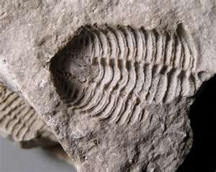
Mold Fossil
A mold is a type of fossil formed when a shell or other hard part of an organism dissolves leaving an empty space or imprint of that organism.
How is a mold formed:
A shell can make an imprint in sand.
After the sand begins to harden, the shell might dissolve, leaving a space shaped like the shell in the rock. The space in the rock is a mold fossil.
When the sediments harden into
rock, they form a fossil that has
the same shape as the shell that
made the mold.

Slide 9
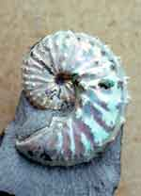
Cast Fossil
When the space of the mold becomes filled in with minerals it will form a cast.
http://www.classzone.com/books/earth_science/terc/content/visualizations/es2901/es2901page01.cfm

Slide 10
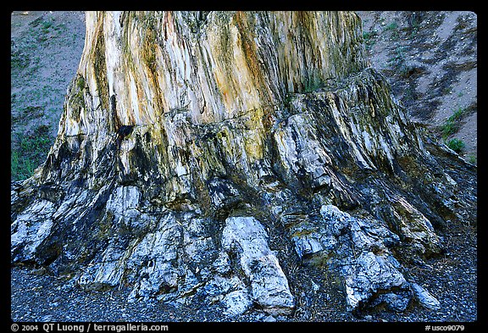
Petrified fossils
Is a fossil formed when the minerals slowly replace all or part of an organism.

Slide 11
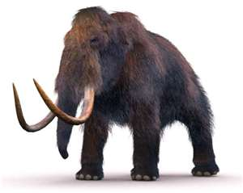
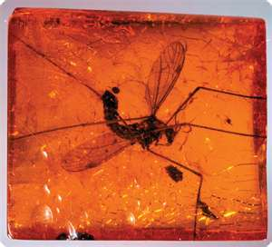
Organisms are preserved in substances other than sediments:
Organisms such as the Mammoth have been perfectly preserved in ice.
Insects like mosquito’s have been preserved in sap of trees, called amber.

Slide 12
Fossil Record
•Record of all of the millions of fossils found
Scientists look for similarities between living organisms and fossils.

Slide 13
Fossil Record
• It provides evidence about the history of life on Earth and how different groups of organisms, including species, have changed over time.

Slide 14
To understand how living things have changed through time, scientists need to be able to determine the age of the fossil. Scientists can determine fossils age in two ways:
Relative dating
2. Radioactive dating
The fossil record provides information about species that are __Extinct__ (or have died out).

Slide 15
Relative dating:
Scientists look at where the rock is located. The
older layers are deeper than the layers above.
This method only provides an estimated age of a
fossil.
The Exact age cannot be determined; you can
only say that something appears earlier or later
than something else.

Slide 16
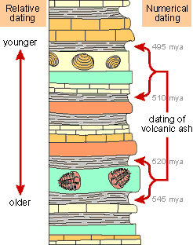
Relative dating - It determines which of the two fossils is older.
Youngest fossil
Oldest Fossil

Slide 17
Radioactive dating:
Scientists determine the actual age of a sample based in the amount of remaining radioactive isotopes it contains.
Calculations are based on half-life – the time it takes
for ½ of the radioactive sample to decay
Two vocabulary terms associated with radioactive dating are:
Half-life – the time it takes for half of the atoms in a radioactive element to decay.
Radioactive element – An unstable element that breaks down into a different element. These elements are used in nuclear fission to produce energy that we use in electricity.

Slide 18
Radioactive dating example:
Naturally-occurring radioactive materials break down into other materials at known rates. This is known as radioactive decay.
Radioactive parent elements decay to stable daughter elements.
Radioactivity decay to measures the age of rocks and minerals.

Slide 19
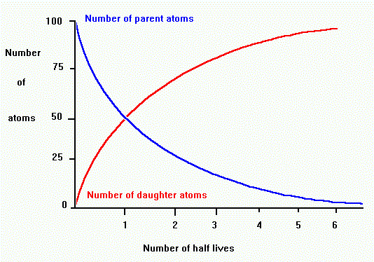
Radioactive decay occurs at a constant exponential or geometric rate. The rate of decay is proportional to the number of parent atoms present.

Slide 20
What the graph tells us:
The proportion of parent to daughter tells us the number of half-lives, which we can use to find the age in years.
For example, if there are equal amounts of parent and daughter, then one half-life has passed.

