Slide 1
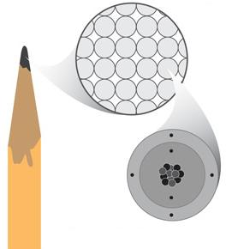
Activating Strategy
Let’s See What you Know…
In our previous lesson we learned that the pencil is
made of ______?
matter
If you look closely at the tip of a sharpened pencil, you will see that it is made of a specific type of matter called graphite.
The image shows a close up picture of the graphite. The graphite is made up of even smaller particles called _____.
These particles contain even smaller particles called _____________________
atoms
protons, neutrons, electrons
Notes:
Instructional Approach(s): The teacher should use the slide to activate students prior knowledge. The teacher can pose the questions to the class, individual students, or let the students pair up to answer the questions. The teacher should not spend more than 5 minutes on the slide. When ready, the teacher can click the mouse to show the answers.

Slide 2

How are atoms and molecules related?
Standard: S8P1a. Distinguish between atoms and molecules
Adapted from www.middleschoolscience.com 2008
Notes:
Instructional Approach(s): The teacher should introduce the essential question and the standard that aligns to the essential question

Slide 3
Use the Atoms and Molecules Notes sheet when instructed
Notes:
Instructional Approach(s): The teacher should give each student the Atoms and Molecules Notes sheet to use to record important information throughout the lesson

Slide 4
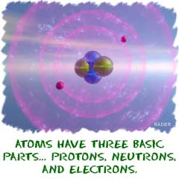
Atoms
Image are from http://www.chem4kids.com
A small particle that
makes up Matter
Consists of Protons (+),
Electrons (-), and Neutrons (N)
*Write information on the Notes Sheet
Notes:
Instructional Approach(s): The teacher should present the information on the slide while the students record the important information on their notes

Slide 5
How big is an atom?
www.scaleofuniverse.com
Notes:
Instructional Approach(s): The teacher should use the link to demonstrate the size of an atom

Slide 6
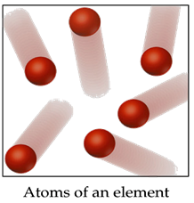
Elements
Consists of only
one kind of atom,
Cannot be broken
down into a simpler
type of matter
*Write information on the Notes Sheet
Notes:
Instructional Approach(s): The teacher should present the information on the slide while the students record the important information on their notes

Slide 7

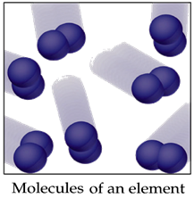
Molecules
A molecule consists of two or more atoms of the same element, or different elements, that are chemically bound together.
In the animation above, two nitrogen atoms (N + N = N2) make one Nitrogen molecule .
*Write information on the Notes Sheet
Notes:
Instructional Approach(s): The teacher should present the information on the slide while the students record the important information on their notes

Slide 8
Distributed Summarizing
Complete Part II of the Atoms and Molecules Notes Sheet.
When instructed, compare your responses to a seat partner.
Notes:
Instructional Approach(s): Students should complete part 2 of their notes sheet. Then have students turn to a partner and discuss the question on the slide. Partners can be determined by the students or the teacher can provide more specific directions such as turn to the person directly in front/behind you or to the right/left of you, etc. It may be necessary to have a group of three if you have an uneven number of students. Do not allow more than 30 seconds to 1 minute of discussion time. The teacher should be walking around listening and redirecting discussions as needed. The teacher can briefly discuss student responses.

Slide 9
Applying Atoms, Elements, Molecules and the Law of Conservation of Matter [Mass]
Notes:
Instructional Approach(s): This slide is an introduction to the remaining slides which apply the concept of atoms, elements, and molecules to the Law of Conservation of Matter

Slide 10
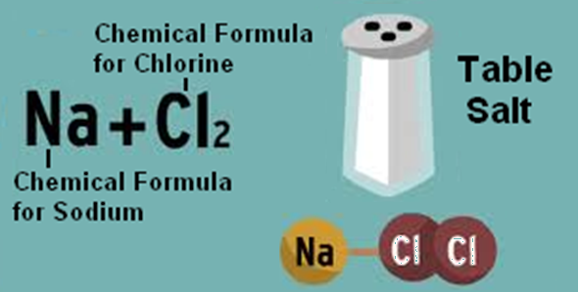
A Chemical Formula is a representation of a substance using symbols for its essential elements.
Notes:
Instructional Approach(s): The teacher should present the information on the slide. The students do not have to know chemical formulas; however, chemical formulas can be used to demonstrate the amount of atoms in matter

Slide 11
A Chemical Formula represents in symbols and numbers the amount of atoms in a specific type of matter.
Look at Part III of your Atoms and Molecules Notes Sheet. Let’s examine a few Chemical Formulas.
H₂O = Water
How many atoms are there in H₂O?
There are 2 Hydrogen Atoms and 1 Oxygen Atom
Answer numbers 4, 5, and 6 on Part III of the Atoms and Molecules Notes Sheet
Notes:
Instructional Approach(s): The teacher should present the animated slide. The teacher should ask the class or call on students to answer the question “how many atoms are there in H₂O?” Click the mouse to reveal the answer, then instruct the students to answer numbers 4-6 on part three of their notes

Slide 12
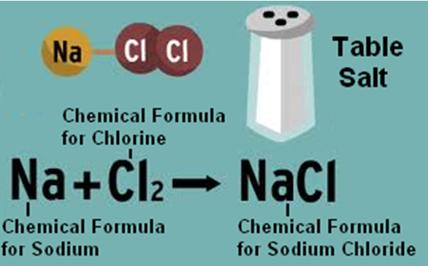
A Chemical Equation is a symbolic representation of what happens when atoms react with each other
Notes:
Instructional Approach(s): The teacher should present the information on the slide. The students do not have to know chemical equations; however, chemical equations can be used to demonstrate the amount of atoms in matter and the Law of Conservation of Matter

Slide 13
Review: What is the Law of Conservation of Matter?
The Law of Conservation of Matter [Mass] states that matter cannot be created or destroyed. It changes form.
A Chemical Equation can illustrate the Law of Conservation of Matter.
Let’s see how
Notes:
Instructional Approach(s): The teacher should present the information on the slide to lead into the remaining slides

Slide 14
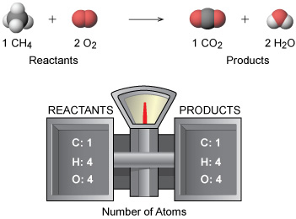
Law of Conservation of Matter [Mass]:
The Mass of the Reactants is EQUAL to the Mass of the Products
Notes:
Instructional Approach(s): The teacher should present the information on the slide. Once again, students do not have to know how to balance equations or identify the reactants and products in an equation. However, a chemical equation can be used to apply the Law of Conservation of Matter

Slide 15
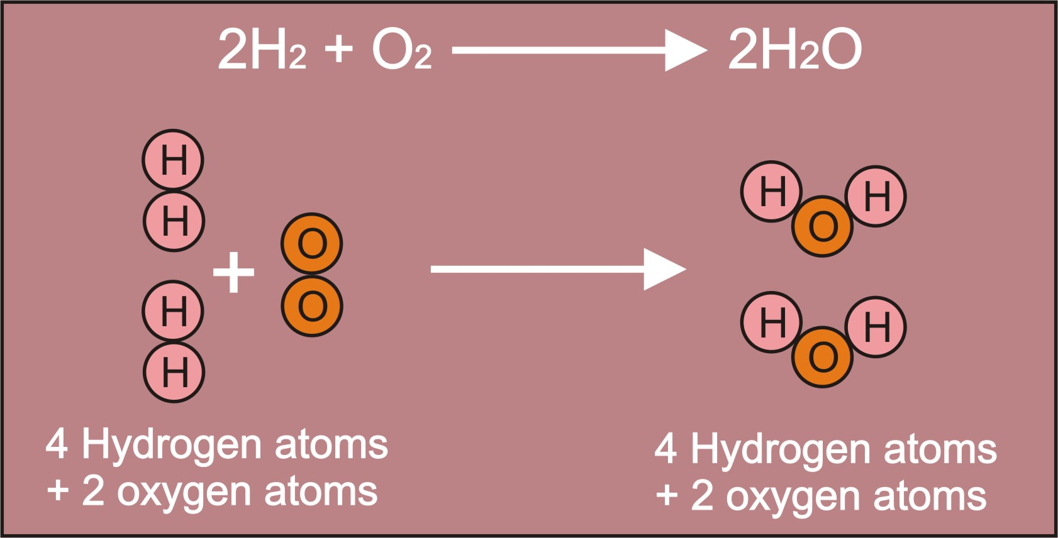
Law of Conservation of Matter [Mass]
Notes:
Instructional Approach(s): The teacher should use the information on the slide to reinforce atoms, molecules, and the law of conservation of matter

Slide 16
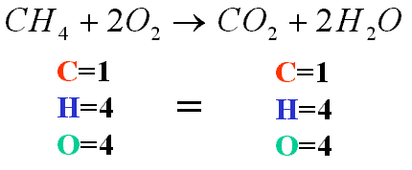
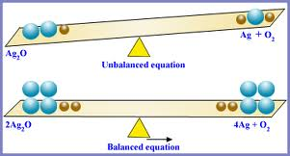
Law of Conservation of Matter [Mass]
Notes:
Instructional Approach(s): The teacher should use the information on the slide to reinforce atoms, molecules, and the law of conservation of matter

Slide 17
See the Curriculum Map for additional tasks to reinforce Atoms, Elements, Molecules and the Law of Conservation of Matter

Slide 18
Summarizing Strategy
How are atoms and molecules related?
In Part IV of the Atoms and Molecules Notes Sheet, complete the two Quad Clusters.
Notes:
Instructional Approach(s): Each student should complete the summarizer. The teacher should use the summarizer to determine the level of student mastery and if differentiation is needed.

Slide 19
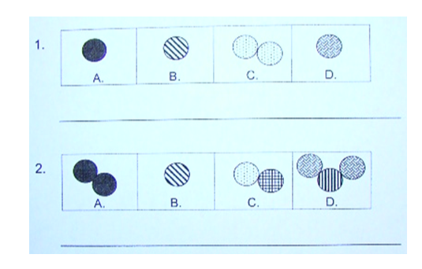
Quad Clusters: Which one does not belong? Explain your answers.

