Slide 1
Sound: Mediums
Essential Question:
How are sound waves
affected by medium?
Notes:
Instructional Approach(s): The teacher should introduce the essential question and the standard that aligns to the essential question

Slide 2

Let’s Review Sound Waves
A Sound wave is a mechanical wave because it has to travel through a medium.
A Sound wave is also a Compressional wave because matter in the medium moves forward and backward along the same direction that the wave travels.
Air molecules move back and forth along the direction the sound wave is moving.
Notes:
Instructional Approach(s): The teacher should present the information on the slide as a review for sound waves.

Slide 3
Sound Waves and Mediums
A medium is the substance through which a wave can travel
Examples of Mediums:
Air
Water
Particles
Strings
Solids
Liquids
Gases
Notes:
Instructional Approach(s): The teacher should present the information on the slide while the students record the important information on their notes.

Slide 4
Sound Waves and Mediums
Sound waves travel through different materials at different speeds.
The speed of sound is usually fastest in solids, where molecules are closest together, and slowest in gases, where molecules are farthest apart.
In a vacuum (such as space), there are no particles to vibrate. So, no sound can be made
Notes:
Instructional Approach(s): The teacher should present the information on the slide while the students record the important information on their notes.

Slide 5
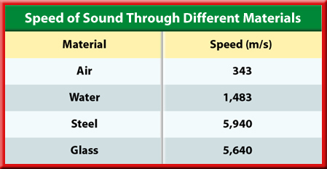
Which material does sound travel the fastest?
Which material does sound travel the slowest?
What causes sound to travel fastest in these types of substances?
Notes:
Instructional Approach(s): The teacher should present the information on the slide as a reinforce how sound travels in different mediums.

Slide 6
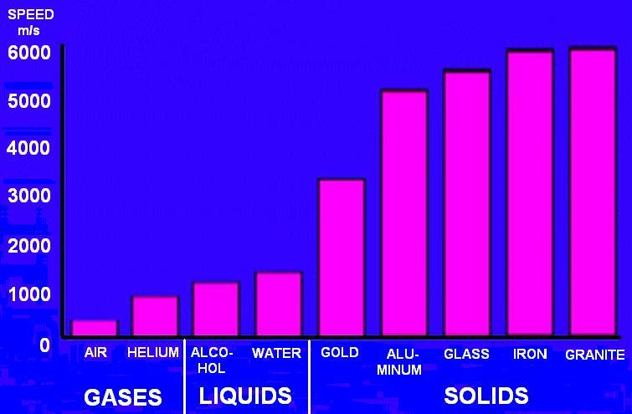
Notes:
Instructional Approach(s): The teacher should present the information on the slide as a reinforce how sound travels in different mediums.

Slide 7
Distributed Summarizing
With a partner, answer the following questions:
In some western movies, a character would be shown putting an ear to the hard ground to find out if someone was coming. Does this work? Why?
You are the commander of a space station and your chief of security tells you that sensors have just detected an explosion. How long will it be before you hear the sound of the explosion?
Notes:
Instructional Approach(s): Think-pair-share. Click to the next slide for the correct answers.

Slide 8
Distributed Summarizing
In some western movies, a character would be shown putting an ear to the hard ground to find out if someone was coming. Does this work? Why? Yes, because sound travels faster and with less loss of energy through the ground than through the air.
You are the commander of a space station and your chief of security tells you that sensors have just detected an explosion. How long will it be before you hear the sound of the explosion? You won’t hear it. Sound waves will not travel in the vacuum of space.

Slide 9
Sound: Speed and Temperature
The temperature of the material affects the speed of the sound.
Molecules move faster in warmer substances. As a substance heats up, its molecules move faster, so they collide more frequently
Sound travels faster in warmer temperatures. The more frequent the collisions are, the faster the speed of sound is in the material.
Notes:
Instructional Approach(s): The teacher should present the information on the slide while the students record the important information on their notes.

Slide 10
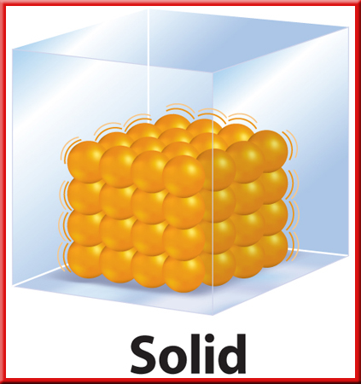
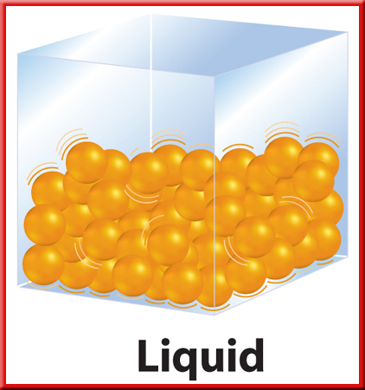
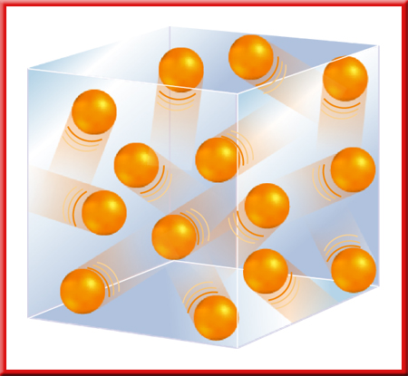
Gas
Watch the animation links below to review the relationship between temperature and the movement of molecules
http://www.middleschoolchemistry.com/multimedia/chapter1/lesson2#heating_and_cooling
http://nortonbooks.com/college/biology/animations/ch04a01.htm
http://chemconnections.org/Java/molecules/index.html
Notes:
Instructional Approach(s): The teacher should use the links on the slide to review the relationship between temperature and molecule movement.

Slide 11
Sound: Changes in Mediums
Like any wave, a sound wave doesn't just stop when it reaches the end of the medium or when it encounters an obstacle in its path.
Rather, a sound wave will undergo certain behaviors when it encounters the end of the medium or an obstacle.
Possible behaviors include absorption, reflection, diffraction, and refraction.
Notes:
Instructional Approach(s): The teacher should present the information on the slide while the students record the important information on their notes.

Slide 12
Sound: Changes in Mediums
Absorption and Reflection
Reflection occurs when a wave strikes an object or surface and bounces off.
An echo is reflected sound.
Your echo bounces off the walls, floor, ceiling, furniture, and people.
A hard, smooth surface (cardboard) reflects sound better than an uneven, soft surface (pillow). This is because the soft surface absorbs most of the sound.
Notes:
Instructional Approach(s): The teacher should present the information on the slide while the students record the important information on their notes.

Slide 13
Sound Reflection and Absorption
Compare sound in a gymnasium and an auditorium (where musical performances occur).
Sound waves easily reflect off the smooth, hard walls of a gymnasium. For this reason, you hear an echo.
In well-designed auditoriums, echoes are reduced by soft materials that absorb sound waves.
Notes:
Instructional Approach(s): The teacher should present the information on the slide while the students record the important information on their notes.

Slide 14

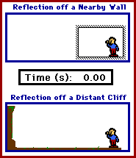
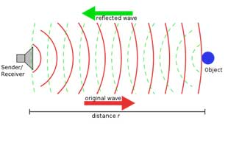
Reflection of Sound
http://www.ndt-ed.org/EducationResources/HighSchool/Sound/reflection.htm
http://www.physicsclassroom.com/mmedia/waves/er.cfm
http://www.physicscentral.com/explore/action/navigatingworld1.cfm
Notes:
Instructional Approach(s): The teacher should use the animations and link on the slide to reinforce reflection.

Slide 15
Sound: Changes in Mediums
Diffraction
Diffraction is the bending of waves around a barrier.
Diffraction of sound waves is commonly observed; we notice sound diffracting around corners or through door openings, allowing us to hear others who are speaking to us from adjacent rooms.
Owls are able to communicate across long distances due to the fact that their long-wavelength hoots are able to diffract around forest trees and carry farther than the short-wavelength tweets of songbirds.
Low-pitched (long wavelength) sounds always carry further than high-pitched (short wavelength) sounds
Notes:
Instructional Approach(s): The teacher should present the information on the slide while the students record the important information on their notes.

Slide 16
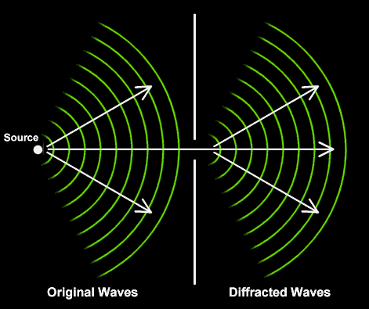
Diffraction of Sound
http://library.thinkquest.org/19537/Physics6.html
Notes:
Instructional Approach(s): The teacher should use the animations and link on the slide to reinforce diffraction.

Slide 17
Sound: Changes in Mediums
Refraction
Refraction is the bending of a wave as it moves from one medium into another
The speed and wavelength of a wave changes during refraction.
Notes:
Instructional Approach(s): The teacher should present the information on the slide while the students record the important information on their notes.

Slide 18
Sound: Changes in Mediums
Refraction
Note: Refraction is most commonly associated with electromagnetic waves; however, sound waves can refract.
The following slide is not required and should be used simply as an example.
Notes:
Instructional Approach(s): The teacher should present the information on the slide.

Slide 19
Sound: Changes in Mediums
Refraction
For example, sound waves are known to refract when traveling over water. Even though the sound wave is not exactly changing media, it is traveling through a medium with varying properties; thus, the wave will encounter refraction and change its direction.
Since water has a moderating affect upon the temperature of air, the air directly above the water tends to be cooler than the air far above the water. Sound waves travel slower in cooler air than they do in warmer air. For this reason, the portion of the wave directly above the water is slowed down, while the portion of the wave far above the water speeds ahead. So, the direction of the wave changes, refracting downwards towards the water.
Notes:
The refraction of sound is not an essential concept. Refraction will be discussed in depth with electromagnetic waves; however, students should have a basic understanding that all waves can reflect, refract, or diffract.

Slide 20
Sound: Changes in Mediums
Refraction
http://www.physicsclassroom.com/class/sound/u11l3d.cfm
Notes:
Instructional Approach(s): The teacher should use the animations and link on the slide to reinforce refraction.

Slide 21
Distributed Summarizing
With a partner, answer the following question:
Discuss everyday examples of the reflection and diffraction of sound.
Notes:
Instructional Approach(s): Think-pair-share. The teacher should walk among the students and listen to ensure mastery and understanding.

