Slide 1
Ohms Law

Slide 2
Current: The path an electric current follows
- Unit for current is amp
An ammeter measures the amount of current flowing past a certain point

Slide 3
Understanding Ohm’s Law
Ohm’s law may be easier to understand with an analogy. Current flowing through a wire is like water flowing through a hose.

Slide 4
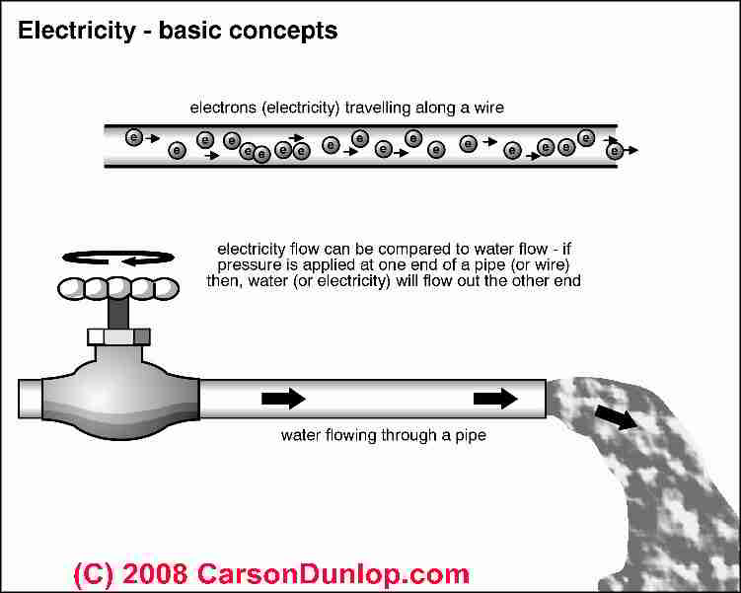

Slide 5
Increasing voltage with a higher-volt battery increases the current. This is like opening the tap wider so more water flows through the hose.

Slide 6
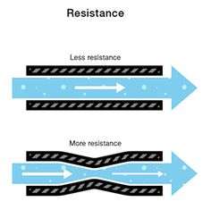
Increasing resistance reduces the current. This is like stepping on the hose so less water can flow through it.

Slide 7
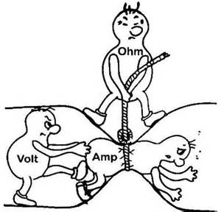
Increasing the resistance, decreases the flow of current…

Slide 8


Slide 9
A series circuit is a circuit in which resistors are arranged in a chain, so the current has only one path to take. The current is the same through each resistor.

Slide 10
You need to be aware of the following rules to work through the next questions.
Current in a series circuit is the same at all parts in a circuit.
In a series circuit, the total, or sum of the voltages across all the components will equal the voltage across the cell/battery.
The total voltage supplied by the cell is 12V. There are three lamps connected in series, so 12/3 = 4V.

Slide 11
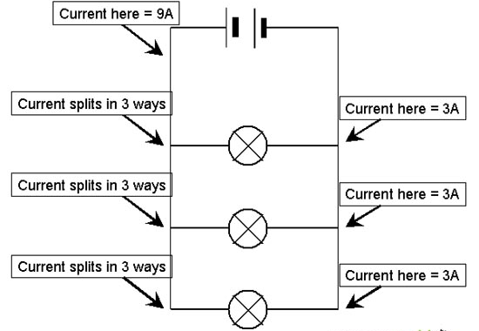
The parallel circuit splits into each routes;
Example:
This means the current also splits into 3 equal amounts. Therefore, 9/3 = 3Amps
The voltage will be the same everywhere

Slide 12
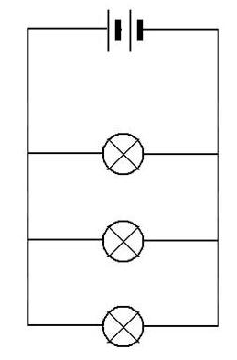
Questions:
The label on the battery says 6V. If we connected a voltmeter across each lamp, what would the readings be?
At lamp 1 - ________V
At lamp 2- ________V
At lamp 3- ________V

Slide 13
Questions
9 V
What type of circuit is this?
What voltage will load 1, 2 and 3 have ?
What current will Load 1, 2 and 3 have?
L1
L2
L3

