Slide 1
Electricity Unit Review

Slide 2
Which statement best explains why there could be a force of attraction between two electrically charged objects?
because they have like charges
because they have unlike charges
because they have the same number of protons
because they have the same number of electrons

Slide 3
A student is testing the conductivity of two solid substances. Substance A has high conductivity and substance B has low conductivity. Based on this information, what must be true regarding these two substances?
Electrons in substance A are able to move more easily than electrons in substance B
There is more energy stored in chemical bonds in substance A than there is in substance B
The atomic nuclei in substance A has more mass that the atomic nuclei in substance B
Substance A contains a higher percentage of radioactive atoms than does substance B

Slide 4
Which of the following is a true statement about the magnetic field between two magnets?
The south pole of one magnet is attracted to the south pole of the other magnet.
The south pole of one magnet is attracted to the north pole of the other magnet.
The north pole of one magnet is attracted to the north pole of the other magnet.
The south pole of one magnet is attracted to the both poles of the other magnet.

Slide 5
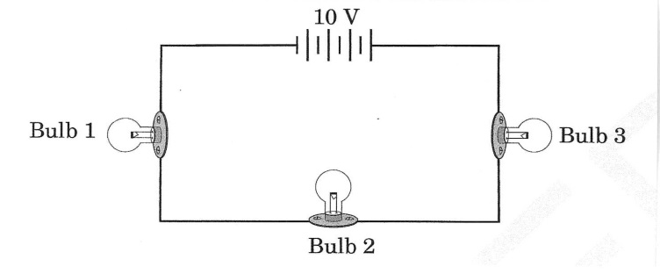
This diagram represents a closed circuit with three light bulbs and a 10-volt battery.
If Bulb 3 burns out in the circuit, what will most likely happen?
Bulb 1 and Bulb 2 will continue to glow.
Bulb 1 and Bulb 2 will not glow as brightly.
Bulb 1 will glow, but Bulb 2 will not glow.
Bulb 1 and Bulb 2 will not glow

Slide 6
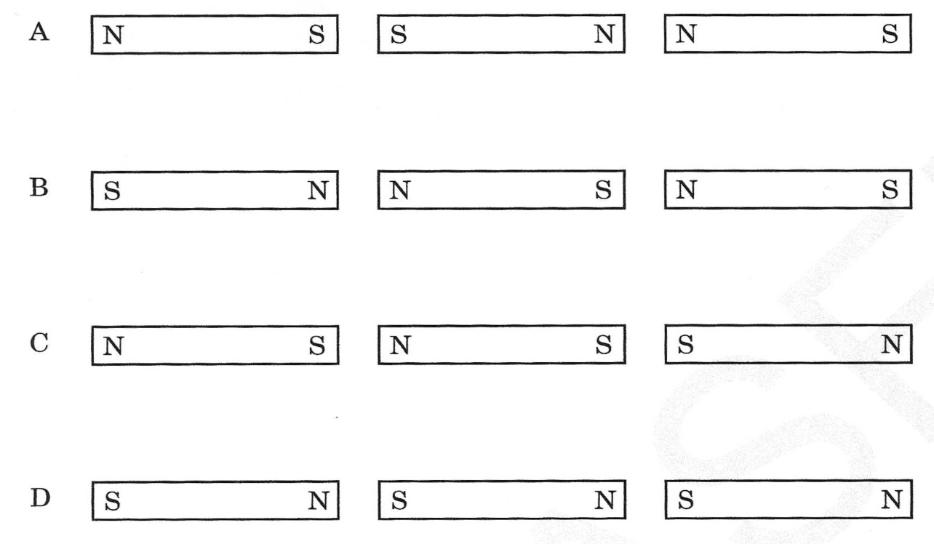
How could 3 magnets be arranged end-to-end so that there will be no attraction between them?
A

Slide 7
What happens when a magnet moves through a coil of wire?
The magnet loses magnetism
The current is induced in the magnet
A current is induced in the wire
Electrical energy is transformed into mechanical energy

Slide 8
Two different materials are rubbed against each other and acquire opposite charges when separated. This is an example of charging by
conduction.
friction.
induction.
Radiation.

Slide 9
Increasing the current applied to an electromagnet will affect which of the following?
The voltage delivered by the electromagnet.
The magnetic field exerted by the electromagnet.
The mass of the electromagnet.
The nuclear force delivered by the electromagnet.

Slide 10
In an electric field diagram, how would a very weak electric field be indicated?
The field lines are very close together.
The field lines are very long.
The field lines are very far apart.
The field lines are very short.

Slide 11
Tammy’s room contains a lamp, a hair dryer, a radio and a TV. What kind of wiring is the circuitry in Tammy’s house if the lamp does not dim as each appliance is turned on?
Tammy’s room is wired as a series circuit.
Tammy’s room is wired as a parallel circuit.
Tammy’s room is wired as a mixed circuit.
Tammy’s room is wired as a direct circuit.

Slide 12
In which way do a permanent magnet and an electromagnet differ?
electromagnet has a fixed magnetic strength
a permanent magnet's strength can be changed
a permanent magnet can be turned on or off
an electromagnet can be turned on or off

Slide 13
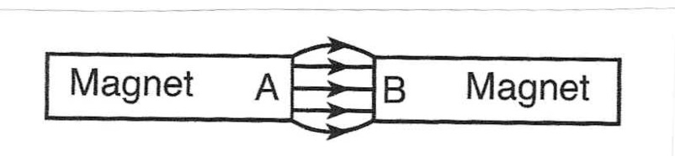
The diagram below shows the magnetic field lines between two magnetic poles, A and B.
Which statement describes the polarity of magnetic poles A and B?
A is a north and B is a south pole
A is a south pole and B is a north pole
Both A and B are north poles
Both A and B are south poles

Slide 14
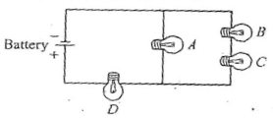
Four identical light bulbs are connected in a circuit as shown below. The current is greatest through which of the light bulbs?
A
B
C
D

Slide 15
An electrician wears rubber gloves for protection. The purpose of the rubber gloves are to
keep the electrician dry.
create an electrical circuit.
produce electricity.
insulate the electrician.

Slide 16
High powered electromagnets are used in recycling centers to separate iron and steel waste from plastics and paper products. You are an engineer that must increase the power of the magnet without using any additional electrical power. What modification should you make to the electromagnet?
insulate the coils
reduce the number of coils
increase the number of coils
increase the distance between the coils

Slide 17
Which of the following statements is NOT true?
A magnet can produce an electric current.
The flow of electricity can produce a magnetic field.
An electromagnet can be strengthened by increasing the number of coils.
An electromagnet can be strengthened by decreasing the number of coils.

Slide 18
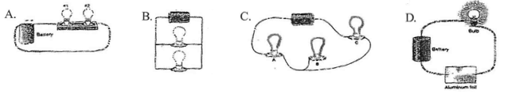
Students are asked to assemble a circuit that contains one battery and one to three small bulbs. The circuits assembled by the students are shown below. Which circuit shown will not light the bulb?
C

Slide 19
An ohm is best defined as a unit of measure for
power.
magnetic fields.
electrical resistance.
electrical potential difference.

Slide 20
What will happen if you break a magnet in half?
The north pole will demagnetize.
The south pole will demagnetize.
Two new magnets will form.
Both poles will demagnetize.

Slide 21
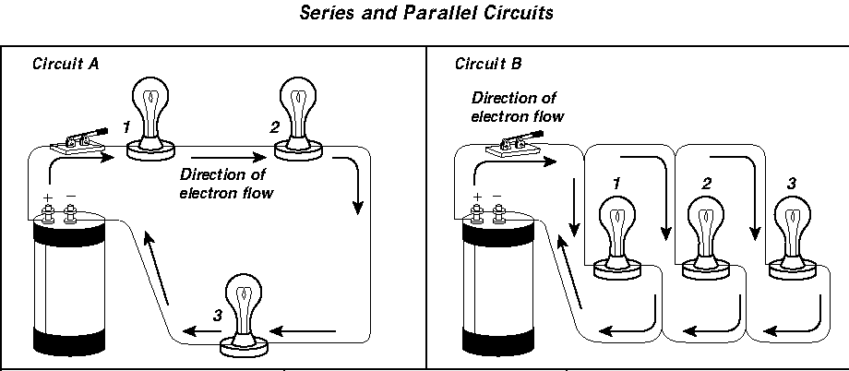
What will happen to the bulbs in circuit A if the switch is opened?
Light bulb 1 will go out but light bulb 2 and 3 will stay lit.
Light bulb 2 and 3 will go out and 1 will stay on.
All the light bulbs will go out.
All the light bulbs will light up.

Slide 22
What will happen if bulb 1 in circuit B is removed?
Light bulb 2 and 3 will stay lit.
Light bulb 2 will go out and 3 will stay on.
All the light bulbs will go out.
Light bulb 3 will go out and 2 will stay on.

Slide 23


A student has a circuit that is missing a component at location X, as shown in the diagram below.
The student wants component Y to warm up after the switch is closed. Which of the following components should the student add to the circuit at location X?
B

Slide 24
The battery in a cell phone provides a constant flow of electrons through conductors in the same direction to power the phone. A cell phone is powered by ____________ current.
Alternating
direct
ampere
Distributed
**Note: Everything that runs off of a battery, plugs in to the wall with an AC adapter, or uses a USB cable for power relies on direct current (DC).

Slide 25
In a simple electrical circuit, electrons flow from a battery through a resistor and back to the battery. In a plumbing system, a pump moves water through pipes. If a larger pump were used to move the water through the pipes more quickly, what electrical concept is MOST like the size of the water pump?
Resistance
Voltage
Current
amperage

Slide 26
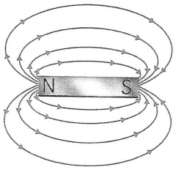
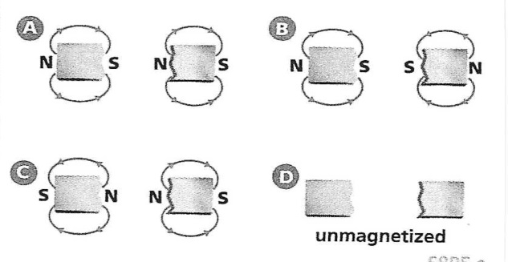
Use the diagram below to answer the question.
If the bar magnet in the above diagram were cut in half, which diagram below best represents the magnetic field of the two new pieces?
A

Slide 27
A parallel circuit containing 2 bulbs and a bell had three paths for current to flow. If the first bulb in the circuit blows out, what effect will it have on the other loads in the circuit?
If one bulb goes out, the other bulb will go out, but the bell will continue to work.
If one bulb goes out, the other loads will not be affected.
If one bulb goes out, all the other devices will stop working.
If one bulb goes out, the others will remain lit, but the bell will no longer work.

Slide 28
Why does a balloon rubbed on wool stick to the wall?
Opposite charges attract, and a charged object will even attract to something neutral.
The surface of the balloon becomes sticky because of the rubbing.
The balloon doesn't stick to the wall, the wool does.
The balloon causes all the protons to become electrons.

Slide 29
The attraction of hair to a briskly rubbed plastic comb is an example of
magnetism.
static electricity.
gravity.
radiation.

Slide 30
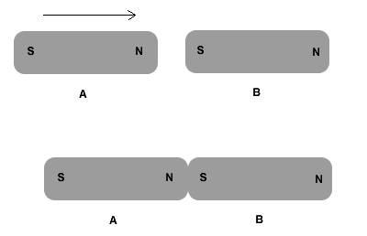
Magnet A is pushed towards magnet B. You observe that the two magnets are attracted to each other and "stick". Which sentence BEST explains this observation?
Both are positively charged.
Both are tightly bonded to each other.
Both are composed of smaller, individual magnets.
Both have all their magnetic domains aligned in the same direction.

Slide 31
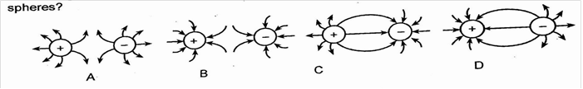
Which diagram represents the electric field between two oppositely charged conducting spheres?
C

Slide 32
A magnetic field is created by a charged particle that is
Balanced
Motionless
Unbalanced
Moving

Slide 33
Magnetic poles are similar to electric charges in that
Like poles repel and opposite poles attract.
Magnetic force is equal to the electric force.
The number of magnetic domains responsible for the poles is conserved.
The mass of the magnetized particle is conserved

Slide 34
Which of the following statements represents Ohm’s law?
(Hint: Potential difference is voltage.)
Current / potential difference = constant
Potential difference / current = constant
Potential difference = current X resistance
Current = resistance X potential difference

Slide 35
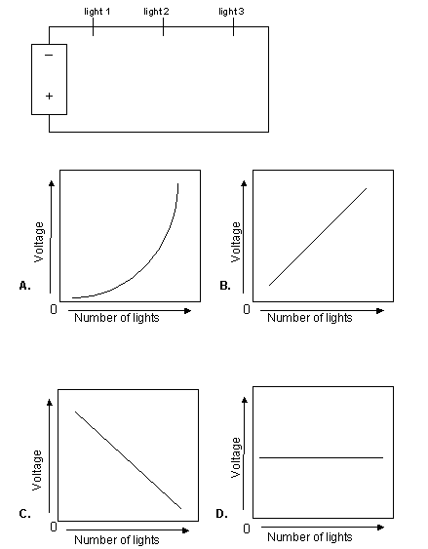
Which graph BEST represents the change in light intensity along the circuit shown here as a fourth, fifth, and sixth light are added?
C

Slide 36
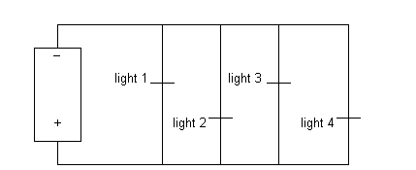
One advantage to using this form of circuit is
that voltage available to each light remains constant regardless of the number of lights that are on.
current drawn from the battery remains constant regardless of the number of lights that are on.
resistance along the circuit remains constant regardless of the number of lights that are on.
current drawn from the battery decreases as more lights are turned on.

Slide 37
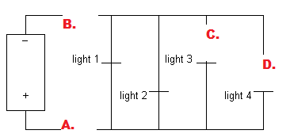
Consider the circuit if switches are added at points A, B, C, and D. All the switches are closed EXCEPT the switch at position D, which is left open. What is the result of this?
Only light 4 will go out.
Only lights 3 and 4 will go out.
All the lights will go out
None of the lights will go out

Slide 38
Magnetism is a
Force
Power
Form of energy
Form of electricity

Slide 39
Chemical, potential energy is stored in a battery. The negative end of a battery is connected to a wire. The wire loops numerous times around an iron nail. The wire returns to the positive end of the battery.
What happens to the nail?
It gains a negative charge.
It gains a positive charge.
It repels other iron items, such as paperclips.
It attracts other iron items, such as paperclips.

Slide 40
If a magnet is allowed to move freely, its north and south poles will always
line up with Earth’s north-south axis.
keep changing places.
point east and west.
repel each other.

