Slide 2
Simple Machines
Lesson 20
Notes:
Part I
The slide show consists of 4 parts. The first part is provided to help work in some background materials and vocabulary dealing with electricity. It provides a few activities that involve the students in helping demonstrate some of the concepts listed previously. The activities and introduction lead into the second part of hands-on lab stations. The third part emphasizes cost and safety. Finally, the fourth part introduces solar power and more hands on materials. Not every school can afford to buy all of the resources listed, but the list is provided in order for the teacher to pick one or two to help in teaching these concepts from year to year.

Slide 3
GPS
S8P3. Students will investigate relationship between force, mass, and the motion of objects.
c. Demonstrate the effect of simple machines (lever, inclined plane, pulley, wedge, screw, and wheel and axle) on work.

Slide 4
Work
Work is the application of a force to an object to move it a certain distance in the direction of the force.
Formula
    work = force x distance or W = F x D

Slide 5
Force
A force is a push or a pull
A force is measured in Newtons (N)

Slide 6
Distance
An amount that an object travels
Measured in meters (m)
1 meter*
* Not drawn to scale

Slide 7
Work
Work is done only when an object moves in the same direction of the force that is being applied.
NO movement!!!!
NO work!!!!
Example:
  Picture a person wearing a backpack and climbing up the side of a mountain, the person is doing work because the direction of motion and force being applied are both upward. (same direction)

Slide 8
Work
Work is not always done when a force is applied to an object.
Example
    A brick wall will not move no matter how much force you apply with your hands. The wall does not move, no work is being done when you push on it.

Slide 9
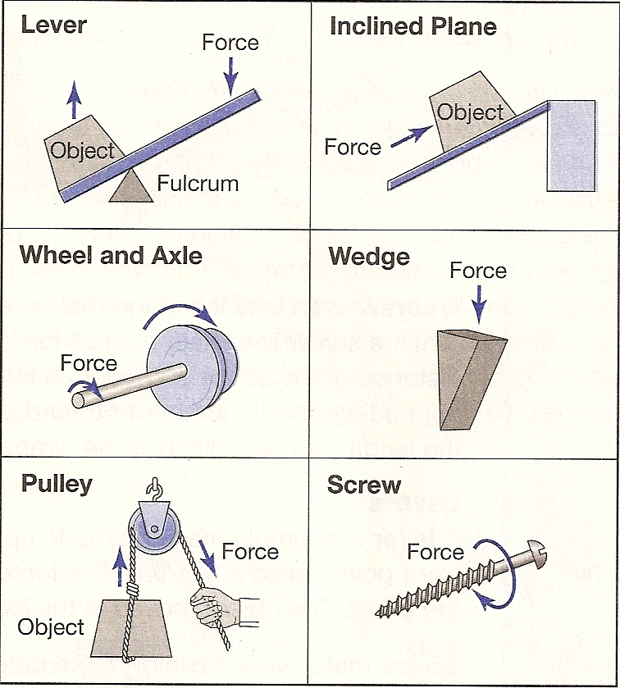
Simple Machines
Six basic types
Designed to make
work easier by changing the size or direction of a force
Have some moving
parts
Can combine to
form compound machines

Slide 10
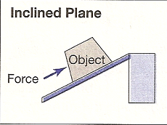
Simple Machines – Inclined Plane
An inclined plane is a straight, slanted surface.
Example:
  A ramp is a stationary inclined plane.
It is easier to push an object up a ramp than it is to lift the same object straight up to the same height.

Slide 11
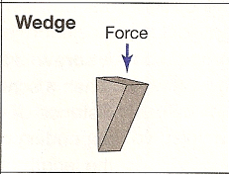
Simple Machines - Wedge
A wedge is an inclined plane that is wider or thicker at one end than at the other.
Example: Knife blade or axe
  When moved it is used to cut, split, or pry apart objects

Slide 12
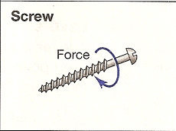
Simple Machines - Screw
A screw is an inclined plane that is wrapped around a cylinder.
Screw, bottle cap
  When turned a small force is applied over the long distance of the screws threads
The amount of work for a screw depends on the number of thread, which is actually the length of the inclined plane

Slide 13
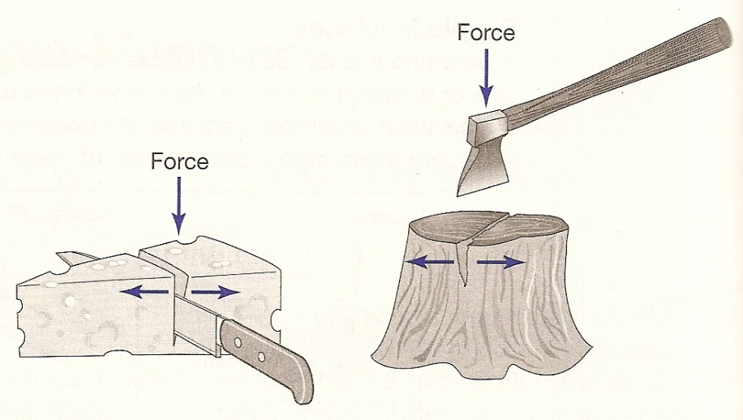
Simple Machines – A Lever
What is it? Made up of a bar that pivots at a fixed point called a fulcrum
The force applied to a lever is called the effort.
The object moved is the load.
They are classified into three different groups
  The groups are based upon the locations of the fulcrum, load, and the input force

Slide 14
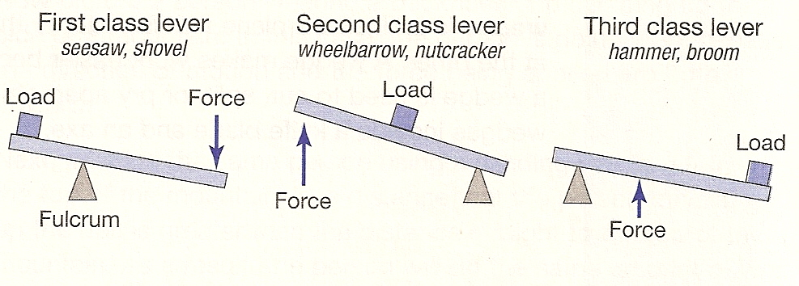
Simple Machines - Levers
In a first class lever, the fulcrum is in the middle, load and force on the ends
  Example: seesaws
In a second class lever, the load (resistance) is in the middle, force and fulcrum are on the ends. Example: nutcracker, wheelbarrow
In a third class lever, the force (effort) is in the middle, the load and fulcrum are on the ends. Example: baseball bat or fishing rod

Slide 15
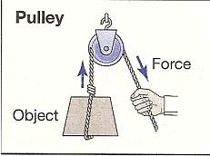
Simple Machines - Pulleys
A pulley is a rope or chain wrapped around a wheel.
A load is attached to one end of the rope and a force is applied to the other end of the rope.

Slide 16
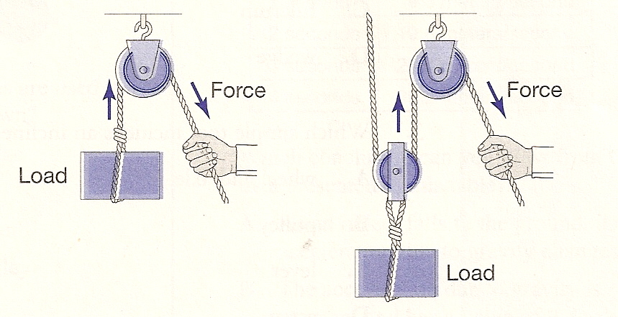
Pulley
A double pulley makes work easier not only by changing the direction of the force, but also by multiplying the effort
A single pulley makes work easier by changing the direction of the effort force
  When you pull down on the rope, the load moves up

Slide 17
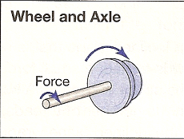
Simple Machines – Wheel & Axel
A wheel and axle is a simple machine that consists of two circular objects of different sizes.
The wheel is always larger than the axle
Example: door knob
By getting more force from the effort put in when compared to the amount of distance

Slide 18
Eduardo is helping his family move out of their old house. Help him decide which task would be easier, and then help him figure out what simple machine makes the job easier.

Slide 19
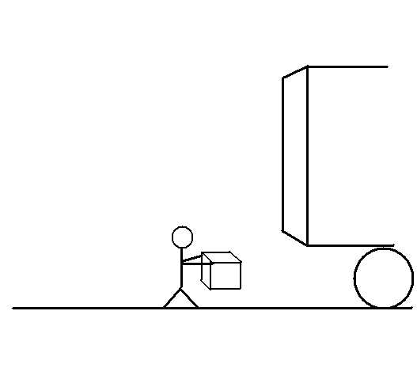
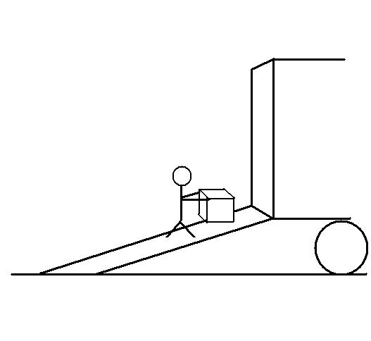
Eduardo has to move some heavy boxes into the moving truck.
A
B
B would be easier because a ramp is an inclined plane.

Slide 20
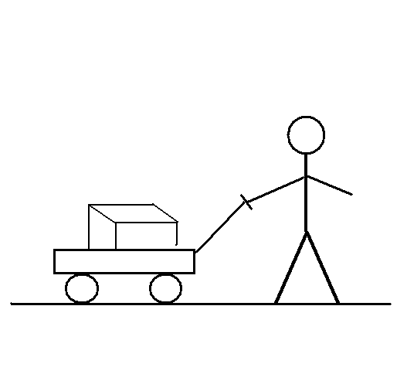
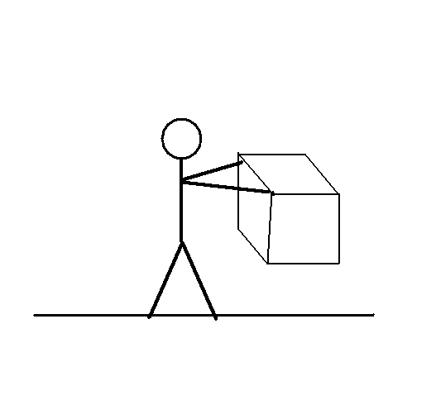
Eduardo has to move a heavy box a long distance.
A
B
A would be easier because the wagon has wheels and axels.

Slide 21
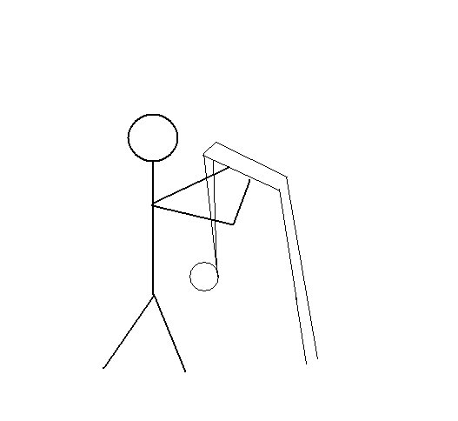
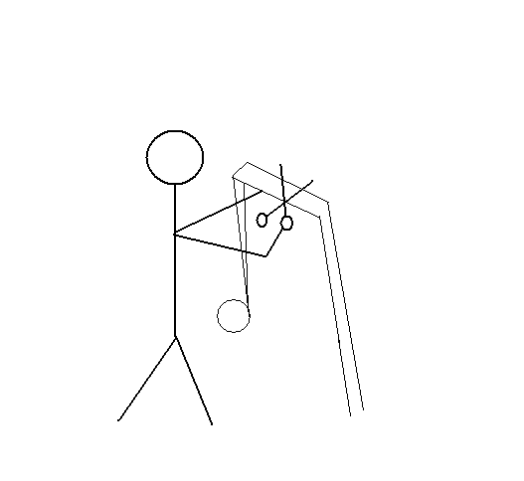
Eduardo needs to tear off a piece of packing tape.
A
B
B would be easier because the edges of the scissors are wedges.

Slide 22
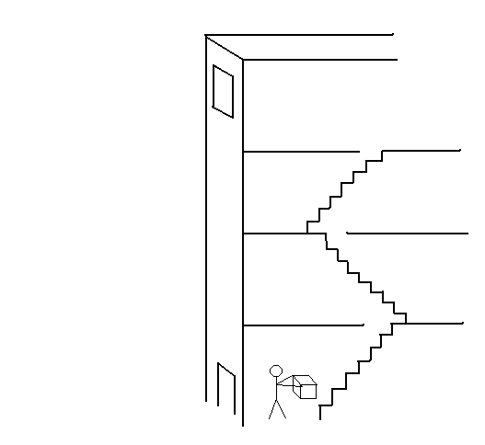
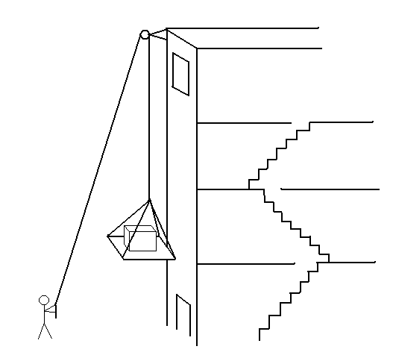
Eduardo needs to move a heavy box to his room on the fourth floor.
A
B
B would be easier because Eduardo is using a pulley.

Slide 23
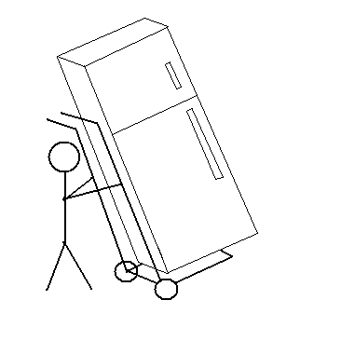
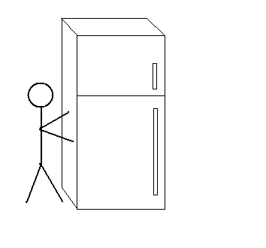
Eduardo needs to help his father move the refrigerator.
A
B
A would be easier because the dolly is a lever (with wheels and an axel).

Slide 24
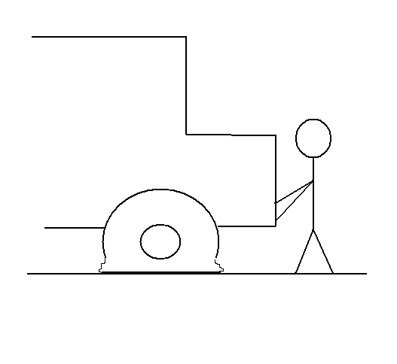
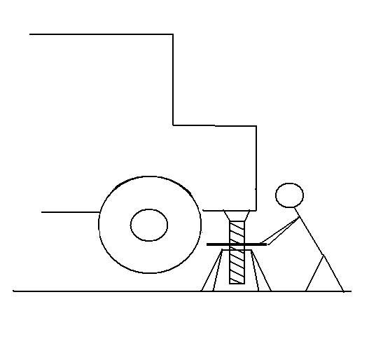
Eduardo needs to help his father change a flat tire on the moving truck.
A
B
B would be easier because a jack uses a screw.

Slide 25
Now that Eduardo and his family have reached their new house, they need some help in unpacking their belongings. Help Eduardo decide on the best simple machine to use in each situation.

Slide 26
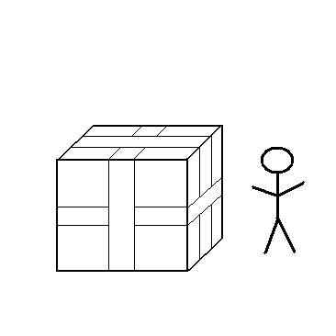
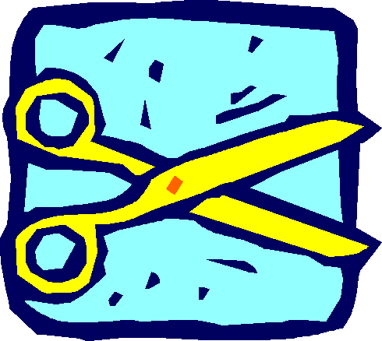
Eduardo needs to open the boxes his mom sealed with packing tape. What simple machine should he use?
Eduardo should use a wedge
(probably a pair of scissors).

Slide 27
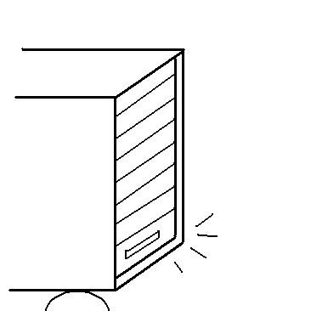
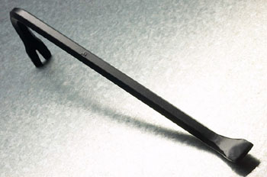
The door to the moving truck is jammed shut. What simple machine might Eduardo’s father use to open it?
Eduardo’s father should use a lever
(most likely a crowbar).

Slide 28
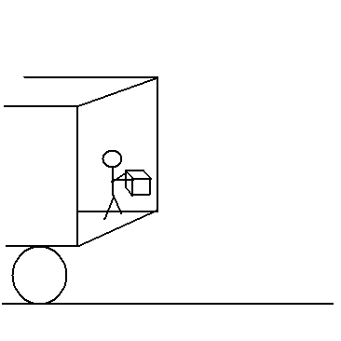
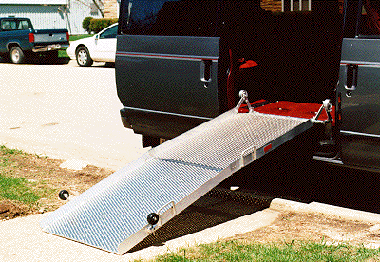
Eduardo needs to carry the boxes out of the moving truck. What simple machine will make this easier?
Eduardo needs an inclined plane
(a ramp) to carry the boxes out of the truck.

Slide 29
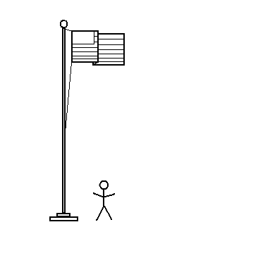
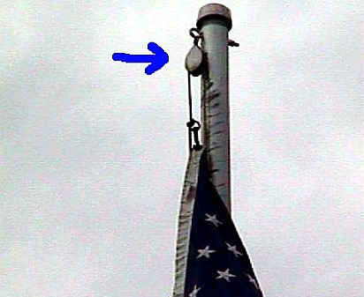
There is a flagpole outside Eduardo’s new school. What simple machine could be used to raise and lower the flag?
A pulley is used to raise and lower the flag.

Slide 30
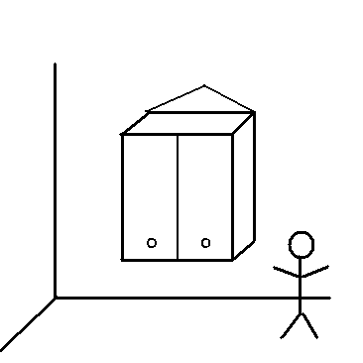
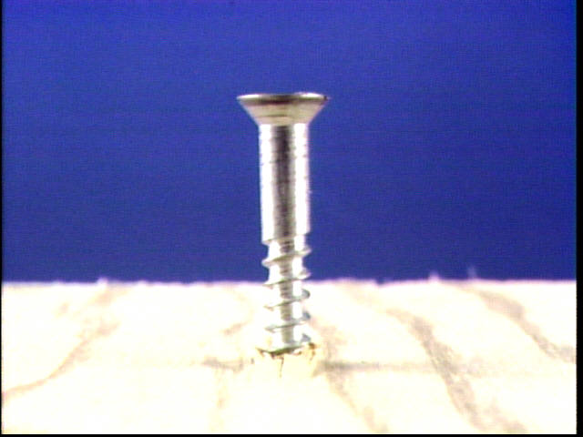
Eduardo’s mom wants to hang a cabinet in the new kitchen. What simple machine might she use to attach it to the wall?
Eduardo’s mom could use a screw to attach the cabinet to the wall and hold it in place.

Slide 31
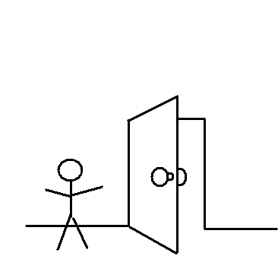
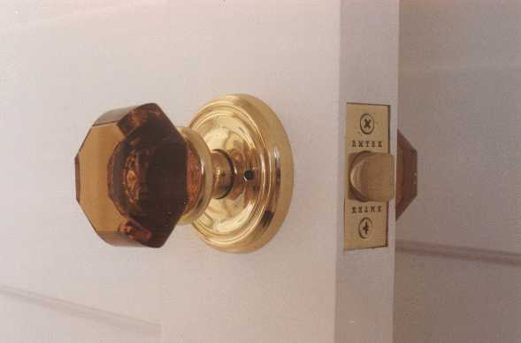
Eduardo helped his father install doorknobs in the new house. What kind of simple machine is a doorknob?
A doorknob is a wheel and axel.

