Slide 1
Velocity and Acceleration

Slide 2
GPS
S8P3. Students will investigate relationship between force, mass, and the motion of objects.
a. Determine the relationship between velocity and acceleration.

Slide 3
Speed
A force is a push or a pull
When a force acts on an object, one possible result is motion.

Slide 4
Speed
A reference point is generally a stationary object such as a tree, a street sign, or a line on the road.
Once a reference point has been established, it is possible to define the motion of an object in terms of speed, position, and direction.

Slide 5
Speed
The speed of an object refers to how fast an object moves.
  To determine speed you need to know both the distance an object moves and the amount of time needed to travel.

Slide 6
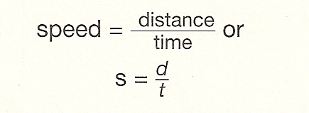
Speed
Calculations using formulas
Most objects do not move at a constant, unchanging speed.
When you use the formula to find the speed of an object you’re actually finding the object’s average speed.

Slide 7
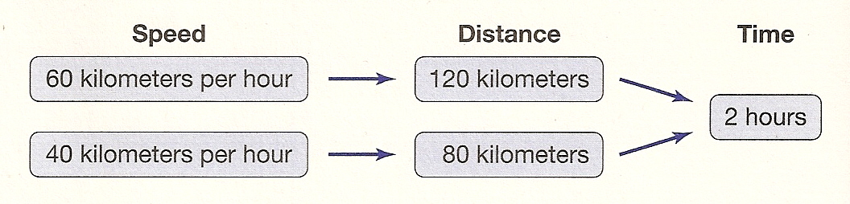
Speed
The diagram shows how two automobiles with different speeds move during the same amount of time.

Slide 8
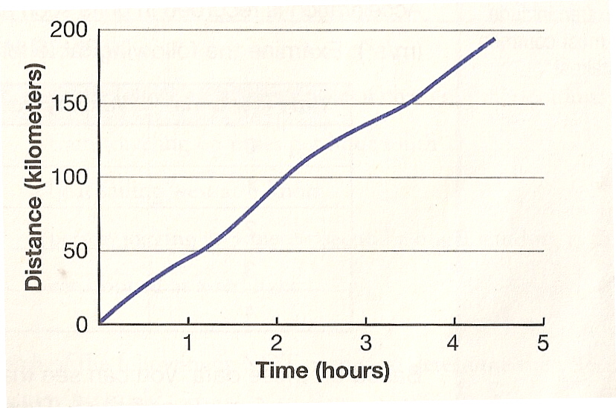
Speed
Speed can be shown on a graph of distance vs. time.
Notice that the line of this graph is not straight. This is because the object’s speed changes.

Slide 9
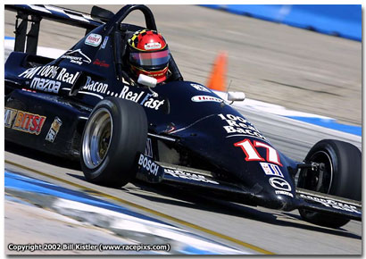
Velocity
Velocity is the speed of an object in a particular direction.
Suppose that two cars traveled at 50 kilometers per hour on the same highway for 2 hours. After two hours, the cars are 200 kilometers away from each other. How is this possible?
Answer: They were traveling in opposite directions.

Slide 10
Velocity
Speed describes distance and time, but does not indicate direction.
When the direction of an object’s movement is included, you are describing an object’s velocity.

Slide 11

Velocity
Velocity changes when the speed or the direction of an object changes.
  If a sailboat’s speed goes from 4 knots to 7 knots, its velocity has changed. If the sailboat continues moving at 7 knots, but changes direction, its velocity has again changed.

Slide 12
Acceleration
Acceleration is the rate at which an object’s velocity changes.
  Velocity changes when an object’s speed and direction changes.
  Acceleration of an object also changes if its speed or its direction changes.

Slide 13
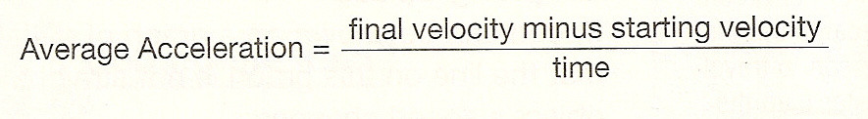
Acceleration
You can calculate the average acceleration of an object by using the following equation.

Slide 14
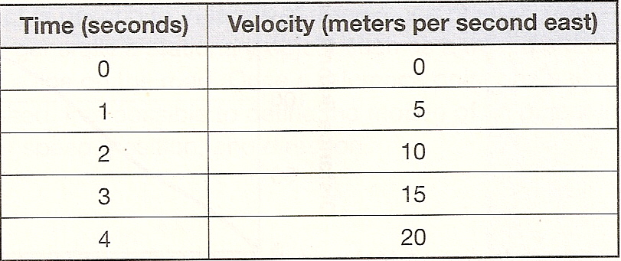
Acceleration
Acceleration is recorded in units such as meters per second squared (m/s²).
        Acceleration of a car
Based on this data, you can see that the acceleration of the car at any time is 5m/s/s or 5 m/s^{2.} Every second, the velocity of the car increases by 5 m/s.

Slide 15
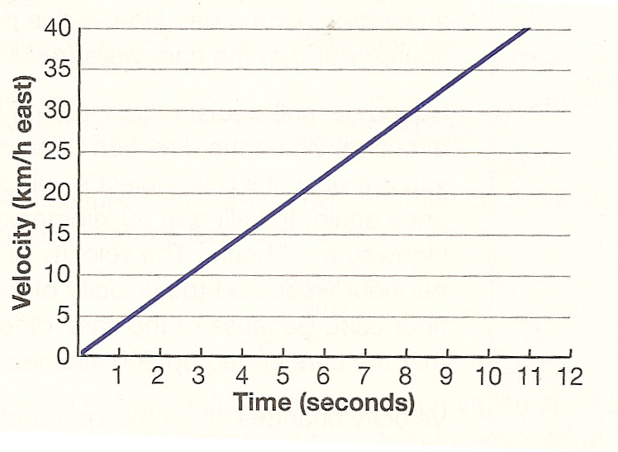
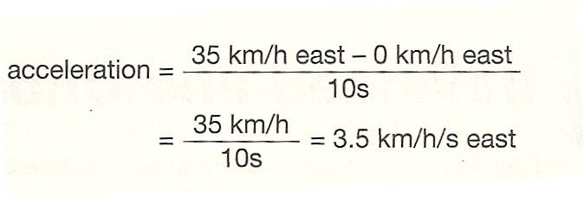
Acceleration
Assume that the following graph plots your acceleration (velocity vs. time) during a car trip. The graph shows that at 10 seconds, the velocity of the car was 35 kilometers per hour east.
These equations can be used to calculate the average acceleration of the car.

