Slide 1
8th Grade Science PLC
November 7, 2017
Erin Anderson

Slide 2
Learning Target
Today I will participate in a science professional learning community to understand the dependence of the new GSE on phenomenon, CER, and the 5 E instructional model. I will know I am successful when I can create a lesson plan for the force and motion unit that integrates these various aspects of science instruction.

Slide 3
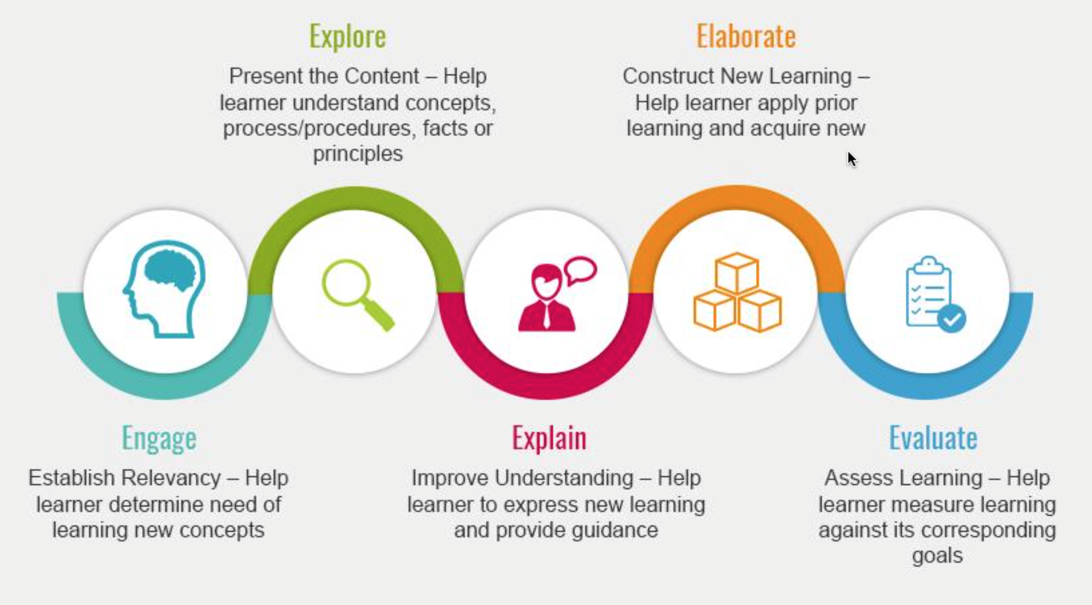
5E Instructional Model
Work Session
Closing
Opening

Slide 4
What is Phenomenon?
Can anything become a phenomenon?
Teaching Channel video on using Phenomena in the science classroom
Let’s try it. Take out your CER graphic organizer.

Slide 5
Claims, Evidence, & Reasoning
What is it…
Claim – a statement that answers a question or states an opinion
Evidence – data, facts, research that supports a claim. Ex: drawings, data tables, measurements (3 quantitative, 2 qualitative)
Reasoning – justification for why the evidence supports the claim using scientific principles

Slide 6
Unit Driving Question
How will it move?

Slide 7

Why don’t the leaves fall immediately?
Falling Leaves

Slide 8

What is the relationship between force, mass, and inertia?
STEMscopes: Change in Motion (Engage)
Module: 8P3BC Forces On and Motions Of Objects

Slide 9
Embroidery Hoop Pen Drop
What happens to an object at rest if disturbed?
Inertia Demo
Sick Science Inertia Ring

Slide 10
Anchor & Supporting Phenomenon
Qualifications
Natural
Observable
Must use science knowledge to explain (GSE standards based)
Must allow students to:
  Gather
  Reason
  Observe/explain using evidence

Slide 11
Brainstorming Session
What are some phenomenon we could use for the upcoming units, or to review matter?
*include phenomenon driving question.
Standards:
S8P1: Matter & Chemistry
S8P2: Energy
S8P3: Force & Motion
S8P4: Waves
S8P5: Forces in Nature (Electricity)

Slide 12
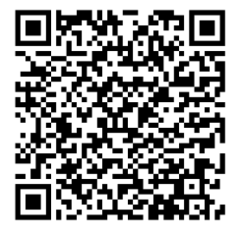
Session Feedback
Sarah Graham will be building a CANVAS course for today’s PLC, and all resources will be loaded into the 8th grade module.

