Slide 1
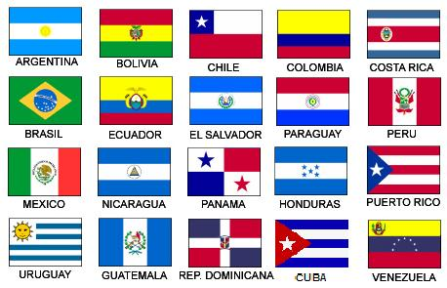
Español II con Senor Bly
rbly@hazelwoodschools.org
Voicemail 314.502.9209
¡Bienvenidos! Continuamos su educación española. ¡No tengan miedo!

Slide 2
Español II
A skill based class focusing on communication
After reviewing some Spanish I concepts, you will be introduced to these concepts (for example, say what you like to do) in class and those concept will be supported thru videos, vocab lists and verb charts posted on Google Classroom.
We will practice our four concepts using four language skills reading, writing, speaking and listening daily with different types of activities and sources
You are expected to demonstrate these skills thru class participation, interviews, projects, frequent formative assessments on Google Forms, and speaking assessments.
Learning a language is a skill attainable by everyone.

Slide 3
Google Classroom
Class Code:
This is our hub, where you will find most of our info, links to resources, schedules,, assignments, and assessments.
Daily, you will be asked to participate in some practice activities and discussion posts in the Stream.
You will find assignments, assessments and projects in the Classwork tab.
Types of assignments and assessments….

Slide 4
Rules and procedures
Please make sure you are making positive decisions that will help you be successful in class.
Be on time. Attempt each activity or assessment.
Attend class. Bring your materials to class.
Use our target language in class.
Be respectful of yourself, your classmates and staff members.
You will have 4 Hall passes per quarter. Any unused Hall passes will earn you 25 points extra credit EACH. Bathroom/locker/water passes are for a maximum of 5 minutes unless agreed upon by Profe Bly.

Slide 5
Rules and procedures
We will follow the school procedures for tardies, truancy, cell phone use and disruptive behavior. In short…
First occurrence, you will be refocused by Profe Bly
Upon second correction, there will be communication with parent or guardian.
Further infractions, will result in communication with grade level office.
Communication with you and your family is important to me. I will share and celebrate your successes, but will also share if you are not attempting To Speak Spanish, not participating in class, or are letting your grade slip below a 70%.

Slide 6
Objetivos - learning targets
Repaso 1 - Review 1 (8 weeks)
Students will be able to:
Greet and say goodbye to others, introduce themselves and others
Describe their friends, family and others
Discuss feelings and emotions
Discuss activities we like and dislike
Discuss their classes and teachers

Slide 7
Objetivos - learning targets
Repaso 2 - Review 2 (8 weeks)
Students will be able to:
Discuss their age, the date and count to 1000
Describe their clothing and colors
Review conjugating -AR verbs (llevar -to wear)
Review conjugating -ER/-IR verbs with clothing and shopping vocabulary
Tell when and how often they do things

Slide 8
Objetivos - learning targets
Capítulo 1 (8 weeks)
Students will be able to:
Discuss sports and clubs, after school activities with stem changing verbs
Discuss events that occurred in the past with chores and time frames
Use the verb IR in the preterit tense with travel vocabulary

Slide 9
Objetivos - learning targets
Capítulo 2 (6 weeks)
Students will be able to:
Talk about food with irregular preterit verbs
Discuss large numbers up to 1,000,000
Discuss the last time they went shopping (grocery, clothing, etc)
Final 2 weeks of school, we will focus on preparing for our final exam.

