Slide 1
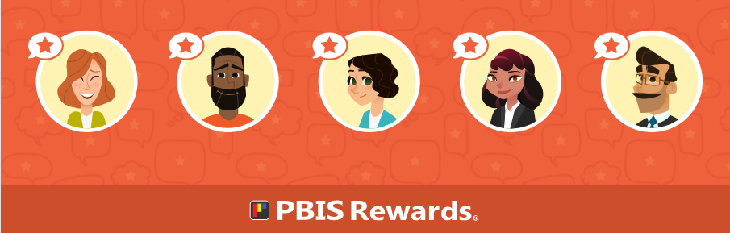
Getting Started with PBIS Rewards
Notes:
In this presentation, we will cover the basics of PBIS and how to utilize the PBIS Rewards system. This will be the beginning slide of the deck we share with you in the session quick links in the follow-up email.

Slide 2

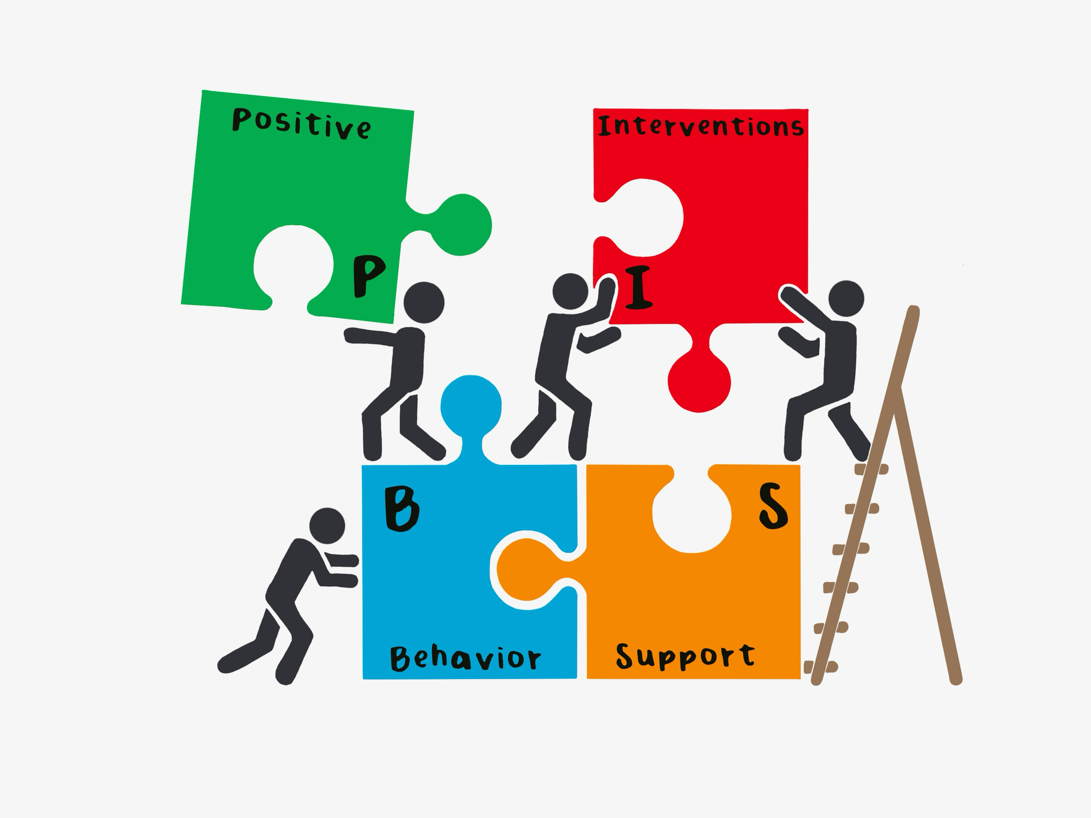
Hello! I’m HSC Brown
Home School Communicator (HSC)
2nd Year in Hazelwood and at Arrowpoint
Super excited for you all to begin using this!
This will be a snapshot of how YOU (the students) can use PBIS Rewards and the points you earn!
Notes:
Start off the session by introducing yourself to your audience and connecting with them. You might say, “I started using PBIS Rewards in _____” or “I first learned about PBIS Rewards from _____.” You might want to tell a quick story about a way you used PBIS Rewards with students or how you think this can make a difference in your classroom or school.
Get an idea about your audience by taking a quick survey – participants can raise their hand if they have used PBIS Rewards before.
On this slide you can add a picture of yourself, a Bitmoji, and your contact information in case they need assistance in the future. Use the prompts above to help you craft this page, and if you don’t use social media or have a blog, feel free to remove those bullets or get creative and add some of your own!

Slide 3
Expectations for Training
EXPECTATION | BEHAVIOR
Be Respectful | Be open to new ideas Actively listen while others are sharing
Be Responsible | Silence all other devices Gather materials (paper, writing utensil) Share the air
Be Safe | Share relevant information and ideas in chat Stay engaged - use non-verbal feedback Don’t be afraid to ask questions
Notes:
Set the tone by establishing expectations for the training.
If you are training virtually, you may need to adjust the expectations. You will also need to adjust expectations to align with those on your school matrix.
Just as we set expectations with our students, we want to do the same for adults.
"Cheers" Norms Matter Video Link: https://www.youtube.com/watch?v=Pdyf9ZRjda8&feature=youtu.be

Slide 4

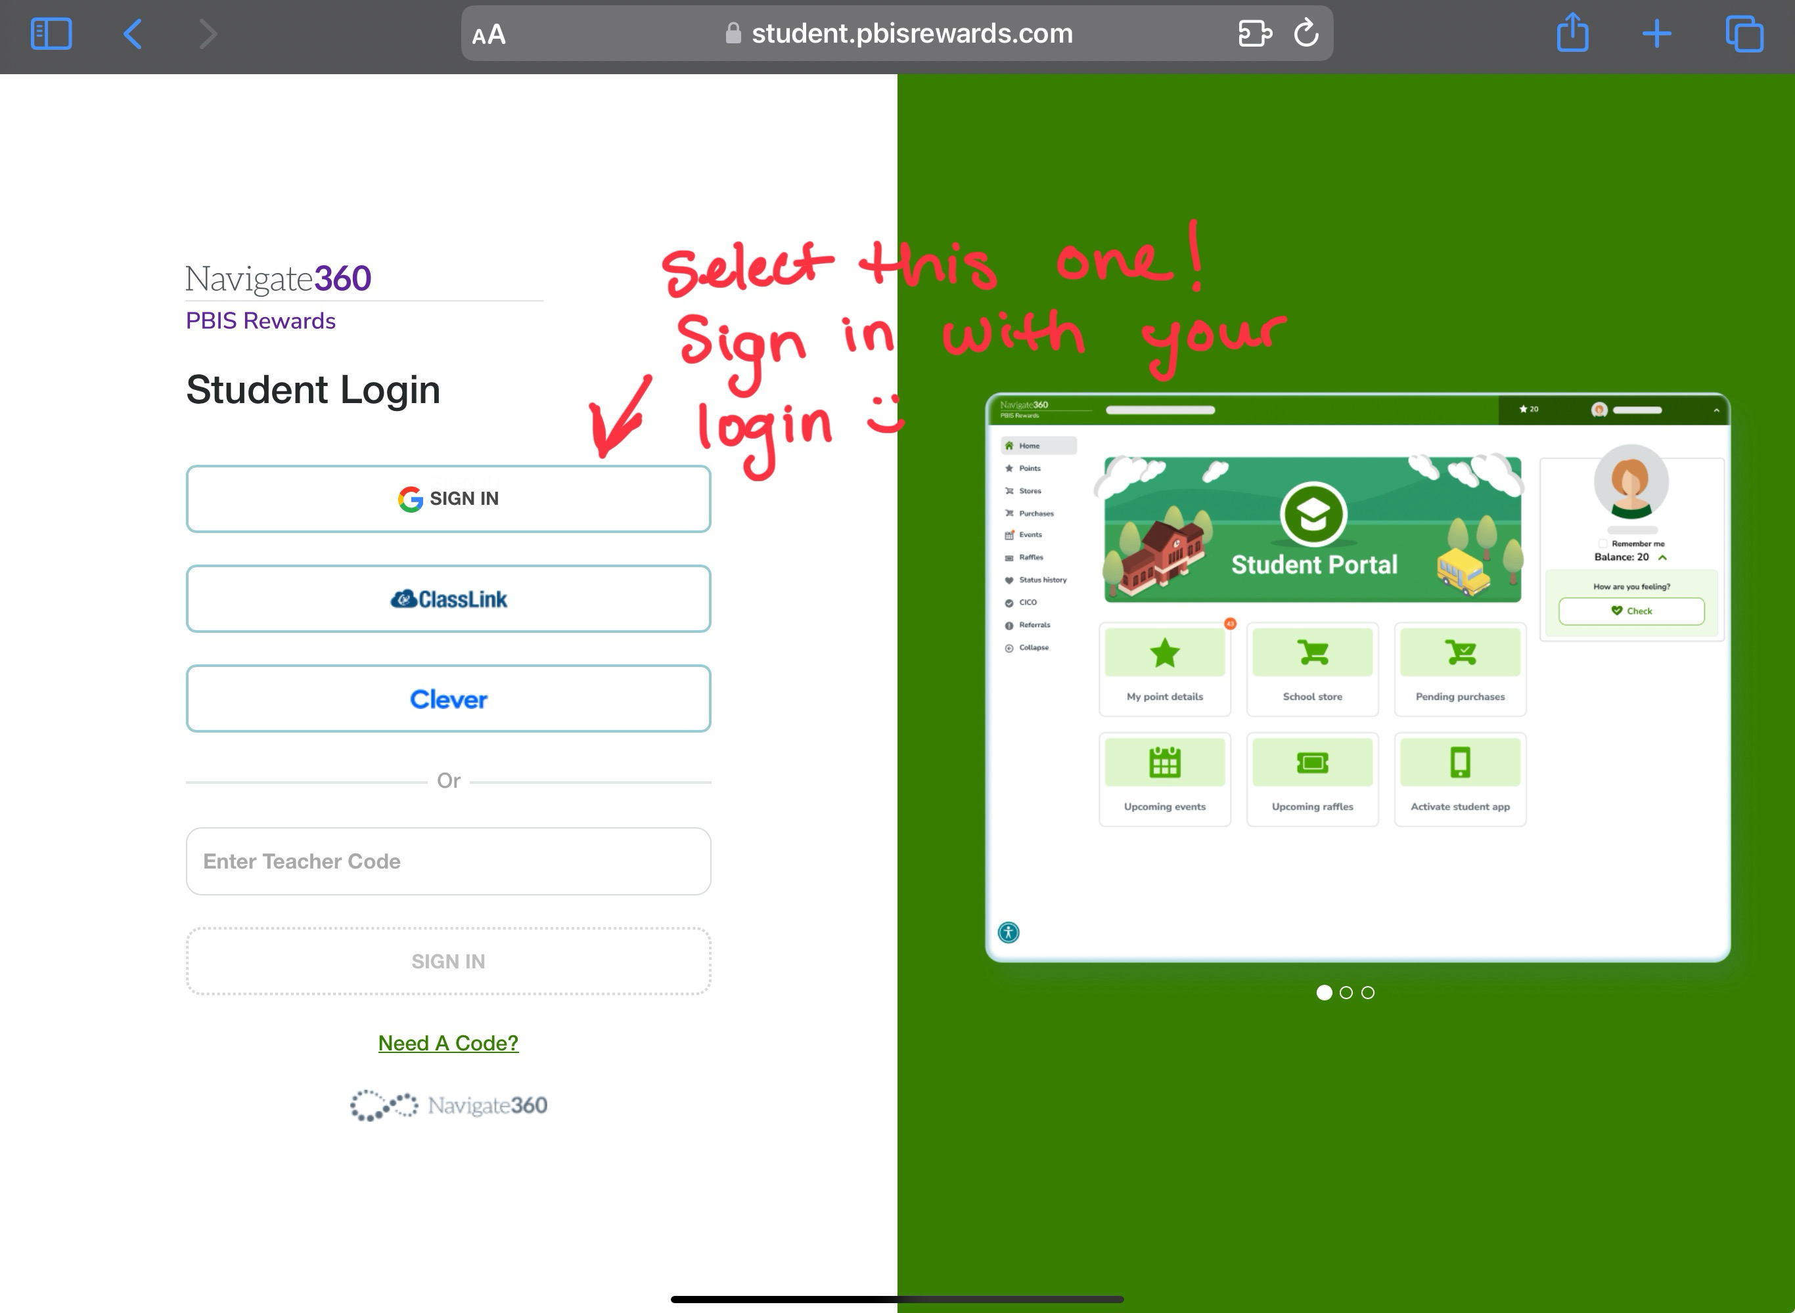
Web Portal Log In
First thing you need to do is go to the following site: student.pbisrewards.com
It will look like the picture below:
Your login information will be the same as you use for your computer
Username: 123456@hazelwoodschools.org
Password: HSD010203
Password is your birth month 01 your birth day 02 your birth year 03

Slide 5

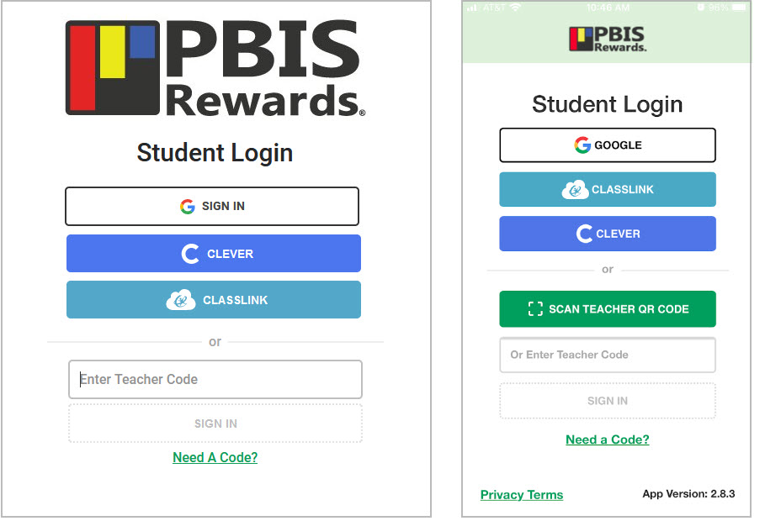
Student Login Page
Student Web Portal: student.pbisrewards.com
Student App
Notes:
Students can log in several different ways, through Google, Clever, Classlink, or even through a teacher Authorization Code in both the web portal and the student app.

Slide 6
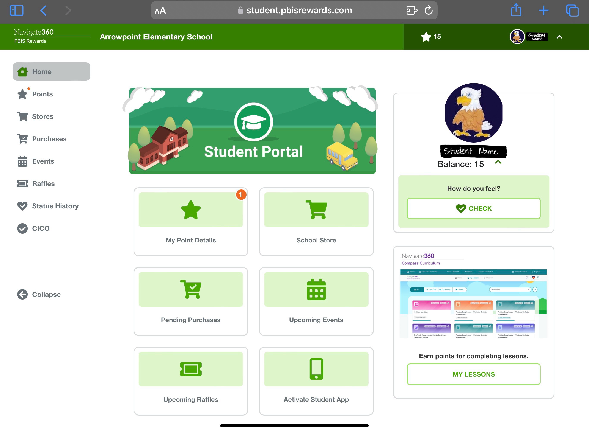
Student Web Portal/App
This is what the homepage for the web portal looks like, student may also download the PBIS Rewards App if they want to!
Notes:
Students can use their web portal and app to see their point balance, point details, comments teachers have made, upcoming events and raffles, Check-In/Check-Out info, stores items, and purchases. They can also purchase items from stores and register for events and raffles from their accounts when admin turns on Student Purchases from the admin settings tab. Students can also see their basic referral info and do SEL/Status Self Checks if Admin turns these features and accessibility on.

Slide 7
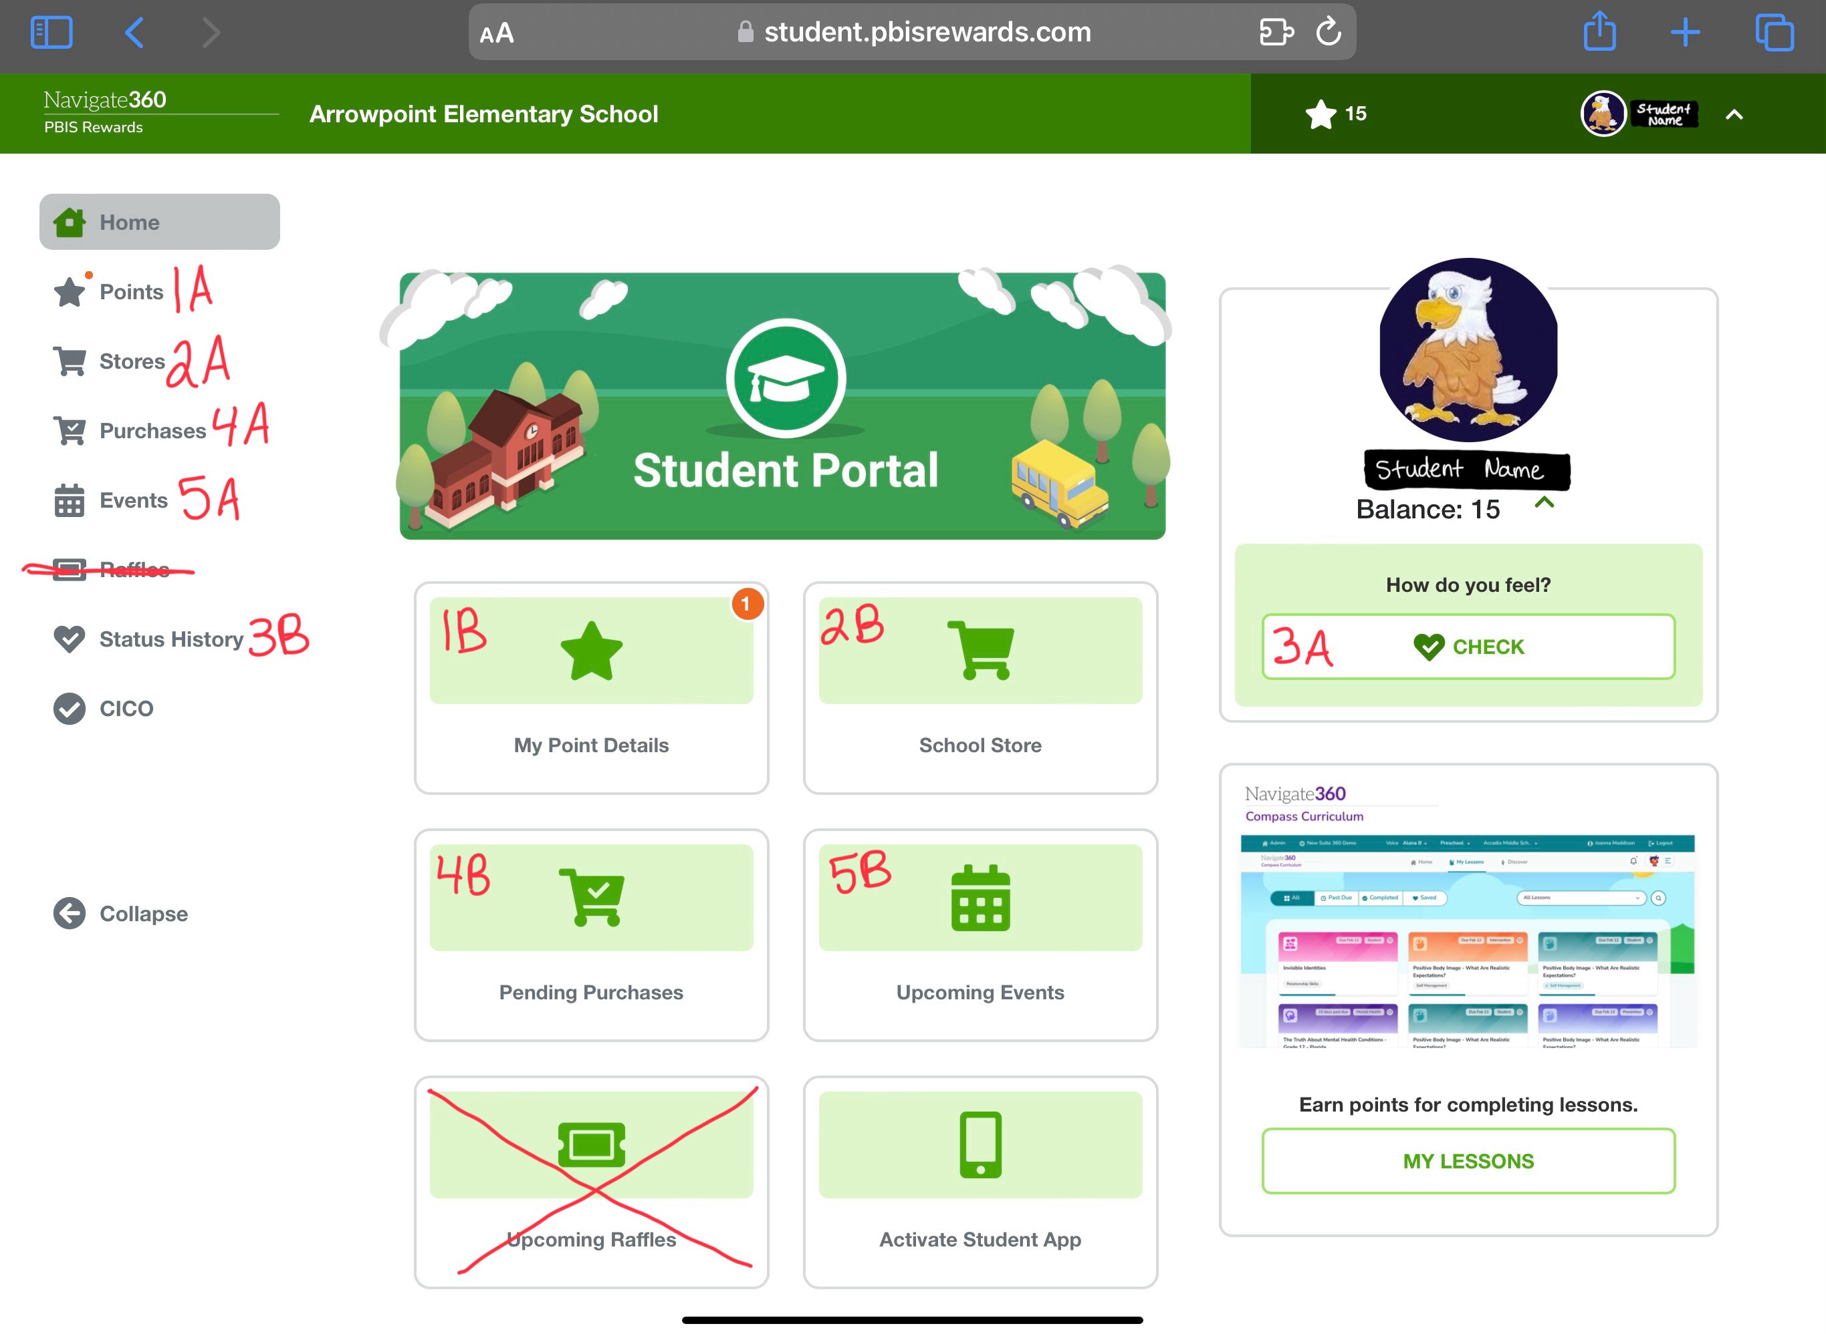
Student Web Portal/App - Navigation
1: Points – there are two spots where students can click to view their points 1A and 1B
2: School Store – this is where students can shop the PBIS store using their points. Click either 2A or 2B
3: SEL Check-In – 3A is where students can complete their SEL check in, 3B is where students can look at their SEL history
4: Purchases – this is where students can see their pending purchases and completed purchases from the store. 4A and/or 4B
5: Events – this will be where students can see the upcoming PBIS events (this is still a work in progress to get up and running)
Notes:
Students can use their web portal and app to see their point balance, point details, comments teachers have made, upcoming events and raffles, Check-In/Check-Out info, stores items, and purchases. They can also purchase items from stores and register for events and raffles from their accounts when admin turns on Student Purchases from the admin settings tab. Students can also see their basic referral info and do SEL/Status Self Checks if Admin turns these features and accessibility on.

Slide 8


How to Earn Points!
Students can earn points by doing the following:
  Follow school/classroom expectations
    Follow the 5 Be’s of Arrowpoint!
  Check In (SEL)
  Arrive on time for class
  Exhibit exceptional character, attitude, and behavior
  Participate in classroom discussions
  Complete and submit classroom assignments on time
    With your best effort as well!!
  Work cooperatively with others in the classroom or in a group
  Go above and beyond on a project or activity
  Help a student/staff member in need
Notes:
Feel free to change this slight to highlight some of your schools expectations and ways students should be acknowledged at your school.

Slide 9

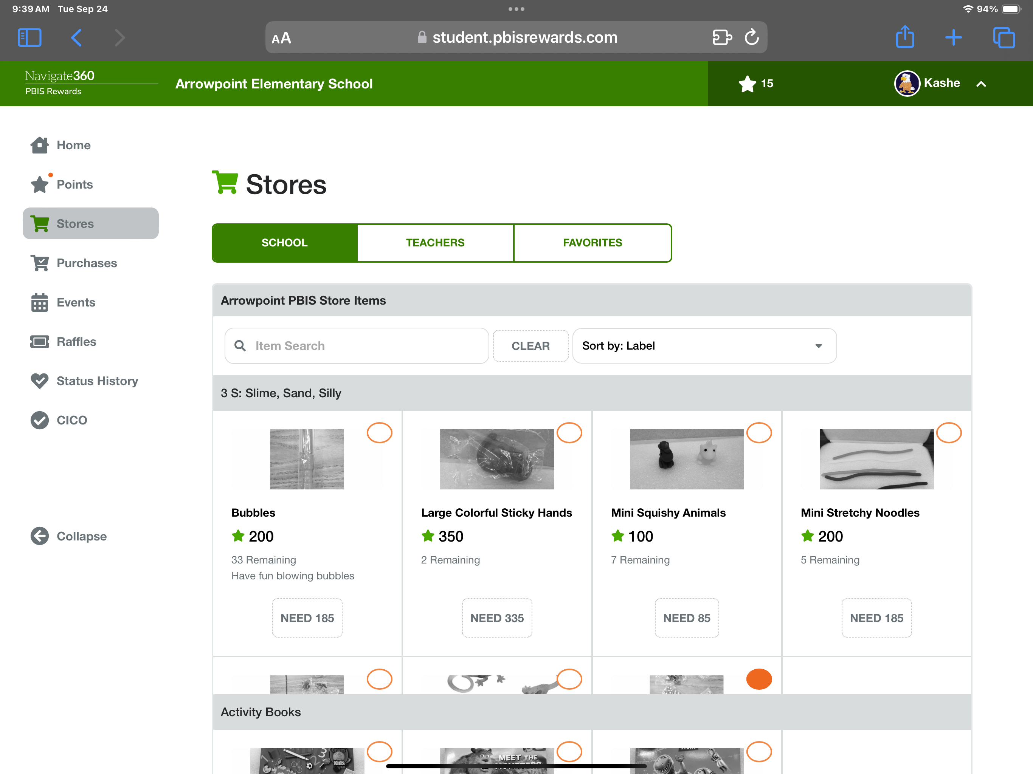
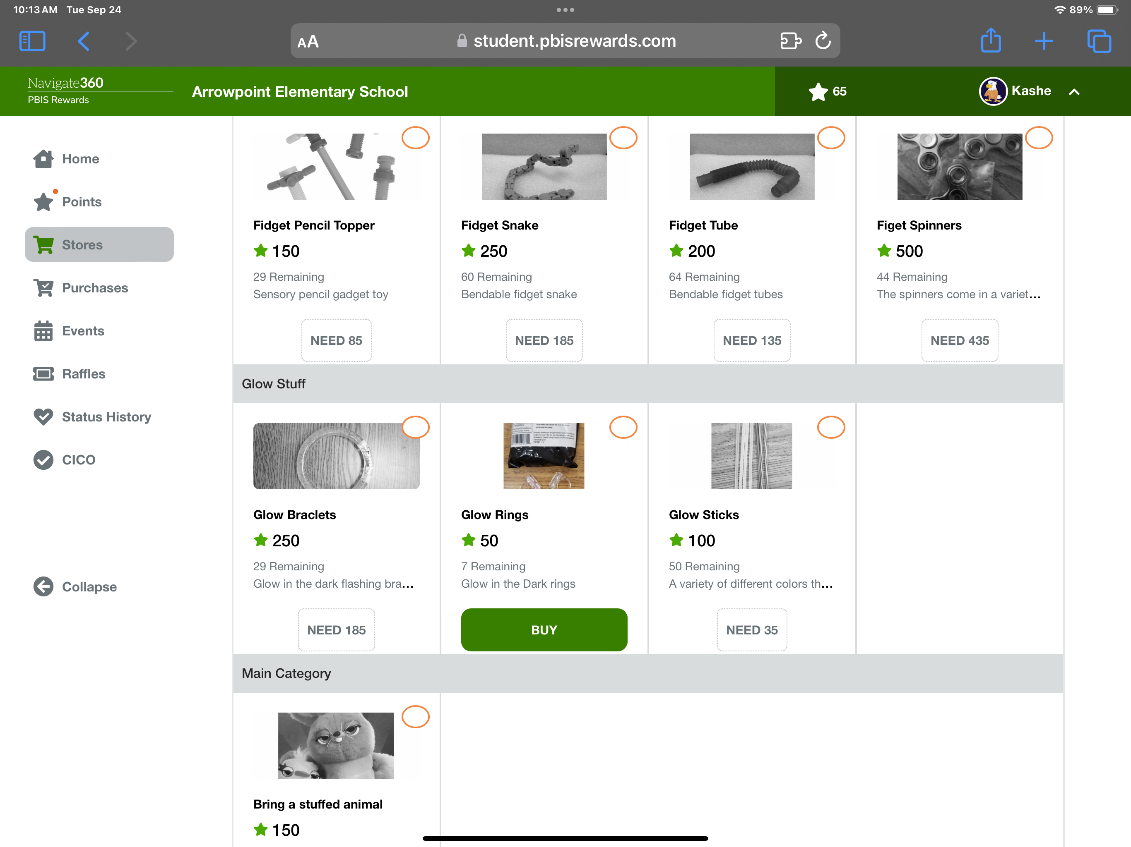
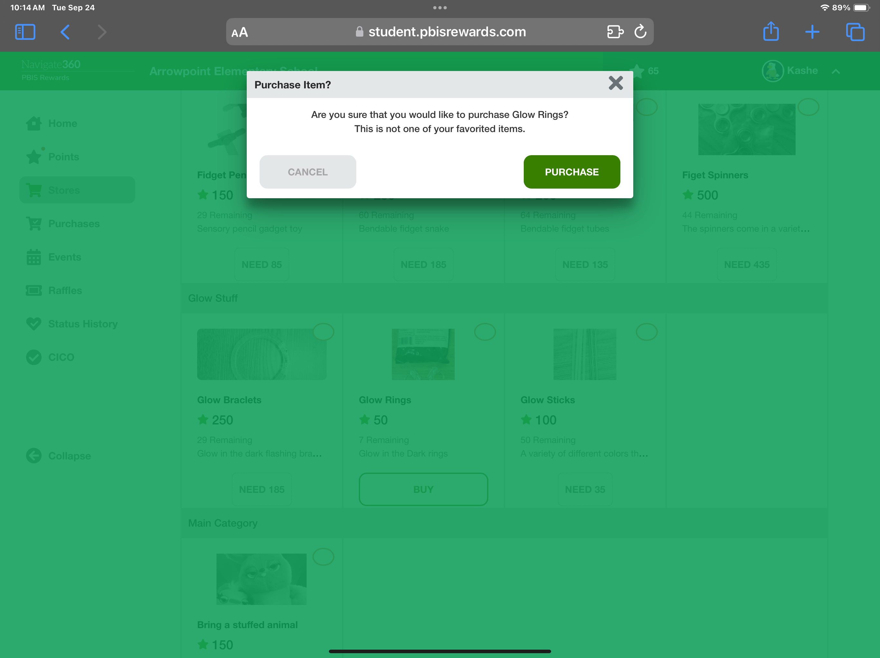
School Store
Step 1: Go to the school store, by clicking one of the two store options. The homepage for the school store will look like the image below
Step 2: Find and select the items you would like to purchase and highlight them or click “buy” shown in the image below
Step 3: Click purchase to finalize the items you want to get, shown in the image below. Then wait for delivery!

Slide 10
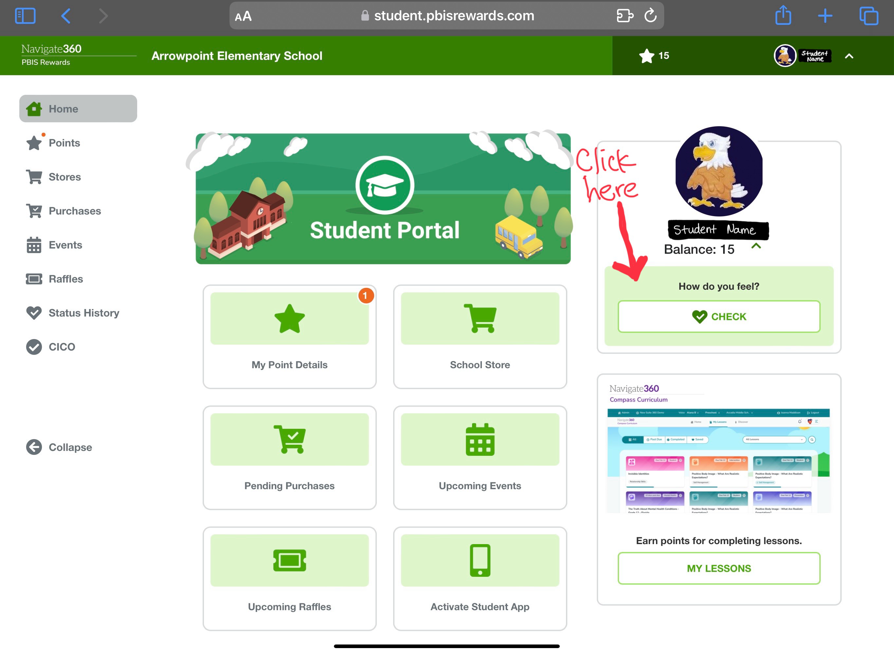
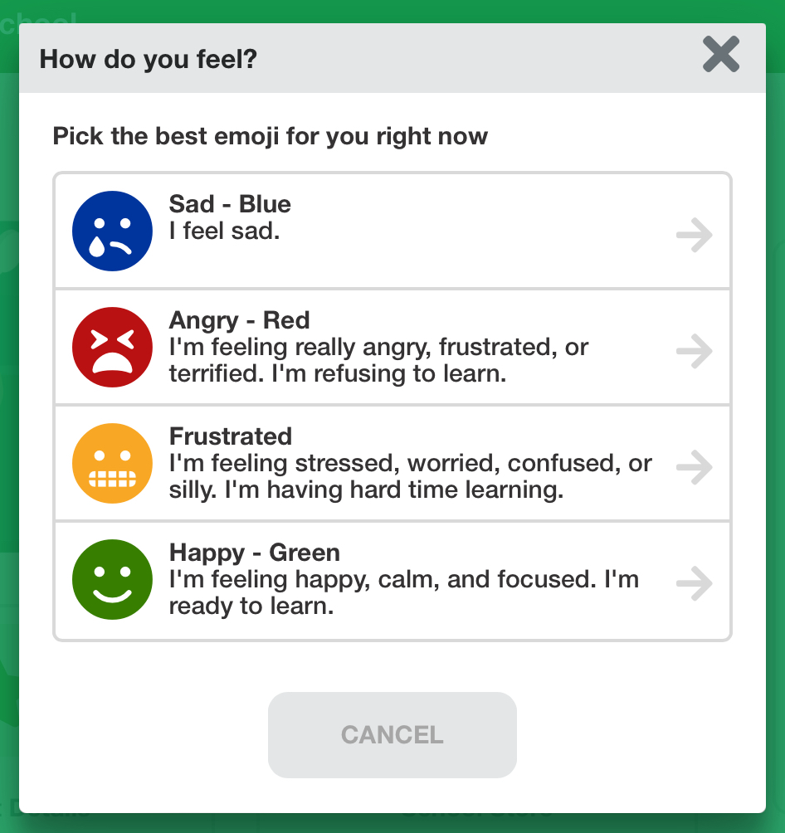
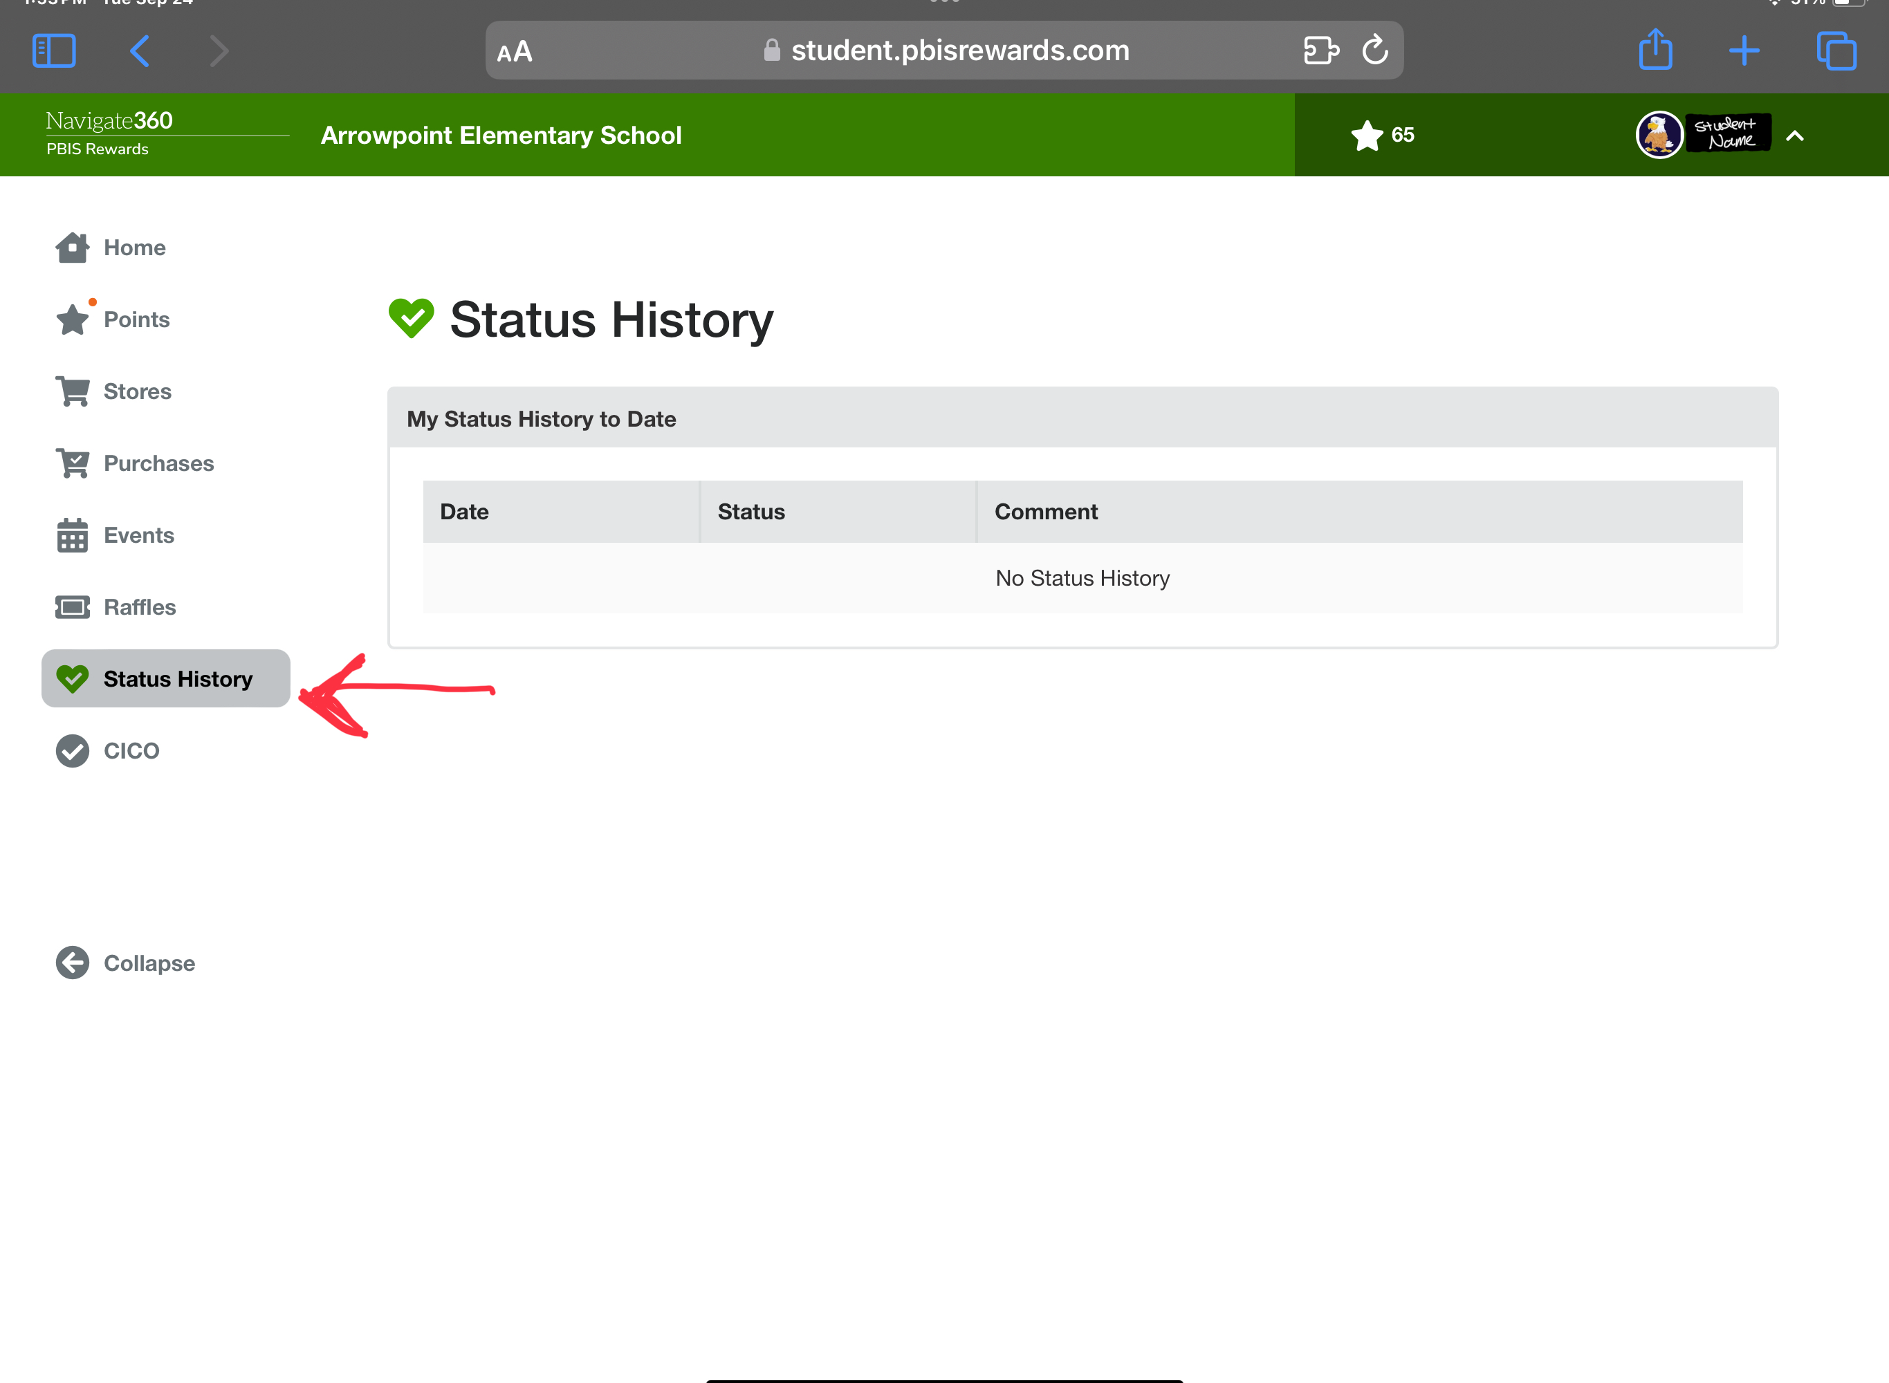
SEL Check-In
Step 1: Click on the box under “How do you feel?” Where it says “Check”
Step 2: This will pop up and you can then submit how you are feeling as well as type about what is going on if you want to
Step 3: This is where you can see all of your check-in history and what you have marked. Student Support Team Members will respond to check-ins as needed

Slide 11
PBIS GAME DAYS
Requirements:
- Fight Free (No physical altercations AT ALL)
Qualify:
-Point Goal (May change)
-Teacher Approval checked by PBIS Staff
Events:
-Staff versus students sports and activities
Notes:
There are 3 types of events in the system:
Redeem – These events will cost the student their points to attend. They will not be allowed to register without having the number of points that events costs.
Qualify – No Cost- students must reach a point goal. School events can automatically register eligible students. Class events can generate a list of eligible students to register those students.
Award – if they attend event, they can earn points from year to year. EX: Open House, Honor Roll, turning in paperwork at the beginning of the year, PTO, Afterschool Tutoring, etc.
Events will not roll from year to year

Slide 12

PBIS Game Days cont.
PBIS Game Days will happen monthly! The event/game will change from month to month but will always be staff versus students. Some may be sports, others may be card or board games, but it will ALWAYS be fun!
In order to participate the following is required:
No fights or physical altercations of ANY kind
Have earned enough points to meet that month’s point goal
Teacher approved based on
  Behavior and Attitude
  Work Completion and Effort
The following are possibilities for games/activities:
Sports
  Dodgeball
  Basketball
  Kickball
  Soccer
  Etc.
Activities
  Board Games
  Card Games
  Minute to Win It
  Etc.

Slide 13


Questions?

