Slide 1
Hazelwood Opportunity Center Virtual Clinic

Slide 2

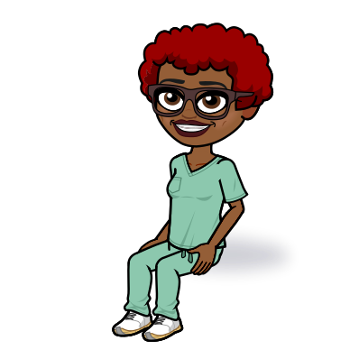

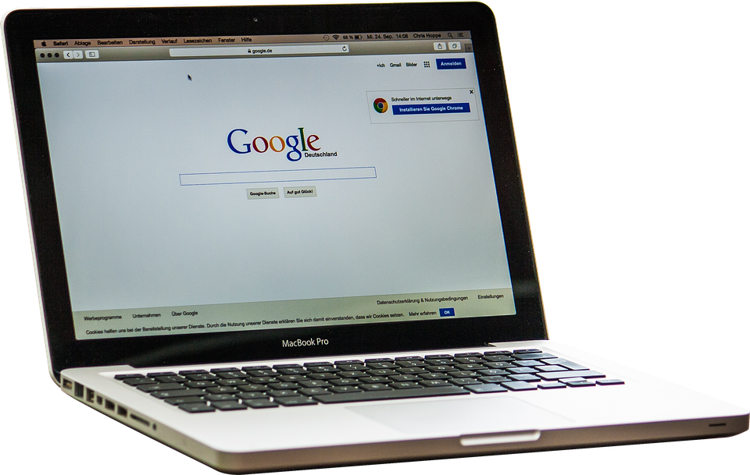



Click to learn more about me!

Slide 3
Hello, my name is Rikki Baylor or Nurse Baylor.
I am the Registered Nurse for the Hazelwood Opportunity Center.
Welcome back to the 2020-2021 school year! This year health practices have been evolving while focusing on keeping everyone safe.
Please checkout my virtual health clinic for some helpful resources and informational video clips!
Click to enter virtual clinic!
Notes:
Hello, my name is Rikki Baylor and I am a Registered Nurse for the Hazelwood Opportunity Center.
Welcome back to the 2020-2021 school year! It’s been a time of evolving with with new health practices geared toward keepin everyone safe. Please checkout my virtual health clinic for some healthful resources and FAQ page.

Slide 4
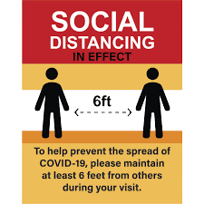




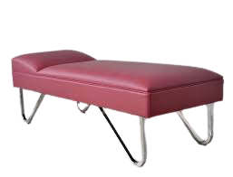


Slide 5

Immunizations and Health Records
https://health.mo.gov/living/wellness/immunizations/pdf/2021schoolrequirements.pdf
https://health.mo.gov/living/wellness/immunizations/vfc-parents.php
http://www.stlouisco.com/Health-and-Wellness/Health-Centers-and-Medical-Services#anchormurphy
Immunization
Schedules
Assistance
Location

Slide 6



Health Promotion and Illness Prevention
https://youtu.be/qJG72sycQB8
https://www.cdc.gov/coronavirus/2019-ncov/daily-life-coping/for-parents.html
https://www.cdc.gov/coronavirus/2019-ncov/prevent-getting-sick/index.html

Slide 7



Health Resources
https://www.cdc.gov/coronavirus/2019-ncov/if-you-are-sick/index.html
https://www.youtube.com/watch?v=Bqozl-9WYgM
https://www.youtube.com/watch?v=HRzLFnr0uUg
https://www.youtube.com/watch?v=ghLkwSlWSXw
https://health.mo.gov/

Slide 8




Before you go, remember to ...
And above all ...

Slide 9


Slide 10
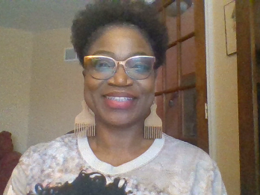
Thank you for visiting the Hazelwood Opportunity Center Virtual Clinic!
Nurse
Baylor

