Slide 1
Introduction to OPWDD
February 2025 Parent Training

Slide 2
Agenda
What is OPWDD?
Getting started
The Front Door Process explained
Eligibility
OPWDD Services
Employment Services
OPWDD Care Management
Assessment

Slide 3
What is OPWDD?
The New York State Office for People With Developmental Disabilities (OPWDD) is responsible for coordinating services for New Yorkers with developmental disabilities, including intellectual disabilities, cerebral palsy, Down syndrome, autism spectrum disorders, Prader-Willi syndrome and other neurological impairments. It provides services directly and through a network of approximately 500 nonprofit service providing agencies, with about 80 percent of services provided by the private nonprofits and 20 percent provided by state-run services.

Slide 4
What is OPWDD?
Supports and services are provided in community settings across the state and include long-term care services such as habilitation and residential supports. Individuals and their families can also choose to manage their own services and manage their own staff by self directing any or all of their services. OPWDD also provides employment supports, including ongoing job coaching, job matching and vocational training.
In addition, OPWDD offers family support services designed to help families provide care for their loved ones who live full-time in their family home.

Slide 5
Structure
Five Developmental Disabilities Regional Offices (DDROs) coordinate and oversee not-for profit provider services, and manage the Front Door process.
Most of your interaction with OPWDD will be through your local DDRO. You may also interact with not-for-profit agencies funded by OPWDD.
OPWDD works in partnership with Care Coordination Organizations (CCOs) to support people in developing and maintaining service plans.

Slide 6
Getting Started

Slide 7
What is the Front Door?
The Front Door is how you access services.
The Front Door offers a person-centered approach to planning supports for people with developmental disabilities. The Front Door process will guide you through the steps involved in finding out if your child is eligible for services offered by OPWDD, identify their service needs, and help you work on a plan for getting those services.
The goal of the Front Door process is to provide supports and services that help individuals and family members in ways that are respectful of their abilities, language and cultural values and traditions.

Slide 8
Front Door Process

Slide 9
Eligibility
The eligibility review process is the way OPWDD determines if your child has a developmental disability and are eligible for OPWDD supports and services.
The eligibility review process begins at one of OPWDD’s five Developmental Disability Regional Offices (DDROs) located throughout New York State. Care Coordination Organizations or Service Access Agencies are available to help you with the eligibility review process by submitting materials and records to the DDRO, such as reports of assessments conducted by medical professionals.
Qualified DDRO staff review this information to see if your child’s disability meets requirements specified in New York State law. If it meets the requirements, your child is deemed to have a developmental disability and becomes eligible for OPWDD services. (Please note: additional steps, such as enrolling in Medicaid, are needed to gain access to most supports and services.)
Depending on the complexity of your child’s condition, the process for obtaining an eligibility determination may require reports from multiple specialty assessments. A face-to-face interview may also be part of this process. Eligibility requests and supporting documentation must be sent to the Eligibility Coordinator at the DDRO where you live.

Slide 10
Eligibility Requirements
In order for a person to be eligible for OPWDD services, New York State Mental Hygiene Law requires:
The presence of a developmental disability that is described by certain qualifying diagnoses or conditions
The disability occurred before the person reached age 22
The disability can be expected to continue indefinitely or permanently
The disability causes a substantial handicap to a person’s ability to function normally in society.

Slide 11
Records Needed
Records for an OPWDD eligibility review would include:
reports of current or recent psychological testing of the person’s intellectual functioning
a standardized evaluation of the person’s “adaptive” behavior functioning
a social/developmental (or psychosocial) history
medical reports indicating the person’s health status. For children or adults with special medical conditions, genetic disorders, or neurological impairment, medical records that confirm the diagnosis of these conditions or disorders are required.
Educational records (the student’s Individualized Education Program (IEP) and report cards) can be helpful, too.

Slide 12
Eligibility

Slide 13
Services
OPWDD services and supports can help your child live in a home of your choosing, find employment and other meaningful activities, build relationships in the community, and support their health.
OPWDD offers an array of supports and services providing different levels of assistance.

Slide 14
Services

Slide 15
Examples of Types of Services
Help to live independently in the community with rent subsidies, community habilitation and other services
Help for your family to support your child in the family home with respite and family support services
Help with employment training and support, volunteer opportunities and other types of community activities you choose
Intensive residential and day services, if needed

Slide 16
Employment and Day Services
OPWDD values the abilities and talents each person contributes and supports people with developmental disabilities in preparing for working and volunteering in integrated community settings. In addition, OPWDD provides supports and services for individuals so that they can participate in community activities that interest them. Individuals who participate in day services can also participate in employment services.

Slide 17
Prevocational Services
OPWDD prevocational services offer people with developmental disabilities an opportunity for career exploration and volunteer experiences to identify their skills, abilities and interests.
Pathway to Employment is a time-limited service that helps your child develop a plan for employment success using Person-Centered Planning to identify their job interests and goals, try various jobs to determine which tasks and work atmosphere they like best, and learn work-related social and communications skills. The outcome of this service is a Career and Vocational Plan that identifies the next step in their path to employment.
You may be eligible for Pathway to Employment if you are receiving day habilitation or community prevocational services, or are a student leaving high school, or someone who is interested in creating a career and vocational plan.
Community Prevocational Services: help people with developmental disabilities learn social and communication skills related to work as well as other work-related skills such as task completion, time management, problem solving, following directions and safety skills that will increase their independence in the community.

Slide 18
Employment Services
OPWDD employment services can help people with developmental disabilities obtain and maintain competitive employment.
Supported Employment (SEMP) supports people in getting and keeping paid competitive jobs in the community. Once a person-centered career plan is developed through Pathway to Employment, Community Prevocational Services or another method, OPWDD service provider agencies offer job development services. OPWDD service provider agencies also offer services to assist with maintaining employment. These services include helping the individual adapt to the workplace, retraining when job requirements change, and travel training.
The Employment Training Program (ETP) offers people an opportunity to work in a paid internship in a community business. ETP participants receive enhanced job coaching and attend job readiness classes that cover topics like conflict resolution and how to dress for work.

Slide 19
Day Services
Community Habilitation (CH): helps people who live independently or at home with family learn about and experience community-based activities. Community Habilitation is a service available at home and in the community. It can be either self-directed or agency sponsored. Community Habilitation staff help the person learn and keep the skills they need to live safely and more independently, maintain or improve their health, work toward other personal goals, meet people and make and keep friends, take part in community activities, and be part of their community.
Day Habilitation: services help people learn and keep the skills they need to live safely and more independently, participate in community activities, identify interests, develop talents and skills, make and keep friends, learn basic life skills, and be a valued member of the community. Day Habilitation activities take place at a set location or within the community
Respite services help families who care for their loved ones in the family home, even if the individuals have more serious health issues or more challenging behavioral needs. These services give caregivers needed breaks. The kinds and locations of respite service available include in-home, camp, recreational and site-based.

Slide 20
Family Services
Family Support Services help families who care for their loved ones at home. These services can provide needed breaks to caregivers, provide training and moral support, recreational and social activities, sibling services, parent-to-parent networking and support in times of crisis.
Services include:
Respite
Family member training
Support groups
Training in how to manage challenging behaviors
Reimbursement
Parent-to-parent networking
Information and referral
Sibling services
After-school programs
Recreation/social activities

Slide 21
Care Management
Care management is the service that helps you and your family get the services and supports your child needs. Care management is provided by Care Managers who work for Care Coordination Organizations (CCOs), organizations that were formed by developmental disability service providers (and are staffed by Care Managers with training and experience in the field of developmental disabilities). Your Care Manager will coordinate a variety of healthcare, wellness and developmental disabilities services to meet your child’s needs.
Your CCO will help you with the OPWDD eligibility determination process, the Level of Care Eligibility Determination process and the process of enrolling in Medicaid.

Slide 22
Care Management Explanation

Slide 23
Assessment
Once your child’s eligibility to receive OPWDD services has been determined, you will start the assessment process. The purpose of the assessment is to identify your child’s current strengths and needs and the natural or community supports he/she can have or can get. This information is used to plan for services they need and to develop their person-centered plan.
Examples include: The Developmental Disabilities Profile (DDP-2) which is a brief assessment used to identify challenges and service needs. The Coordinated Assessment System (CAS) which is a comprehensive tool used to identify strengths, needs and interests, and to assist in person-centered planning.

Slide 24
Assessment

Slide 25
Transitioning from School to OPWDD
Local school districts provide special education services until a student graduates or completes their school program at the end of the school year in which they turn age twenty-one (21). Schools are expected to help plan the student’s transition to adult services before their 15th birthday. Families also should begin the process of determining OPWDD eligibility and planning for services ahead of time.
OPWDD’s Front Door staff, working with Care Managers, will help students at local schools plan for the OPWDD supports they may need as adults.

Slide 26
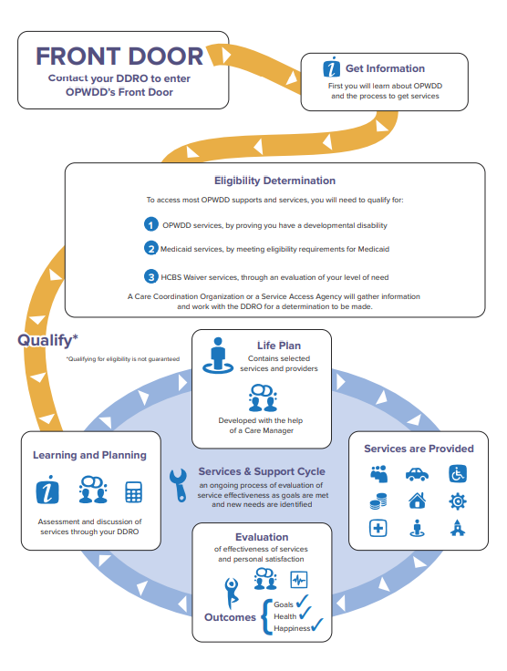

Slide 27
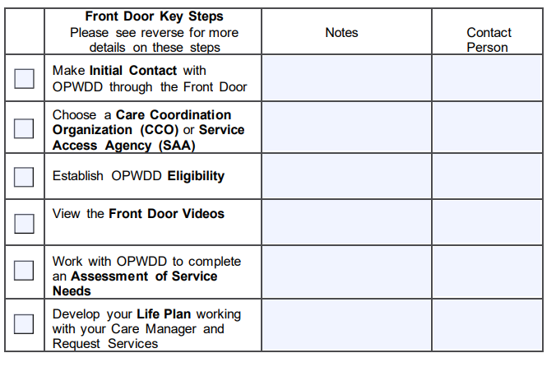

Slide 28
Contact Information
OPWDD toll-free information line: 1-866-946-9733 for questions about supports and services.
Front Door Access to Services pamphlet
English
Spanish
Front Door Videos
Long Island General Information Number: 631-434-6100.

