Slide 1
Credit Check How To

Slide 2
Step 1: Login to HAC Step 2: Go to Grades → Transcripts

Slide 3
Step 3: Use Your Transcript to Complete Credit Check Form

Slide 4
Consider each square a semester. If you took and passed both semesters, put a check mark in both boxes. Typically one check mark = ½ credit.

Slide 5
Use the letters in the course # to determine the type of credit awarded for each class. (Ex. PA = Practical Art)

Slide 6
If you are currently taking a class, put a circle around the square so you know that it’s a credit in progress, but not yet completed

Slide 7
Any credit above what is required for graduation will count as an elective (ex. if you have taken more than 1 Fine Art, your extra FA credits should be written in under Electives)

Slide 8
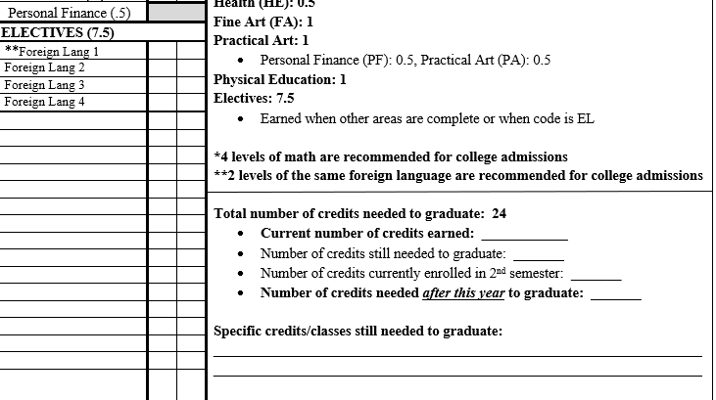
At the bottom of your form tally the # of credits you have already earned, the credits you’re currently enrolled in and the credits still needed for graduation.

