Slide 1
What is Title I and How Can I be Involved?
Ebinport Elementary
Notes:
https://docs.google.com/forms/d/e/1FAIpQLSd_8hS3UcuaYOEu8Xyg3eLqTUuqhxQVmTllHCf8s7-Oo-nfnw/viewform?usp=sf_link
1

Slide 2
Definition of Title I:
Title I provides federal funding to schools to help students who are low achieving or at most risk of falling behind.
Title I is allocated to schools based on the percentage of students receiving free/reduced lunch.
Schools with a percentage of at least 40% are eligible for a schoolwide program.
Notes:
2

Slide 3

Ebinport Elementary operates a Title I Schoolwide Program.
Notes:
3

Slide 4
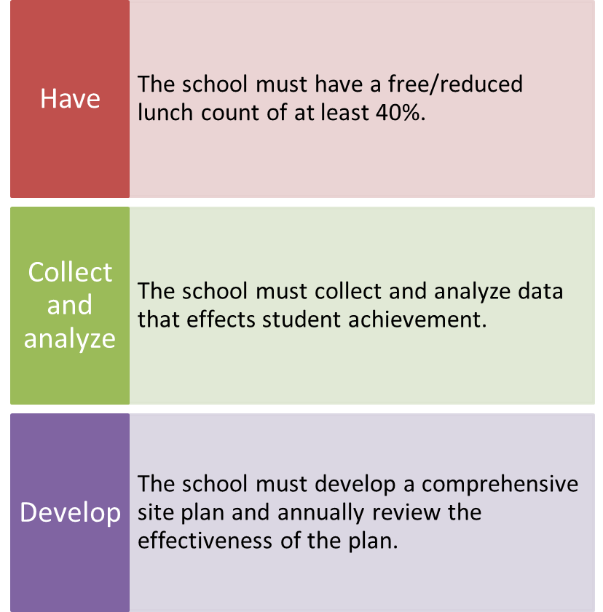
To be a “Schoolwide” School:
Notes:
4

Slide 5
Ebinport’s
Title I Schoolwide Program
Notes:
5

Slide 6
Summary:
Literacy Intervention Specialist
Provide opportunities to meet challenging academic standards.
Provide early interventions to our most at-risk students and to close the achievement gap by third grade.
Pre-K Teacher
Provide early interventions to our most at risk population to prepare for the rigorous academics of the kindergarten classroom.
Pre-K Assistant
Assist in the early childhood program transition.
Assist the Pre-K teacher and to maintain the correct teacher- student ratio in the Pre-K classroom.
Teacher: Reduction in Class Size
Provide classroom instruction.
Supplies, Materials, Academic Programs
Use of effective instructional strategies
Purchasing necessary supplies and materials to allow for the Title I programs to successfully impact our at-risk population.
Behavior Coach
Provide classroom support in area of social/emotional regulation.
Provide students with positive behavior support and intervention in order to have both behavioral and academic success.
Notes:
6

Slide 7
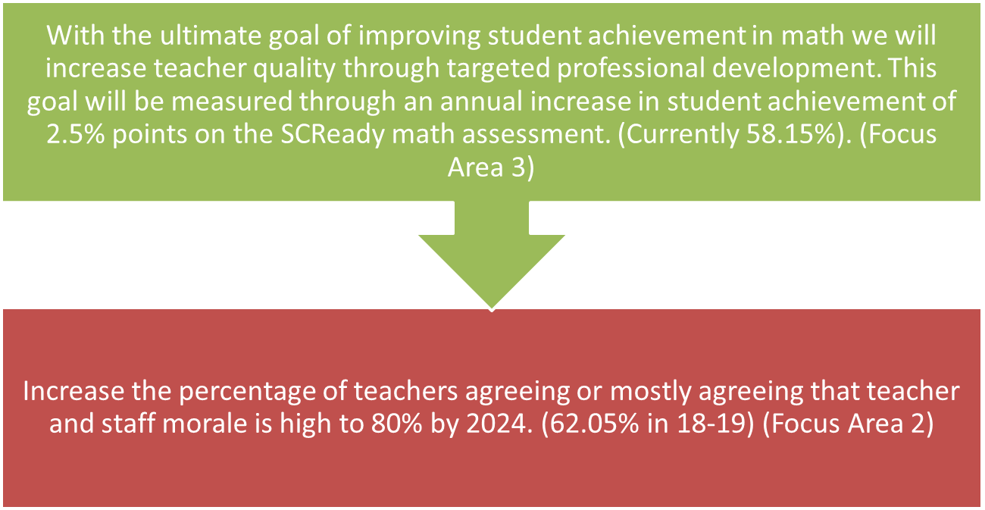
Focus Goals

Slide 8

Title I Parent Notification Requirements

Slide 9
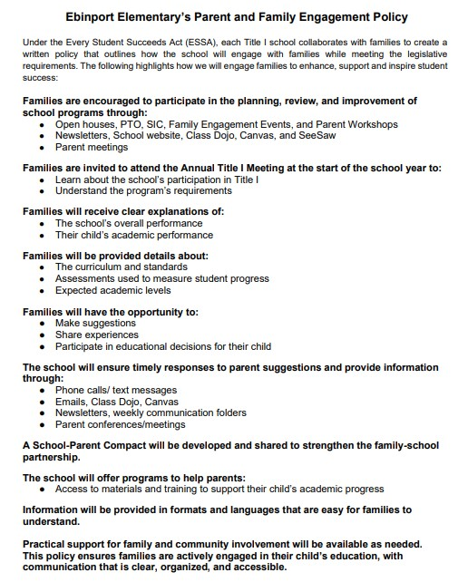
Parent Involvement Policy

Slide 10

Parent’s Right to Know –
Student Achievement
Individual Student Reports are sent home.
Notes:
10

Slide 11

Parent’s Right to Know –
Non-Highly Qualified Teachers
Schools are required to notify parents if their child has been taught for four or more consecutive weeks by a teacher that is not highly qualified.
At Ebinport, all teachers are highly qualified.
Notes:
11

Slide 12
How Can You Be Involved?
Notes:
12

Slide 13
Parent Involvement Opportunities
School Improvement Council
PTO: Everyone is invited and welcomed to attend
Class DoJo
Classroom Volunteers
  Organize/communicate events
  Aid the teacher with preparing materials and supplies
  Serve as an advisor to the teacher
Notes:
13

Slide 14
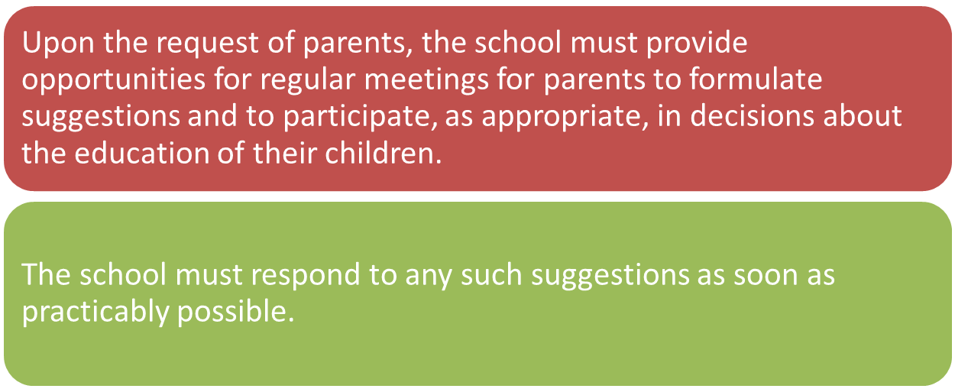
Right to Request Meetings

