Slide 1
NHS Meeting May 5th
Agenda, slides, and information 5/5/2021

Slide 2

Call to Order- Pressley Phillips Item #1- Stoles Item #2- 2022 Presidential Election Canidate information Item #3- Point Tracker, "Service" Essay & Graduation Requirements Item #4 Contact List and information Questions????? Close Meeting
Agenda 5/5/2021-All Member Meeting

Slide 3
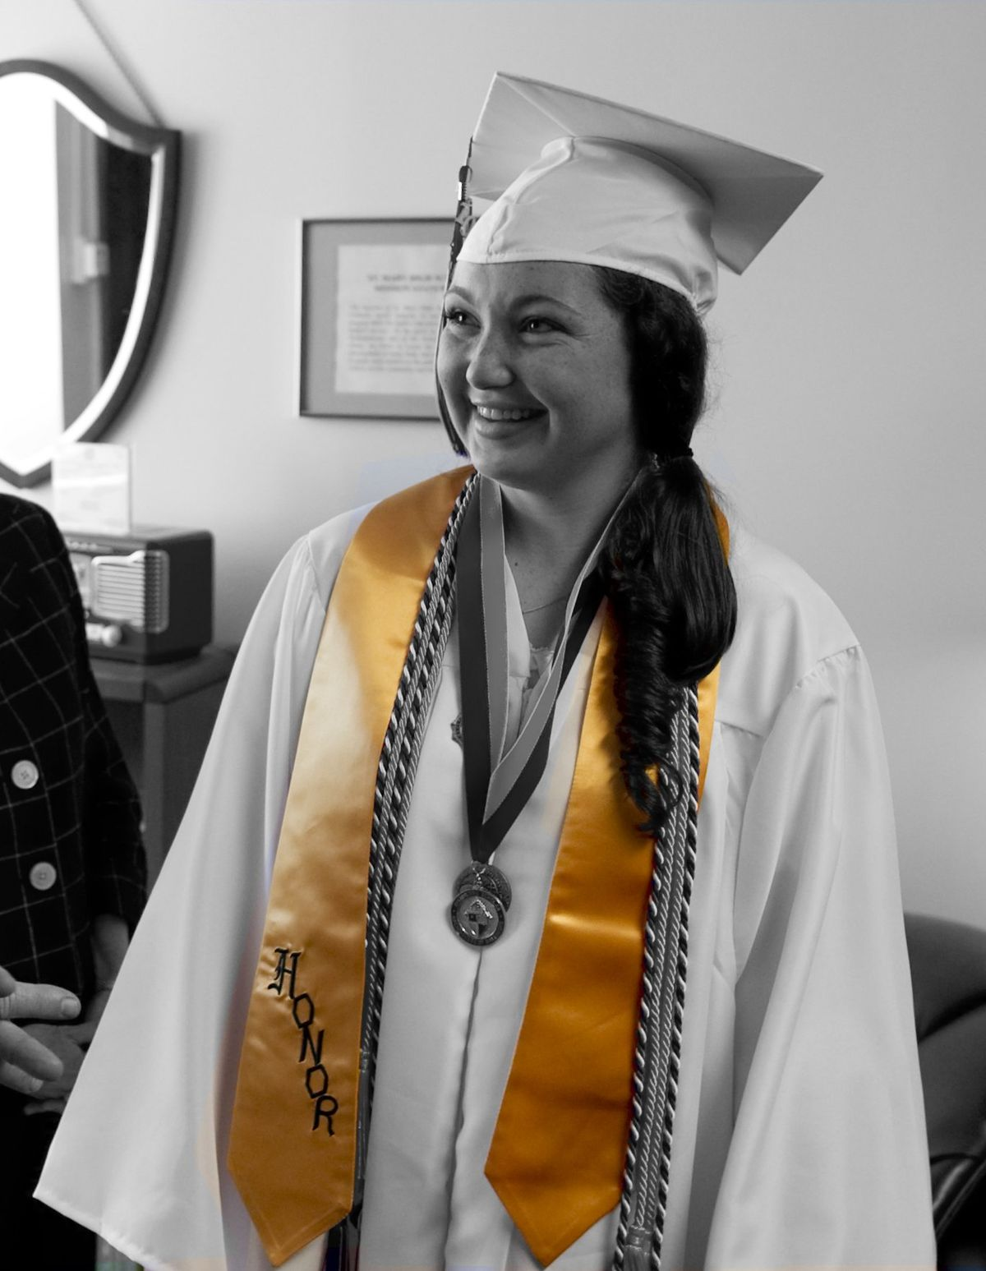
Item#1- Stoles Stoles will be ordered and available for graduation Members must meet eligibility requirements *Freedom High School Chapter member * 3.5 or above cumulative GPA * No suspensions * Complete Essay Prompt (Due 5/12/2021)
Blue
Blue
BLUE
DONATIONS OF $15 OR MORE CAN BE MADE AT THE STUDENT STORE
Stoles

Slide 4

Item#2- Canidate Information/Presentations from Allison Felix and Mia Phounrath approx. 2 minutes each Election will take place from May 10th-13th (in person or online) Voting is for current juniors in good standing Link to be posted on the website starting Monday and ballots will be availible in B-204 (Hollister's Room) one vote per person
Additional Cabinet positions will be made in
August 2021
VP, Treasurer(x2) secretary, Historian

Slide 5
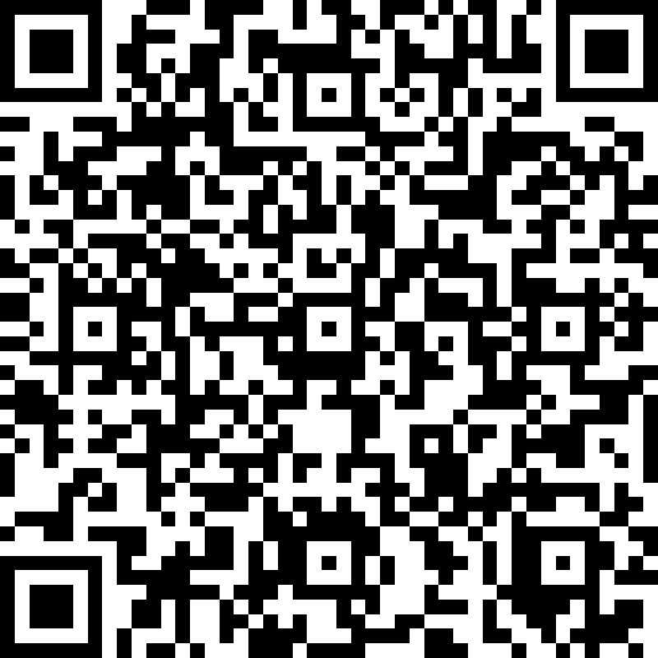
Item#3- Active Membership Essay Response
ALL Members must write and submit a response to maintain active membership What does this mean? To be elegible to receive graduation recognition (this year, or next) members must submit their essay by 5/12/2021 @ 3pm
https://ca01001129.schoolwires.net/Page/19772
Freedom's Webpage>Academics>NHS>Active Membership Response
QR Code for Essay Information

Slide 6


Item#4- Contact Information Are you on the emial distribution list? Are you familiar with the website?
Email Mr. Hollister @ hollisterj@luhsd.net

