Slide 1
NHS Meeting May 26th
Agenda, slides, and information 5/26/2021

Slide 2

Call to Order- Pressley Phillips
Item #1- Chapter Advisor Update
ITEM #2- STOLES, PICKUP DATE
Item #3- 2 dates in MPR for induction
Item #4- Applications for remaining cabinet positions
Item #5 Contact List and information
Questions?????
Close Meeting
Agenda 5/26/2021-All Member Meeting

Slide 3

2021-2022 NHS Advisor Update
Welcome Mrs. Angelo and Ms. Woodcock
Mr. Garcia is pursuing other opportunities away from Freedom. Mr. Hollister will remain.
While NHS and CSF will remain separate clubs, there are some synergies for all involved.
Item 1

Slide 4

Item#2- Stoles will be available for pickup on 5/27 and 5/28
*Students must be on the Graduation Recognition List (listed on website)
* Students must bring ID and sign out for their stole
Pickup is in B-204 (Mr. Hollister's Room) from 1:15-3:00
Thursday 5/27 and Friday 5/28
Stoles
This Photo by Unknown author is licensed under CC BY-SA.

Slide 5
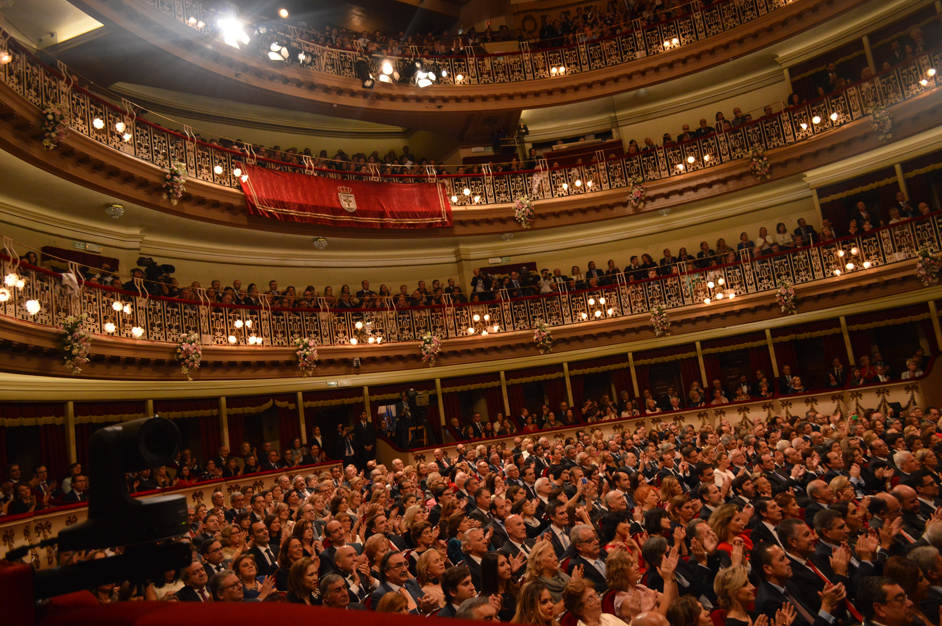
Induction Ceremony
Item#3- Induction Dates for new members will take place next school year on August 19th, 2021 in the MPR. This is a semi-formal event and if allowed, guests are permitted.
Future Members (sophomores next year) will have their induction on May11th, 2022
Induction- August 19th Approx. 5-7pm
Expected to be an in-person event

Slide 6
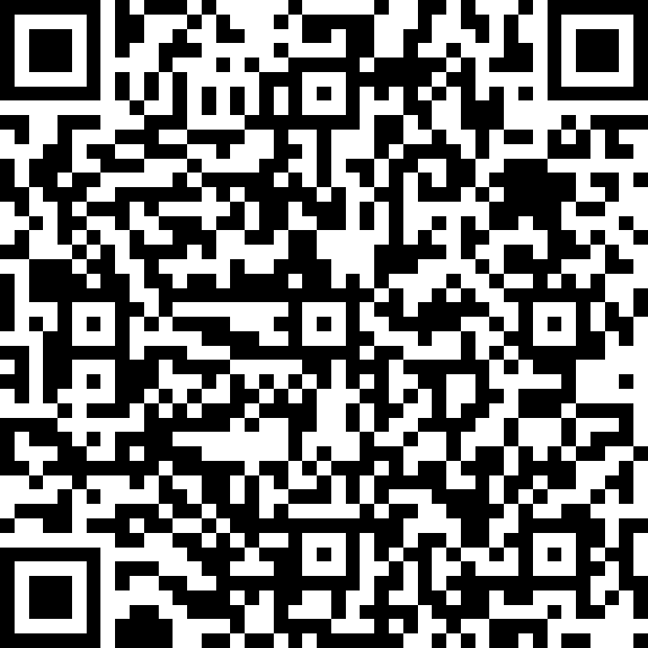
Elections for VP., Treasurer, Secretary and Historian
Currently accepting applications until June 3rd at 3PM
Link available on the Website too
Remaining Cabinet positions for eligible Juniors (must be inducted)
VP, TREASURER(X2) SECRETARY, HISTORIAN
QR Code for Election Information

Slide 7


Item#5- Contact Information
Are you on the email distribution list?
Are you familiar with the website?
Email Mr. Hollister @ hollisterj@luhsd.net

Slide 8

Questions?
Close Meeting
Email Mr. Hollister: hollisterj@luhsd.net
As needed

