Slide 1
NATIONAL HONOR SOCIETY
Meeting #3
October 20th, 2021

Slide 2
Agenda 10/20/2021
Group Photo
Donations for Food sales
Safe Halloween
Voting Item- Reusable Sign, Drinks for Food Fair
Points Sheet- (Sign-off)

Slide 3


Group Photo
Today
Wednesday 10/20/2021
3:30PM Sr. Hill
All active members should attend for our annual group photo. This photo will be part of the 2020-2021 Yearbook

Slide 4
Food Sales Donations
Next week October 25th-29th CFS Food sales week
November 1st-5th NHS Food Sales week
Donations needed (single serve packaging)
  Ex. Goldfish
  Fruit snacks
  Cheetos
  Sun chips
  Rice Krispy treats
  Fruit roll ups
  Cheez-its
  Single serving snack pack items

Slide 5


Slide 6


Safe Halloween
Wednesday 10/27/2021
4:30pm-6:00pm FHS Main Quad
NHS will have a booth and participate in Safe Halloween, presented by CSF.
Mystery Items

Slide 7

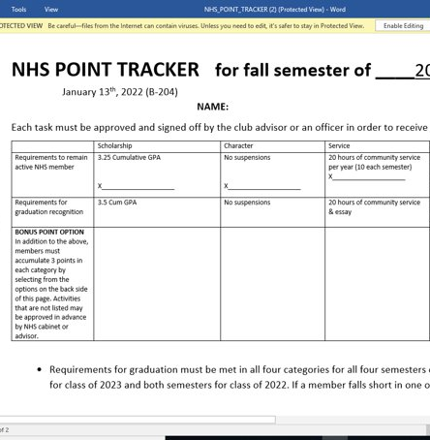
Point Sheet/ Attendance/Graduation Recognition
Sign-offs for bonus points available today after pictures in B-204

Slide 8
Voting Items
1) Authorization up to $100 for a permanent event sign
2) Lemonade for Food Fair drinks

Slide 9
Club Information
Sign up for remind: Text @NHSFHS22 to 81010
Check school issued email: Download the Outlook app
Check School Website frequently!
STUDENTS MUST BE RESPONSIBLE FOR STAYING UP TO DATE ON ALL CLUB MEETINGS/ACTIVITIES

Slide 10
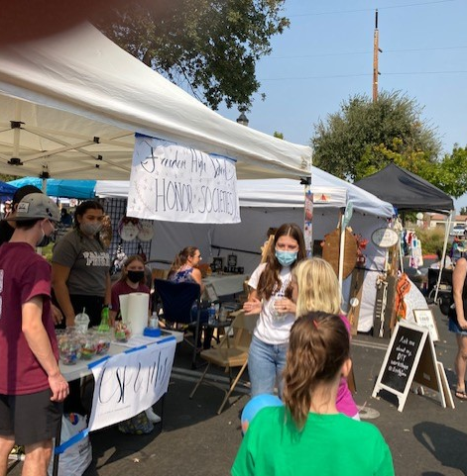
Recap of Recent Events
Chipotle Fundraiser, $369.25
Heart Of Oakley Festival, a success

