Slide 1

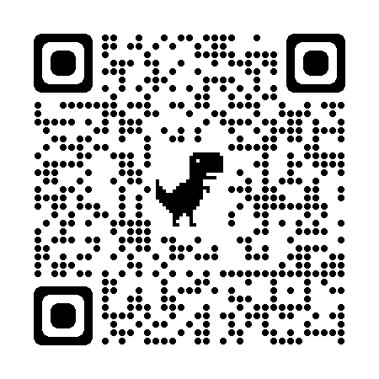

NATIONAL HONOR SOCIETY
Sign in using the QR code!
Meeting #7
April 13th, 2022

Slide 2
Agenda 4/13/2022
Food Sales Week Recap
Upcoming Car Wash Fundraiser
Induction and Awards Night May 11th
Scholarship Update for NHS Members
Sophomore Applications for NHS Membership 4/15-4/29
Juniors interested in NHS officer positions
Treasurers Report
State Seal of Civic Engagement
CSF Business
Upcoming Dates of Interest

Slide 3


Food sales Week 2/28 Recap
* Great Donation Turnout
* $191 - deposited

Slide 4

Upcoming Car Wash? Saturday 4/16
Rain is in the forecast for Saturday. Car washes don't work in the rain :(
We will need to cancel this year's carwash.

Slide 5
Awards Night/Induction
Wednesday May 11th: NHS and CSF will be having our awards night and NHS induction. This is an opportunity for us to celebrate our accomplishments and receive our graduation stoles. Additionally new members will be inducted to become part of the NHS Chapter at Freedom High School. Details to come.

Slide 6

Scholarship Update
Class of 2022: NHS scholarships will be awarded for members who submitted applications to the career center in the fall and checked the box that they were interested in the NHS scholarship.
22 applications received

Slide 7
Spring Recruitment 4/15-4/25
Our recruitment campaign will begin on Friday 4/15. Remember, for NHS, you only need to apply and be accepted one-time during high school. This campaign will be designed for current sophomores.

Slide 8
2022-2023 Officer positions
Juniors: Check your email (both school and personal) you have been sent information about executive board opportunities with NHS during the 2022-2023 school year. This is an amazing way to build your college application resume and gain valuable leadership skills.
Deadline is 4/20/2022

Slide 9


Treasurers Report
Current Balance $1,925.78
as of 4/11/22
Reminder NHS is still accepting yearly donations, see point tracker for details
We have our PO for the certificates from NHS, they are on backorder, we hope to have them before 5/11
This Photo by Unknown author is licensed under CC BY-SA.

Slide 10

Seal of Civic Engagement
Applications Due April 18th!
What do I need to turn in?
  Time-card with 20 verified community service hours.
  Either a signed Statement of Character OR a letter of recommendation.
  Capstone project (see application for instructions).
Who do I turn this in to?
  Any Government or Economics teacher.
  Any CSF or NHS advisor.
Can I turn this in past April 18th?
  No, the district needs the list of students who have completed the requirements for the Seal of Civic Engagement in time to prepare for graduation.

Slide 11
CSF Items
  CSF Meeting today after school in Mrs. Angelo's room!
  Updates for CSF important events/dates announced at meeting today.

Slide 12
Upcoming Dates
Car Wash April 16th
We need more sign-ups, at least 12 students or else it will be cancelled
Seal of Civic Engagement Application/ Hours/Project
Due April 18th
Community Service and Point Tracker due May 4th
Induction and Awards Night May 11th

Slide 13
Club Information
Sign up
Sign up for remind: Text @NHSFHS22 to 81010
Check
Check school issued email: Download the Outlook app
Website
Check School Website frequently!
Be
STUDENTS MUST BE RESPONSIBLE FOR STAYING UP TO DATE ON ALL CLUB MEETINGS/ACTIVITIES

