Slide 1



NATIONAL HONOR SOCIETY
Sign in using the QR code!
Meeting #8
May 9th, 2022

Slide 2
Agenda 5/9/2022
Food Fair Recap
Awards Night, May 11th
Officers for 2022-2023
Sophomore Applications for NHS Membership
Treasurers Report
State Seal of Civic Engagement-Student List
CSF Business

Slide 3


Food Fair Recap
$138, to be deposited this week.

Slide 4
2022-2023 NHS Officers
President- Estella Wittstruck
VP- Leticia Gonzalez (Outreach)
VP- Marissa Scudero (Executive)
Treasurer- Alyssa Fisher
Treasurer- Constance Radar
Secretary- Ava Cotroneo
Secretary- Penelope Ross

Slide 5
Awards Night Only (no induction)
Wednesday May 11th: This event is for active members who have qualified for graduation recognition in either NHS/CSF or both. To qualify you need to be:
* a senior in good standing
* Received an invitation in class and via email
* Complete and submit (today) your point-tracker, community service log, and reflection.

Slide 6
Awards Night Part 2
Wednesday May 11th: We will distribute the NHS stoles to those that qualify for graduation recognition. This event is in conjunction with CSF.
Juniors: If you can assist on Wednesday, please contact Mr. Hollister via email or in person. We need help with passing our programs and audio/visual assistance.

Slide 7
New Member Update
Class of 2024: NHS received approximately 65 applications from sophomores to become new members.
Details about full membership will be announced to prospective members on or before May 22nd.

Slide 8


Treasurers Report
Current Balance $2,200.78
as of 5/9/22 + Food fair money to be deposited $138
Reminder NHS is still accepting yearly donations, see point tracker for details
We have our PO for the certificates from NHS, they are on backorder, we hope to have them before 5/11.
This Photo by Unknown author is licensed under CC BY-SA.

Slide 9
Seal of Civic Engagement
LUHSD-Freedom High School
Deanne Andrada
Angela Baltzell
Dante Benedetti
Noelia Chamberlain
Alson Cheong
Andrea De La Cruz Palma
Allison Felix
Sebastian Garcia
Jasmin Hernandez
Ashar Huda
Sumneet Kaur
Jessica Kwasny
Sevanah Melgoza
Alexis Murazzo
Leslie Perez Arnold
Adelynn Piper
Mia Phounrath
Basim Shahzad

Slide 10
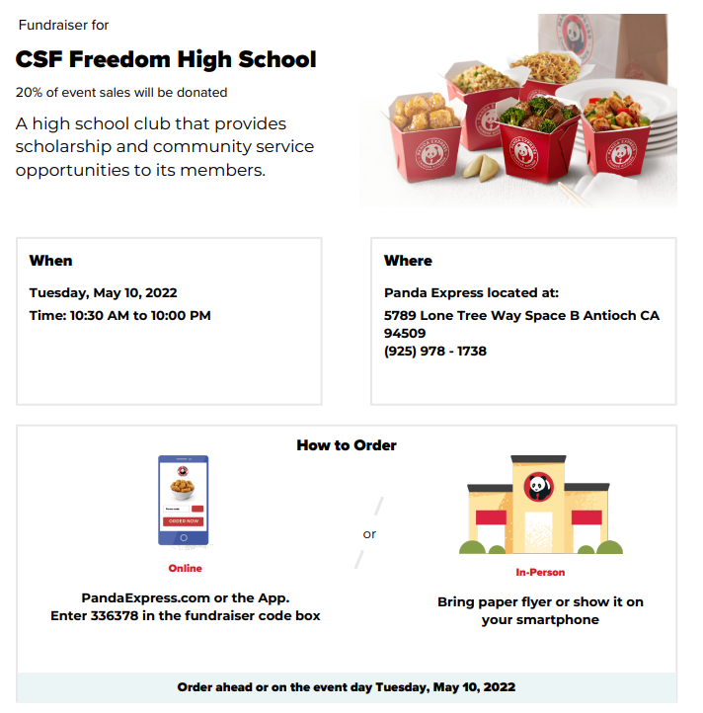

CSF Items

Slide 11
Upcoming events
Awards Night May 11th
Signing of the Chapter Book (more to come)
Graduation June 11th

Slide 12
Point Tracker Sign-off and collection-must be complete for NHS graduation honors.
List all points on your tracker
Have an officer sign off
staple and turn in to Allison

Slide 13
Club Information
Sign up
Sign up for remind: Text @NHSFHS22 to 81010
Check
Check school issued email: Download the Outlook app
Website
Check School Website frequently!
Be
STUDENTS MUST BE RESPONSIBLE FOR STAYING UP TO DATE ON ALL CLUB MEETINGS/ACTIVITIES

