Slide 1
NATIONAL HONOR SOCIETY
Meeting #2
September 6th, 2022

Slide 2
Agenda 9/6/2022
Induction Recap
Mod Pizza Fundraiser Updates
Food Fair
Trash Pickup
Homecoming Parade
State Seal of Civic Engagement
Points Sheet- NHS Expectations
NHS Online Account
Shirts (NHS/CSF)
Other September Events

Slide 3
Club Information
Sign up for remind: Text @NHSFHS23 to 81010
Check school issued email: Download the Outlook app
Check School Website frequently!
STUDENTS MUST BE RESPONSIBLE FOR STAYING UP TO DATE ON ALL CLUB MEETINGS/ACTIVITIES

Slide 4
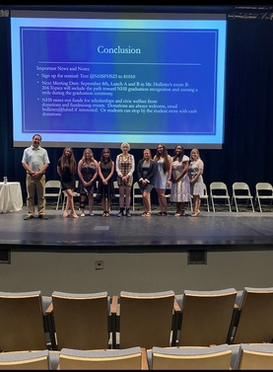
Induction Recap
* About 150 guests attended
* 47 new members inducted and recognized
* Guest Speaker Principal Kelly
* Public speaking opportunities for 7 of our members

Slide 5
Mod Pizza Fundraiser Updates
Mod Pizza Fundraiser: 20% of all proceeds went to support NHS, including scholarship opportunities for members.
Total sales: $565.93
Donated amount: $113.19
Goal for end of year: $1,000 in scholarship money
NHS Donations are suggested to help raise money for stoles, scholarships, and more!
Seniors - $20
Juniors - $20

Slide 6

Food Fair
Thursday, September 8
Snapple
We will be selling chow mein with CSF

Slide 7
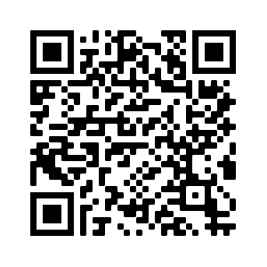
Trash Pickup
Saturday, September 10
This is an event for community service
It will be held at Freedom High School
From 9/9:30 to about 3
It will be hot so be sure to dress
Be sure to bring water, snacks and a
Small lunch
We will check you in when you get there and check you out when you leave just be sure to notify us( one of your officers of cabinet) or the Supervisor being Mr. Klezmer
Use QR code on right to sign up.

Slide 8
Homecoming Parade
Homecoming Parade begins at Almond Grove Elementary School and concludes at Freedom High School.
It will count as NHS points
It will be on Friday, September 23 at 5pm!
We will be participating! If you would like to be there please talk to Estella. We would love to see you there!

Slide 9
State Seal of Civic Engagement
Presented by Ms. Woodcock
DUE: 5 May 2023
5 Criteria to earn a graduation Seal of Civic Engagement
Earn a diploma to prove that you graduated high school.
Take and pass courses in World History, U.S. History, Government, and Economics.
Complete 20 hours of community service (verified by your Government/Econ teacher or your NHS advisors).
Complete a "capstone" project reflecting on your community service and civic engagement. See Section 4 for various options.
Obtain a letter of recommendation from a member of the community, or have a teacher fill out the "Affirmation of Character Traits" form.
First California class to be offered this achievement opportunity

Slide 10
Point Sheet/ Attendance/Graduation Recognition
https://www.luhsd.net/Page/16537 Forms
Minimum 80% attendance to meetings is required to be an active member
Completed Points Sheet for each semester
Qualified 4 total semesters
Class of 2023 – Qualify for 2 more semesters
20 Hours of community service, 10 hours each semester.
Fall 2022 Points Sheet due January 20th, 2023

Slide 11
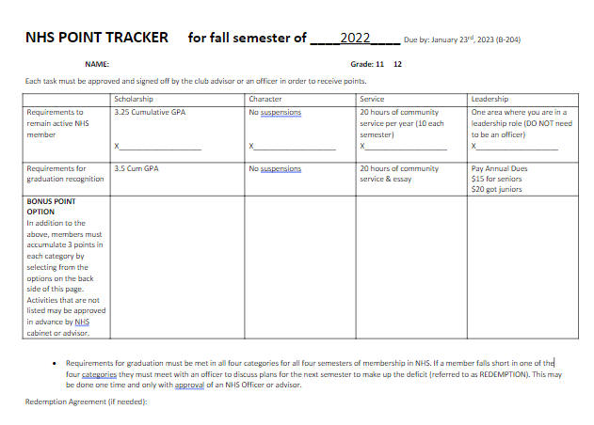

Slide 12
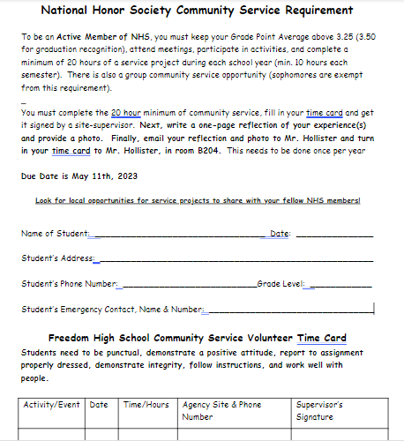

Slide 13
Join NHS Online
https://www.nhs.us/create-an-account/
Check your school email, Mr. Hollister will send an email with details soon
What are the benefits of creating a student account?
Students with online accounts will receive regular updates about student program services, including new information about awards, resources such as #Futuready or the Career Exploration Series, project ideas from the National Student Project Database, updates on student conferences, and more. Senior members of NHS are required to have a verified profile to apply for the NHS Scholarship each October. Once verified, students will also earn a digital badge.

Slide 14

New for 2021-2022 Club T-Shirts $20.00
T-Shirts Available soon ($20 dollars)

Slide 15
Other September Events
Campus clean up (Sep 10) with Klezmer
Root-beer Float Fundraiser Sept. 16th (tentative)
CSF Car Wash Sept. 17 9am-12pm
Restaurant Fundraiser CSF Sept. 21 @ The Habit
Sign ups on link tree in Instagram Bio!!!

