Slide 1
NATIONAL HONOR SOCIETY
Meeting #3
October 24th, 2022

Slide 2
Agenda 10/24/2022
Group Photo
Donations for Food sales
Safe Halloween
Points Sheet- (Sign-off)

Slide 3


Group Photo
Today
Wednesday 10/24/2022
3:30PM Sr. Hill
All active members should attend for our annual group photo. This photo will be part of the 2022-2023 Yearbook

Slide 4
Food Sales Donations
10/31-11/4 NHS Food Sales week
Donations needed (single serve packaging)
  Ex. Goldfish
  Fruit snacks
  Cheetos
  Sun chips
  Rice Krispy treats
  Fruit roll ups
  Cheez-its
  Single serving snack pack items

Slide 5


Safe Halloween-NHS
Tuesday 10/25/2022
3:30 pm for those that volunteered…prep work in Mr. Hollister’s room. Carving pumpkins and prepping our booth.
NHS will have a booth and participate in Safe Halloween, presented by CSF.
Mystery Items,

Slide 6

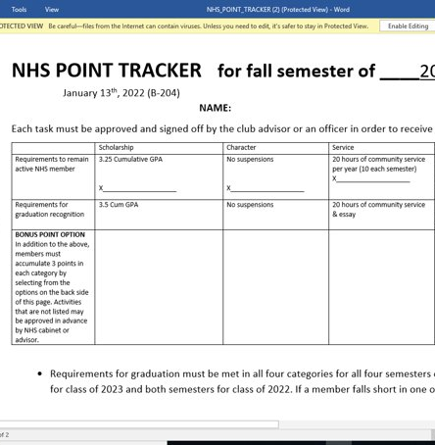
Point Sheet/ Attendance/Graduation Recognition
Sign-offs for bonus points available today after pictures in B-204

Slide 7
Club Information
Sign up for remind: Text @NHSFHS22 to 81010
Check school issued email: Download the Outlook app
Check School Website frequently!
STUDENTS MUST BE RESPONSIBLE FOR STAYING UP TO DATE ON ALL CLUB MEETINGS/ACTIVITIES

Slide 8
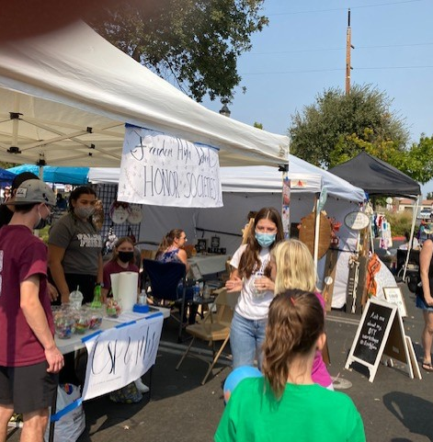
Recap of Recent Events
Mod Fundraiser, $113.19

