Slide 1
NATIONAL HONOR SOCIETY
Meeting #4
November 10th, 2022

Slide 2
Agenda 11/10/2022
Food Fair Results
Food Sales Week
Account Balance
Points Sheet- (Sign-off)

Slide 3


Hot Cocoa
Q2 Food Sales Results 11/9/2022
$109 profit
Special thanks to all those who helped and a shout-out Leticia G. for donating additional time, cups, cocoa, and urn.

Slide 4
Food Sales Preparation
NEXT WEEK 11/14-11/18 NHS Food Sales week
3-7 Volunteers needed on Monday AM at 7:30, to prepare the food sales bags.
20 Volunteers to sell the items in the bag during the week, and return the money by Friday at lunch.
This will count as points toward service and help the club raise funds for scholarships and community events.
Find a friend and come help out- message
Estella to confirm your participation.
A special thanks to all the families that stepped up to donate food, we have plenty of great snacks to be packed and sold.

Slide 5

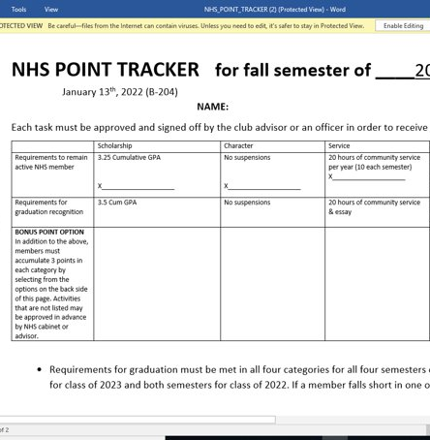

Point Sheet/ Attendance/Graduation Recognition
Sign-offs for bonus points available today after the meeting.
Fall Semester Sheets Due
January 23rd, 2023

Slide 6

Account Balance as of 11/10/2022
$1654.97
Please note the suggested donation is $20 annually. This money goes to buy the stoles and provide scholarships.
We will need the balance up over $3,000 to make our expenses. Thus far this year no donations have been made.
To donate please being cash or check to the Student Store and let Ms. Watson know this is for NHS.
This Photo by Unknown Author is licensed under CC BY-NC-ND

Slide 7
Club Information
Sign up for remind: Text @NHSFHS22 to 81010
Check school issued email: Download the Outlook app
Check School Website frequently!
STUDENTS MUST BE RESPONSIBLE FOR STAYING UP TO DATE ON ALL CLUB MEETINGS/ACTIVITIES

