Slide 1


NATIONAL HONOR SOCIETY
Please be sure to sign in
Meeting #7
February 27th, 2023

Slide 2
Agenda 2/27/2023
Active Member List
Recap of Recent Events
Krispy Kreme Restaurant Fundraiser
Spring Festival
Treat Week
Future Cabinet Candidates
Treasurer's Report
State Seal of Civic Engagement
Upcoming Dates of Interest

Slide 3

Active Member List
* List will posted on the club website soon, only Active Members are eligible for graduation recognition/stole.
*If you know any sophomores, encourage them to apply!!
The following are requirements to remain an active member in NHS:
Maintain a 3.25 academic G.P.A. prior to and during membership
Attend meetings, demonstrate leadership and strong character
Complete 20 hours of community service each year (10 each semester) and submit a summary essay.

Slide 4
Recap of recent events
Food Fair
  Sold churros w/ option of toppings
  Made $202
NHS Community Cleanup
  25 people attended & finished cleaning entire campus by 12:00
  After cleanup, members worked on cleaning out leadership bins, organizing leadership classroom, and writing thank you notes for teachers

Slide 5
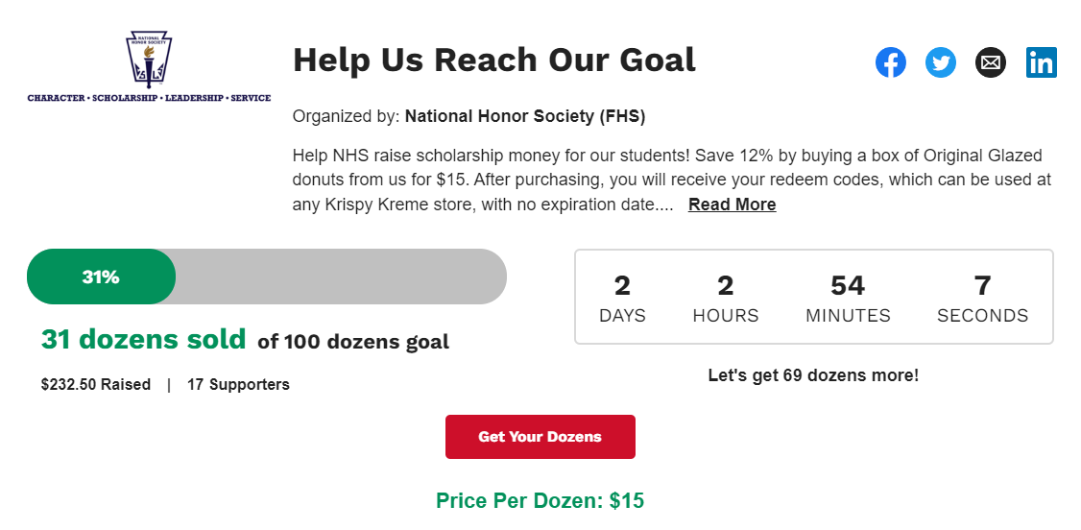
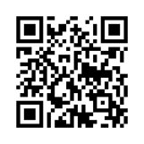
Krispy kreme restaurant fundraiser
LAST DAY TO PURCHASE IS TOMORROW

Slide 6
Spring Festival
Tuesday April 4th 2023, 4:30-7pm
New partnership with Little Falcons! Spring Festival will now have food trucks
NHS will be selling popcorn and flavored lemonade + have a water balloon toss.
If you’re part of a different club, encourage them to sign up for a booth! (Text Remind code @springhass to 81010 to sign your club up for Spring Festival)
Volunteer hours through the event and helping with work parties. Work parties will be scheduled towards end of Spring Break and day before.

Slide 7
Spring Festival
Tuesday April 4th 2023, 4:30-7pm
Clubs already signed up read as follows: Little Falcons, NHS( obviously), Math Club, D&D, Center Stage, Key Club, and FCCLA. There is one more position to be taken to fundraise at the event however booths for activities for the community are always welcome
If you’re part of a different club, encourage them to sign up for a booth! (Text Remind code @springhass to 81010 to sign your club up for Spring Festival)

Slide 8
Treat Week
April 10th-14th before school
Booth will be in main quad
Selling cupcakes, muffins, candy, and more!
Donations such as cups, napkins, snacks etc will count towards your trackers

Slide 9
2023-2024 Officer positions
For those that have responded a general meeting will be held. Check your emails soon (sometime this week) for an email from Mr. Hollister.
This will be a general email.

Slide 10


Treasurer's Report
Current Balance $2,092.10
as of 2/22/2023
Reminder NHS is still accepting yearly donations, see point tracker for details.
Suggested/voluntary donations are $20/year

Slide 11
Upcoming Dates
Seal of Civic Engagement Application/ Hours/Project
Due April 2023
Community Service and Point Tracker due
May 11th

Slide 12

Club Information
Sign up
Sign up for remind: Text @NHSFHS23 to 81010
Check
Check school issued email: Download the Outlook app
Website
Check School Website frequently!
Be
STUDENTS MUST BE RESPONSIBLE FOR STAYING UP TO DATE ON ALL CLUB MEETINGS/ACTIVITIES

