Slide 1
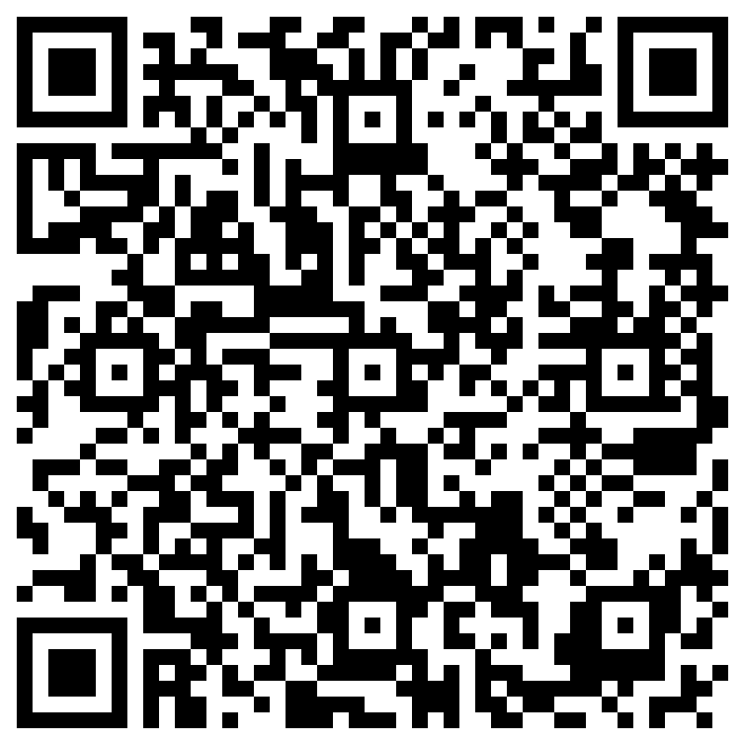
NATIONAL HONOR SOCIETY
Meeting #2
September 19th, 2023
Sign in with the QR Code

Slide 2

Opening of Meeting
Opening of Meeting (Robert's Rules of Order)

Slide 3
Agenda 9/19/2023
Induction Recap
Panda Fundraiser Recap
Food Fair
Homecoming Parade
Scholarships
Club Pictures
Points Sheet- What Counts?
Recent Club Information (email, Remind)
Treasurer's Report
Close of Meeting
Remember to sign in

Slide 4
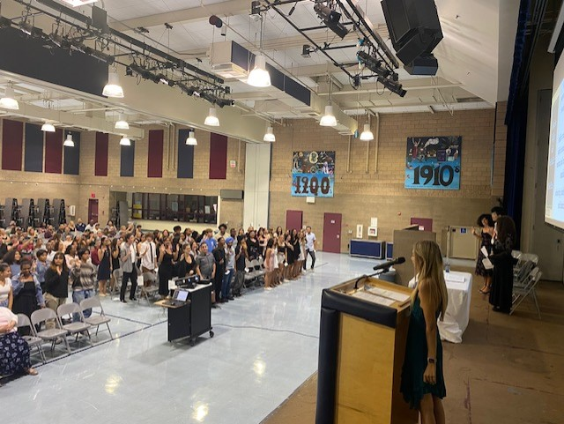
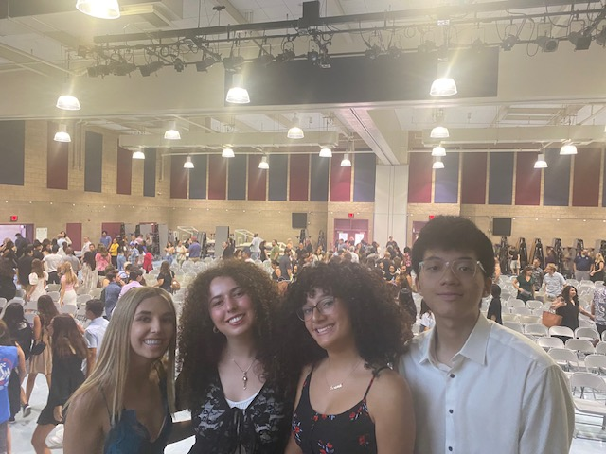

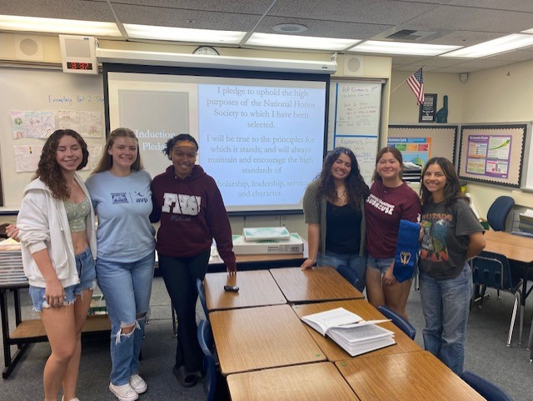
Induction Recap 8/24/2023 101 class of 2025 students have been inducted

Slide 5
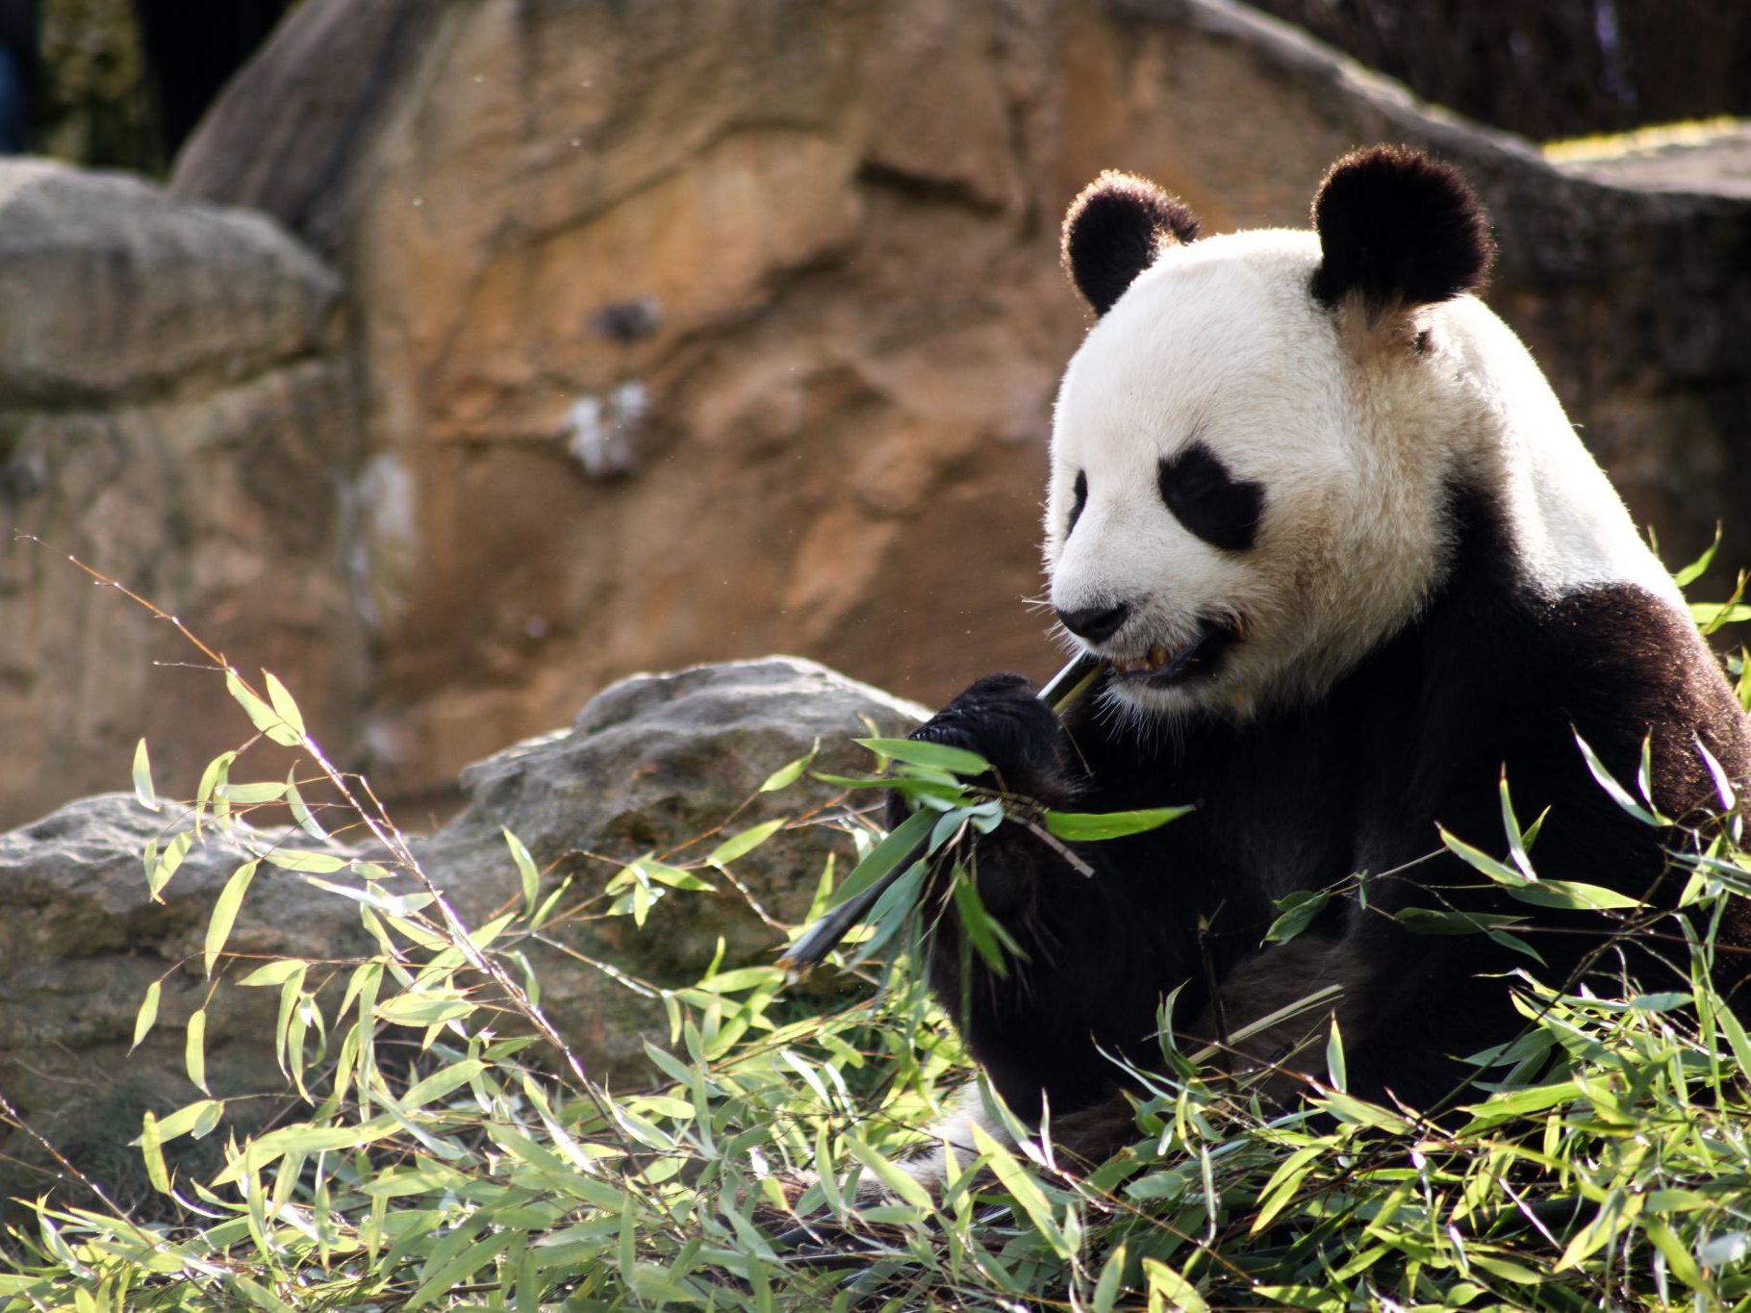
Panda Fundraiser Recap
Our Panda Fundraiser on 8/31was a success, details and funds raised TBD. Information from Panda Express is still pending.

Slide 6


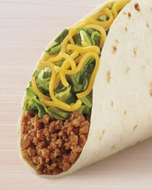
Food Fair-Thursday 9/21 $5 meal includes one taco and one Baja blast
Please support our club and others here on campus.
Food Fair is Cash Only

Slide 7
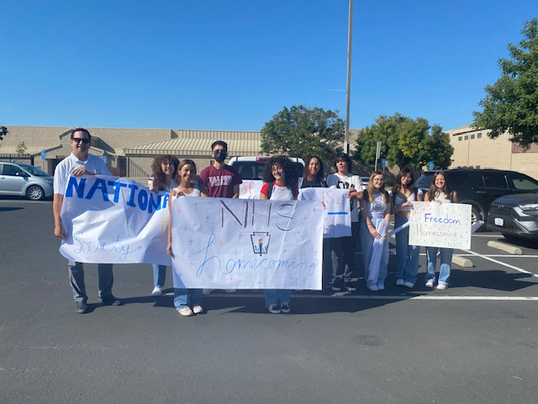
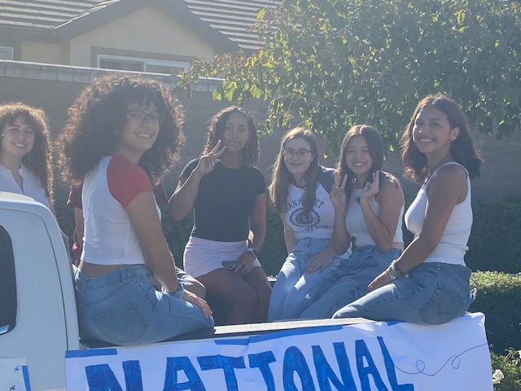
Homecoming Parade Sept. 8th, 2023
The Brentwood Press 9/8/2023

Slide 8

Local and NHS Scholarships
FHS Local Scholarship Link
NHS National Scholarhips Link

Slide 9

Club Picture Date
09/26/2023 (Tue.)
3:40pm - 3:50pm PDT
Main Quad, After School
NHS and CSF share the timeslot, 2 separate pictures

Slide 10
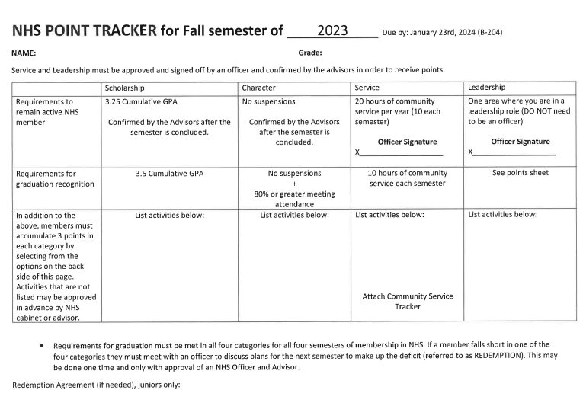
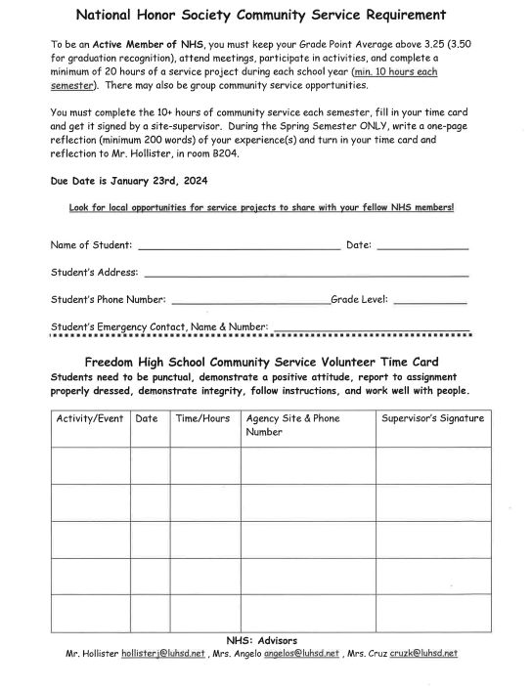
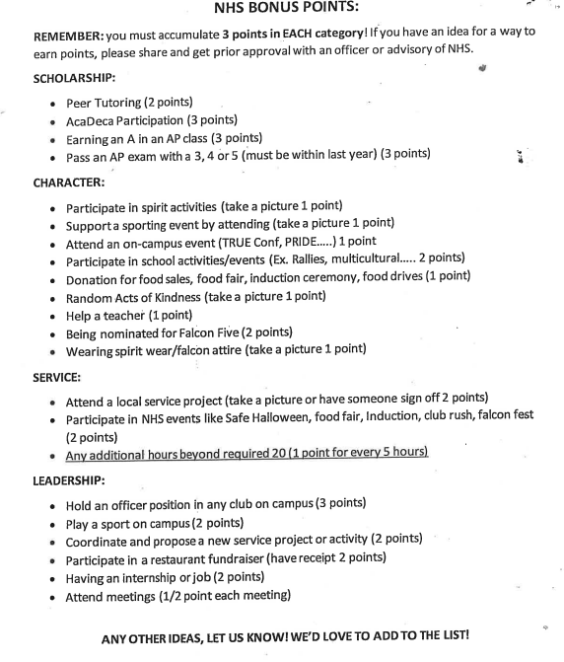
Points Sheet Community Service must involve the community, outside of Freedom. However, Events at School, where the community is invited, count. Examples are Homecoming parade and safe Halloween.
https://www.luhsd.net/Domain/70

Slide 11
Point Sheet, Attendance & Graduation Recognition
Point sheets available in B-204
Minimum 80% attendance to meetings is required to be an active/honors member
Completed point sheet and Community Service submitted by deadline, each semester.
See sheets for all expectations and requirements.

Slide 12


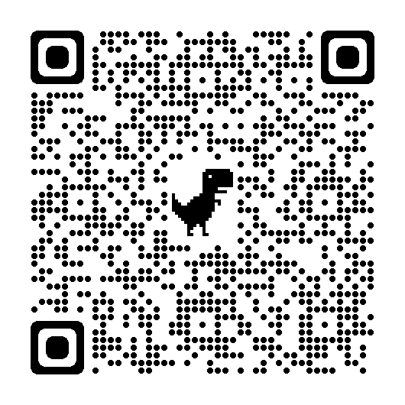

Treasurers Report-
Current Balance $1,738.10
Goal $4,000 by, May 2024,
NHS is accepting yearly donations, see point tracker for details. Donations can be accepted via the student store.
Please use the QR Code to access the school webstore link.
(Click Reload once you arrive at the page)

Slide 13
Club Information
Sign up for remind: Text @fhsnhs23 to 81010
Check school issued email: Download the Outlook app
Check School Website frequently!
STUDENTS MUST BE RESPONSIBLE FOR STAYING UP TO DATE ON ALL CLUB MEETINGS/EVENTS/ACTIVITIES

Slide 14
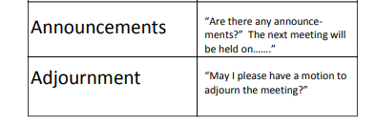
Close of Meeting
Did you check-in (attendance)?
Do you have any questions?
Sign up for remind: Text @fhsnhs23 to 81010
Close of Meeting (Robert's Rules of Order, names and time)

