Slide 1


NATIONAL HONOR SOCIETY
Meeting #4
October 24th, 2023

Slide 2

Agenda 10/24/2022
Check School Outlook email in Clever>Office
Donations for Food sales, volunteers needed
Safe Halloween
Points Sheet- (Sign-off)

Slide 3
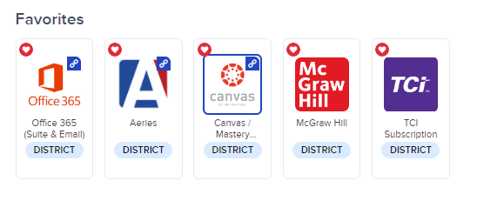
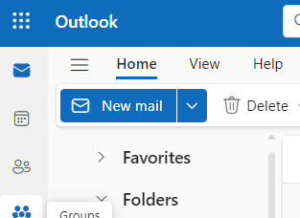

Check your school email for updates, including a new email with sign-up opportunities for upcoming events.

Slide 4


Food Sales Donations
10/30-11/3 NHS Food Sales week
Donations needed by Friday 10/27 (single serve packaging)
  Ex. Goldfish
  Fruit snacks
  Cheetos
  Sun chips
  Rice Krispy treats
  Fruit roll ups
  Cheez-its
  Single serving snack pack items
  Need student volunteers to pack and sell, check school email for Sign Up Genius

Slide 5

Safe Halloween-NHS
Thursday 10/26/2023 3:30-7pm
3:30 pm for those that volunteered…prep work in Mr. Hollister’s room. Carving pumpkins and running our booth.
NHS will have a booth and participate in Safe Halloween, presented by CSF.
Need student volunteers to set-up and run booth.
Check school email for Sign Up Genius

Slide 6
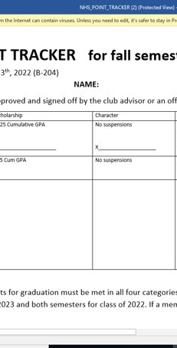
Point Sheet/ Attendance/Graduation Recognition
Sign-offs for bonus points available today by cabinet members. Please be prepared with proof of engagement (pictures, receipts etc.)

Slide 7

Club Information
Sign up for remind: Text @FHSNHS23 to 81010
Class Code @fal2con3
Check school issued email: Download the Outlook app
Check School Website frequently!
STUDENTS MUST BE RESPONSIBLE FOR STAYING UP TO DATE ON ALL CLUB MEETINGS/ACTIVITIES

